Slide 1

Opportunity Zone Prospectuses and 2022-2027 Acadiana CEDS
Acadiana Planning Commission’s WealthWorks Strategy:
Presenter: Kade Jones, APC

Slide 2
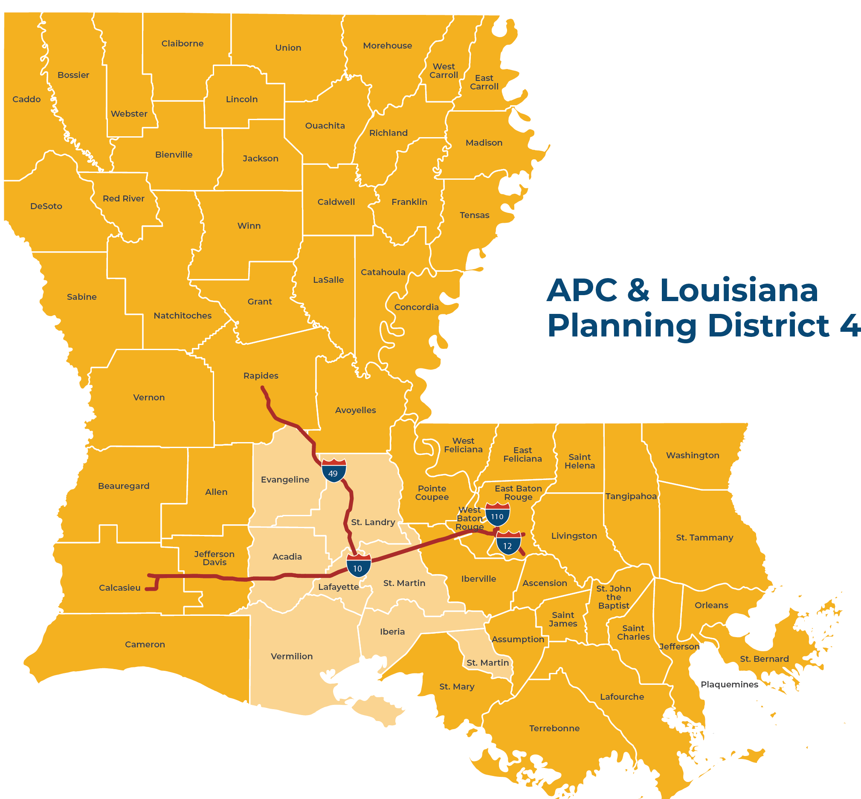
Acadiana Planning Commission (APC)
Federal & State Designations:
U.S. EDA Federal Economic Development District
U.S. FHWA Designated Acadiana Metropolitan Planning Organization (MPO)
Louisiana Planning District 4
Notes:
The Acadiana Planning Commission (APC) — Louisiana Planning District 4 — is a quasi-governmental multi-service agency that serves the public sector throughout the Acadiana area. APC is focused on promoting economic development and growth, strengthening communities, improving the transportation system and more.

Slide 3
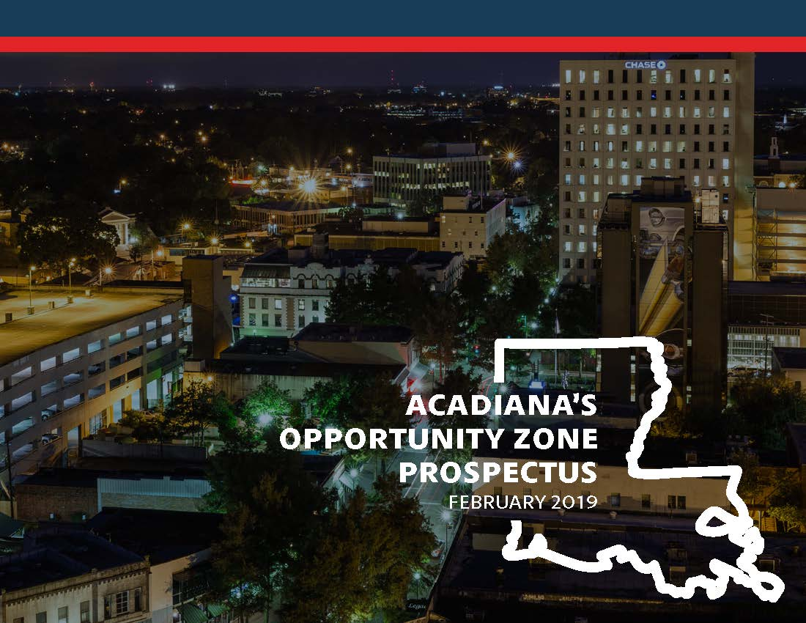
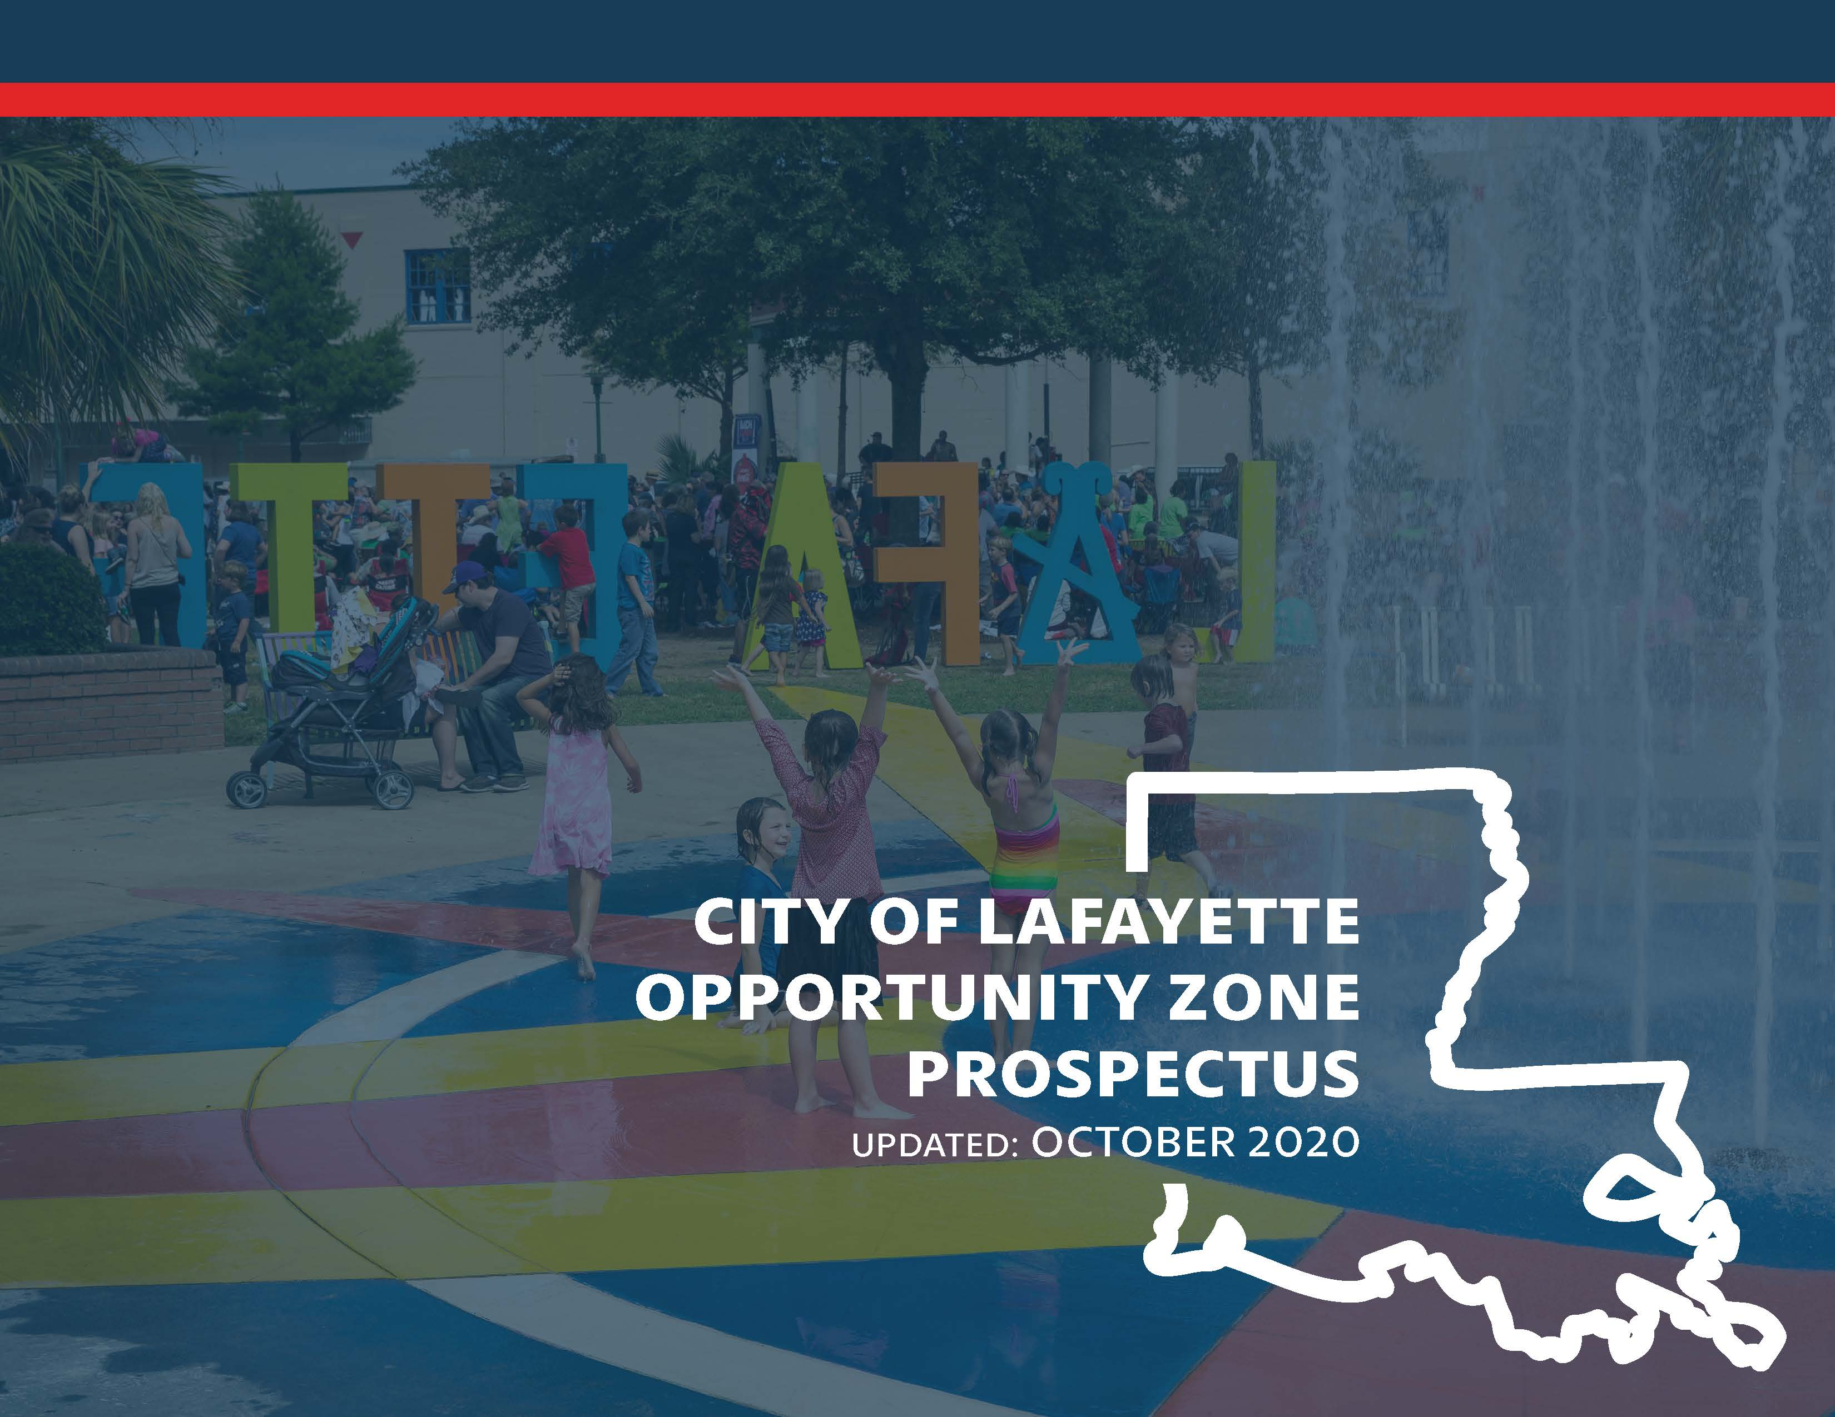
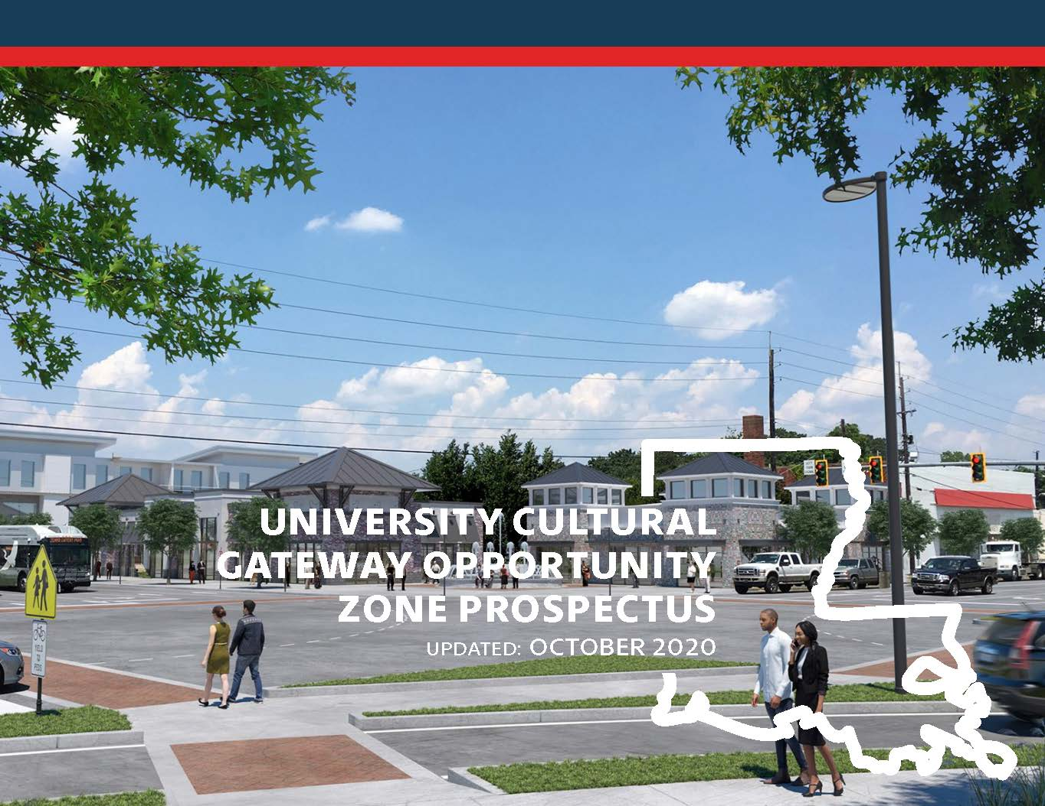
Invest Acadiana Initiative
Joint Initiative: Acadiana Planning Commission (APC) and One Acadiana (1A)
Purpose: Promote Opportunity Zone investment in nine-parish Acadiana region
Acadiana Region
City of Lafayette
University Census Tract

Slide 4


Slide 5
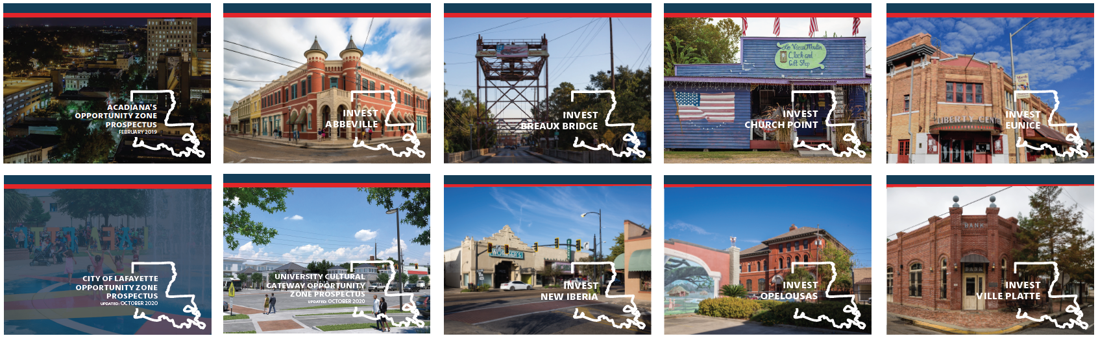
7 More Prospectuses!
Abbeville
Breaux Bridge
Church Point
Eunice
New Iberia
Opelousas
Ville Platte

Slide 6
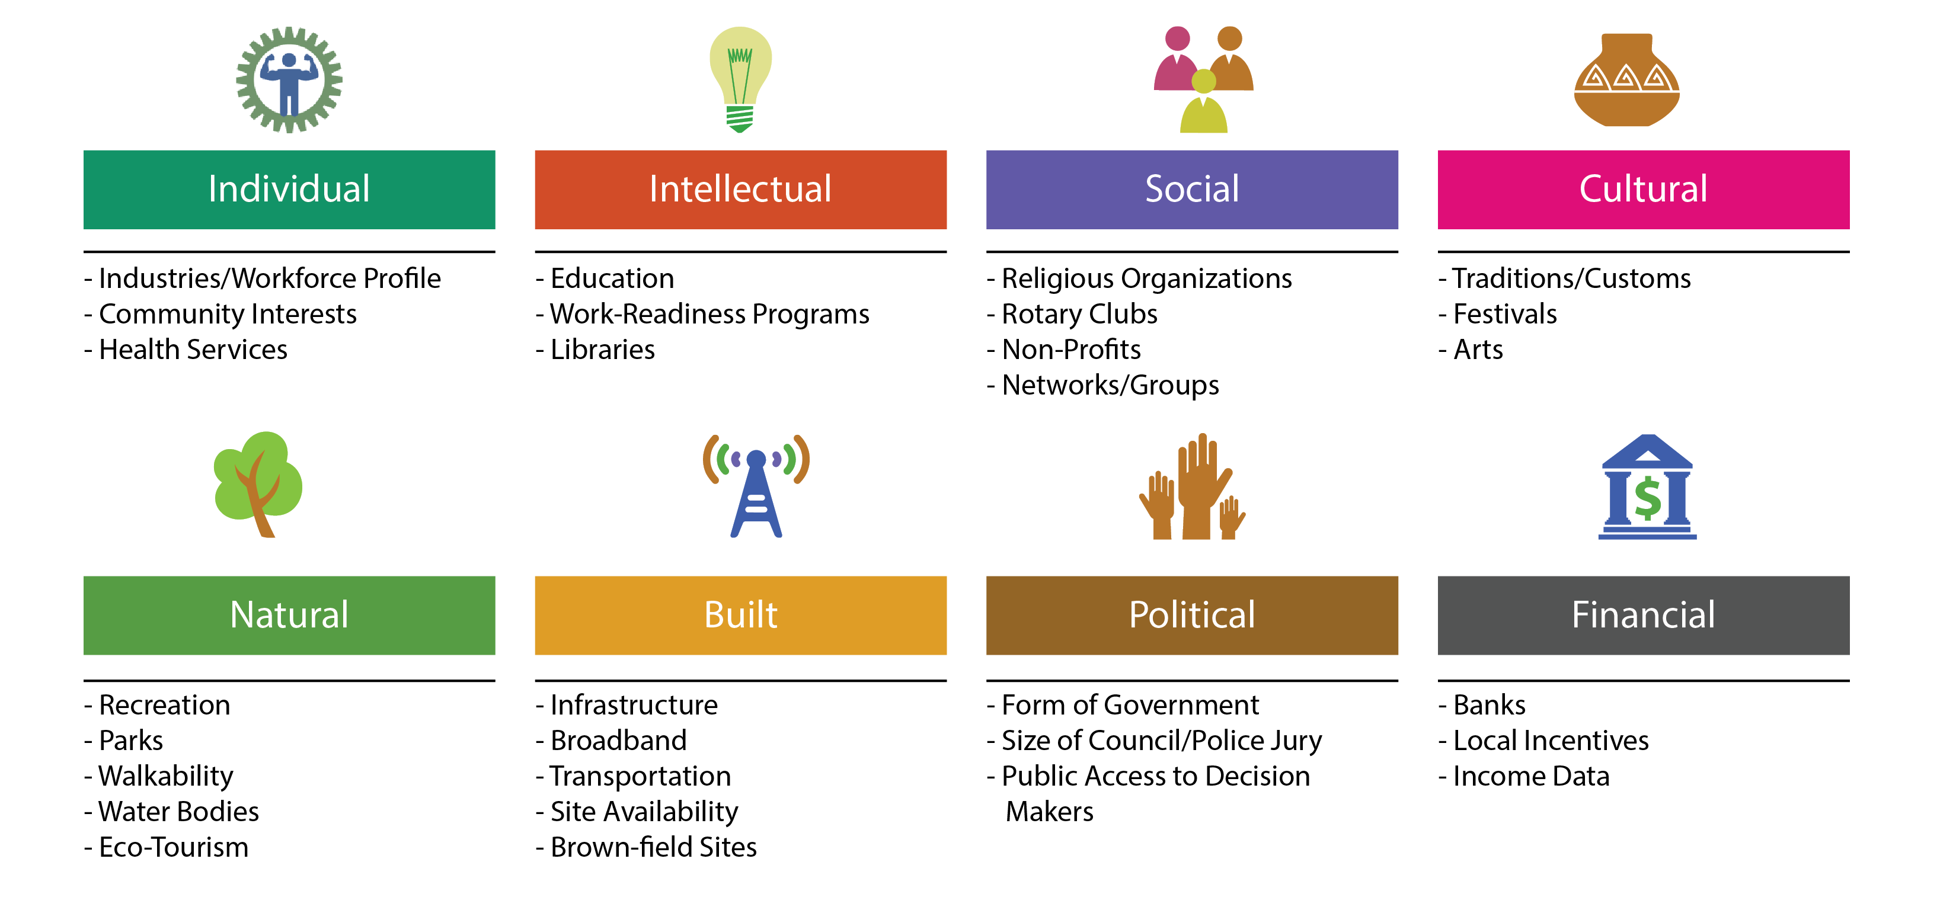
WealthWorks Methodology

Slide 7
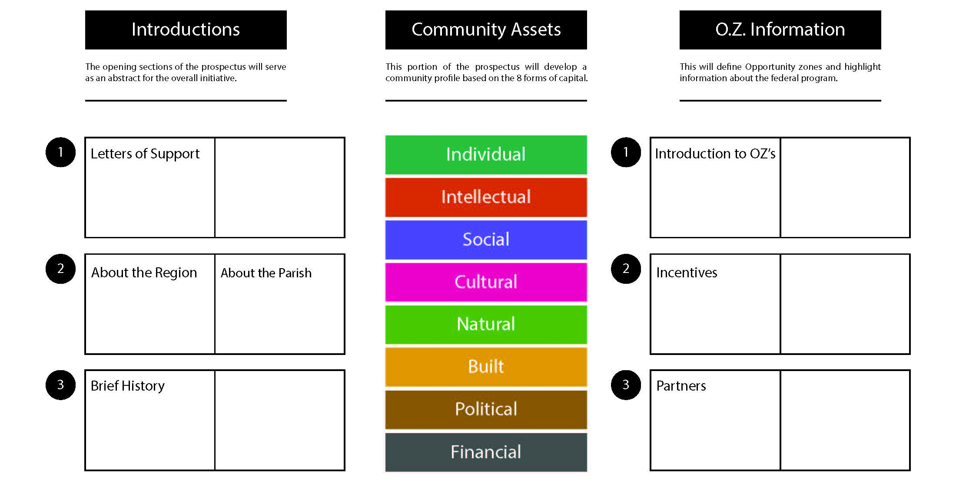
Prospectus Template Utilizing WealthWorks

Slide 8
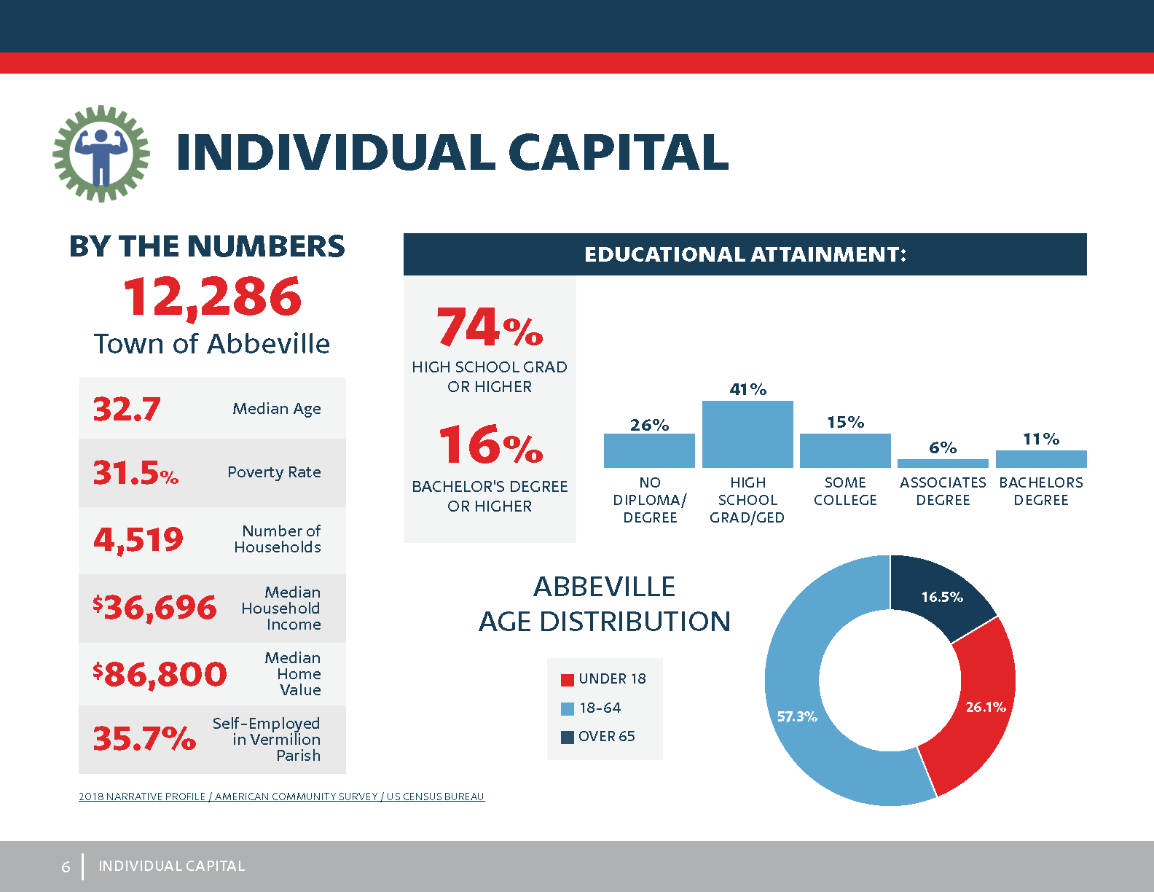

Slide 9
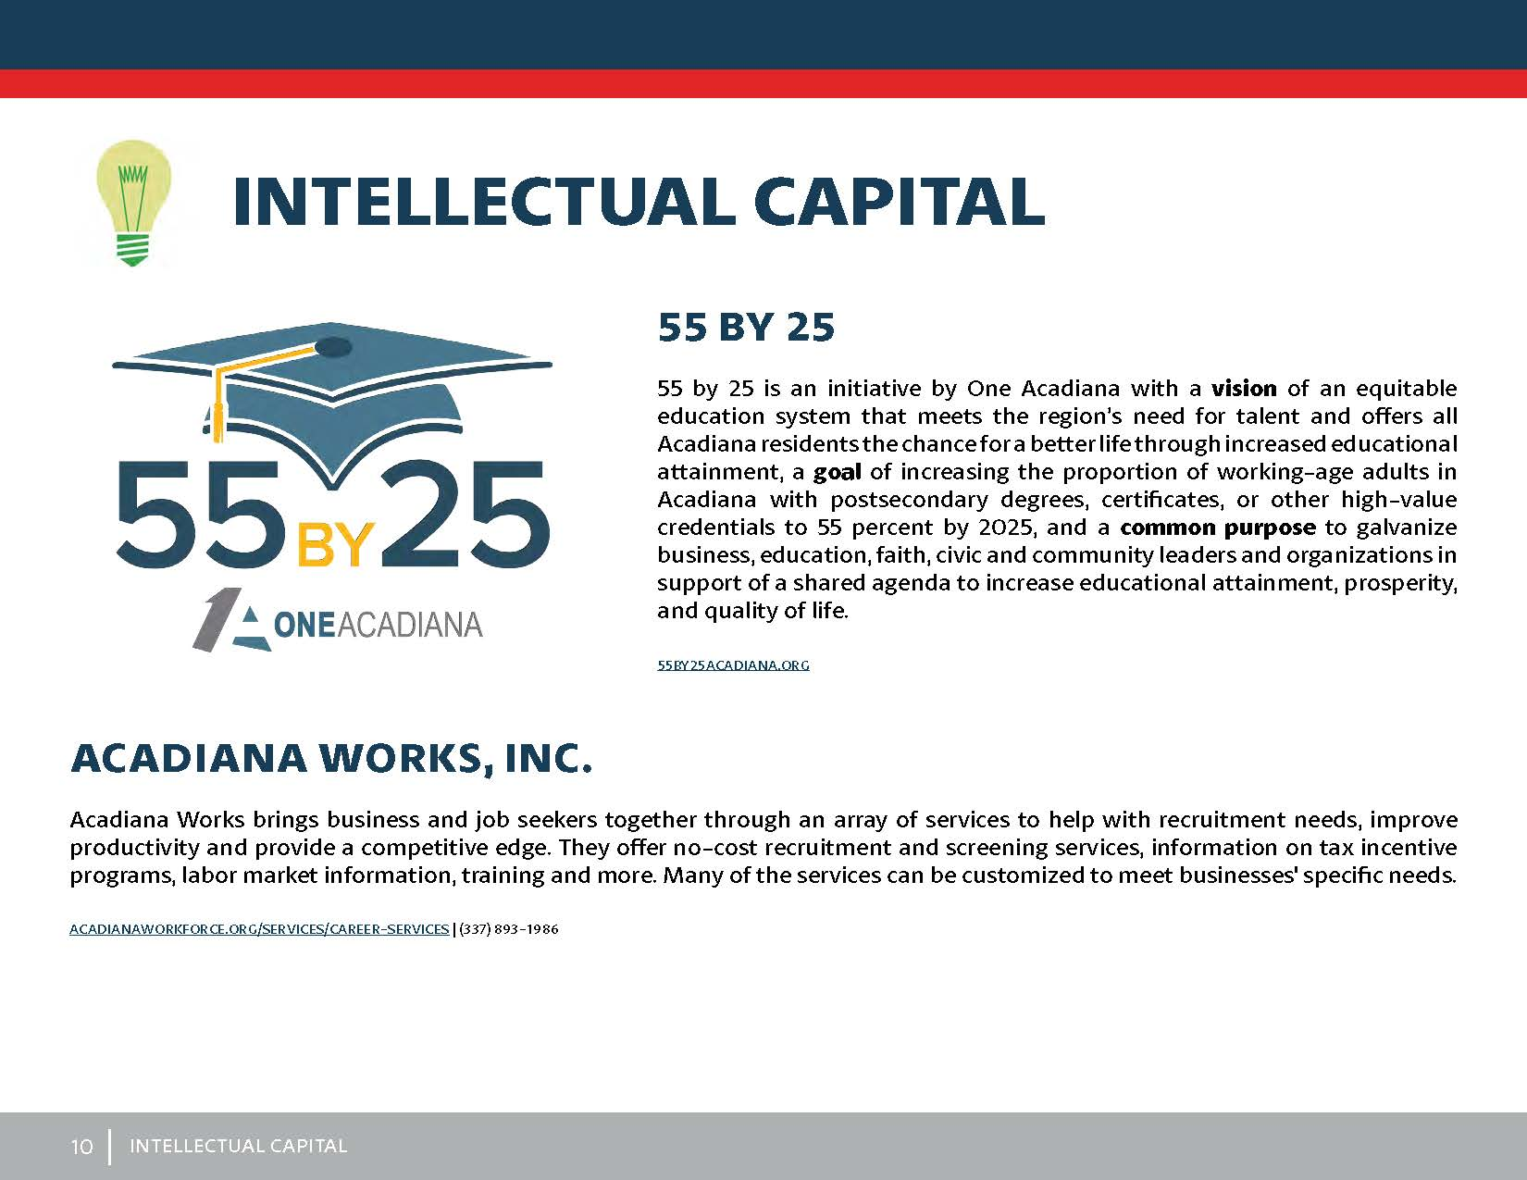
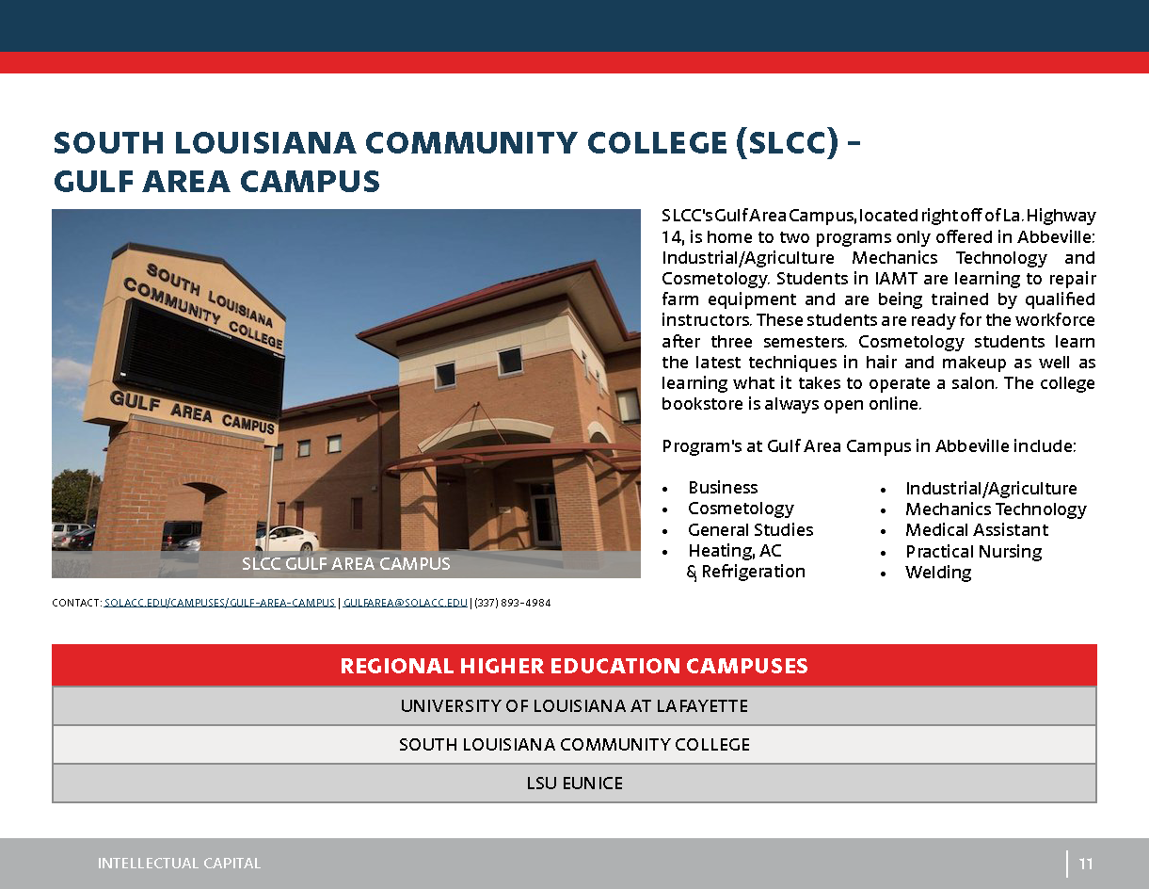

Slide 10
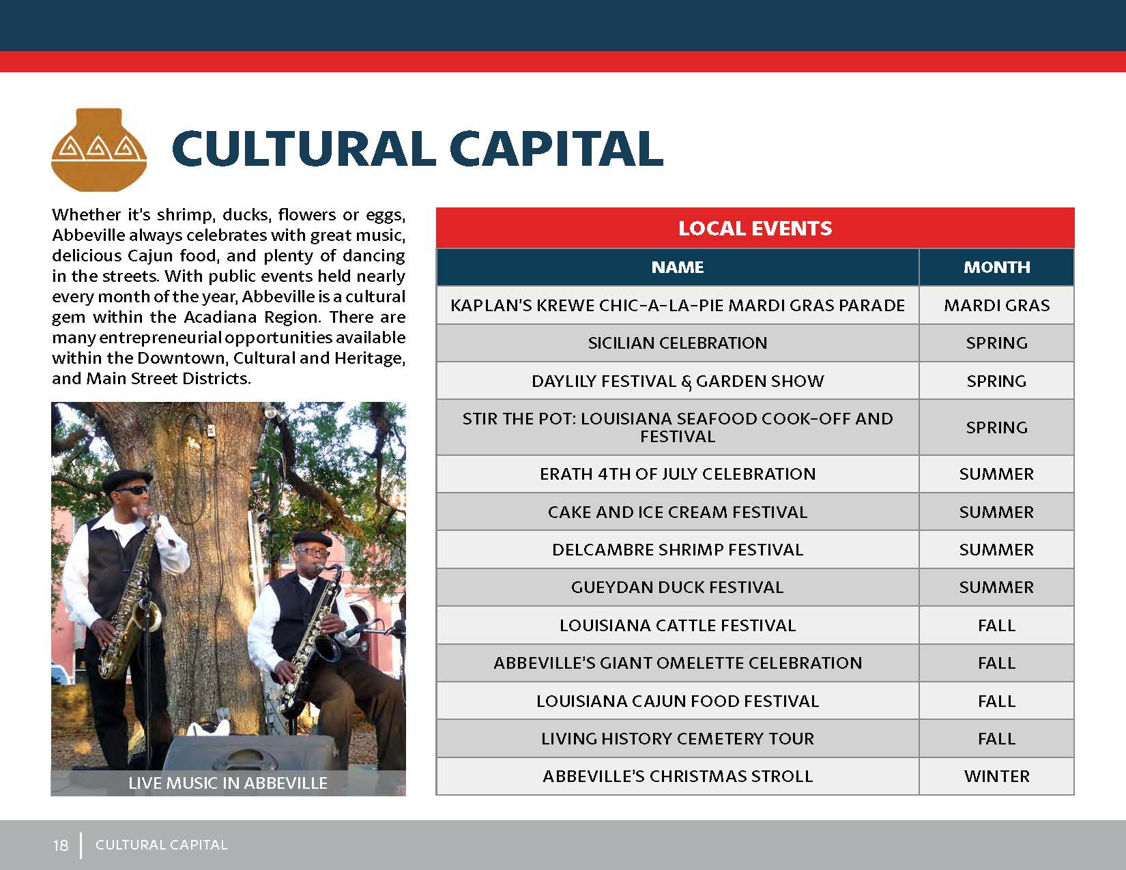

Slide 11
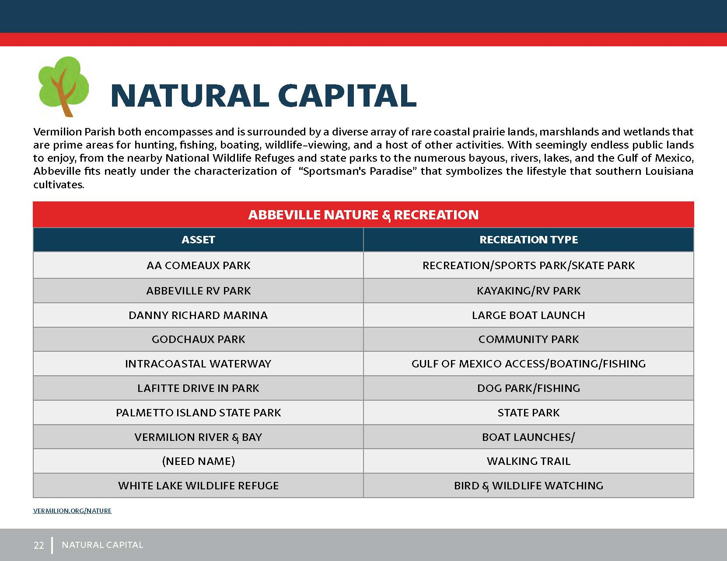
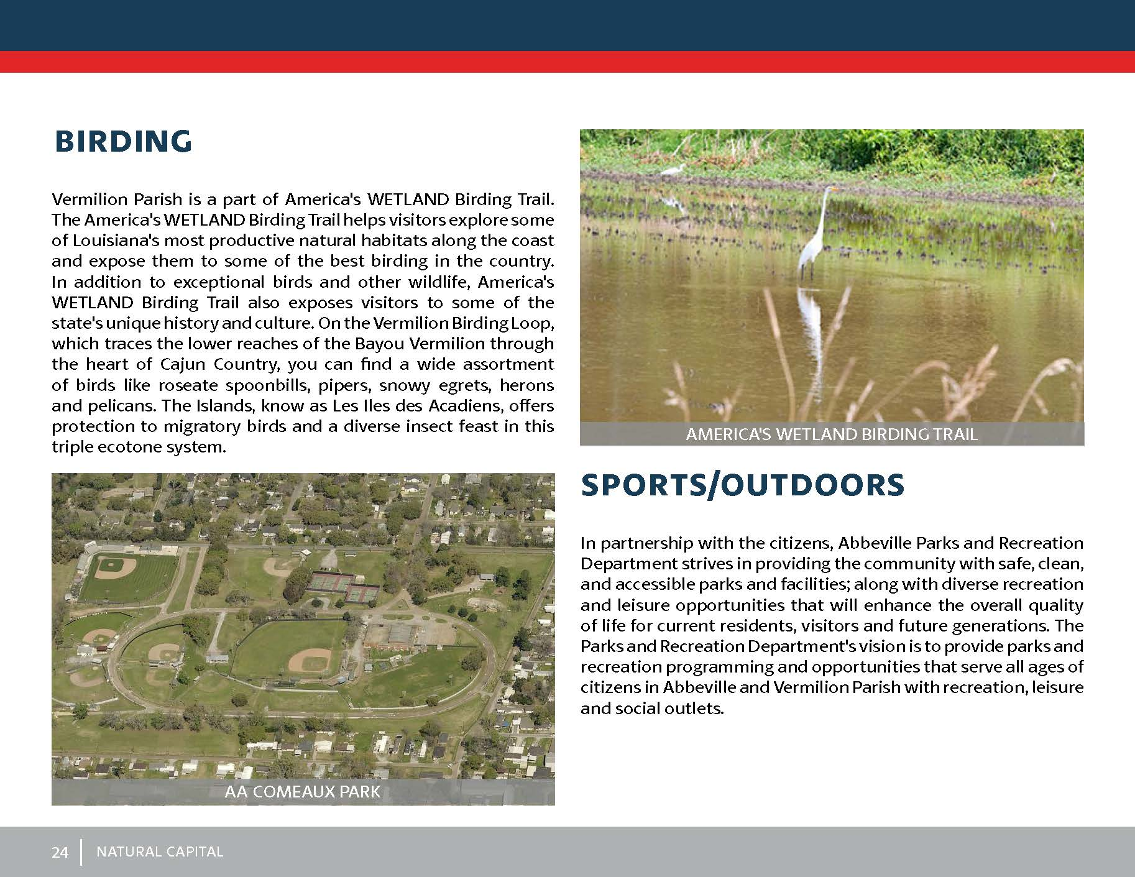

Slide 12
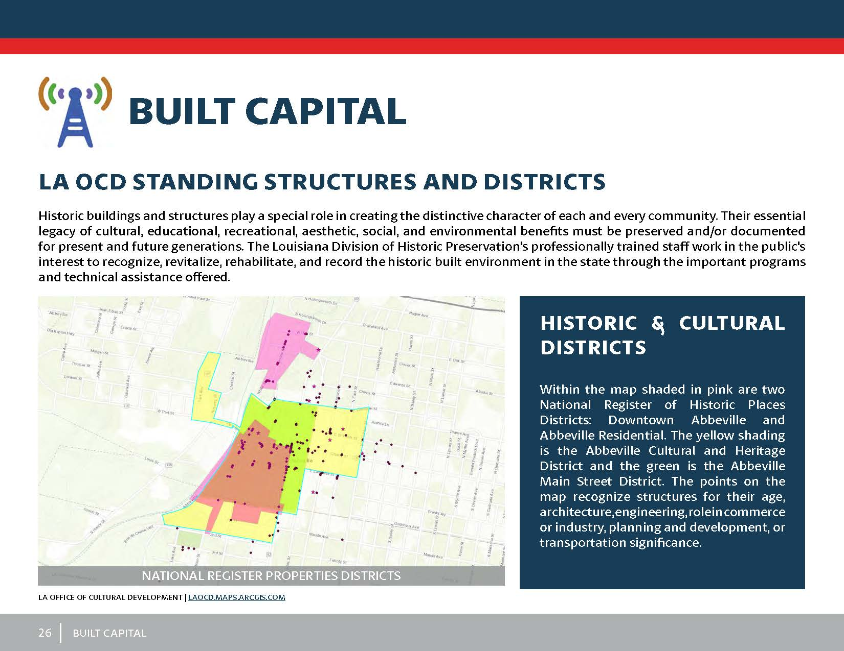
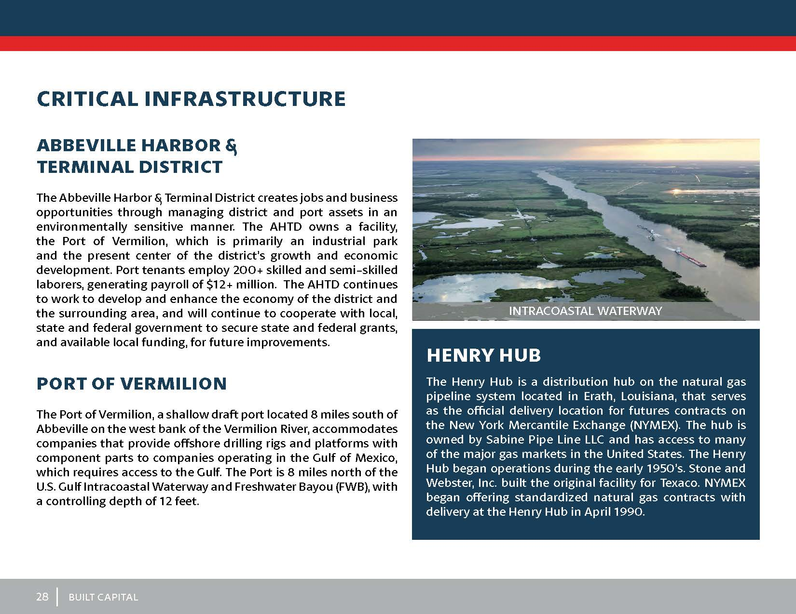

Slide 13
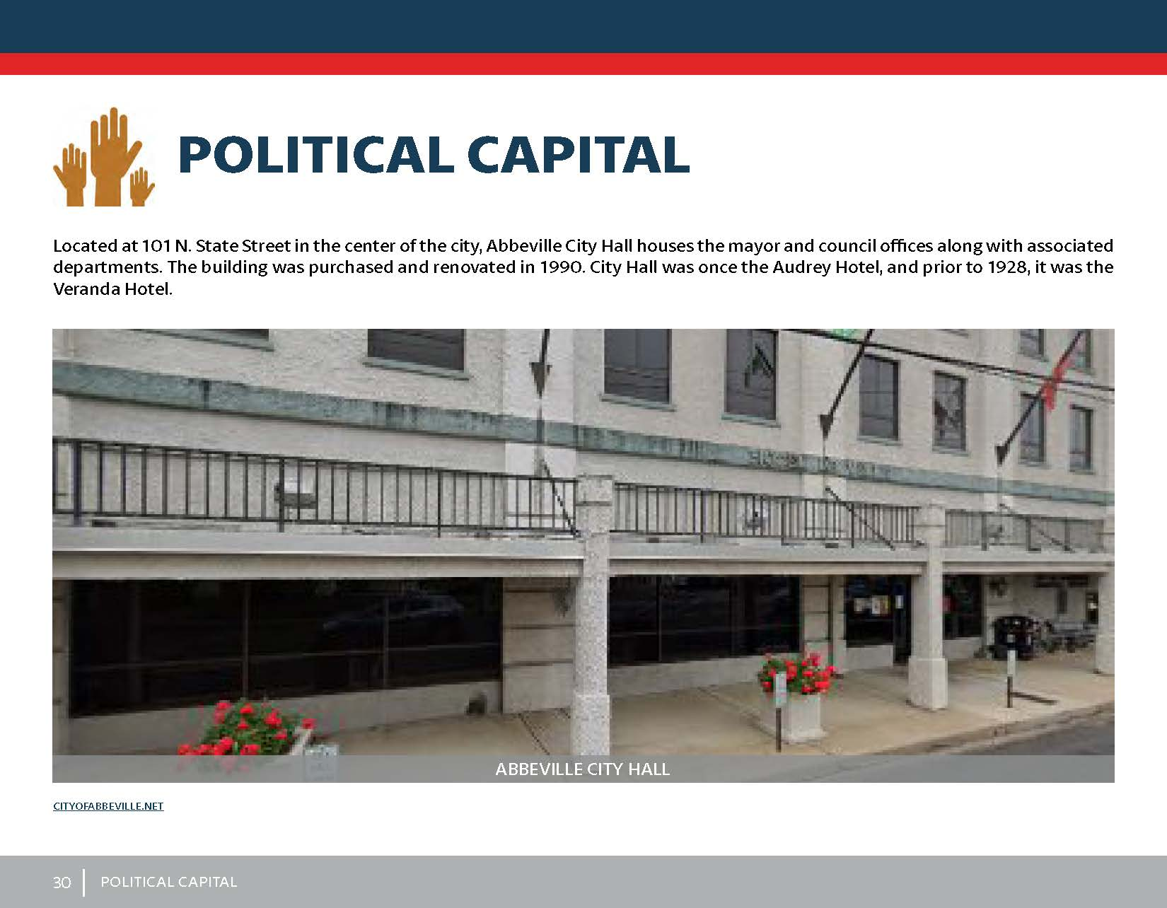
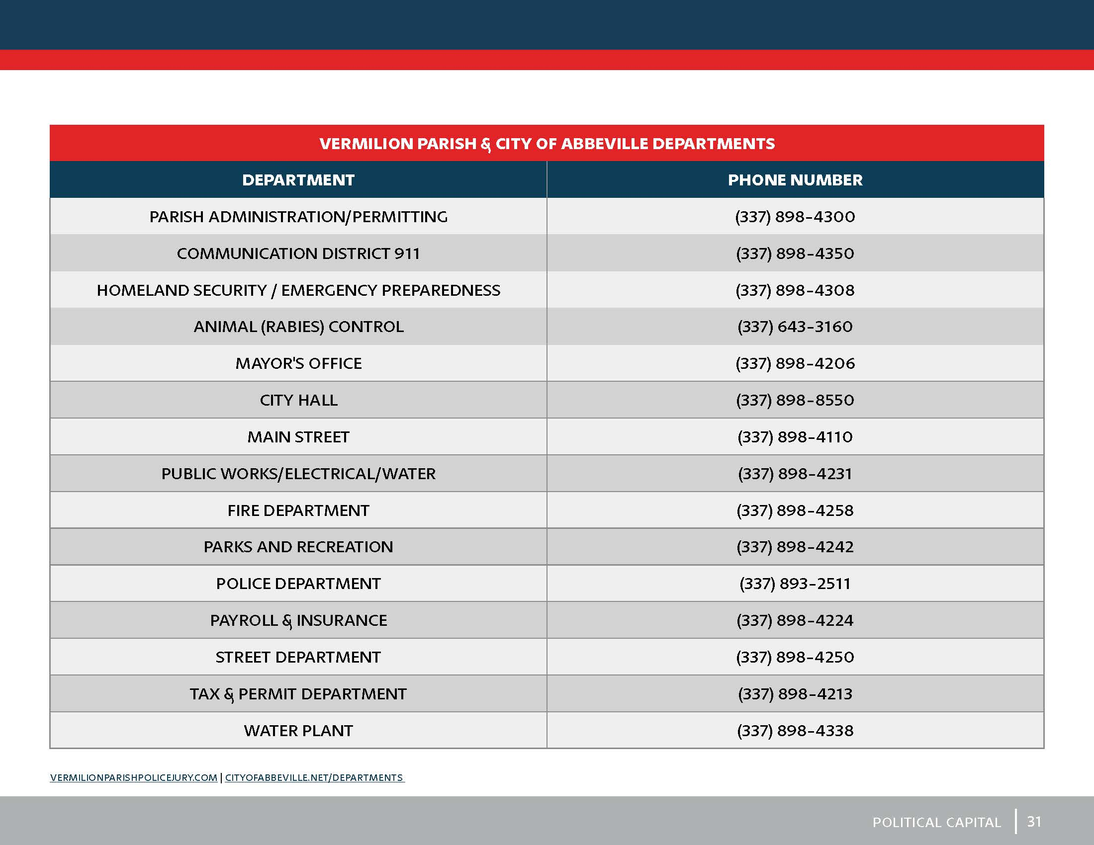

Slide 14
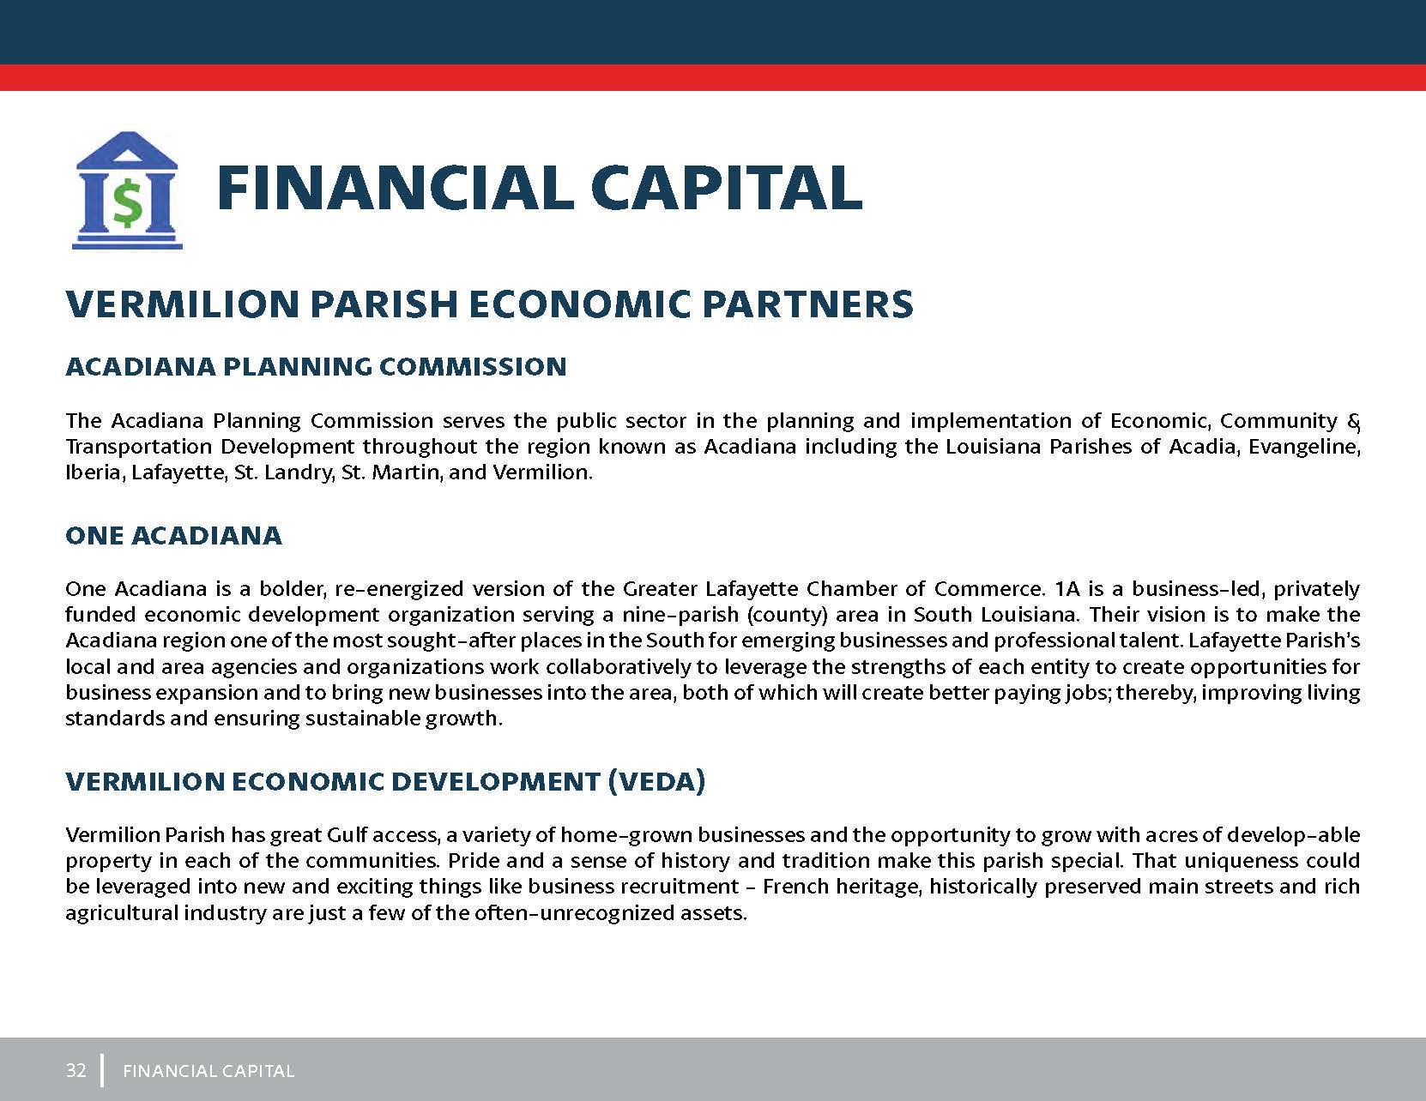
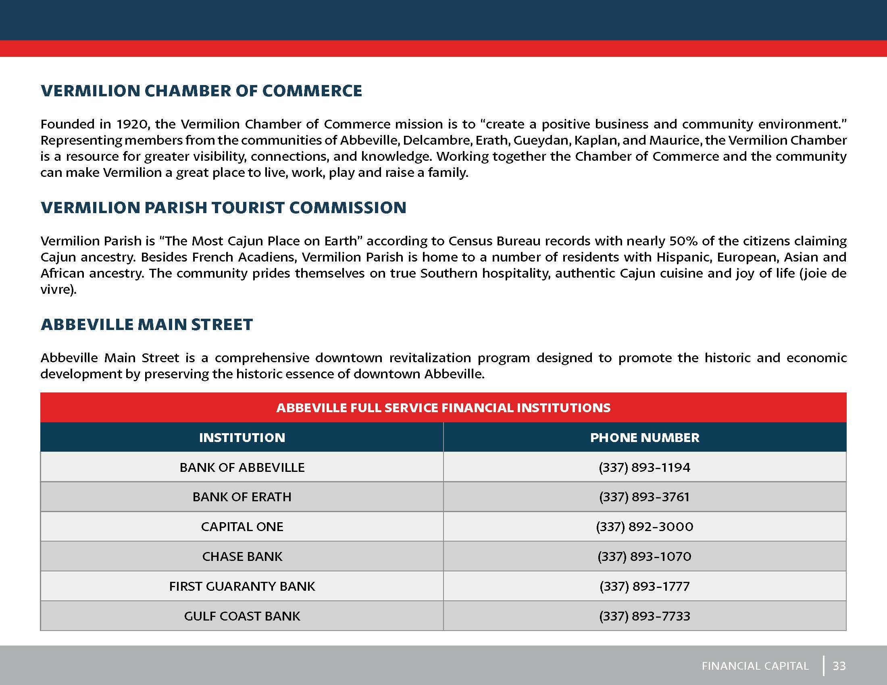

Slide 15
Comprehensive Economic Development Strategy (CEDS)
A CEDS is a strategy-driven plan for regional economic development. A CEDS is the result of a regionally-owned planning process designed to build capacity and guide the economic prosperity and resiliency of an area or region.

Slide 16
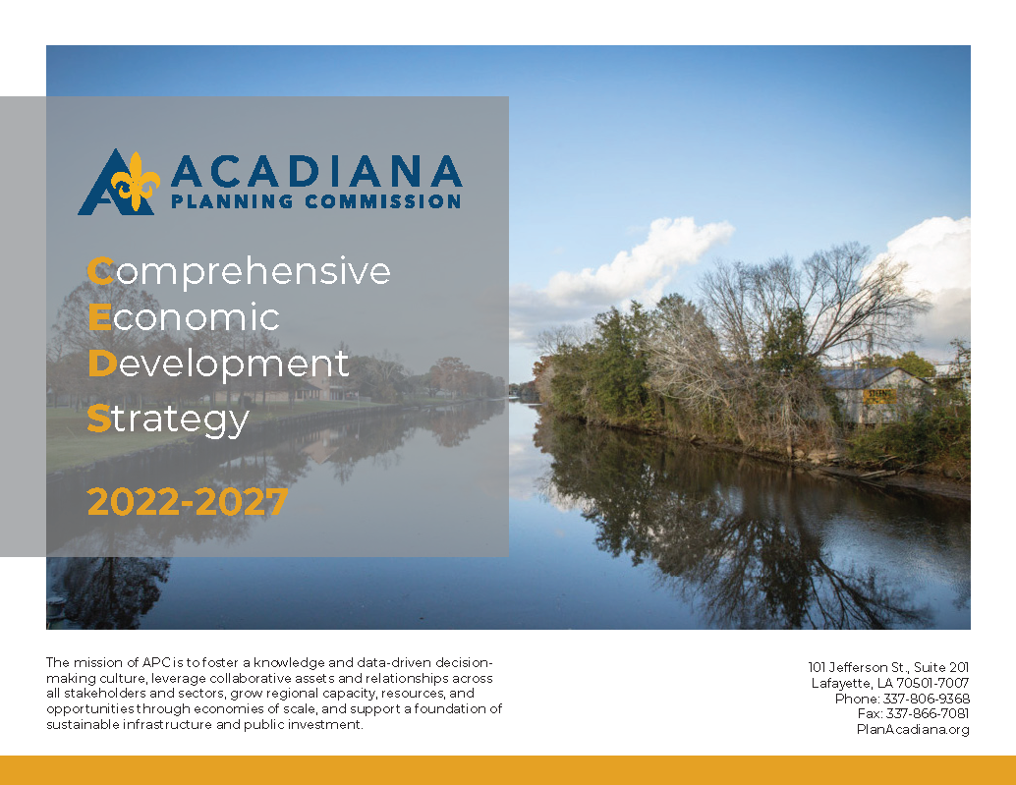

Slide 17
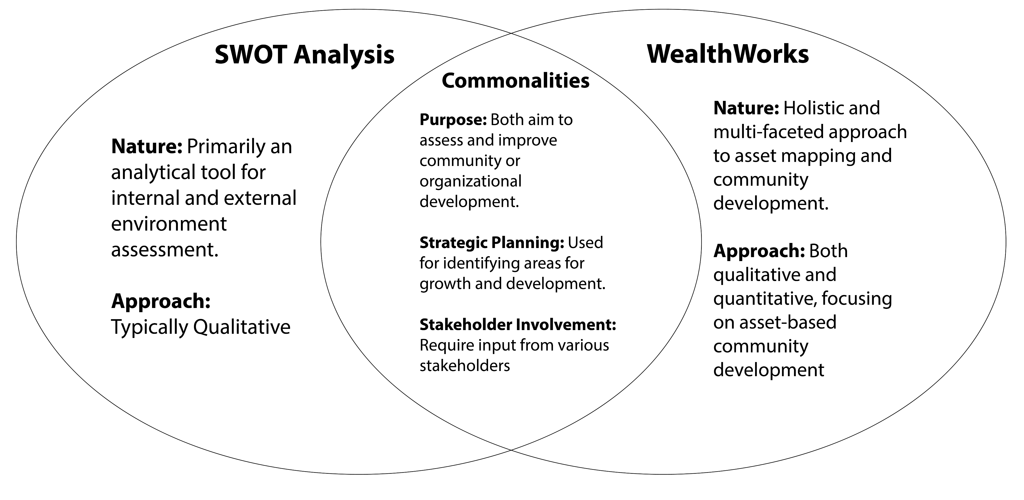
Selecting a Methodology

Slide 18

CEDS Strategy Meetings
Meeting #1 - Successes of the Region’s Economic Development Activities
  Wednesday March 22, 2023, 10:00 A.M. - 11:30 P.M.
  Grand Ballroom of the Grand Opera House of the South, Crowley, LA
Meeting #2 - SWOT Analysis
  Tuesday April 11, 2023, 10:00 A.M. - 11:30 A.M.
  St. Landry Economic Development (SLED), Opelousas LA
Meeting #3 - Future Goals, Objectives, and Strategies of the Region
  Thursday, May 11, 2023, 2:00 P.M. - 3:30 P.M.
  Lafayette, Economic Development (LEDA), Lafayette, LA

Slide 19
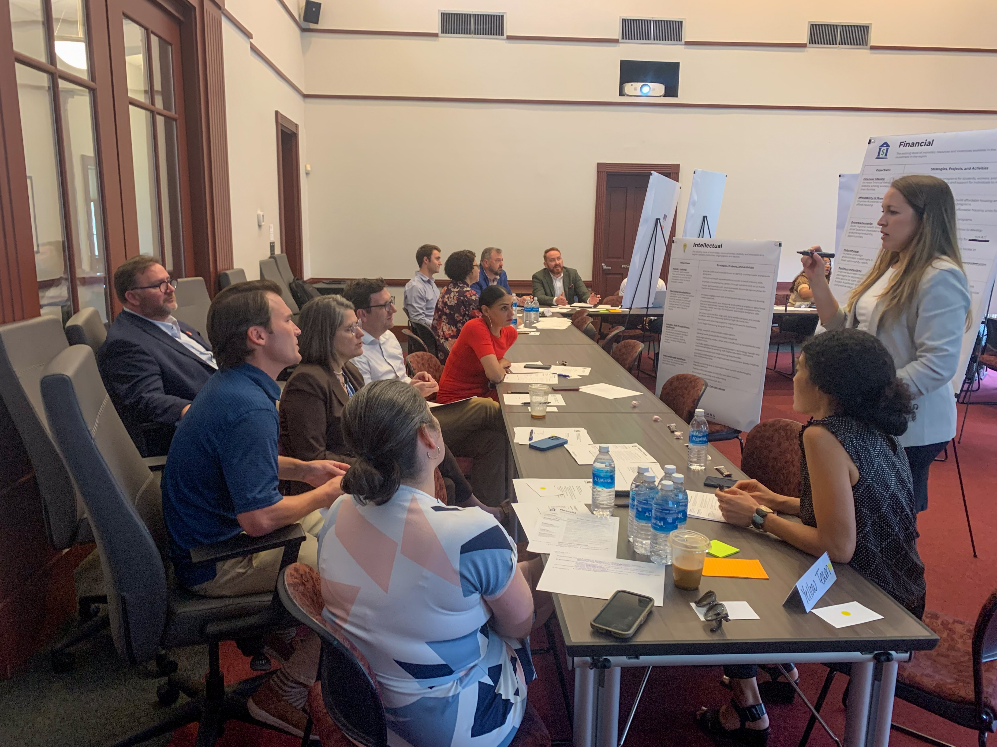
CEDS Stakeholder Engagement:
Arts and Cultural Organizations
Local Government Agencies
Chambers of Commerce and Business Associations
Community Foundations and Nonprofits
Energy Companies
State Economic Development Agencies
Local Economic Development Authorities
Educational Institutions
Private Sector Companies

Slide 20
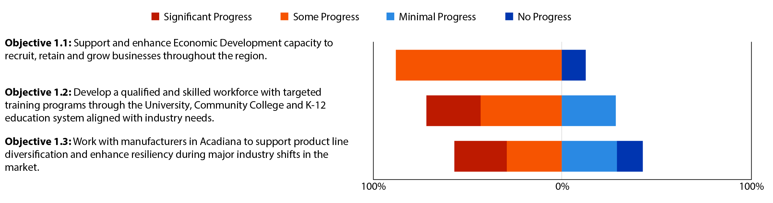
Preliminary Baseline Survey
2017-2022 CEDS
Goal 1 - Economic Diversification and Growth: Promote economic development strategies to foster stability and resiliency within Acadiana's existing industries.

Slide 21
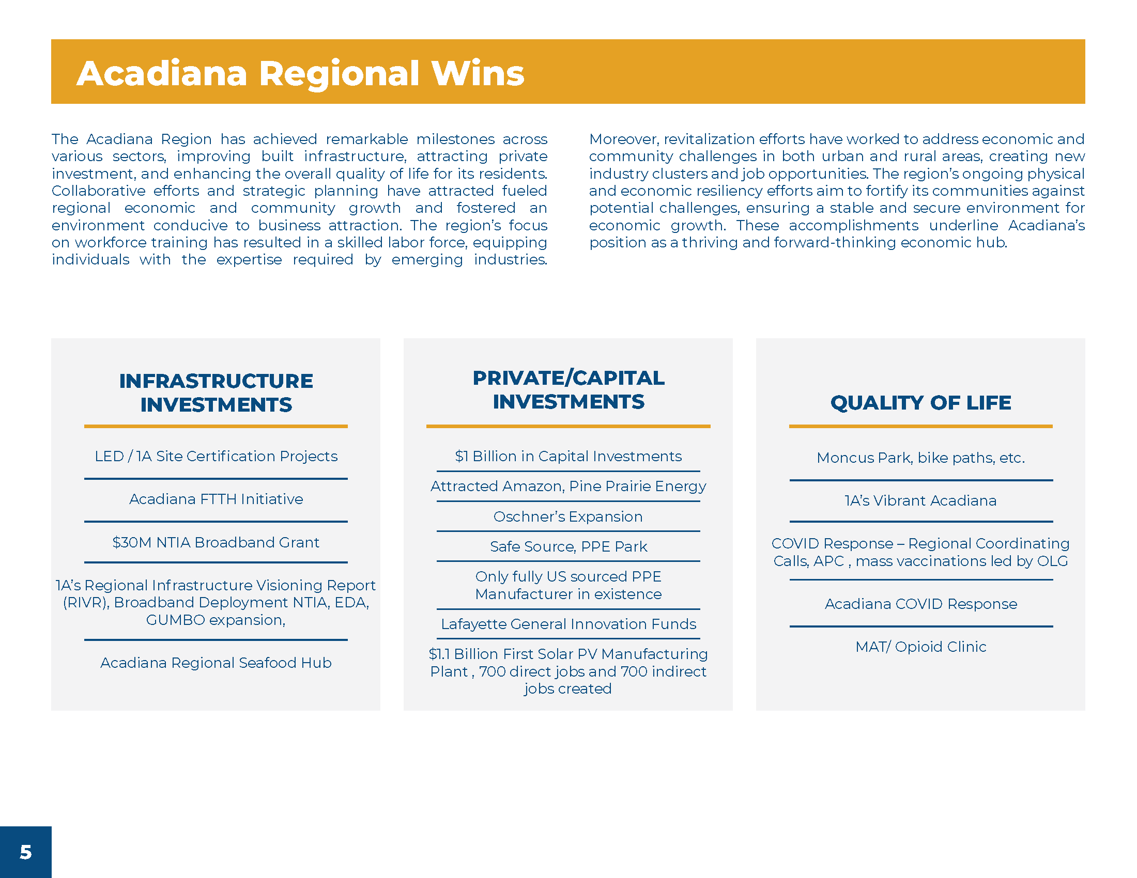
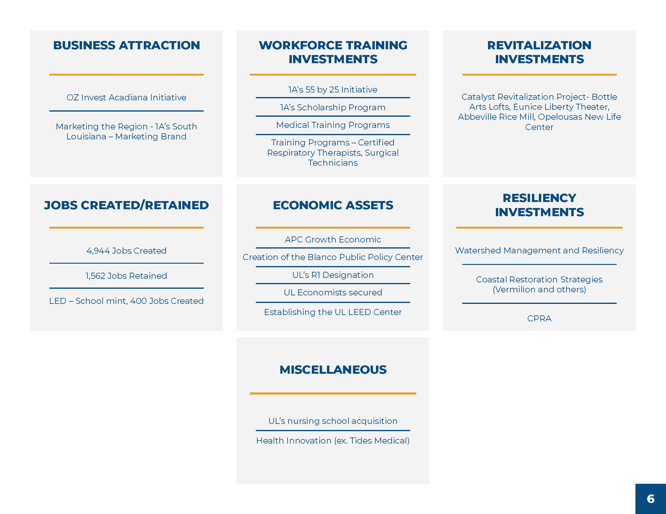
Regional Wins

Slide 22
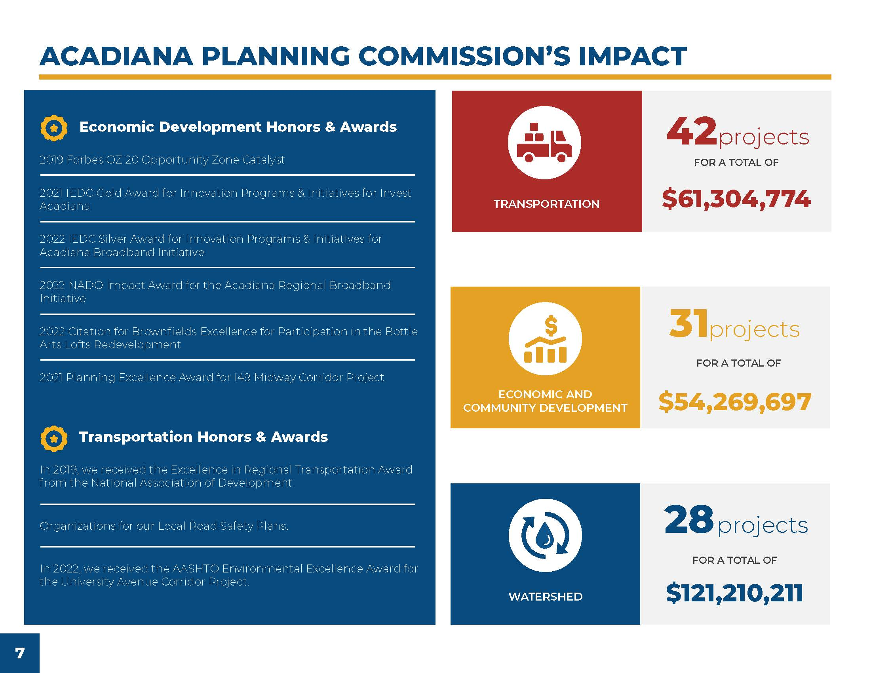

Slide 23
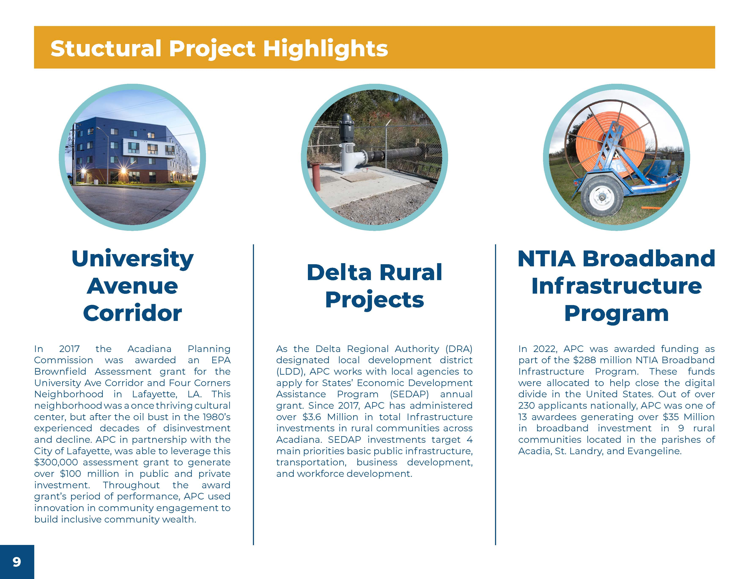
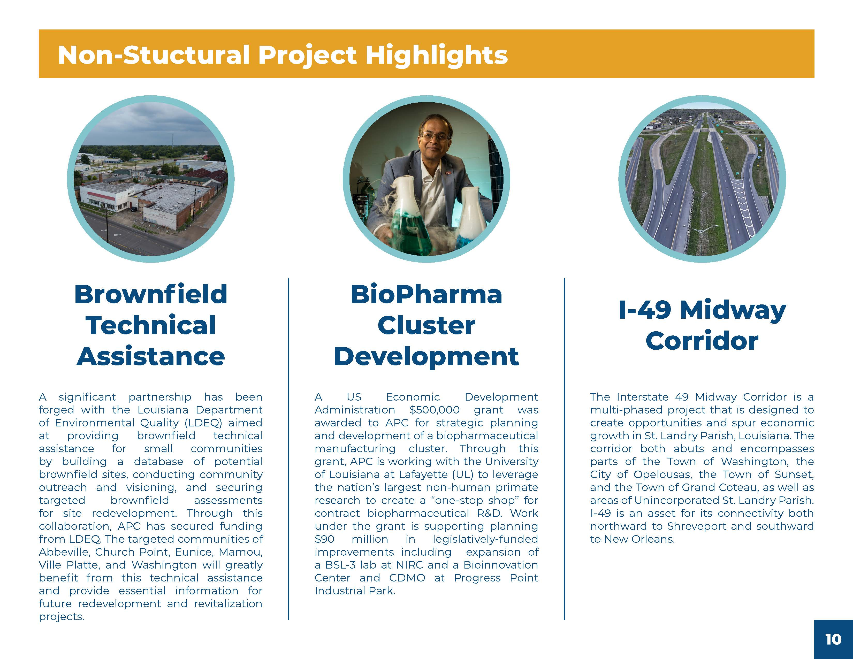
APC’s Impact (continued)

Slide 24
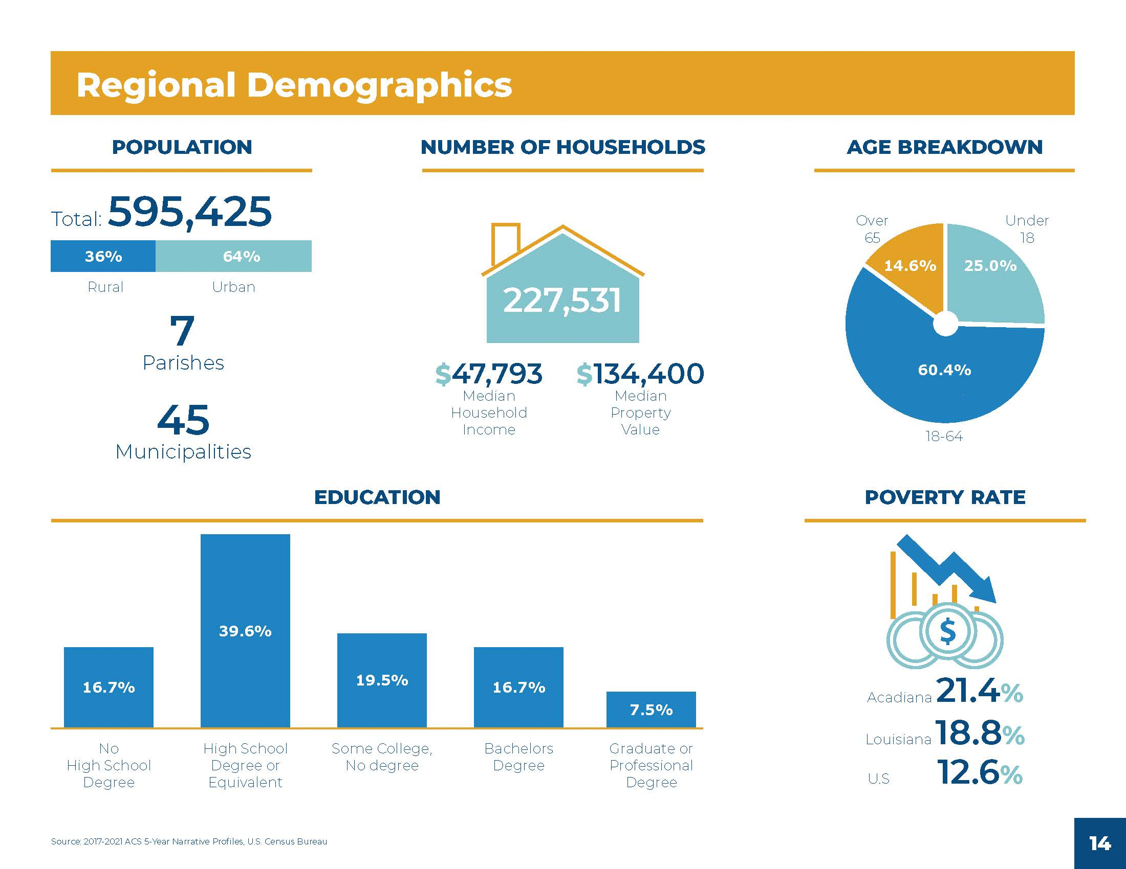
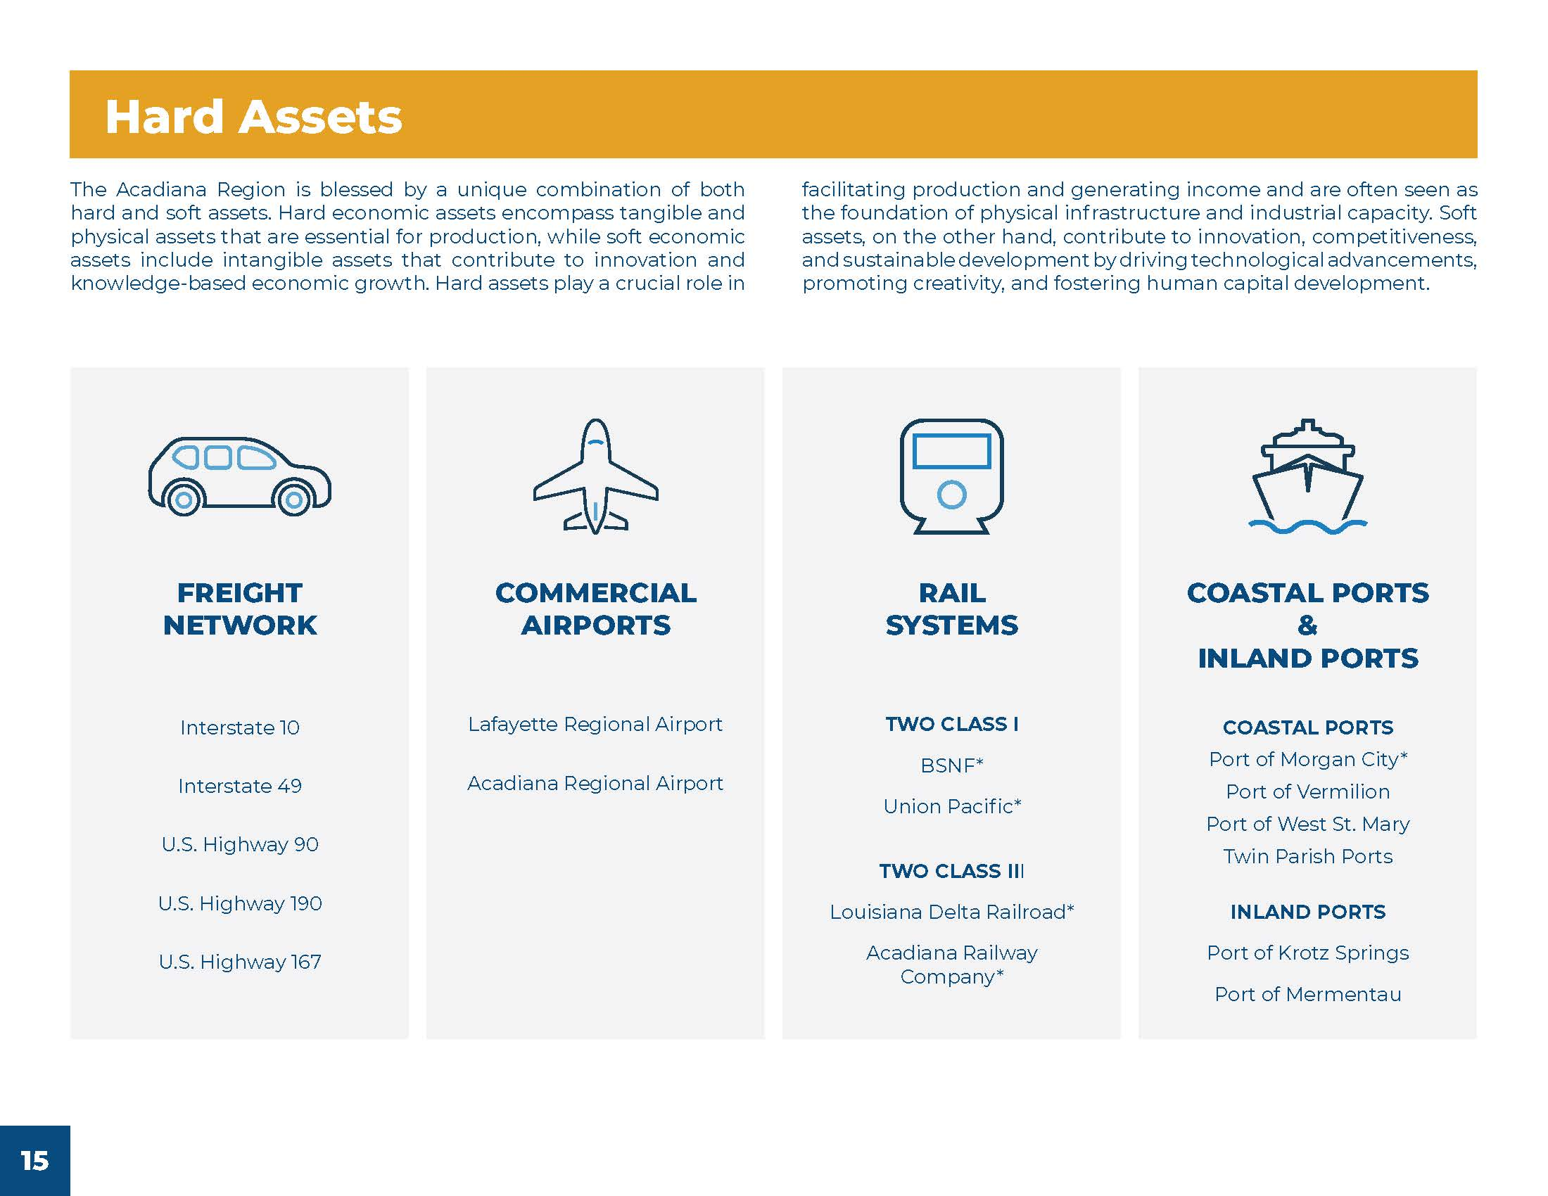
Economic Profile

Slide 25
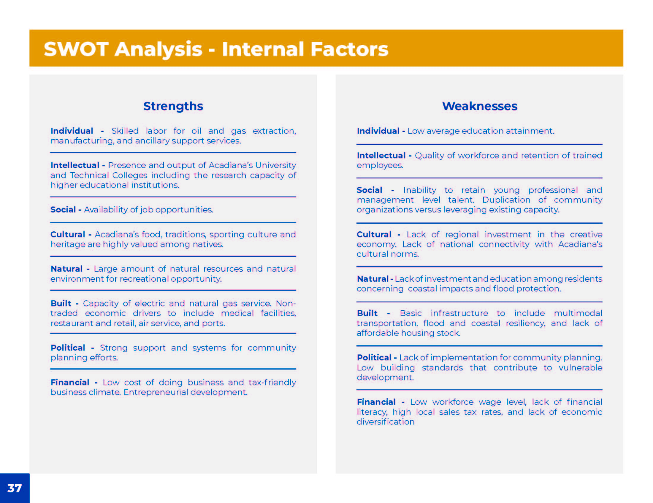
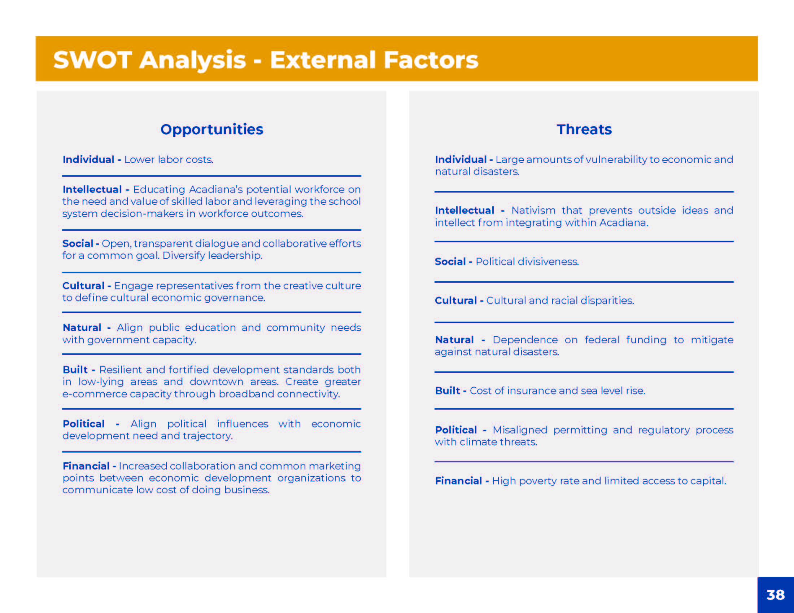
SWOT Analysis Results Based on the 8 Capitals

Slide 26
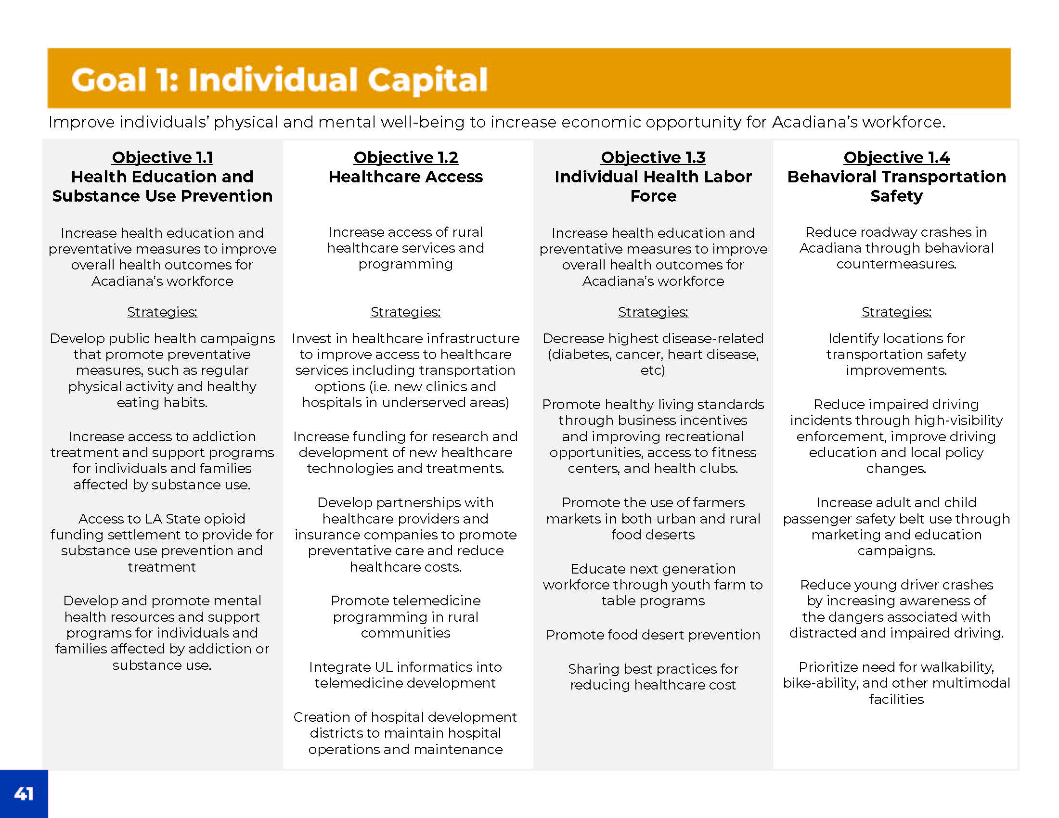
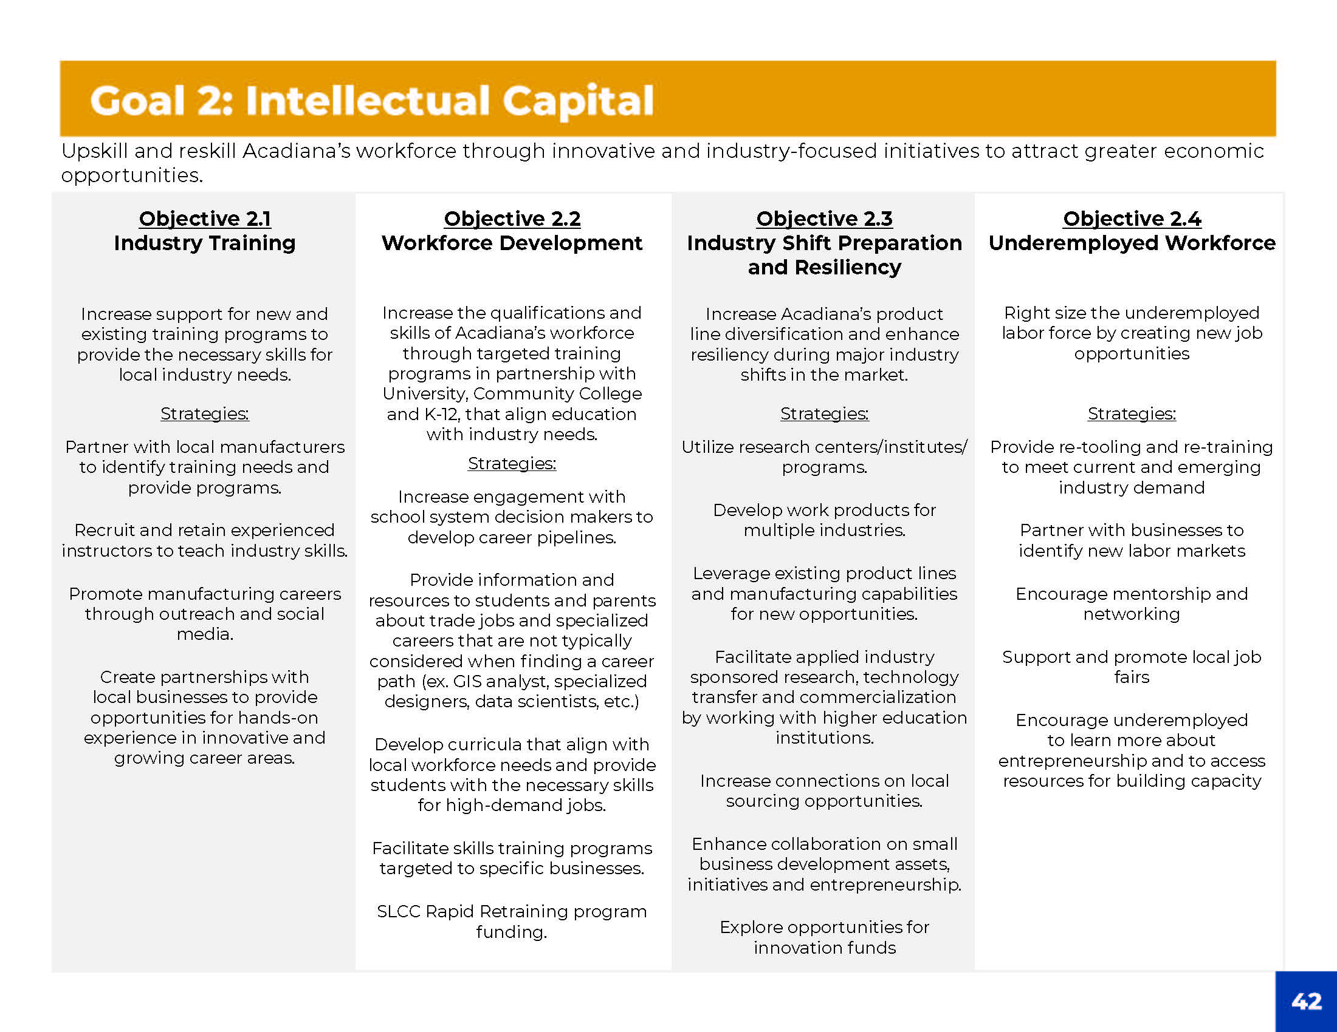
CEDS Goals and Objectives for the Next 5 Years

Slide 27
Questions?
Thank You!
Presenter: Kade Jones, APC

