Slide 1
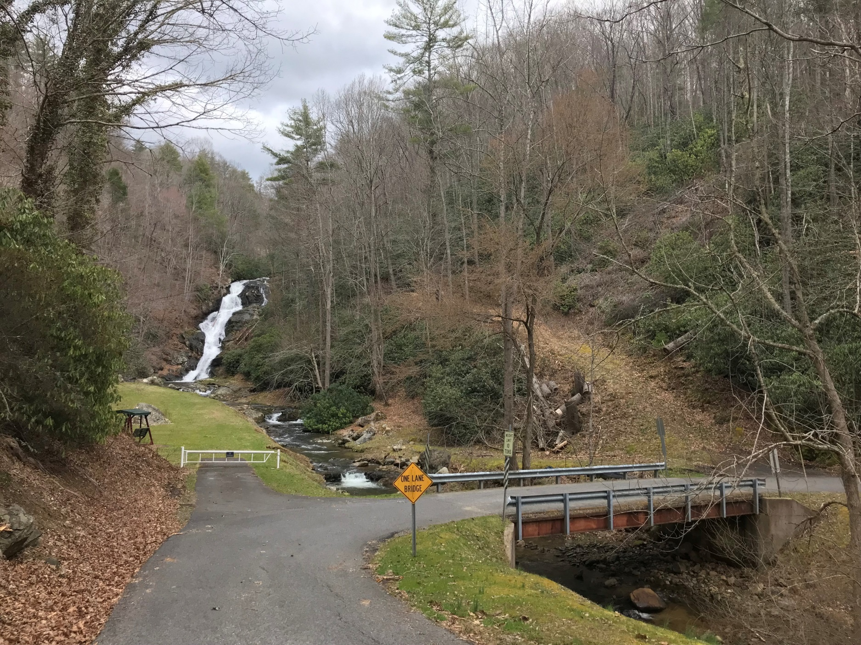

First Tennessee Rural Planning Organization
Bridge over
Spivey Creek,
Unicoi County
Tennessee

Slide 2
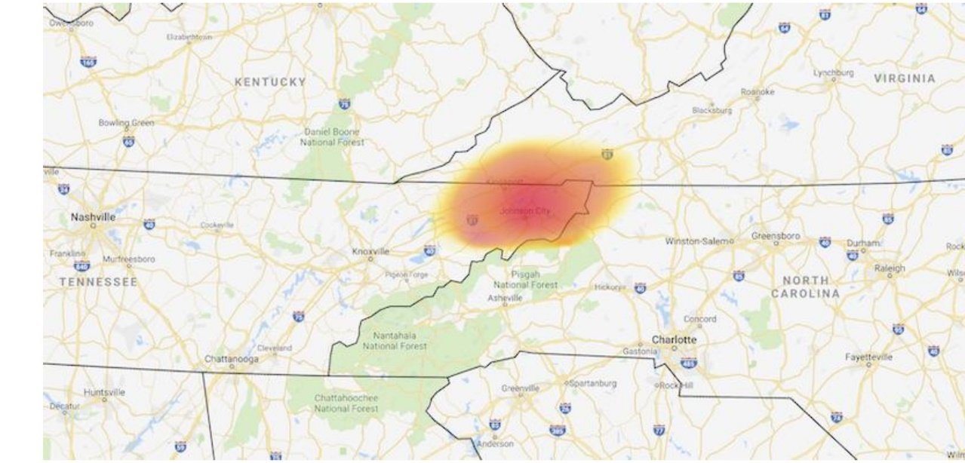
The Appalachian Highlands/Tri-Cities is a Combined Statistical Area of more than 500,000 residents. Johnson City placed as #14 on Forbes’ Best Small Places for Business and Careers List recently, and as one of The 10 least Expensive Places for Living in the US by Kiplinger. The attributes of affordable housing and below average utility, transportation and healthcare costs are shared by each of the communities across the Tri-Cities.

Slide 3

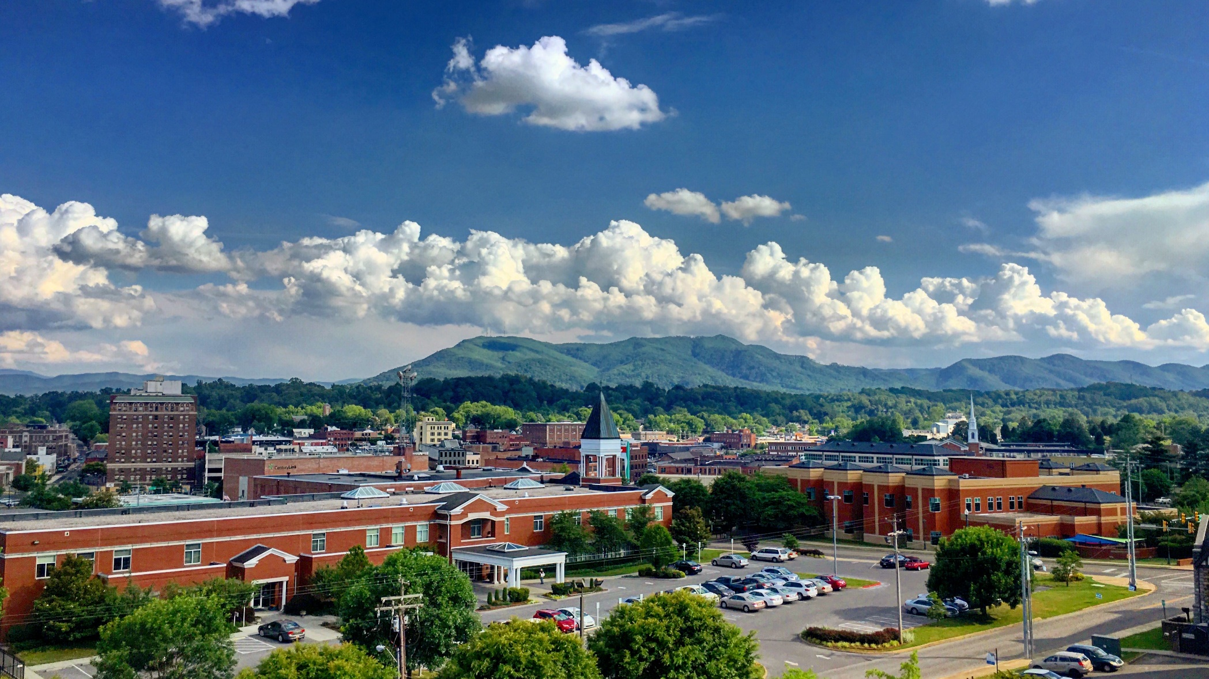

Northeast Tennessee’s Tri-Cities of Bristol, Kingsport, Johnson City and small towns along the way make up a diverse region of outdoor recreation, music, history and everything in between.

Slide 4
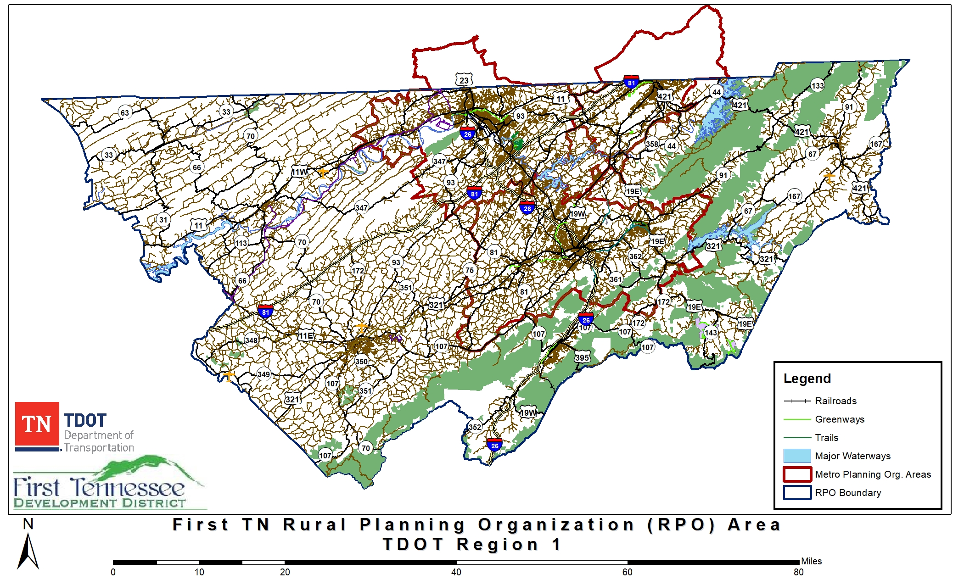
First TN RPO Region

Slide 5
What is an RPO?
Rural Planning Organization
Formed in 2005 to enhance state- and regional-level partnerships in rural areas for transportation planning purposes
12 RPO’s within Tennessee
Funding for transportation projects and programs are channeled through this planning process
FTRPO housed within the FTDD (one of nine Development Districts in TN)

Slide 6
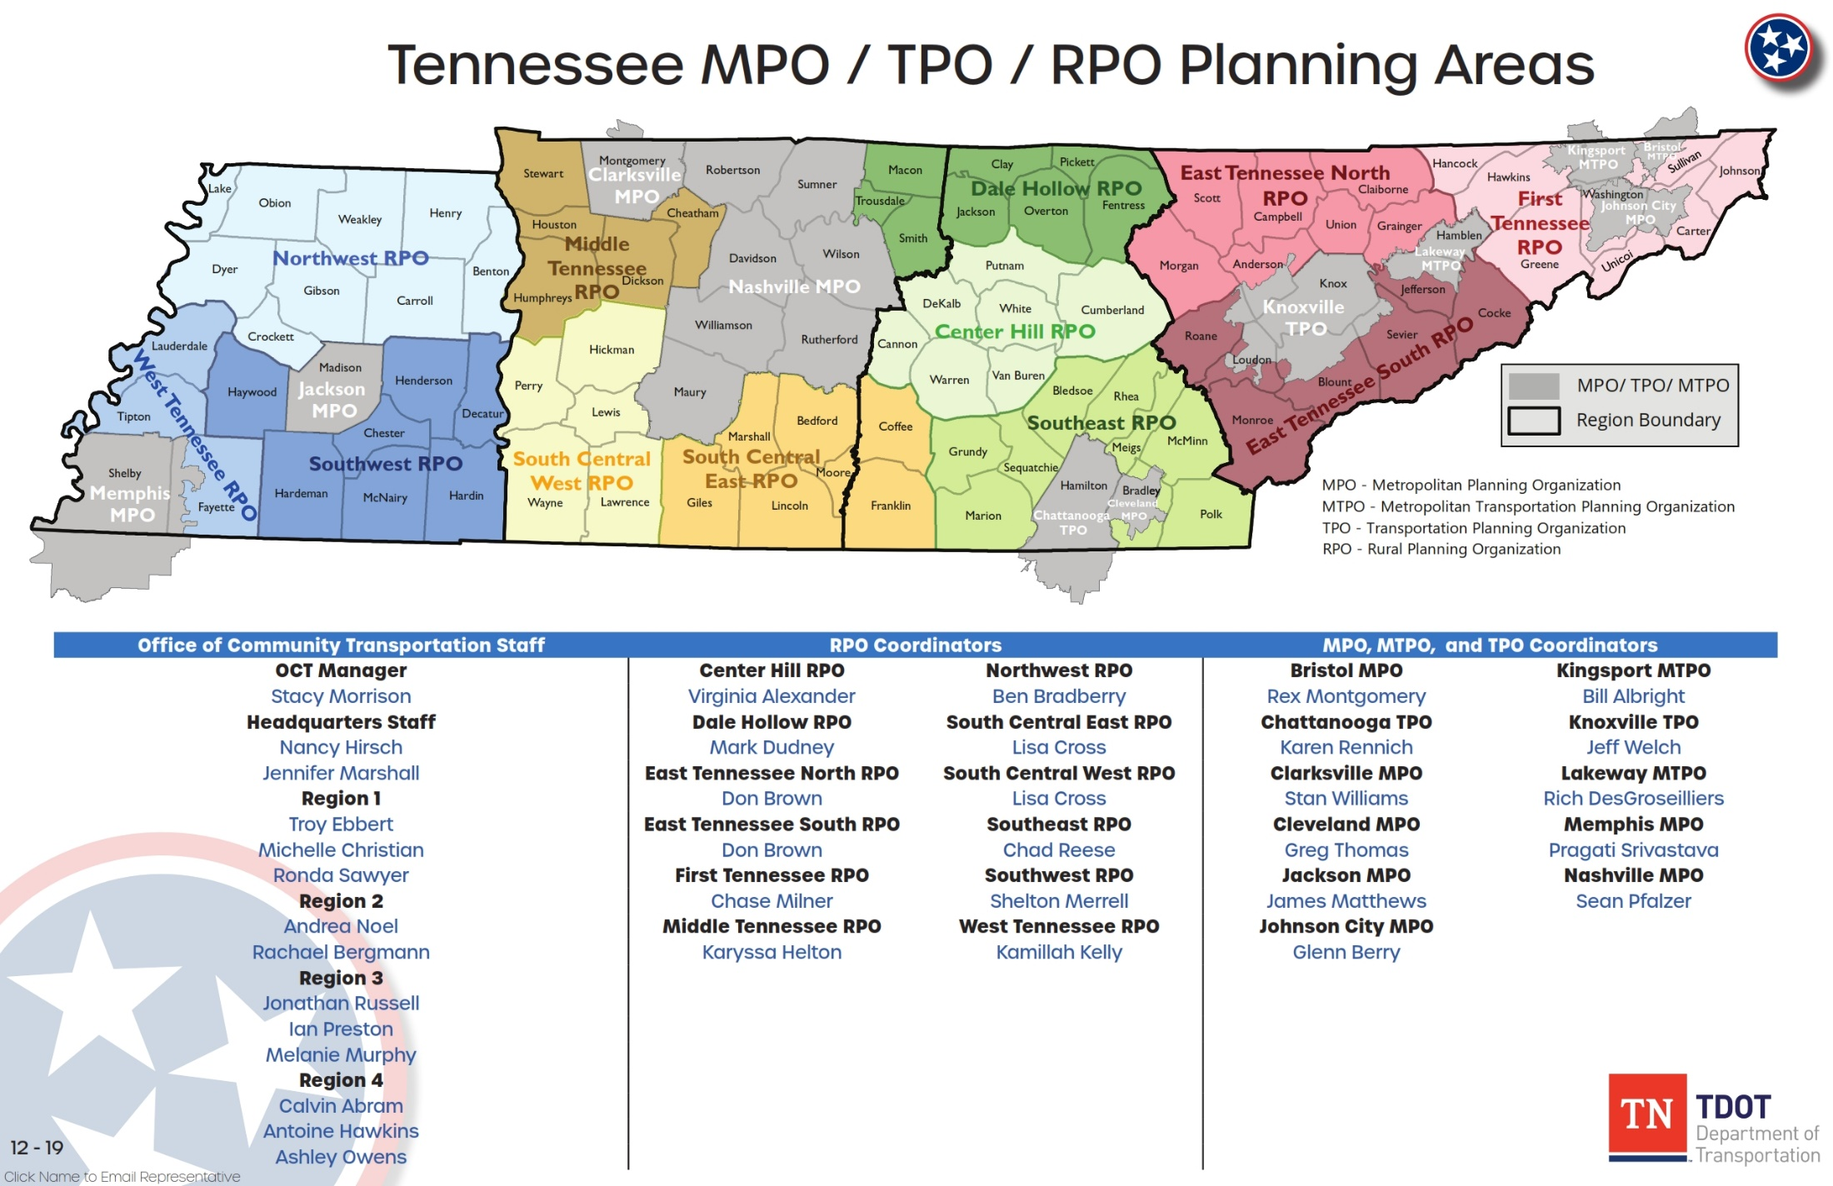

Slide 7
What is the purpose of the RPO?
The purpose of an RPO is to involve local officials in multimodal transportation planning, through a structured process, to ensure quality, competence, and fairness in the transportation decision-making process.

Slide 8
What does the RPO do?
Consider multimodal transportation needs on a local and regional basis
Review long-term needs as well as short-term funding priorities
Rural regional transportation planning
RPO centric Task 5 Work Plan Objectives (Ex. EVSE/Climate)
Make recommendations to TDOT

Slide 9
RPO EVSE/Climate Opportunities Underway
EMPOWER
NEVI/TEVI (TDOT)
USDOT R.O.U.T.E.S Toolkit
DOE
1. Communities Taking Charge Accelerator, Fiscal Year 2024 Funding Opportunity Announcement
2. Rural Reimagined

Slide 10
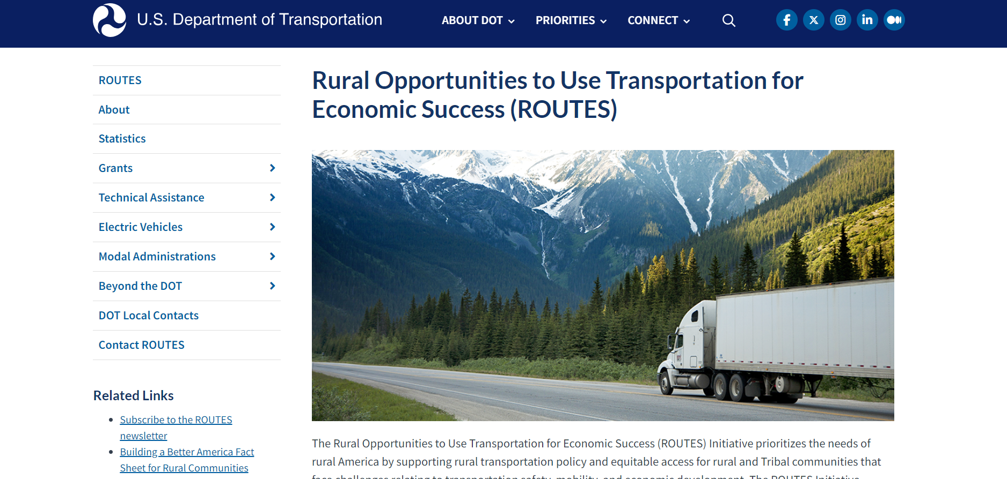
https://www.transportation.gov/rural

Slide 11
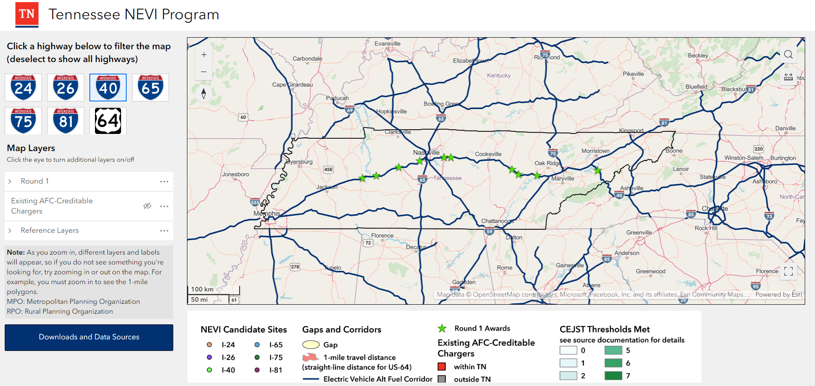
Wait…What is (TEVI)?TN Electric Vehicle Infrastructure?
Notes:
The Infrastructure Investment and Jobs Act (IIJA) (also known as the Bipartisan Infrastructure Law, or BIL) includes a total of up to $7.5 billion in dedicated funding to help make electric vehicle (EV) charging stations accessible to all Americans for local and long-distance trips. That funding includes a $5 billion National Electric Vehicle Infrastructure (NEVI) Formula Program that helps states create a network of EV charging stations along Alternative Fuel Corridors designated by the Federal Highway Administration (FHWA).
States must submit comprehensive plans to the U.S. Joint Office of Energy and Transportation (Joint Office) by August of each year to receive NEVI Formula Program funds. The Tennessee Departments of Transportation (TDOT) and Environment and Conservation (TDEC) are working collaboratively to implement an EV Infrastructure Deployment Plan that details how Tennessee will use NEVI Formula Program Funds.

Slide 12
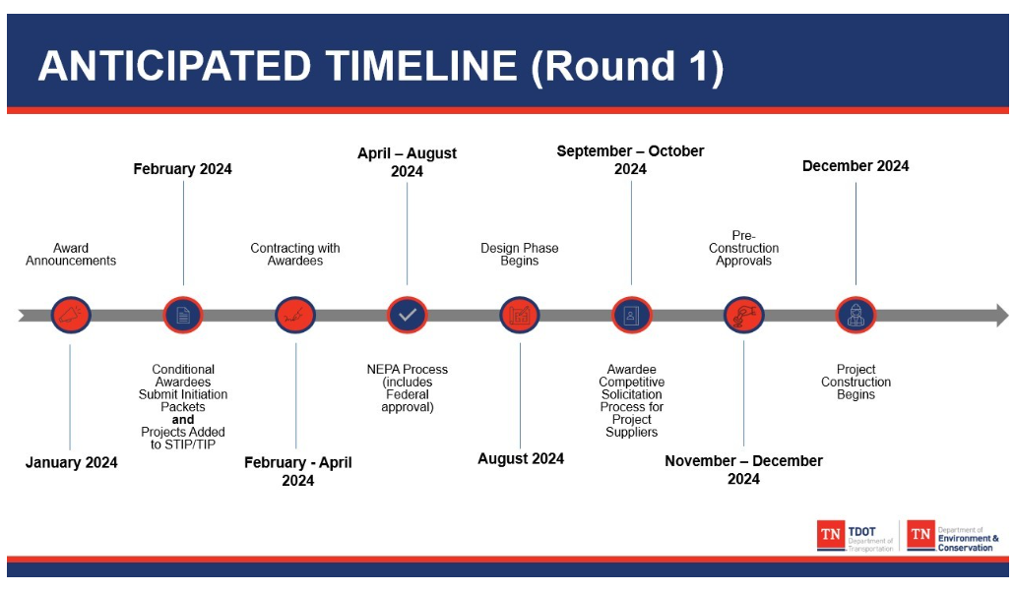
TN Electric Vehicle Infrastructure (TEVI)
Notes:
EV charging infrastructure acquired or installed with NEVI Formula Program funds should be located along a designated Alternative Fuel Corridor until all Alternative Fuel Corridors in the state are designated as “fully built out” by the Secretary of Transportation.
An Alternative Fuel Corridor will be considered “fully built out” only once the following criteria are met:
Charging infrastructure is installed every 50 miles
Chargers are no farther than one mile from corridors
Each charging location includes at least four 150kW Direct Current (DC) Fast Chargers
These four chargers use Combined Charging System (CCS) ports
The station can simultaneously charge at least four EVs at 150 kW
19 Fast Charging Sites to date (42 DCFC’s), with 24 more planned with LPC’s

Slide 13
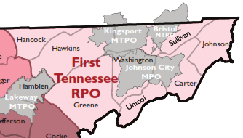




First Tennessee RPO’s FY23-24 Work Program At A Glance
DET/Rural Reimagined/TEVI
Project Planning
REGIONWIDE
Mountain City - USDOT Thriving Communities Program
EVSE Infrastructure Workshop in Kingsport March 2024
DMRA OHV Access Mgmt. Study Completed
Tennessee State Parks Electric Wheelchair Program ADA Interagency Accessibility Development Project
Notes:
The District’s population increased from 506,266 in 2010 to 516,931 in 2020, a 10,665 person or 2.1% increase. Washington County had the largest increase in population for the region’s eight counties. Washington County’s population increased from 122,979 in 2010 to 133,001 in 2020, a 10,022 person or 8.2% increase.

Slide 14
FTRPO Rural Planning Initiatives – Task 5 Completion FY2024 Projects
Co-hosted EVSE workshop Thursday March 14th at the Kingsport Chamber of Commerce with ETCF
Applied for USDOT Safe Streets and Roads for All (SS4A) Planning and Demonstration Grant Spring, 2024
Administering a $90,000 sub-grant award as received from USDOT (TCP) Mountain City & Johnson County, TN
Continuing EVSE partnership with Tennessee Tech University’s Rural Reimagined: Building an EV Ecosystem and Green Economy for Transforming Lives in Economically Distressed Appalachia (DOE Control Number: 2475-1693)
Attending annual continuing education opportunities to better understand how best to prepare for resilient transportation planning (APA National and NADO Conferences) in 2024
Chase Milner cmilner@ftdd.org 423-722-5217

Slide 15
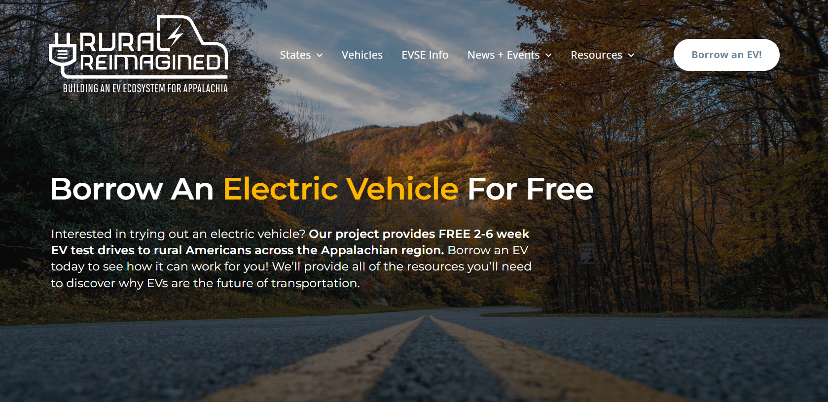
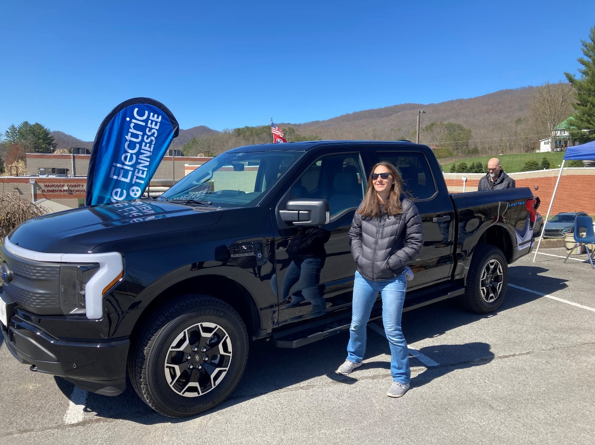
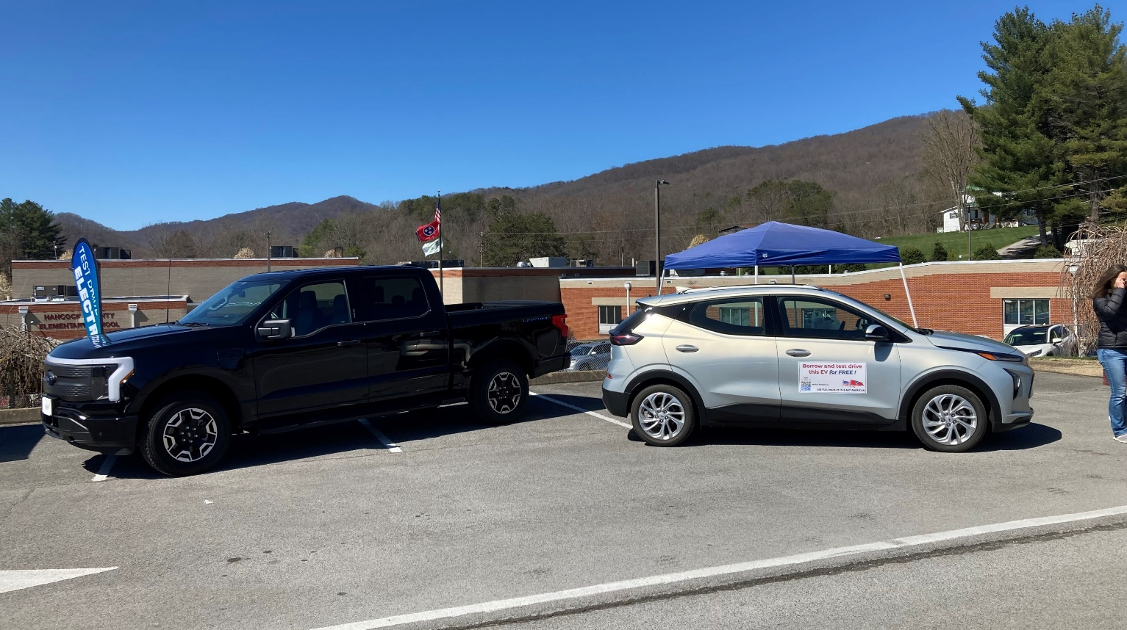

Slide 16
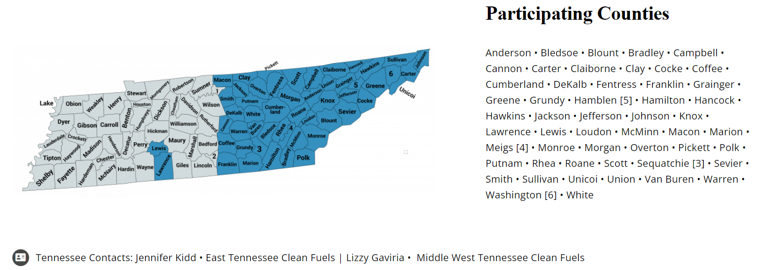
Find An EV → https://rural-reimagined.com/

Slide 17
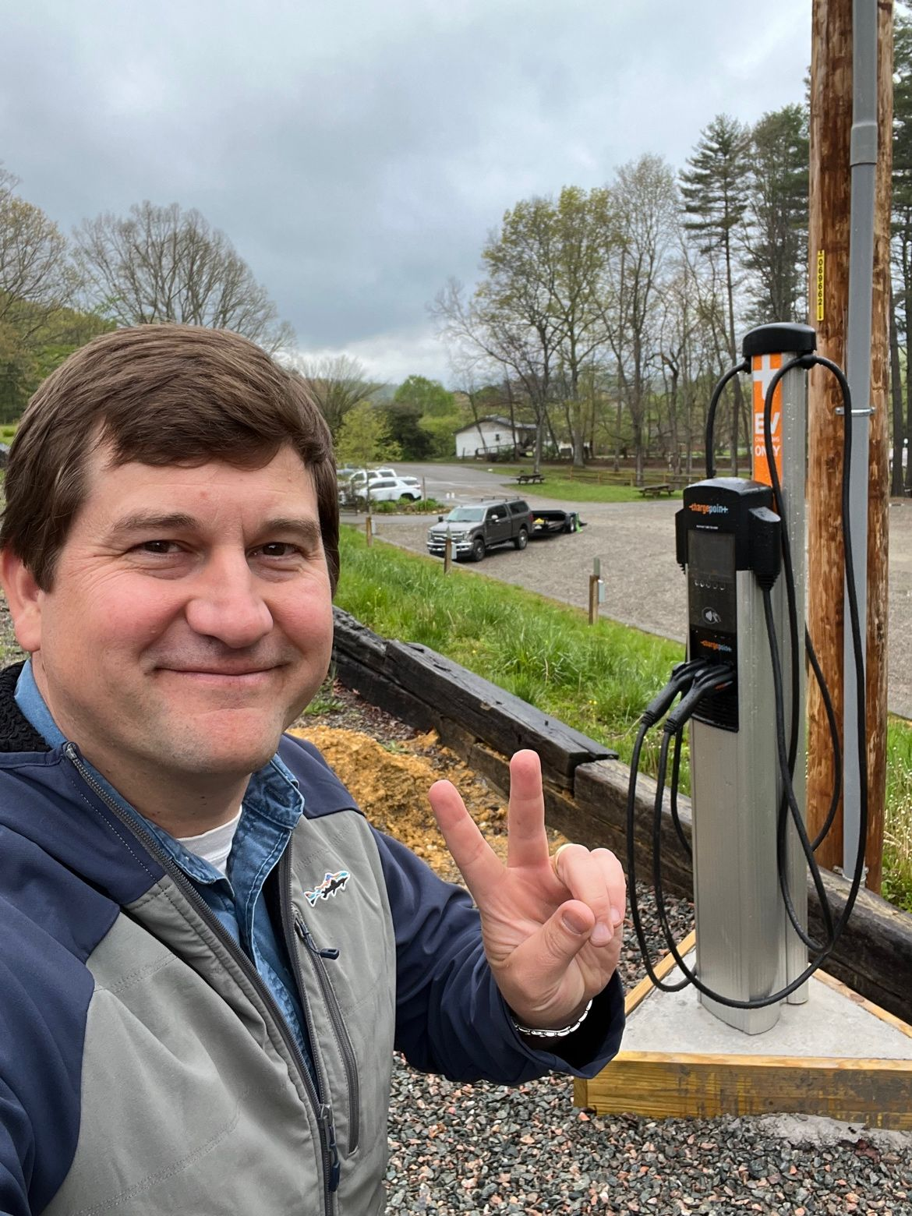
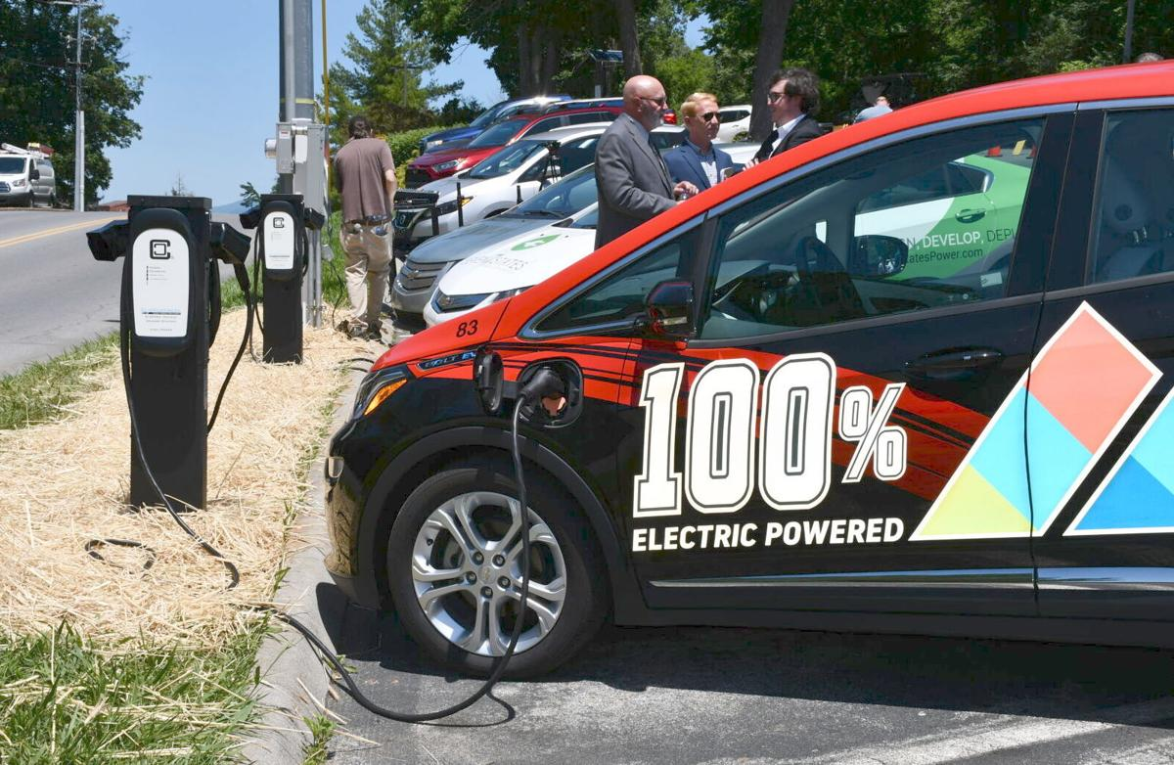
Rural Reimagined: Building an EV Ecosystem Across the RPO
1) Multi-layer Charging Infrastructure Development
  2) EV Acquisition and Demonstration
  3) Data Collection and Analysis
  4) Information Exchange, Outreach and Education
  5) Workforce Training and Economic Development
2nd L2 Rural Reimagined EV Charger
in Johnson County, TN

Slide 18
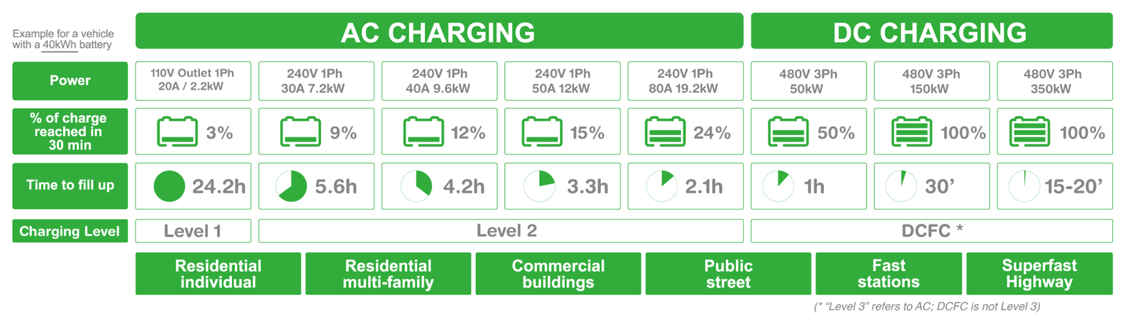
Rural Reimagined : Vanguard of the Rural TN EV infrastructure revolution
FTRPO has partnered with Tennessee Tech University (Project Lead) on the newly awarded
Rural Reimagined: Building an EV Ecosystem and Green Economy for Transforming Lives in Economically Distressed Appalachia (DE Control Number: 2475-1693)
The project aims to provide clean and affordable mobility options to the underserved communities by developing needed charging infrastructure, and adopting and demonstrating various cost-effective EVs in diverse applications
40 partners across five subprojects in five central Appalachian states (OH, TN, WV, KY, and VA)
  1) Multi-layer Charging Infrastructure Development:
  2) EV Acquisition and Demonstration
  3) Data Collection and Analysis
  4) Information Exchange, Outreach and Education
  5) Workforce Training and Economic Development
Notes:
The RPO is supporting the project by serving on the steering committee, sharing and gathering information with local stakeholders, and attend monthly meetings.
Purpose
To educate the local government, local power companies, and First TN RPO members on the importance and benefits of Electric Vehicle infrastructure and alternative fuels; provide tools to communities to create resiliency and reliability in transportation systems

Slide 19
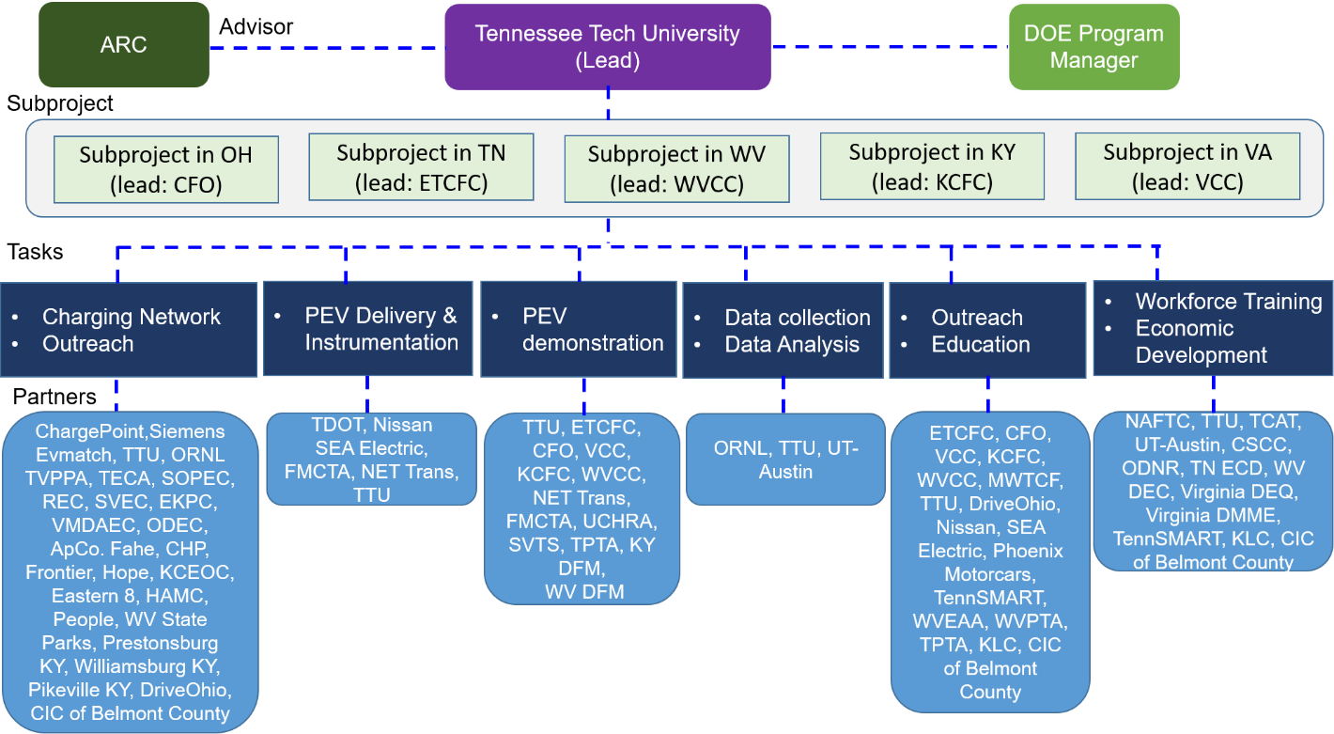
Project Organization Chart

Slide 20
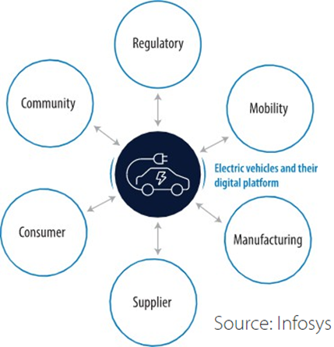
Rural Reimagined Main Tasks
EV Charging Infrastructure Development
  Public level-2, public DCFC, multi-family, fleet (by rural transit agency)
Delivery and Instrumentation of PEVs
  Hatchback, SUV, pickup truck, transit van
EV Demonstration
  EV test-drive program
Data Collection and Data Analysis
Information Sharing, Outreach, Education
  EV outreach event, workshop, webinar, transportation/mobility forum
Workforce Training & Economic Development
  Vehicle engineering program (TTU), training program at community colleges

Slide 21

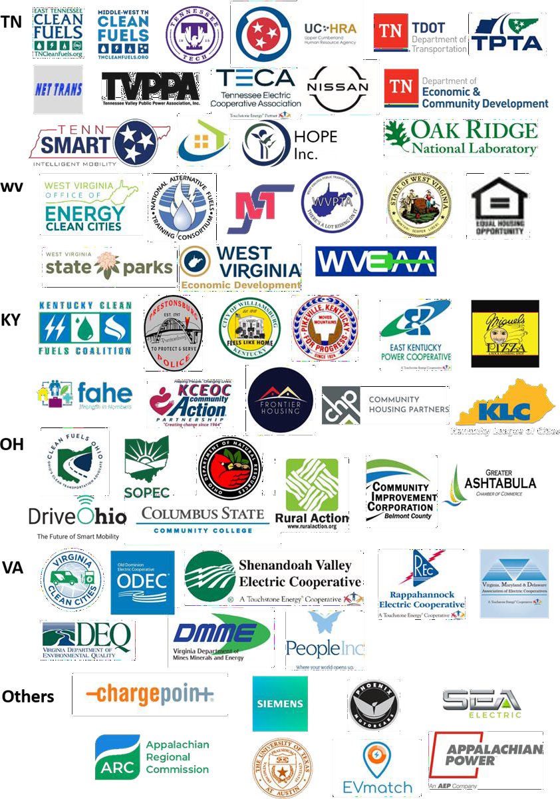


Rural Reimagined Project Overview
Project Team (64)
Timeline
Start: August 1st, 2022
End: October 31st, 2025
Barriers addressed
Lack of EV exposure and experience in rural
communities
Lack of EV infrastructure in rural areas
Lack of information for EV adoption in rural areas
Lack of awareness and training for clean energy jobs
Budget
Total project funding: $8,026,086
  $4,012,930 - DOE (Sponsor)
  $4,013,156 - Cost Share

Slide 22



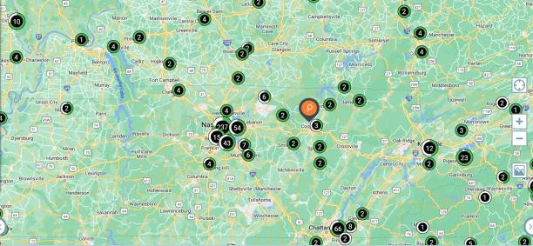
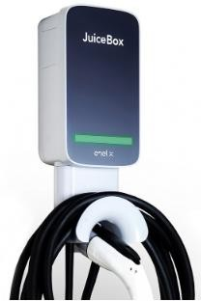
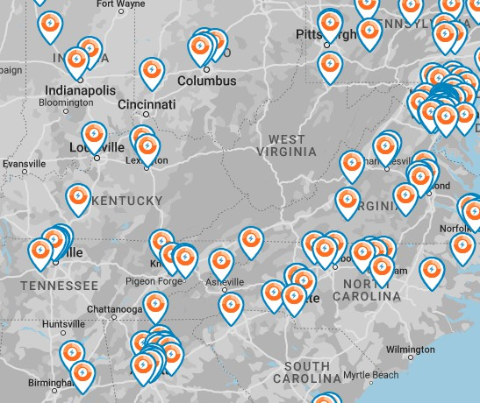
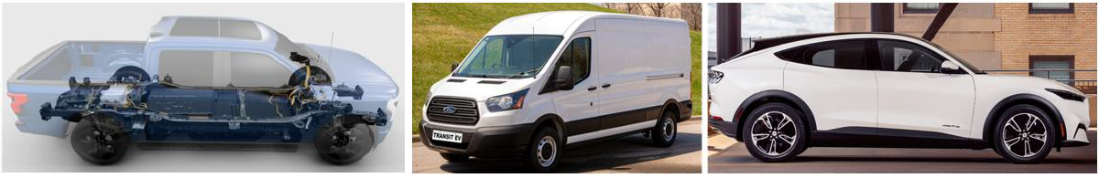



Proposed Technologies
Multi-layer EV Charging Infrastructure Development
(CT4025)
(CPE250)
(CPF50)
(JuiceBox 40)
Affordable EV Technologies

Slide 23
Interested In More Rural Reimagined Info?
Principal Investigator and Presenter: Prof. Pingen Chen Tennessee Technological University
Email: pchen@tntech.edu; Phone: (931) 372-3310

Slide 24
Rural Reimagined : Rural TN EV infrastructure site host selection ongoing, continually updating
2023
2024
Notes:
11 sites identified for year 1 of program.

Slide 25


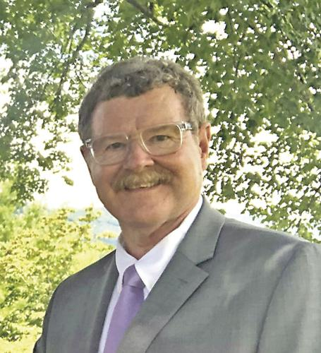
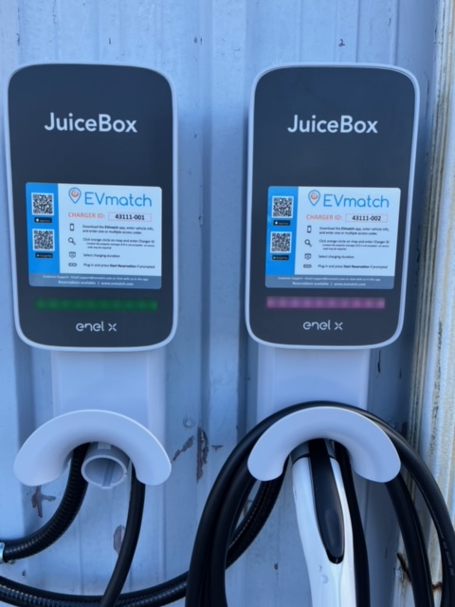
Build Out EVSE In Mtn City → Through Rural Reimagined
Thank you for your site hosting partnership, Town Mayor!
FIRST EVSE INSTALL IN ENTIRE RURAL REIMAGINED PROGRAM
EV Level 2 Evmatch
JuiceBox
Mayor Jerry Jordan
EVSE build out completed
September, 2023

Slide 26

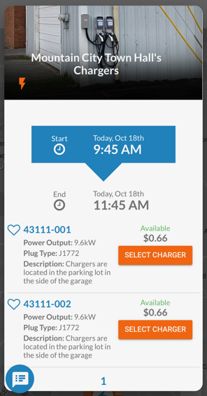
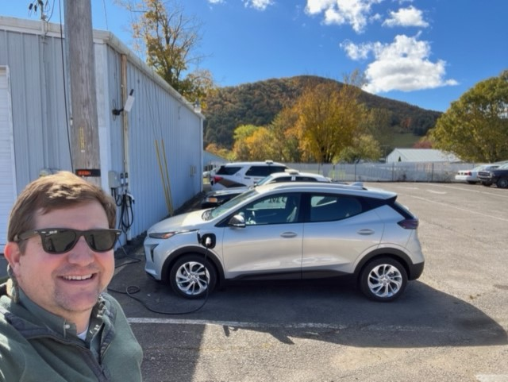
First Charge of the trip in Mtn City
I added JuiceBox to the Plugshare Location App while there
First Charge October 18th 2023

Slide 27
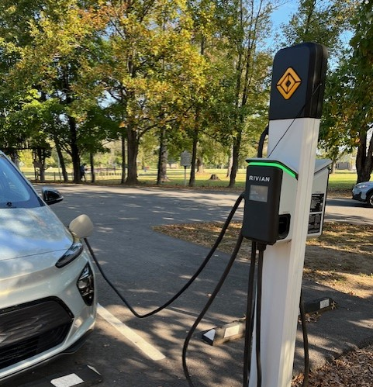
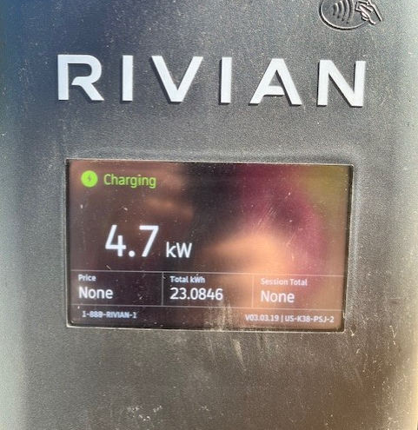
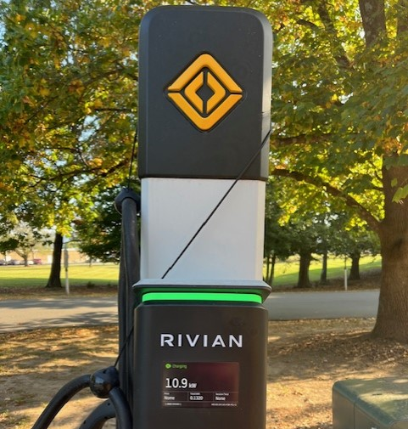
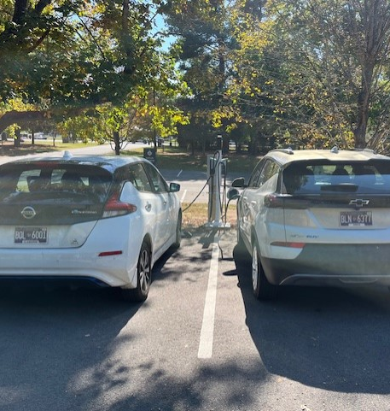
Exciting Private/Public Level 2 EVSE Partnership w/Rivian and TN State Parks
Sycamore Shoals State Historic Park

Slide 28
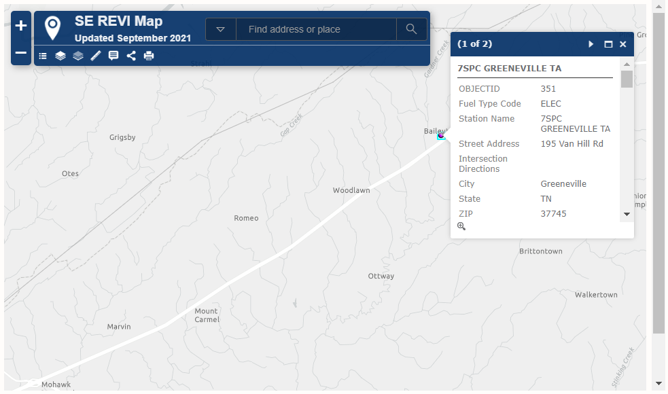
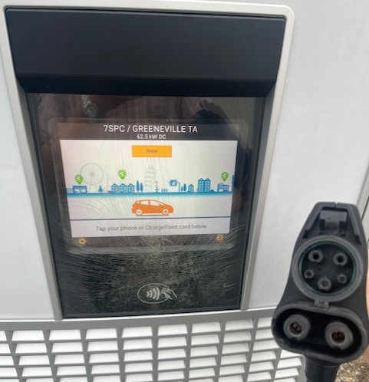
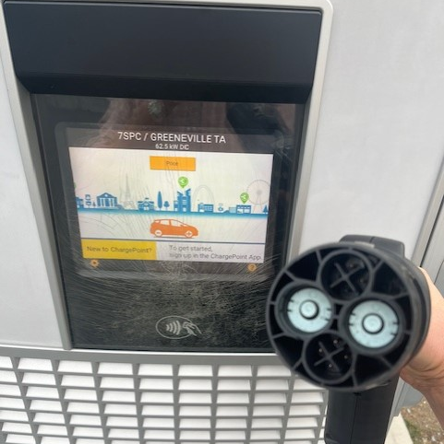
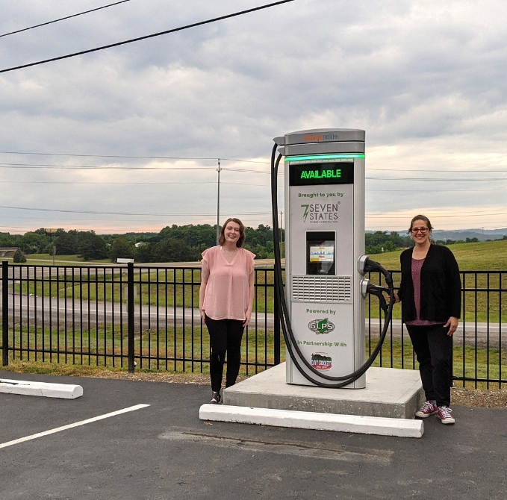
I-81 Exit 36
Level 3 DCFC in Baileyton TN Exit 36
Davey Crockett TA
ChargePoint (fee) Southern States Coop

Slide 29
Mtn. City to Memphis Road Trip Lessons Learned
Tennessee is EV ready already! 154 DCFC Locations (572 ports), 714 L2 locations (1392 L2 ports)
TEVI build out is eliminating range anxiety w/19 Fast Charge Stations today (42 DCFC plugs)
Projected EV Range vs. Actual Mileage Range is a challenge when driving solo
It’s great to create partnerships with Clean Cities Coalitions (East TN Clean Fuels), and Universities
Always be prepared for externalities and mishaps
Read PlugShare Reviews – Especially Recent EVSE Site Location Charging Status Commentary
EV driving co-pilots are ideal for on the fly EVSE locating to help prevent distracted driving
Charging Apps currently can take your money with no $$$ return available

Slide 30
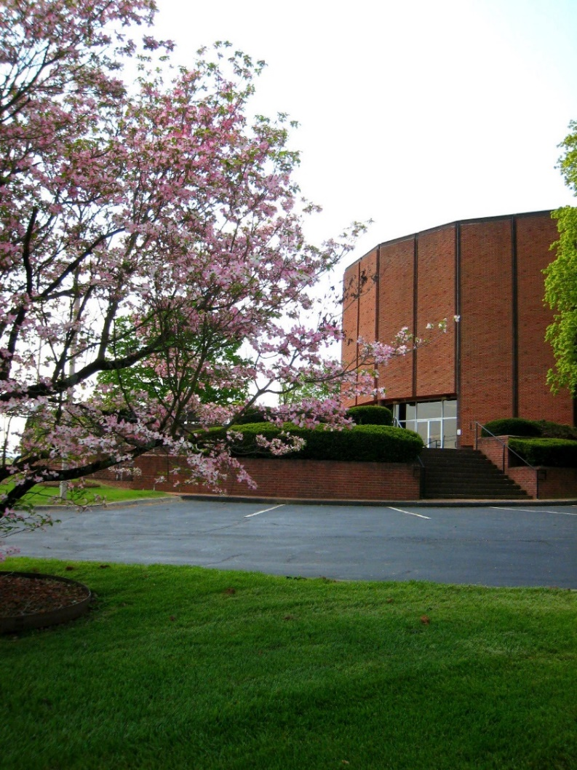
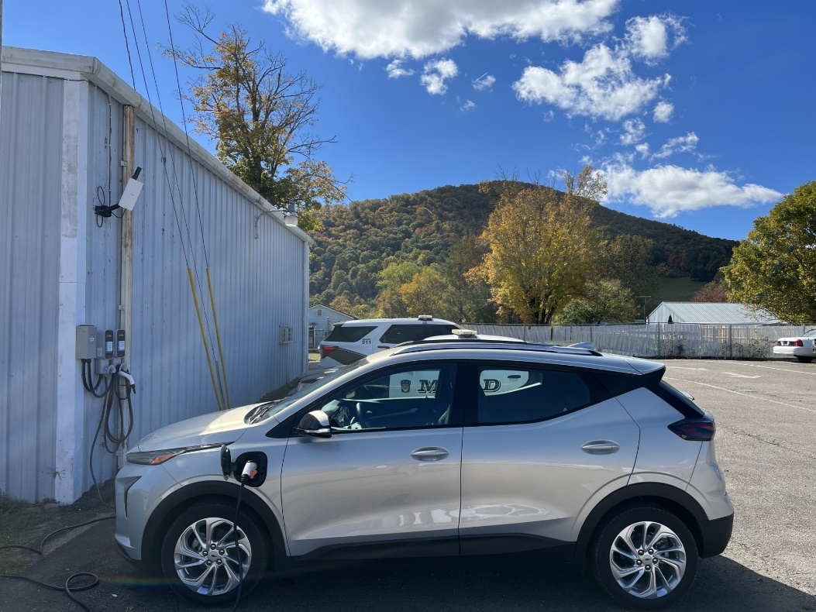
Questions?
Chase Milner
Rural Planning Organization Coordinator
First Tennessee Development District
3211 N. Roan Street
Johnson City, TN 37601
o: 423-722-5217
cmilner@ftdd.org
www.FTDD.org
FIRST Rural Reimagined EVSE installed in Mountain City – September, 2023
FTDD Office, Johnson City
Notes:
Since the First TN RPO was formed in 2005-2006, the main goal of the program has been to assist local governments with identifying multi-modal rural transportation needs through the Development District. As transportation funding mechanisms change throughout the District and nation, the RPO process will continue to be a valuable tool for local governments.

