Slide 1



Building Partnerships and Engaging New Demand Partners
SUBTITLE OR TAGLINE HERE

Slide 2
Relationships…Relationships…
Relationships
Build relationships with other community partners to focus on a sector
Build relationships with demand
Build relationships with other producers, suppliers, etc.
Build relationships with support partners (e.g., educational institutions, financial institutions, Cooperative Extension)
And many, many others!
Coordination role is central and critical!
Notes:
carrie

Slide 3
Uncovering Motivation for Engaging
What is their self-interest in engaging further?
What benefits can we/the product offer that they value?
This is their “value proposition.”
Three levels of Interests:
Self: What’s in it for me?
Shared: What’s in it for us?
Common: What’s in it for other
people/the region?

Slide 4
Exercise: Value Propositions
Think about a project/initiative you’re actively working on now with external partners.
Spend 5 minutes thinking through these prompts for your own initiative – partnerships and value propositions.
Share at your table.
Peer review: What makes sense? What doesn’t make sense? Where did people get stuck?
E

Slide 5
Opportunities to Build Partnerships
E
Community Capital | Current committee members (or other leadership) | Potential partners working to build these assets | Why would they be interested in participating in your work? How would you engage them?
Individual capital (health, wellness, workforce, education, other skills)
Intellectual capital (innovation partners)
Natural capital (businesses, organizations, or agencies focused on land, water, air, etc.)
Built capital (owners and operators of infrastructure, including private sector)
Notes:
Carrie

Slide 6
Partner Strength Assessment
E
Partnership Characteristics | Strongly Agree | Agree | Neutral | Disagree | Strongly Disagree
My organization and our core partners have a shared vision for creating change.
My organization and our partners collect data, measure progress, maintain alignment of our programming, and hold one another accountable for maintaining momentum
Our various activities are coordinated through either a shared plan of action or our own separate (yet aligned and complementary) plans.
My organization and our core partners communicate about our work consistently and continuously.
My organization and our core partners are organized in some way so that our working relationships will extend beyond the short-term.
Notes:
Carrie

Slide 7
Preliminary Demand Research
Talk with businesses
What are other sources of demand – scale, buyer types, added value, replacing imports.
Talk with current and potential buyers (demand partners)
Notes:
Once you’ve narrowed down opportunities.
Needs and desires vs. market demand.
Desire to buy a product and an ability pay for it.
What are existing businesses selling to whom at what prices? What other markets have they tried in the past? Other market opportunities they haven’t seriously considered.
Other sources of demand – scale, buyer types, added value, replacing imports.
Talk with current and potential buyers (demand partners) – what do they want? Challenges and opportunities with regional businesses? Potential business partners?
Secondary info on sector.

Slide 8
Identify & Engage Market Players
Talk to local businesses and stakeholders
Understand challenges and opportunities.
Who else should you talk to?
Take inventory of market players – start with demand (Customers), then Core Chain, then Support Partners, then Rules and Regulations.

Slide 9
How to Design an Elevator Pitch
The three W’s—the “who,” “what” and “why” of your message or request.
The benefits of collaboration—to both you and your partner.
Any barriers you’ve identified that could make it challenging to work together, and how you plan to get past them.
A call to action that clearly identifies what you are asking potential stakeholder to do if they say “yes.”
Notes:
Melissa

Slide 10
Demand Partner Elevator Pitch
E
Pitch Element | Questions to Help You Get There
Three W’s | Who are you and who do you represent? What do you or your org do? Why is your org doing this work? What need are you serving? How will their participation benefit you and your org? What is the value-added to the potential partner of collaborating with you?
Benefits and Barriers | How will their participation benefit you and your organization? What is the value-added to the potential partner of collaborating with you? What are potential barriers to working together? How will you address these barriers?
Call to Action | What specifically are you asking their organization to do? What are the immediate next steps that you would like them to take?
Notes:
Nmelissa

Slide 11
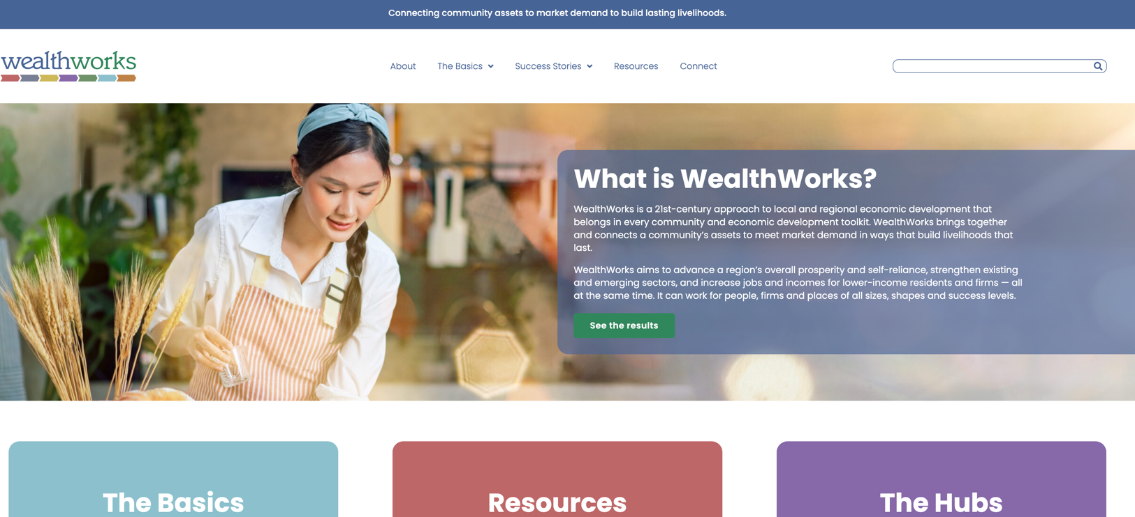
WealthWorks Website - www.wealthworks.org

Slide 12
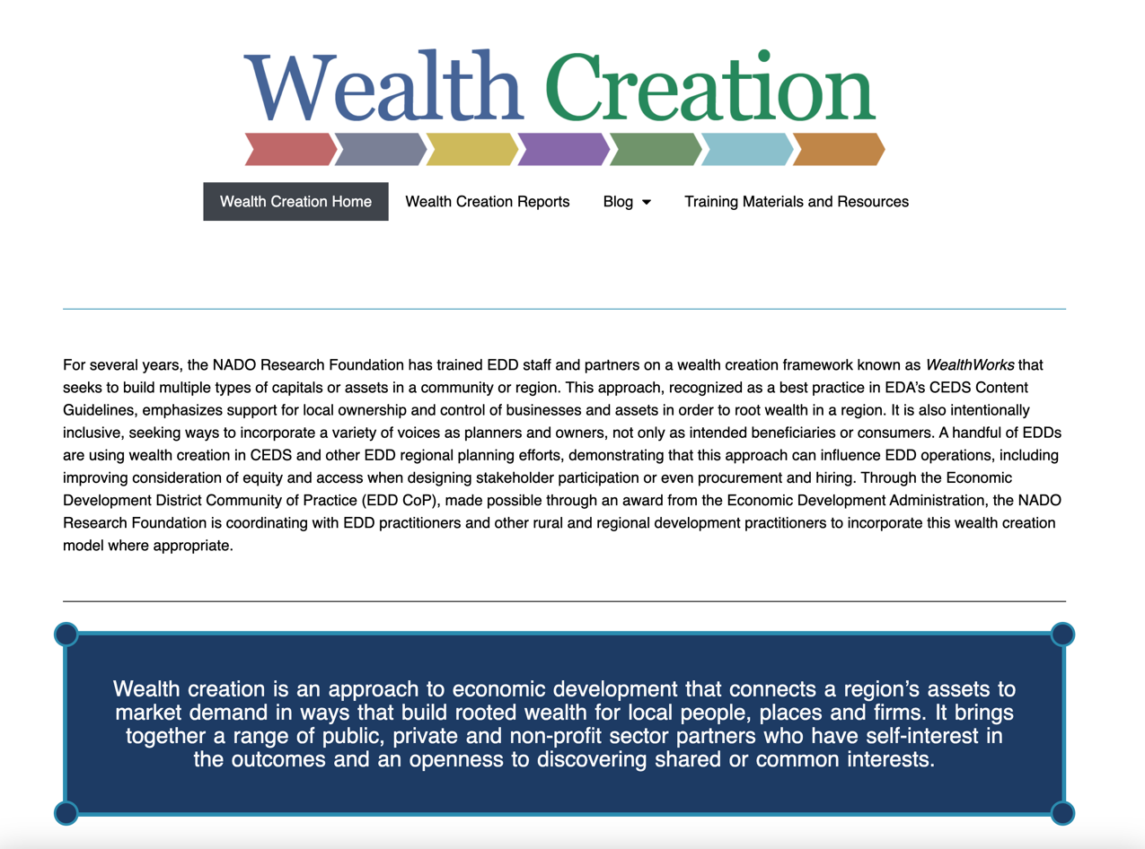
NADO Wealth Creation Website – www.nado.org/wealthcreation

Slide 13
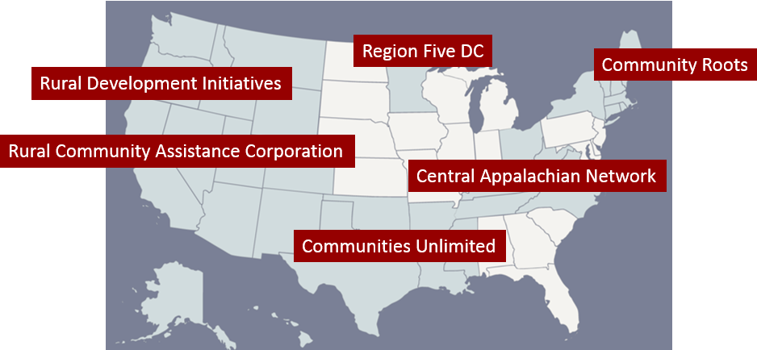
WealthWorks Regional Hubs
http://www.wealthworks.org/connect/hubs

Slide 14

For More Information
Melissa Levy
NADO
mlevy@nado.org
www.nado.org
Carrie Kissel
NADO
ckissel@nado.org
www.nado.org

