Slide 1
Outreach and Communications in Active Transportation
Jean Crowther, AICP
Principal/Innovative Mobility

Slide 2
Retrospective of Strategies
5 Plans/5 Approaches

Slide 3
1
2
3
4
5
Listening Sessions
Community-Led Decision-making
Everyday Language
Democratizing Design
Broadening the Tent

Slide 4
1
2
3
4
5
Listening Sessions
Community-Led Decision-making
Everyday Language
Democratizing Design
Broadening the Tent
Walkable Community Action Plans (SC)
Let’s Bike Oakland (CA)
Salt Lake City Mobility Hub (UT)
Hall County Safety Plan (GA)
PedPDX (OR)

Slide 5
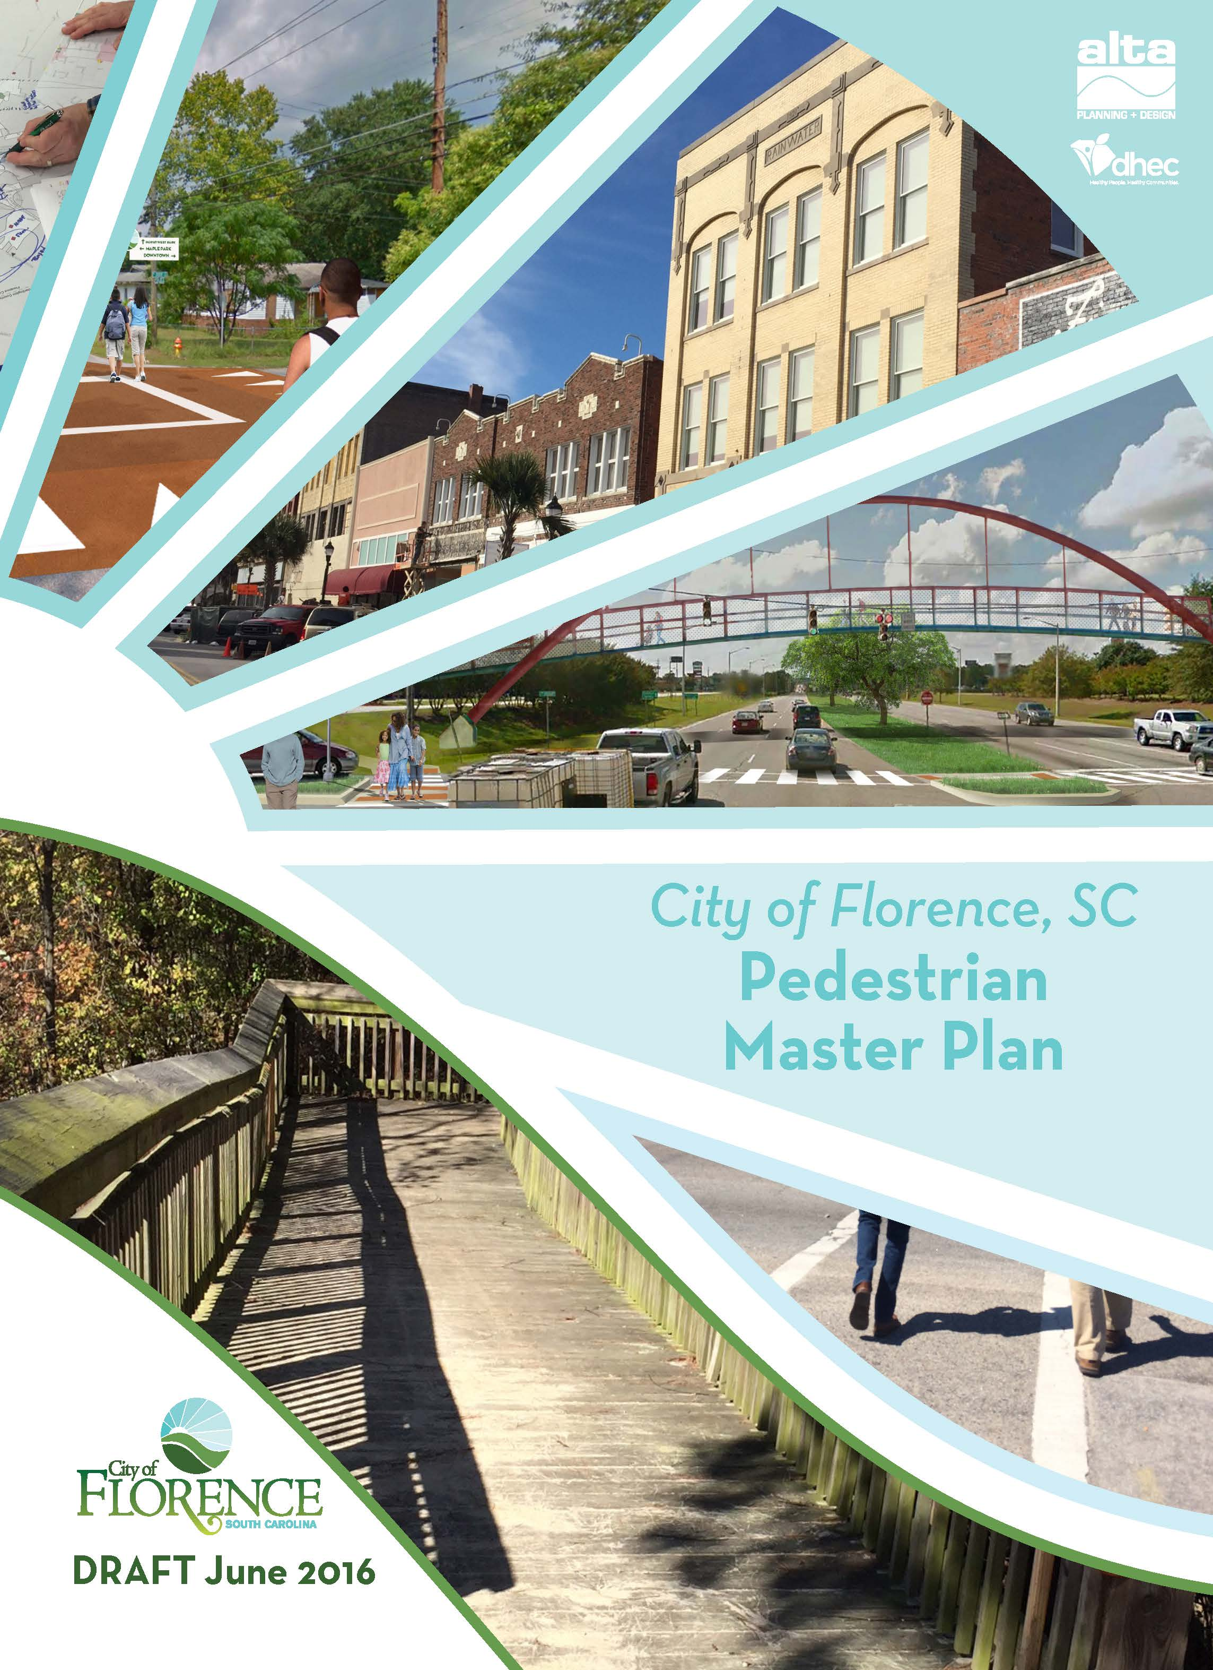
Walkable Community Action Plans (SC)
Section Title Goes Here…

Slide 6
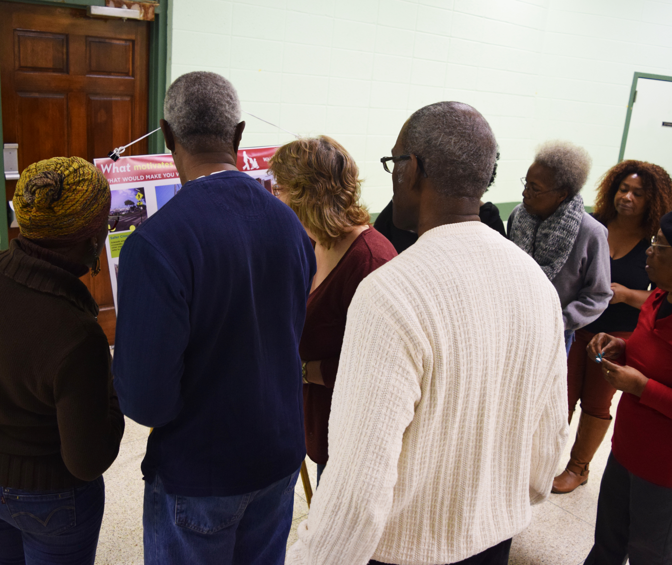
Walkable Community Action Plans (SC)
Section Title Goes Here…

Slide 7
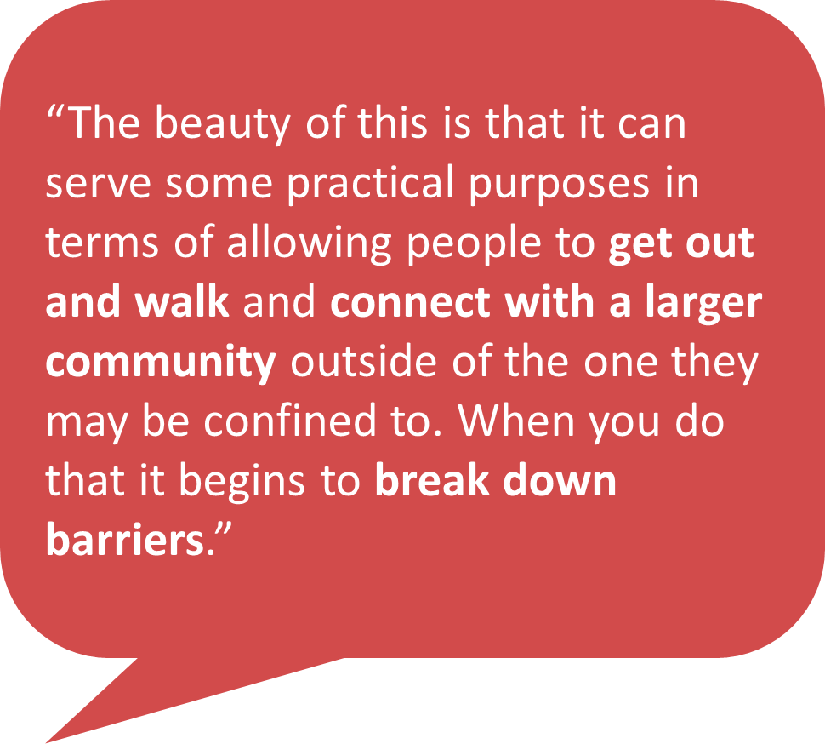
Walkable Community Action Plans (SC)
Section Title Goes Here…
“People want to move to or stay in communities that are connected.”
“When people are out walking it creates the ‘bump into’ factor. You begin to bump into each other and fears go away.”

Slide 8
Let’s Bike Oakland (CA)
Section Title Goes Here…
APA Award Winner
National Planning Achievement Silver Award for a Best Practice

Slide 9
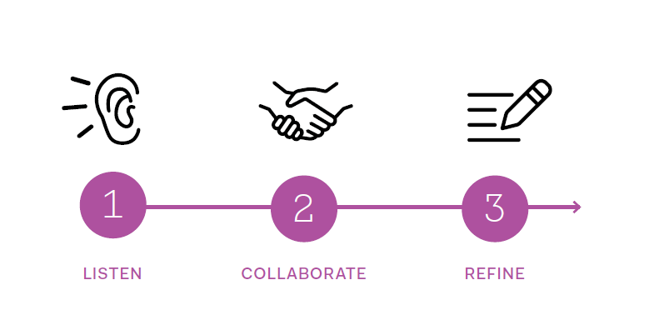
Let’s Bike Oakland (CA)
Section Title Goes Here…

Slide 10
Let’s Bike Oakland (CA)
Short Description of image on right…

Slide 11
Let’s Bike Oakland (CA)
Short Description of image on right…

Slide 12
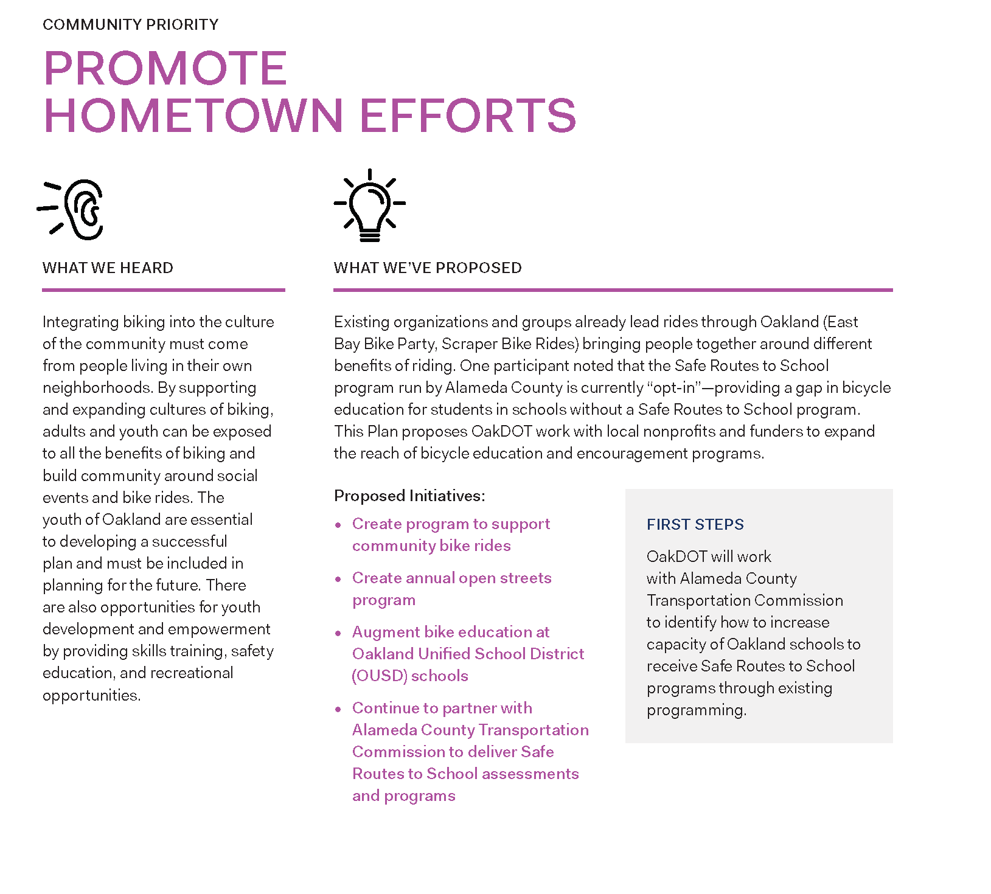
Let’s Bike Oakland (CA)

Slide 13
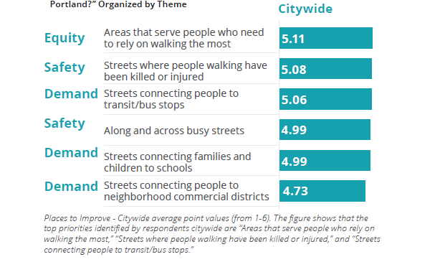
PedPDX (OR)
Award Winner
Oregon PHA Champion for Healthy Environments + WTS Oregon Innovative Solutions Award
Citywide responses to Q2:
What kinds of places are most important to improve in Portland?

Slide 14
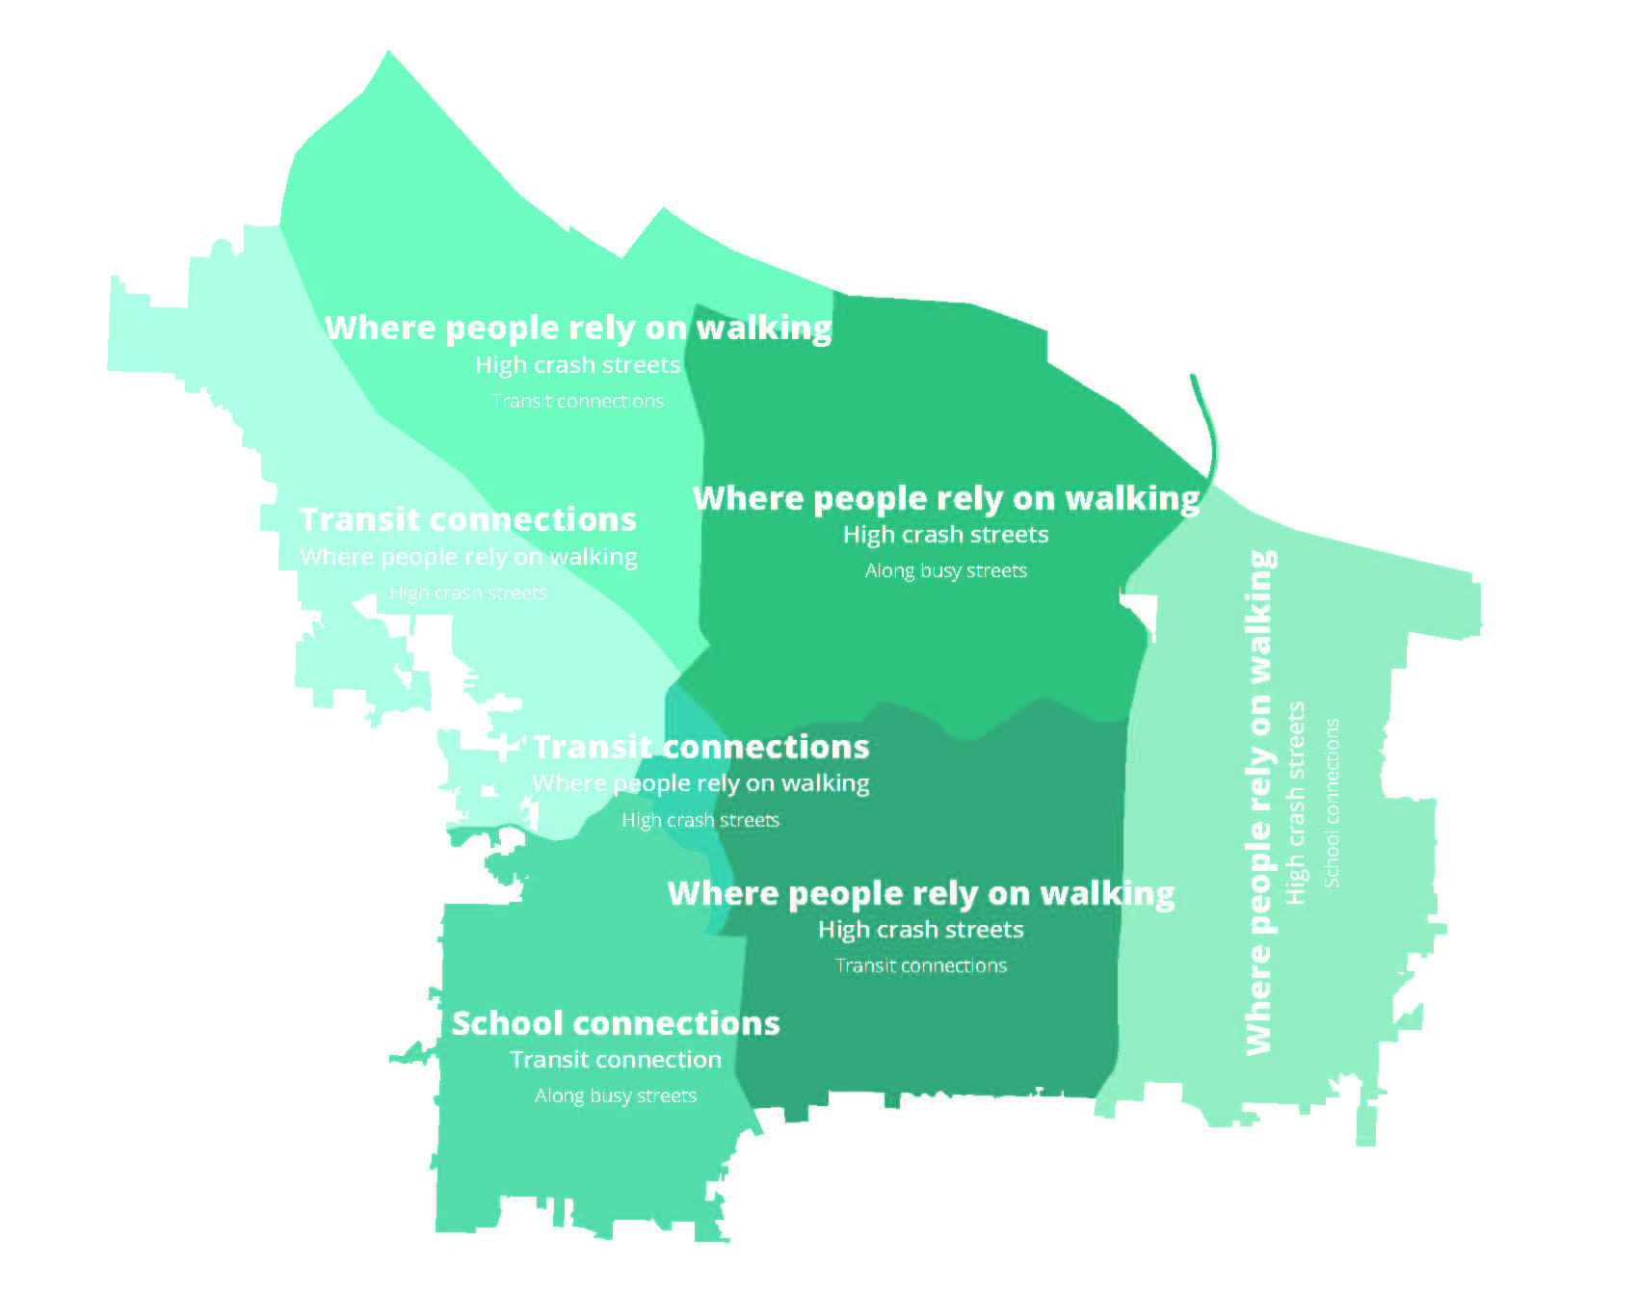
PedPDX (OR)
Award Winner
Oregon PHA Champion for Healthy Environments + WTS Oregon Innovative Solutions Award
Citywide responses to Q2:
What kinds of places are most important to improve in Portland?

Slide 15
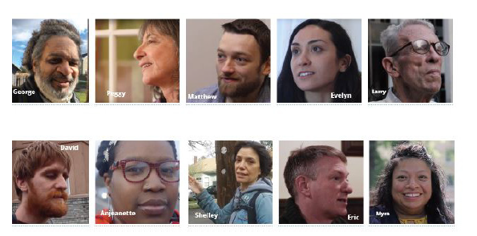
PedPDX (OR)
Award Winner
Oregon PHA Champion for Healthy Environments + WTS Oregon Innovative Solutions Award
Pedestrian Stories
The Pedestrian Stories project was a partnership between PedPDX, the University of Oregon School of Journalism and Communications and the Agora Journalism Center, with financial support from America Walks and the American Planning Association’s Transportation Planning Division. Graduate student teams followed eight different people with different abilities, from different parts of the city as they narrated what walking means to them, the challenges they face walking in Portland, and their hopes for Portland as a great walking city for everyone. The goal was to elevate the range and diversity of needs that Portlanders have when it comes to walking.

Slide 16
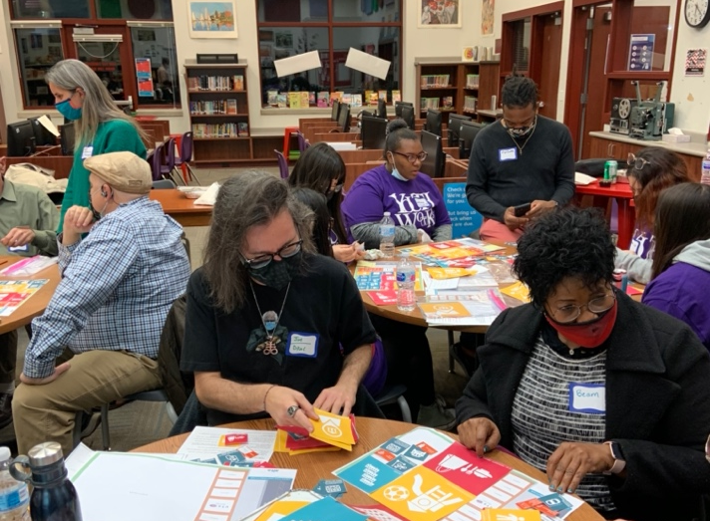
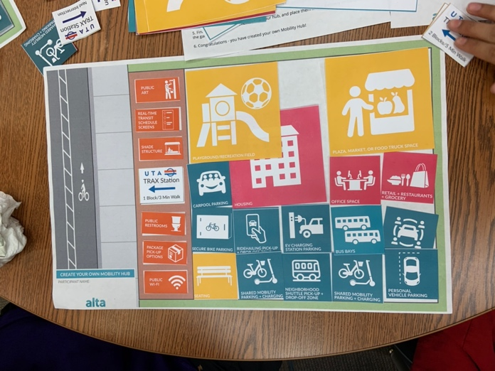
North Temple Mobility Hub (UT)

Slide 17
North Temple Mobility Hub (UT)

Slide 18
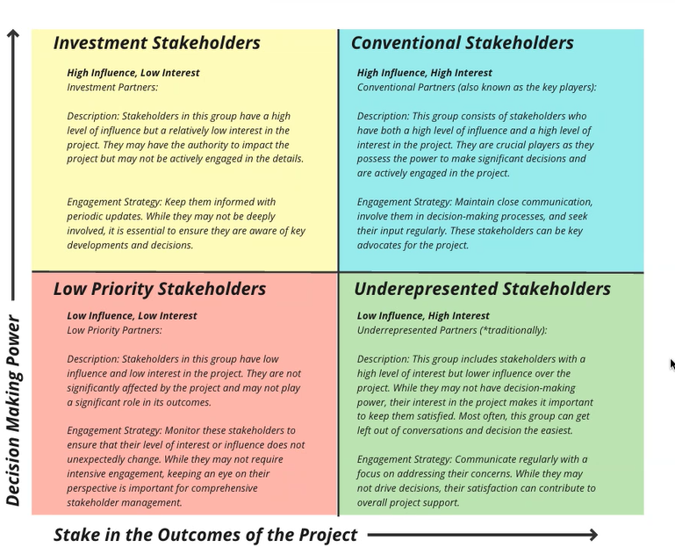
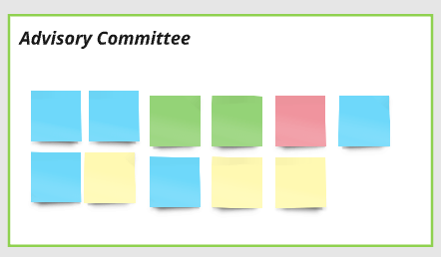
Hall County Safety Action Plan (GA)
Influence
Impact

Slide 19
Thank you!
JeanCrowther@AltaGO.com

