Slide 1
Complete Streets Case Study: Dorchester County, SC
NADO Conference
July 31, 2024
Kyle James
kylej@bcdcog.com

Slide 2
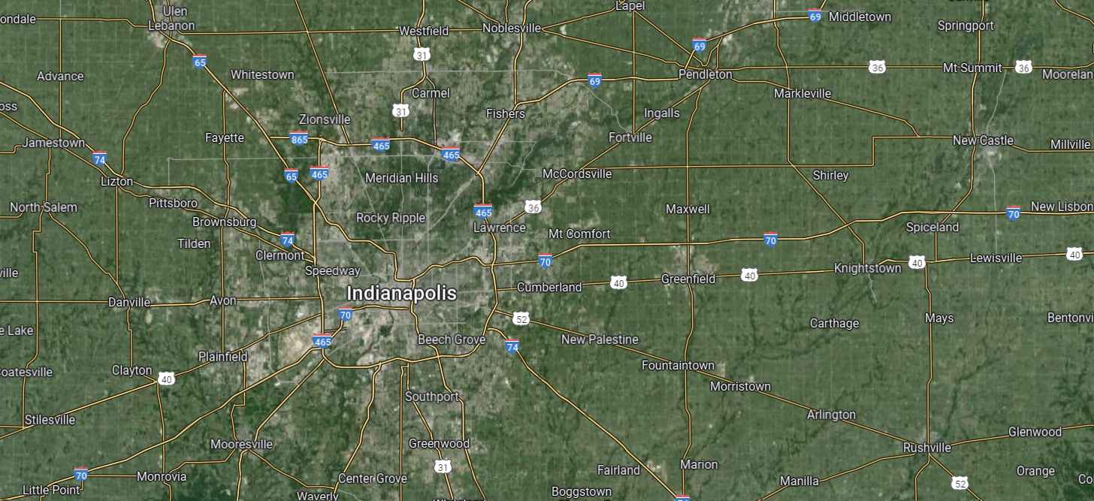
3%
Source: Google Maps
Complete Streets Case Study

Slide 3
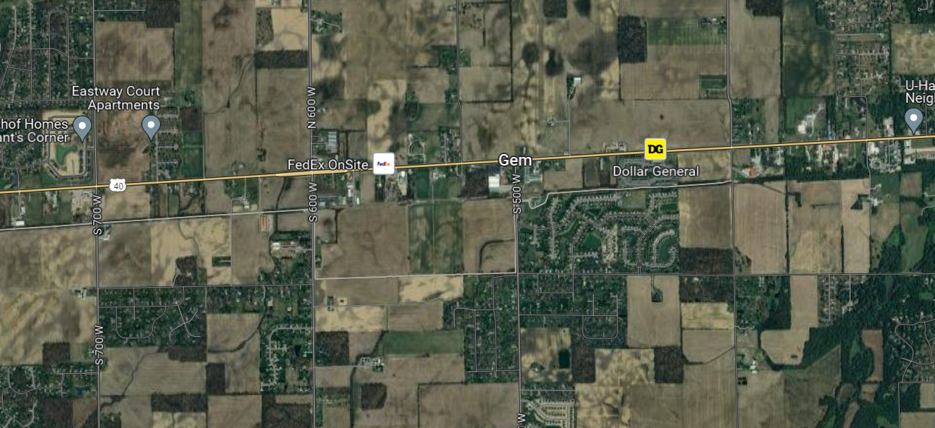
6%
Source: Google Maps
Complete Streets Case Study

Slide 4
GEM
9%
Source: Google Maps
Complete Streets Case Study

Slide 5
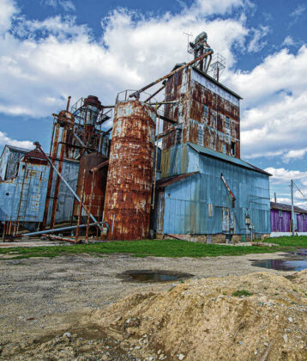
100+ year-old grain silo
11%
Source: Tom Russo, Daily Reporter

Slide 6
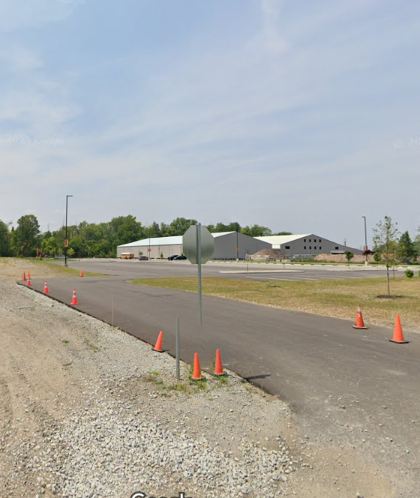
14%
Source: Tom Russo, Daily Reporter
Source: Google Maps

Slide 7
Agenda
Location
Purpose
Lessons Learned
Contract + Scope
Public Engagement
Draft + Scoring
17%

Slide 8
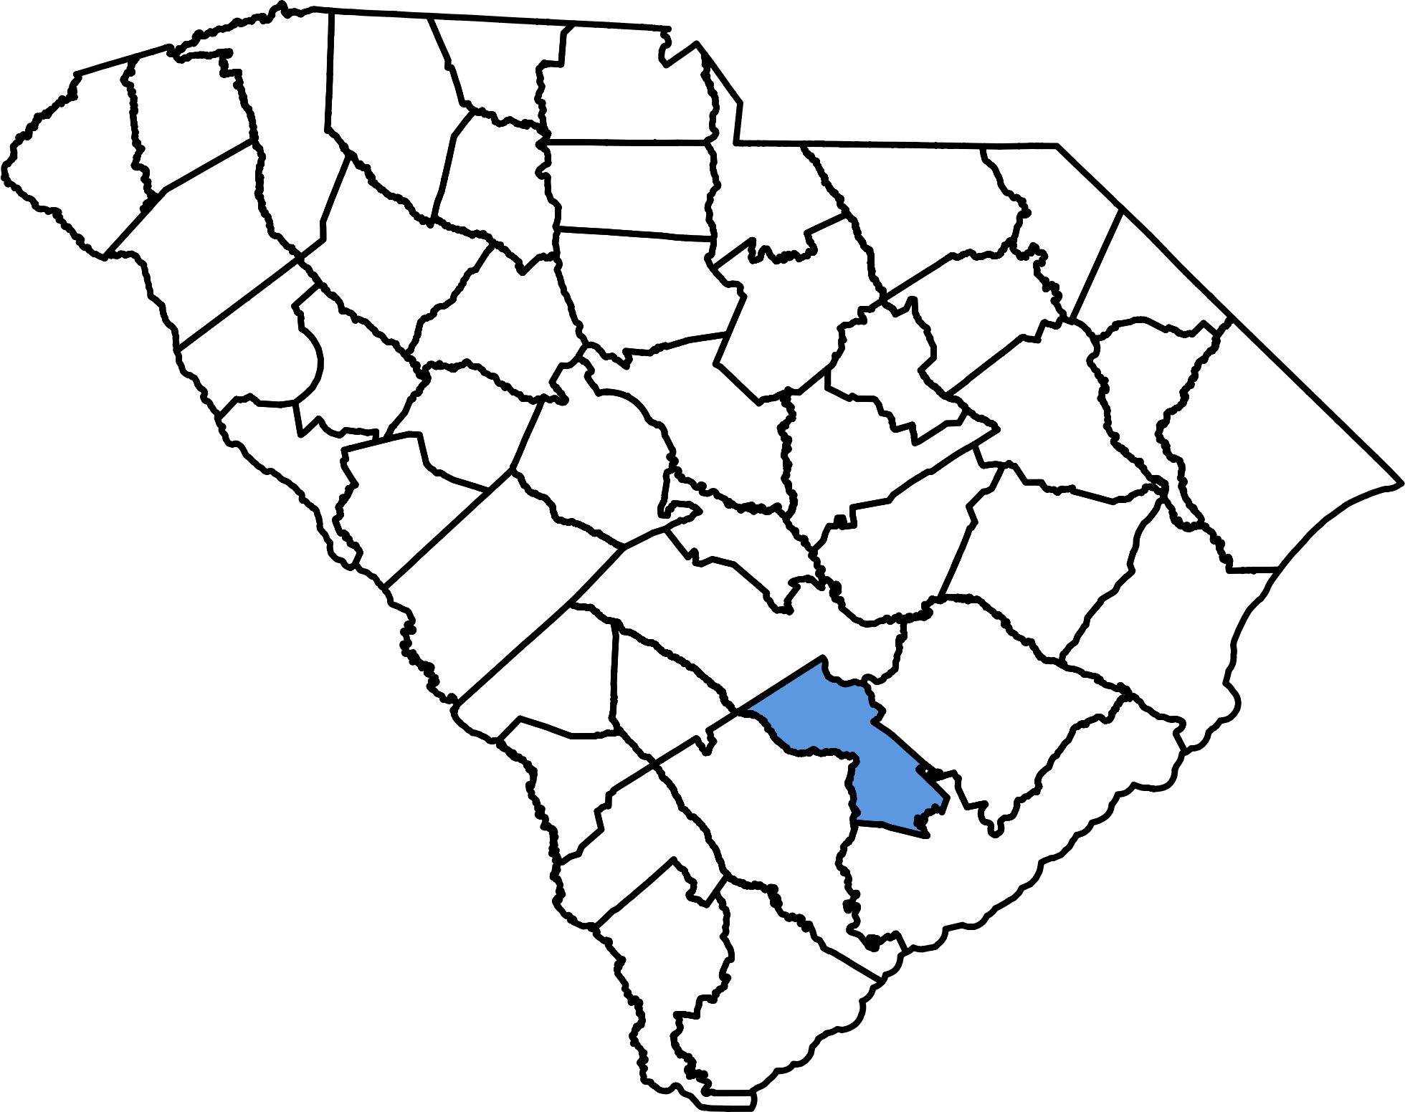
Location
Greenville
Columbia
Charleston
20%

Slide 9
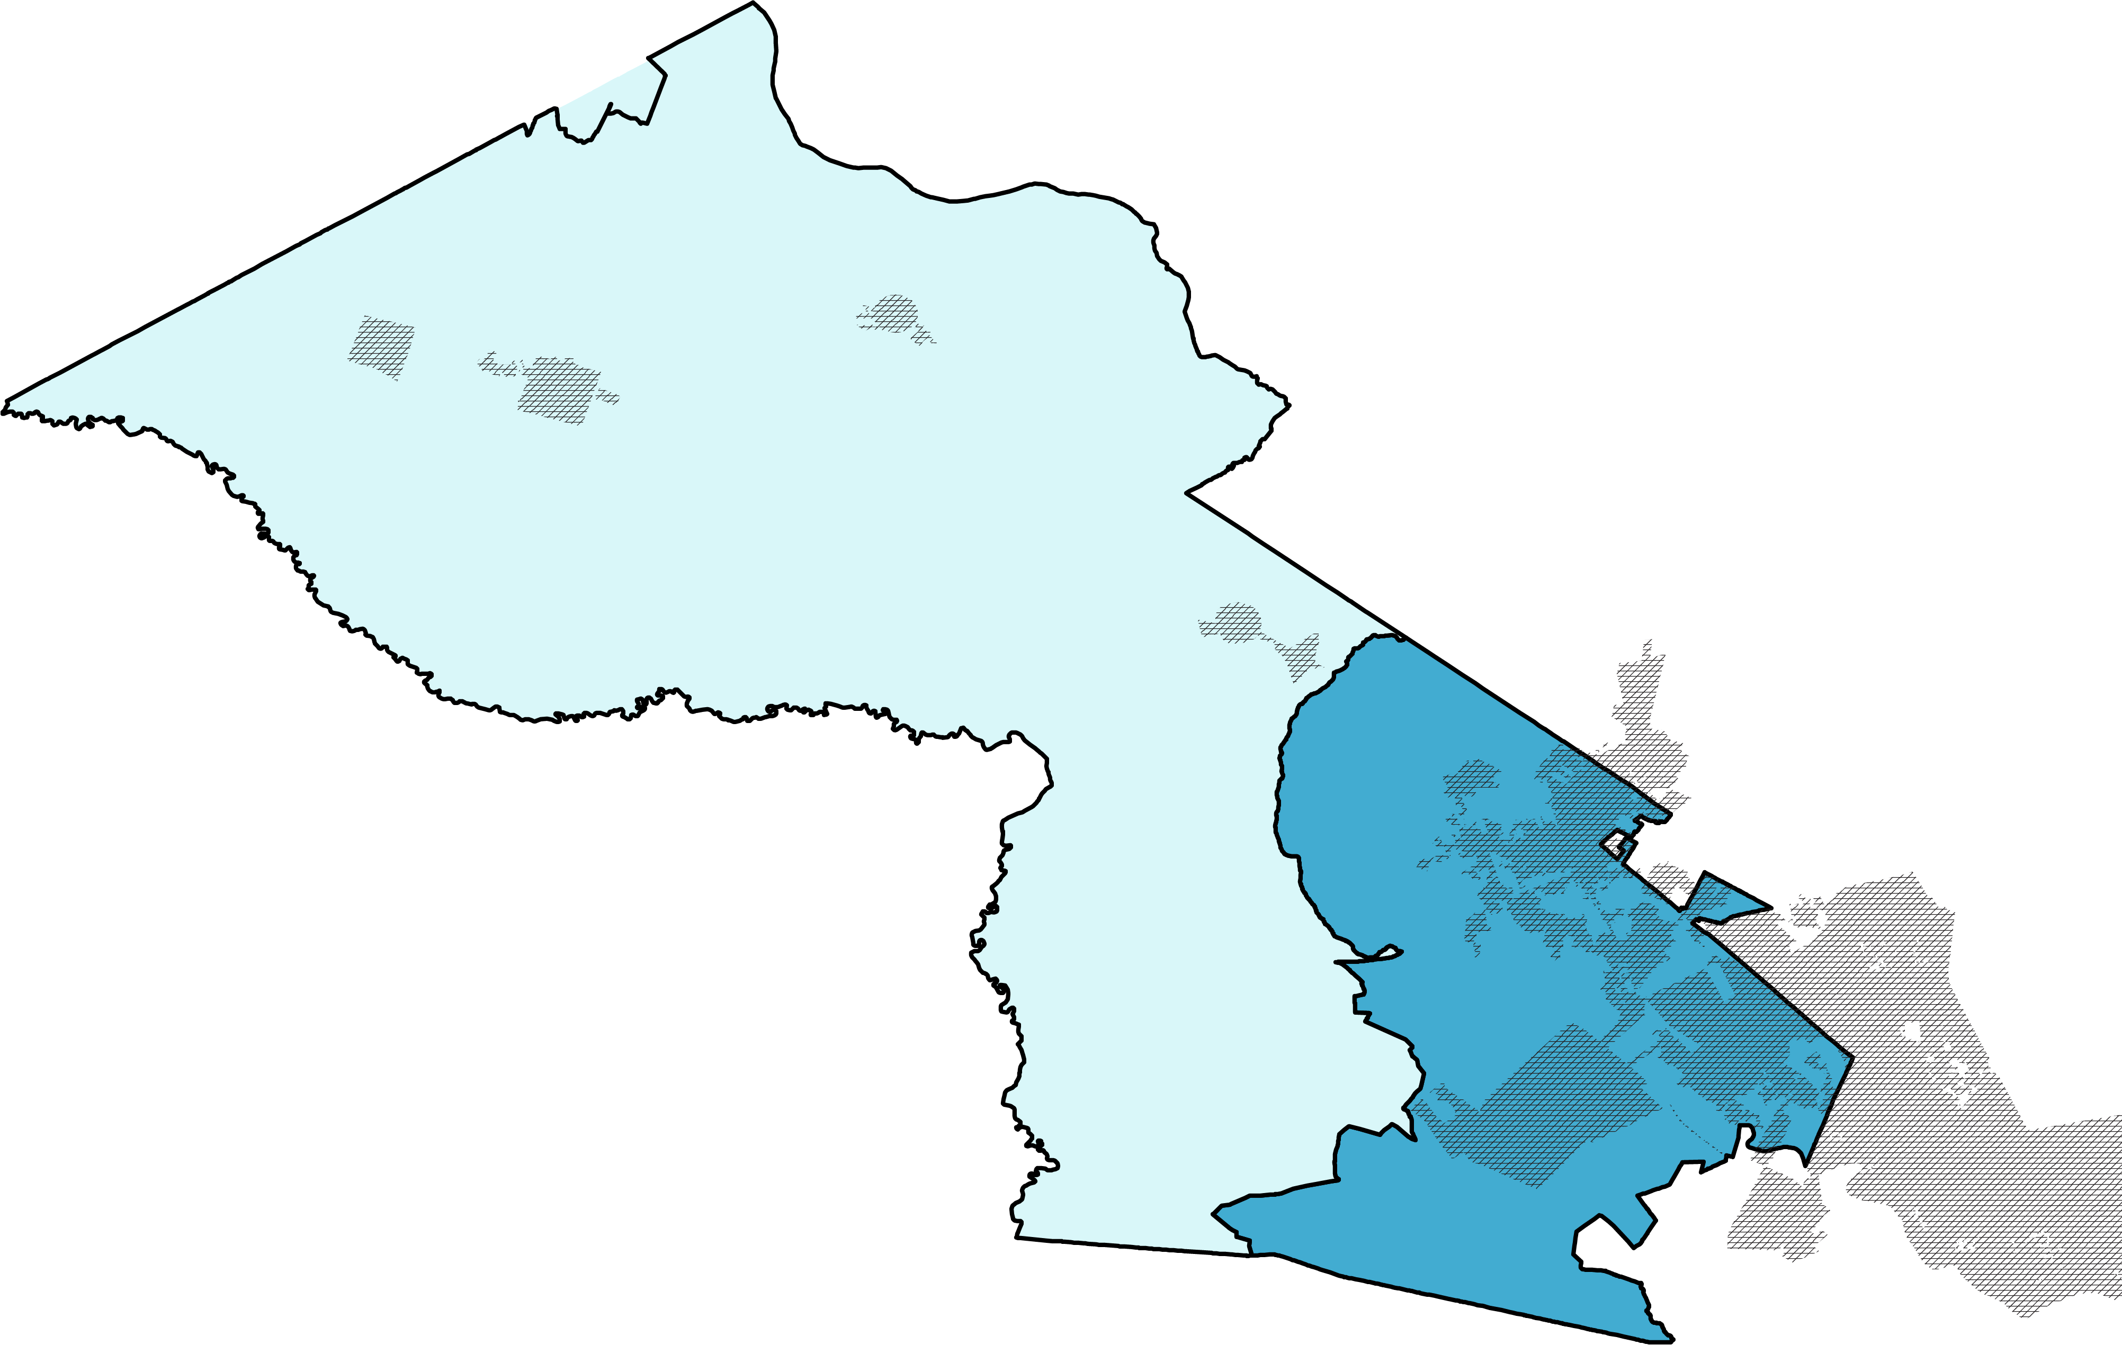
Location
Upper = Rural
Lower = Urban
Dorchester
County, SC
23%

Slide 10
Location
Reevesville
Population
+18% (2010-2024)
“Gem-ification”
Harleyville
St George
Summerville
North Charleston
26%

Slide 11
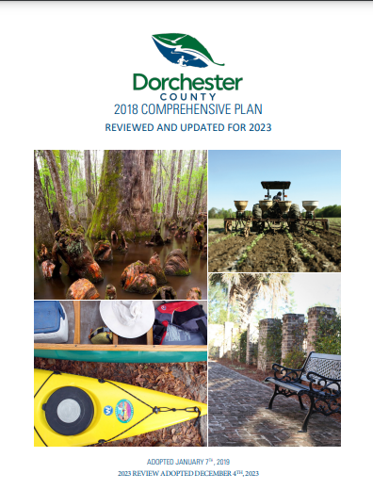
Purpose
Adopt a “Complete Streets” ordinance that:
Sets clear expectations for developers on their responsibilities for paying for new transportation infrastructure to support their development
Establishes a framework for monitoring compliance with the developer requirements
Initiates the process for future design guidance that identifies the minimally required transportation infrastructure based on the type of road and surrounding land uses
29%

Slide 12
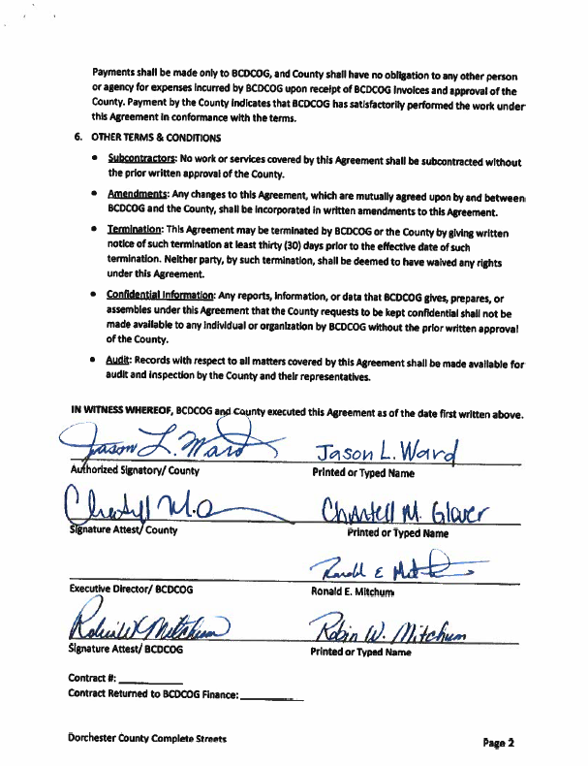
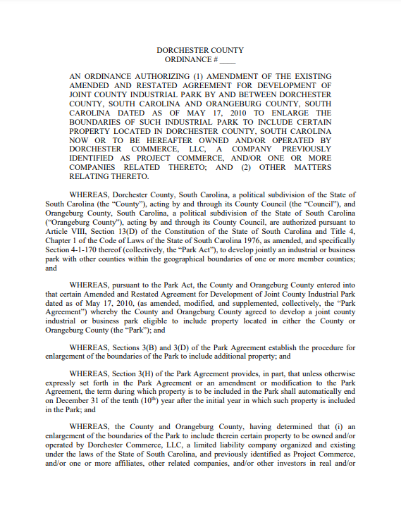
Contract
$25,000 budget
$3,000 local funds
$22,000 BCDCOG’s Complete St Set-aside
>50% for public engagement
31%

Slide 13
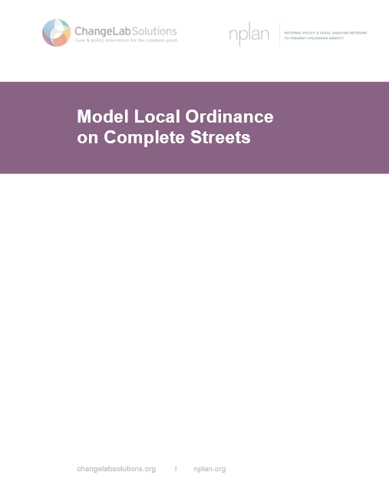
Scope
Change Lab Solutions
Smart Growth America
MN DOT
34%

Slide 14
Scope
Show available options
Highlight tradeoffs
37%

Slide 15
Scope
Policy Type
40%

Slide 16
Scope
Model Ordinance Language
Interagency Coordination. [insert appropriate jurisdictional agencies] [shall make; will consider] Complete Streets practices a routine part of everyday operations, [shall; will] approach every transportation project and program as an opportunity to improve public [and private] streets and the transportation network for all users, and [shall; will] work in coordination with other departments, agencies, and jurisdictions to achieve Complete Streets.
The head of each affected agency or department shall [or should] report back to the [jurisdiction] [within one year of the date of passage of this Ordinance; annually] regarding the steps taken to implement this Ordinance, additional steps planned, and any desired actions that would need to be taken by [jurisdiction] or other agencies or department to implement the steps taken or planned. [Tailor this clause to direct agencies to carry out additional, specific implementation tasks, as appropriate.]
Model ordinance language
43%

Slide 17
Scope
Applicable Projects
Types
Phases
New construction
Upgrades/improvements/enhancements
Reconstruction/retrofit
Rehabilitation/Resurfacing/repaving
Restriping
Planning
Scoping
Design
Approval process
Implementation
Operation
Monitoring
Maintenance

Slide 18
Engagement Champions

Slide 19
Engagement
What we needed to learn
Targeted Users
What modes of travel should be targeted in the policy?
Design Guidance
What type of facility meets residents needs in various contexts?
Applicable Projects
To which general project categories should the policy apply?
Exceptions
Should there be exceptions to the generally applicable project categories?
51%
Dorchester County Complete Streets Ordinance

Slide 20
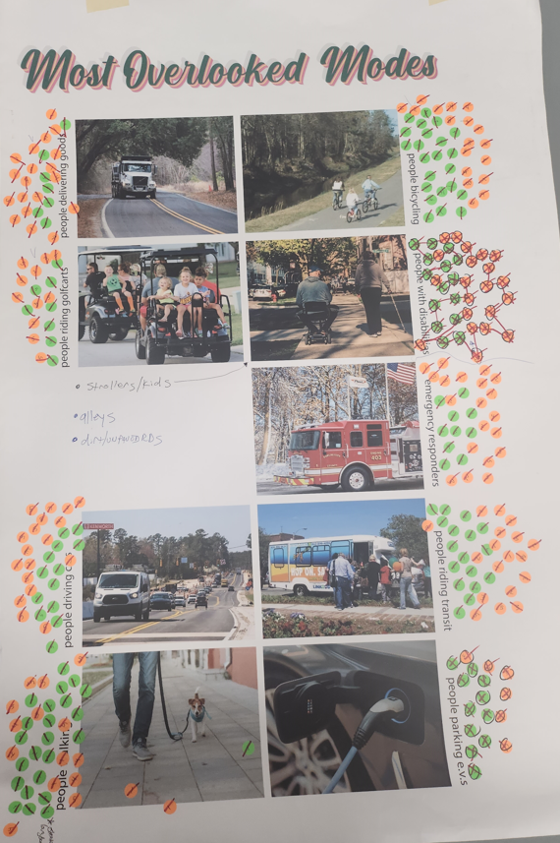
Online
Engagement
Mirrored Formats
In-person
54%
Dorchester County Complete Streets Ordinance

Slide 21
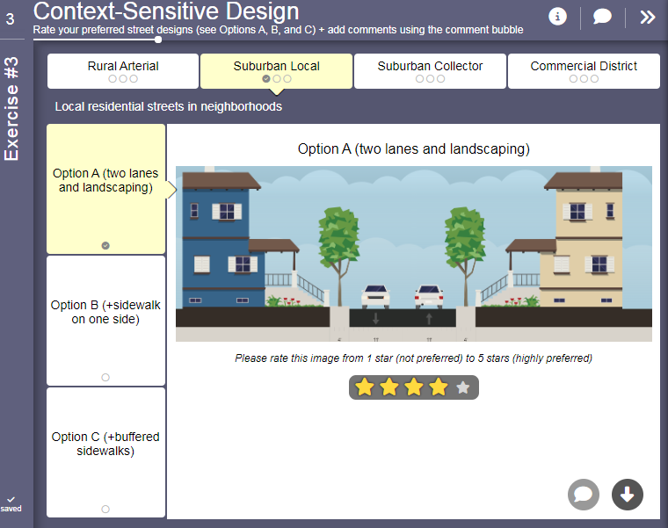
Engagement
Engagement
Mirrored Formats
57%

Slide 22
Engagement
Targeted Users
1.0 = Most Overlooked
5.0 = Least Overlooked
60%

Slide 23
Target Users
1.0 = Most Overlooked
5.0 = Least Overlooked
Most Overlooked Modes (Average Rank) | Rural | Urban
Walk | 2.4 | 2.3
Drive | 2.5 | 2.5
Bike | 3.1 | 2.7
Emergency Vehicles | 2.5 | 3.2
People with Disabilities | 3.0 | 3.1
Transit | 3.2 | 3.1
Commercial/Dump Trucks | 3.8 | 3.7
Golf Carts | 3.3 | 3.7
Electric Vehicles | 3.6 | 4.0
Residents identified Walking and Driving as the 2 most overlooked modes of travel
2.4
2.3
2.5
2.5
Biking was the 3rd most overlooked mode in urban areas
2.7
2.5
Access for emergency vehicles was the 3rd most overlooked mode in urban areas
Rural in-person meeting participants identified sand mine dump trucks as a safety issue
63%
Notes:
Identify the Following Target Users in the Ordinance Language… provide definitions for each user type
Urban: (1) Walk - ADA Compliance, (2) Drive, (3) Bike, (4) Transit
Rural: (1) Walk - ADA Compliance, (2) Drive, (3) Emergency Vehicles, (4) Sand Mine Dump Trucks

Slide 24
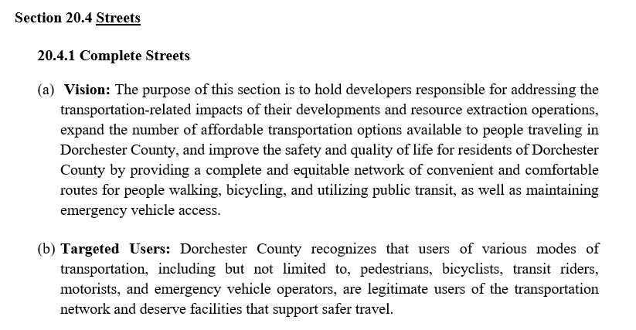
Engagement
Mirrored Formats
66%
Dorchester County Complete Streets Ordinance

Slide 25
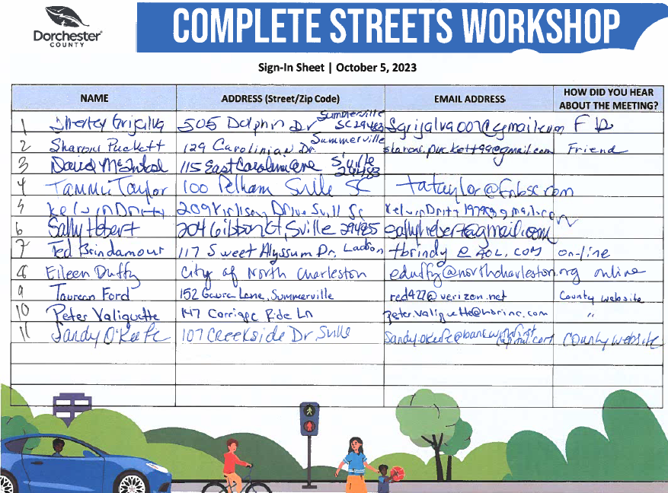
Engagement
Interim Public Update
69%
Dorchester County Complete Streets Ordinance

Slide 26
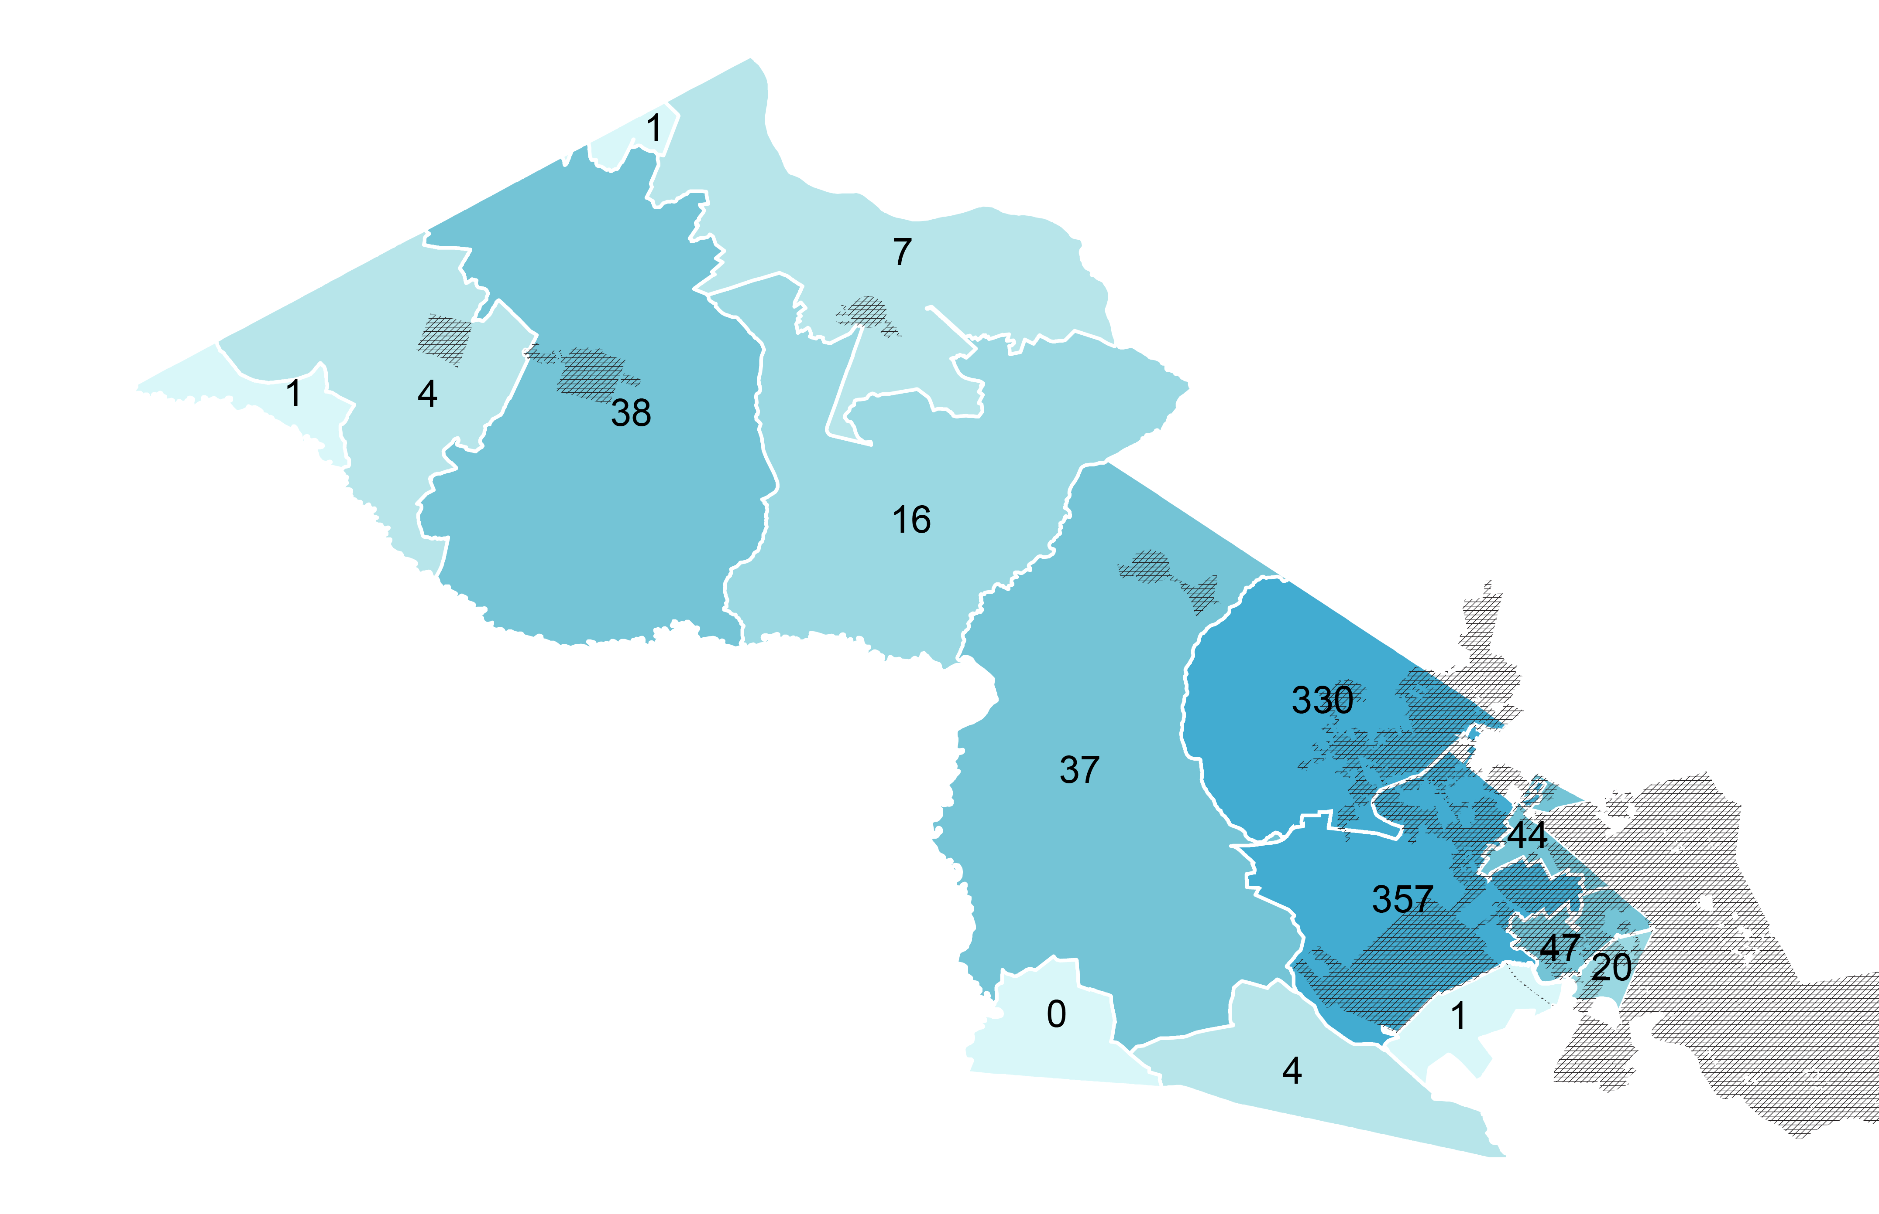
Geographic Distribution
Online Survey Responses
by Zip Code
Reevesville
Harleyville
Ridgeville
St George
Summerville
North Charleston
26% of survey responses did not include a Zip Code
71%
Dorchester County Complete Streets Ordinance

Slide 27
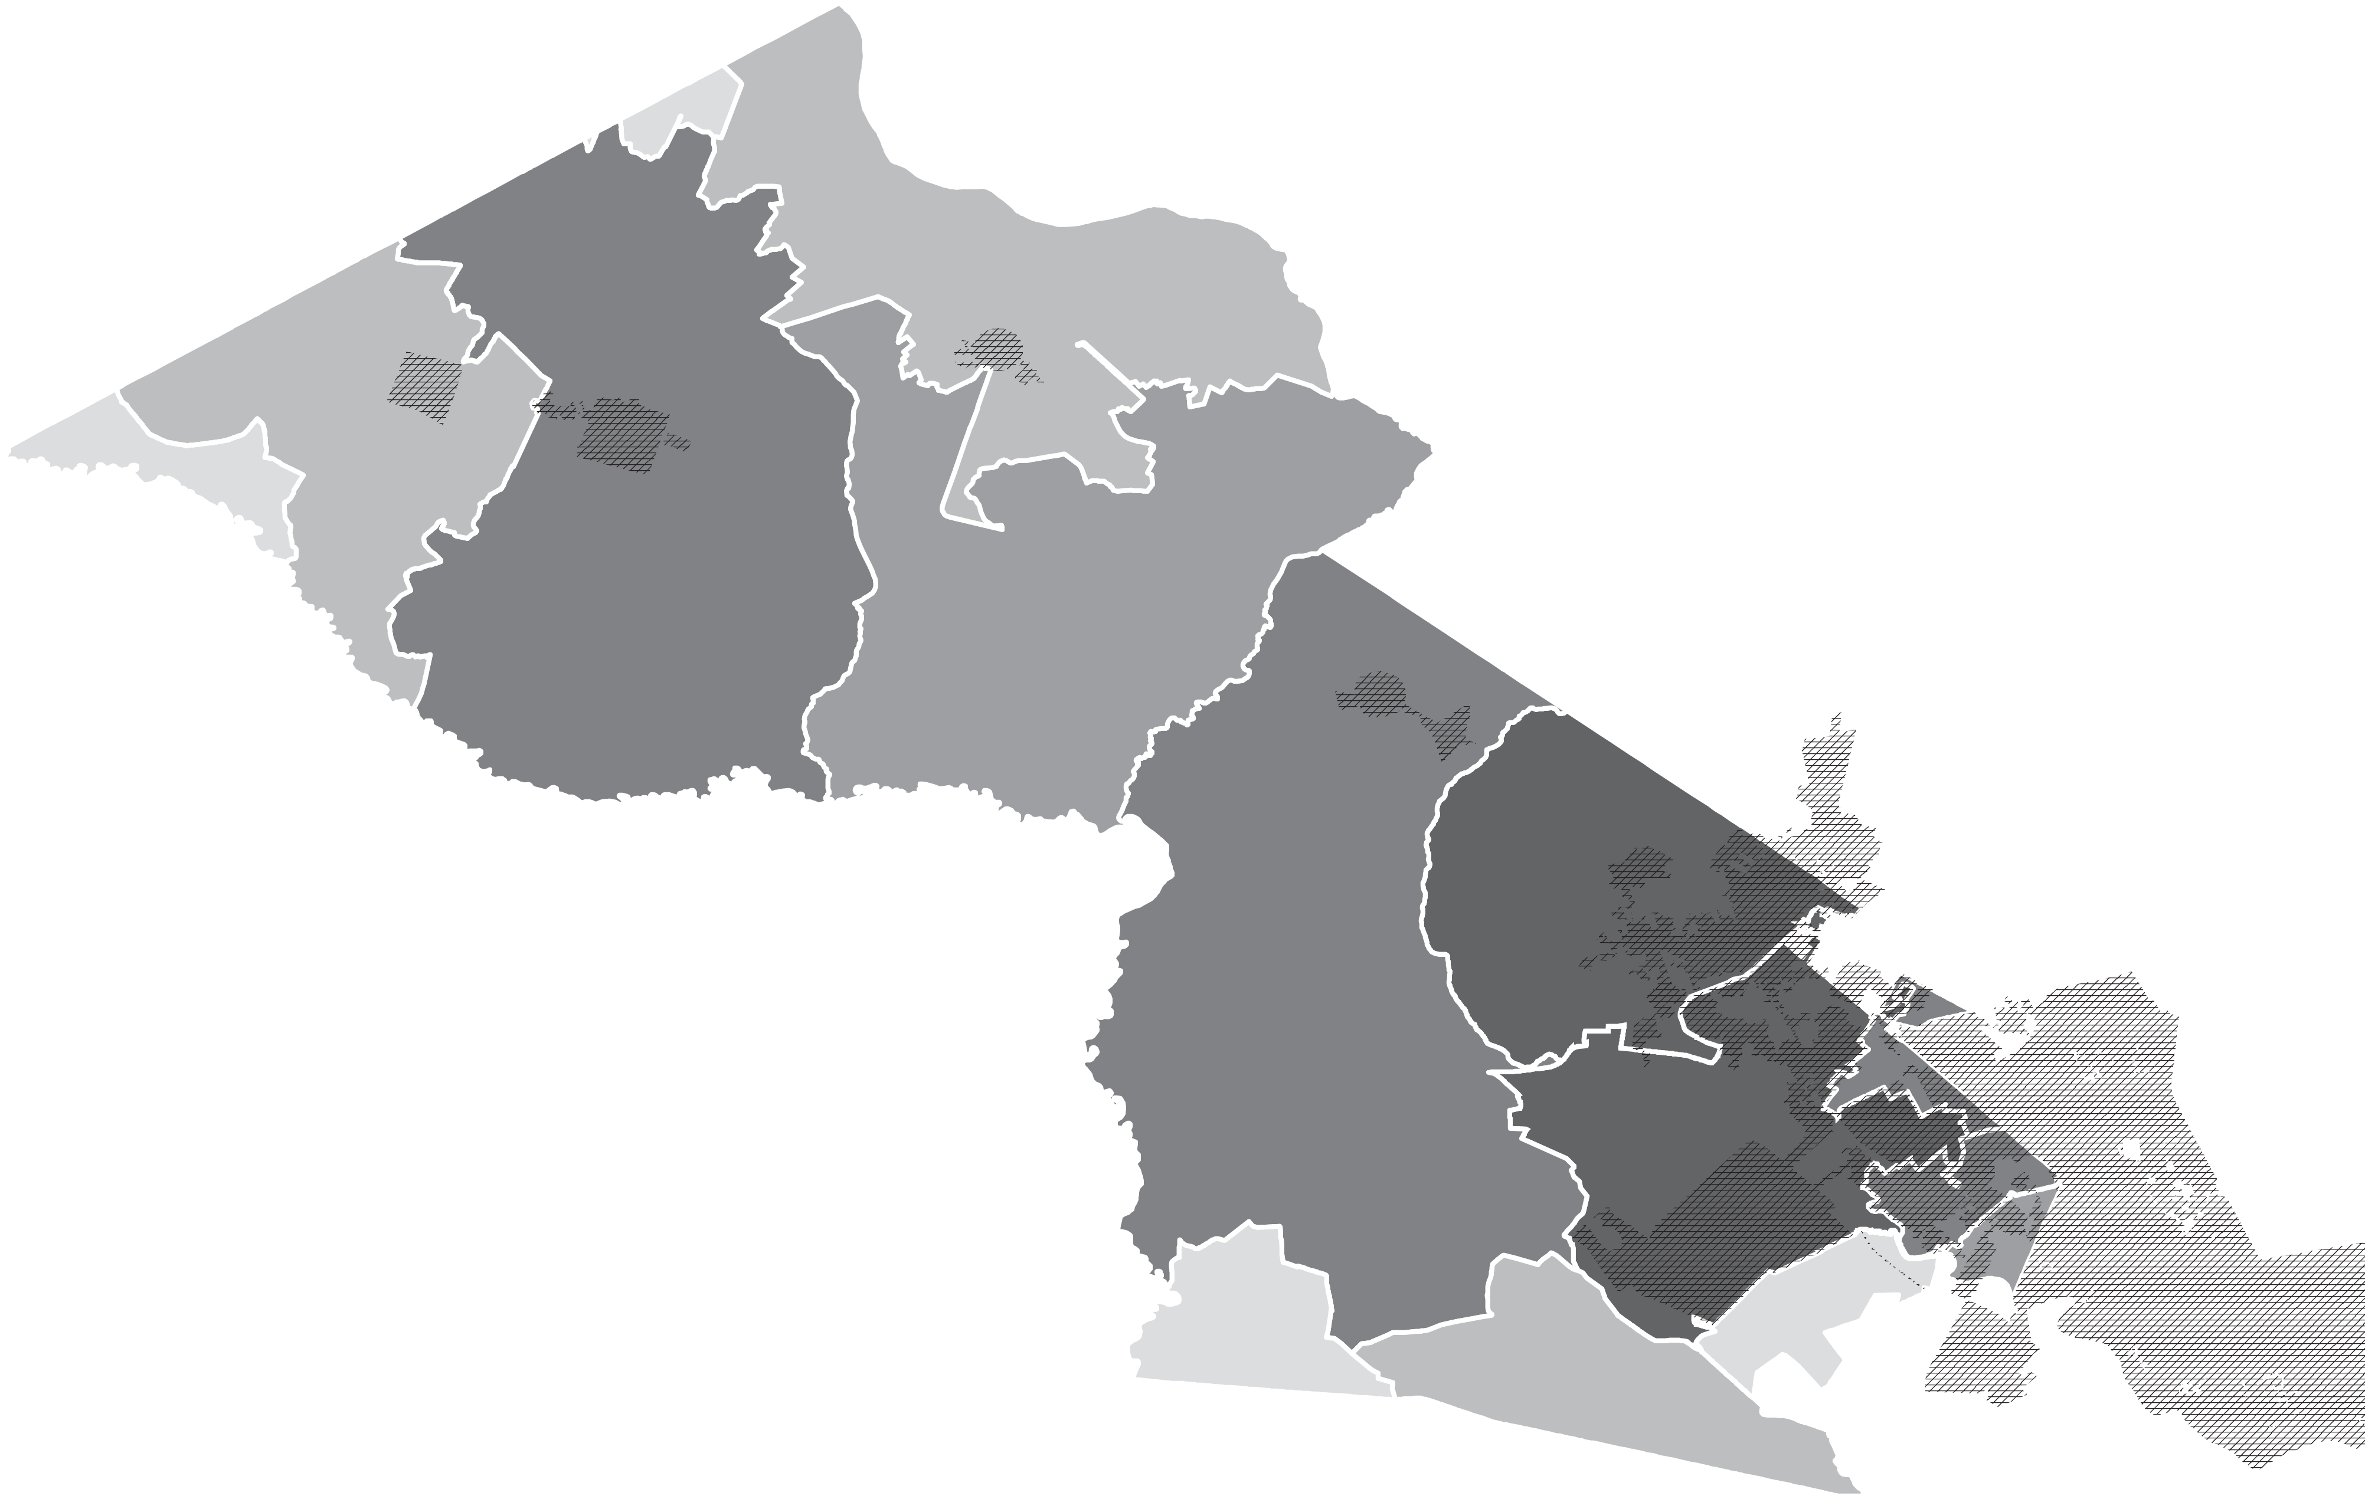
Geographic Distribution
Dec. 12th
American Legion
In-Person
Participation
by event
Oct. 26th
Rosenwald School
4
28
18
Oct. 5th
Alston Middle School
Oct. 7th
Davis-Bailey Park
34
74%
Dorchester County Complete Streets Ordinance

Slide 28
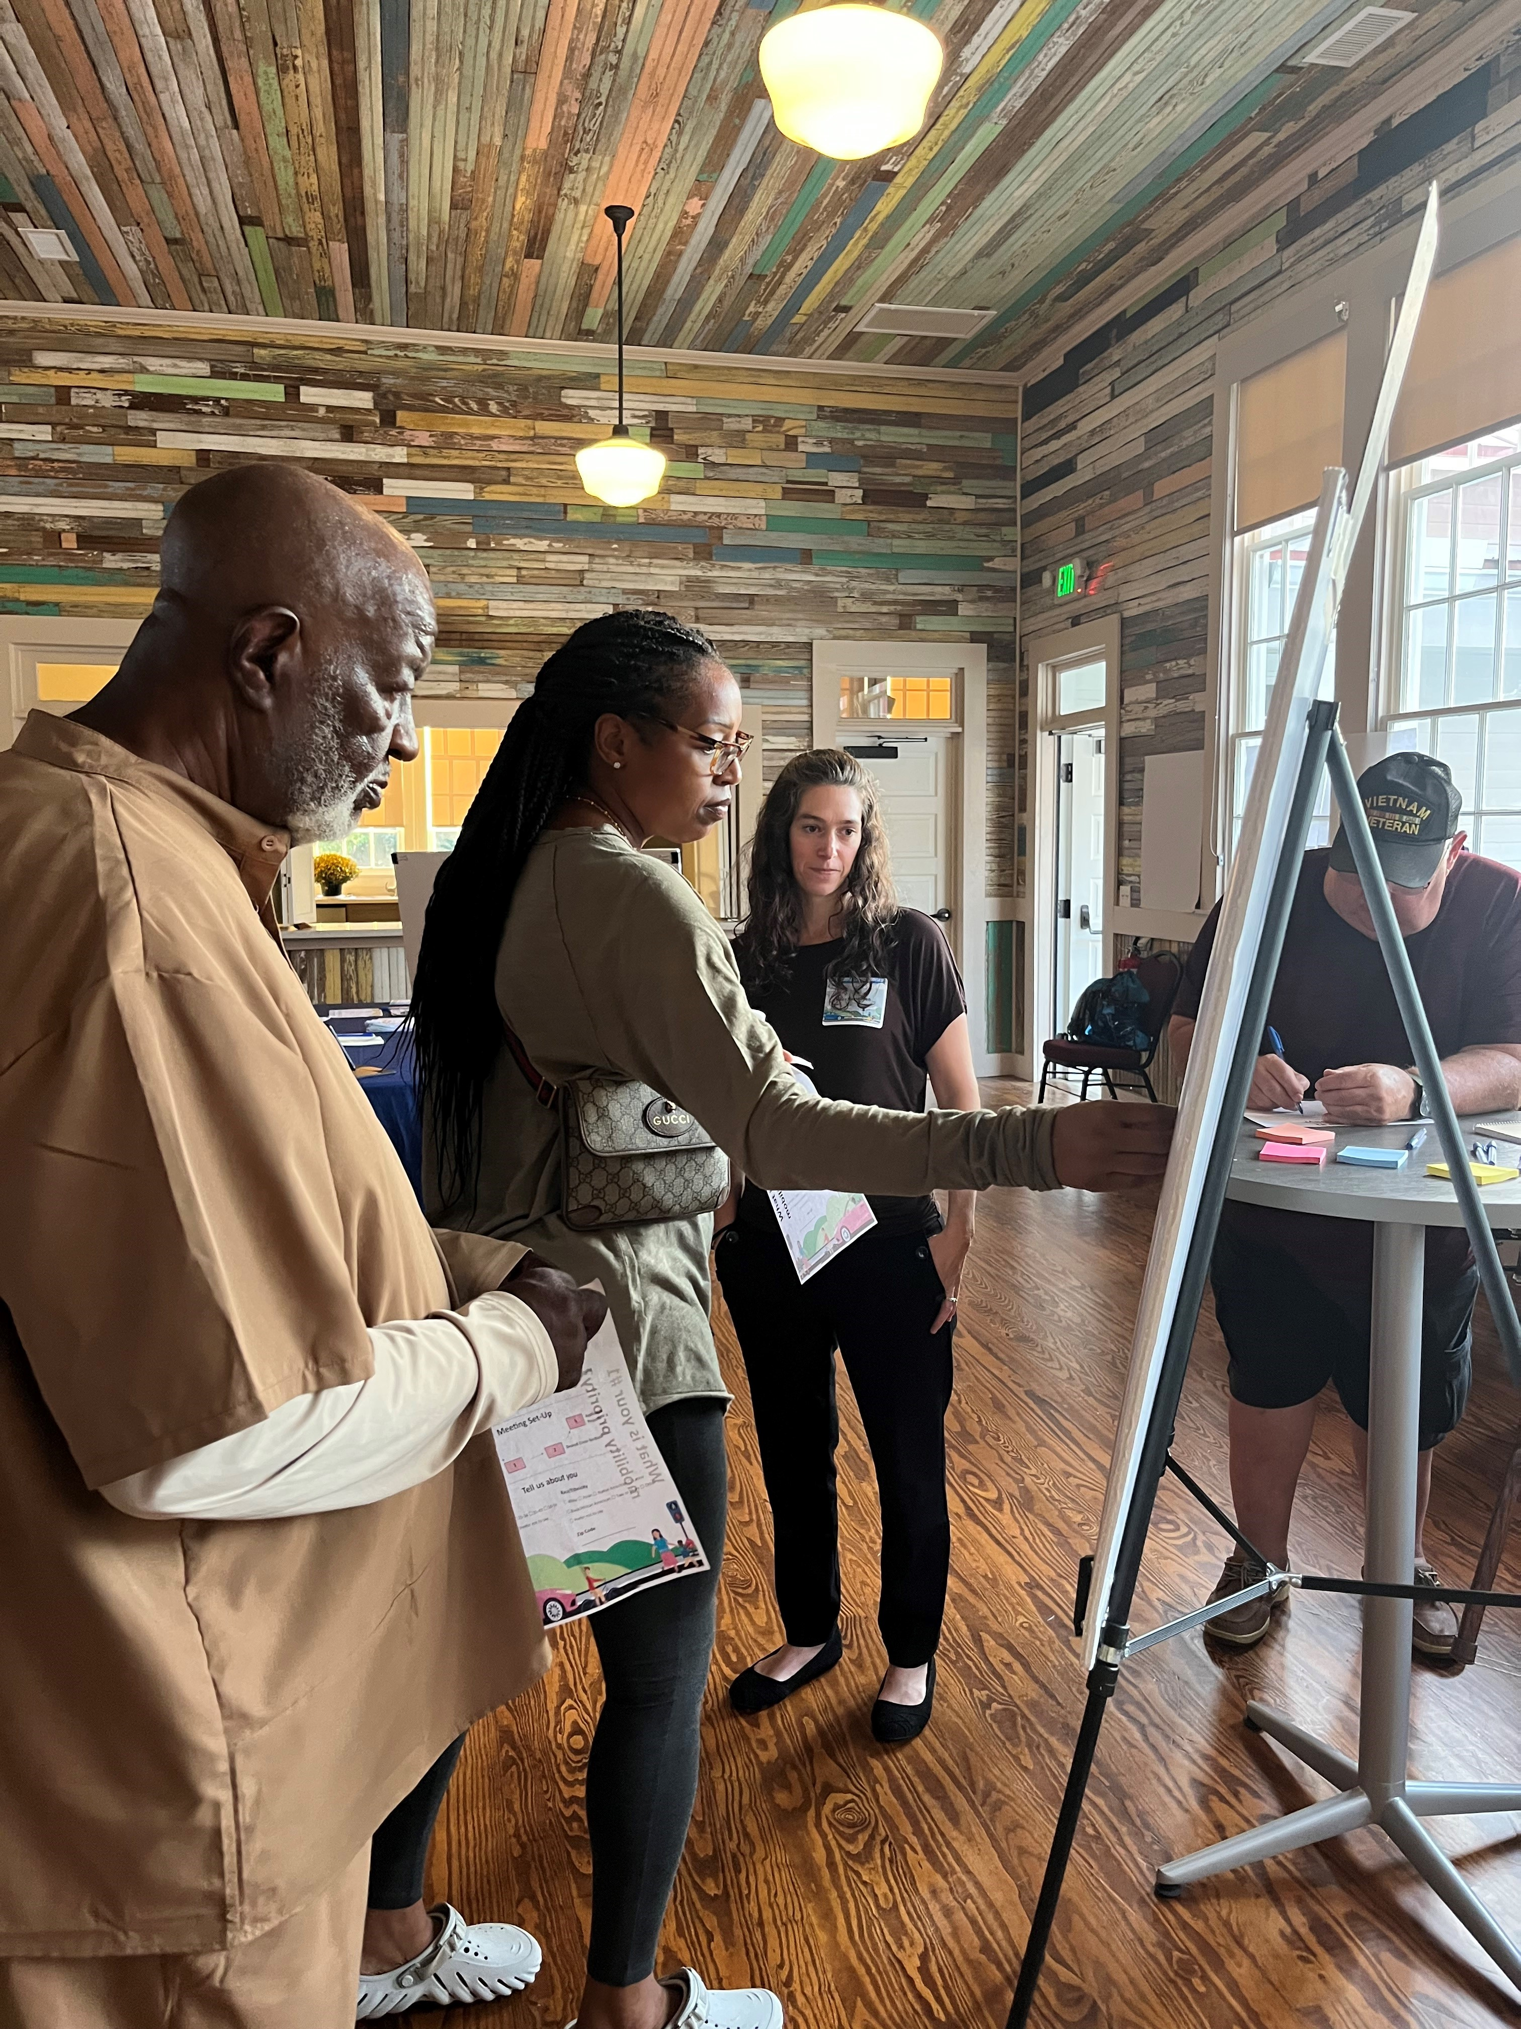
Engagement
84 in-person meeting participants
1,201 online survey responses
481 open-ended survey comments
How the feedback translated into specific policy language:
Targeted Users – Sand Mining
Design Guidance – Upper v. Lower
Applicable Projects – New Priorities
Exceptions – Fee-in-lieu
77%
Dorchester County Complete Streets Ordinance

Slide 29
Draft + Scoring
National
Average
Initial Score
31
56
0
10
20
30
40
50
60
70
80
90
100
80%
Dorchester County Complete Streets Ordinance

Slide 30
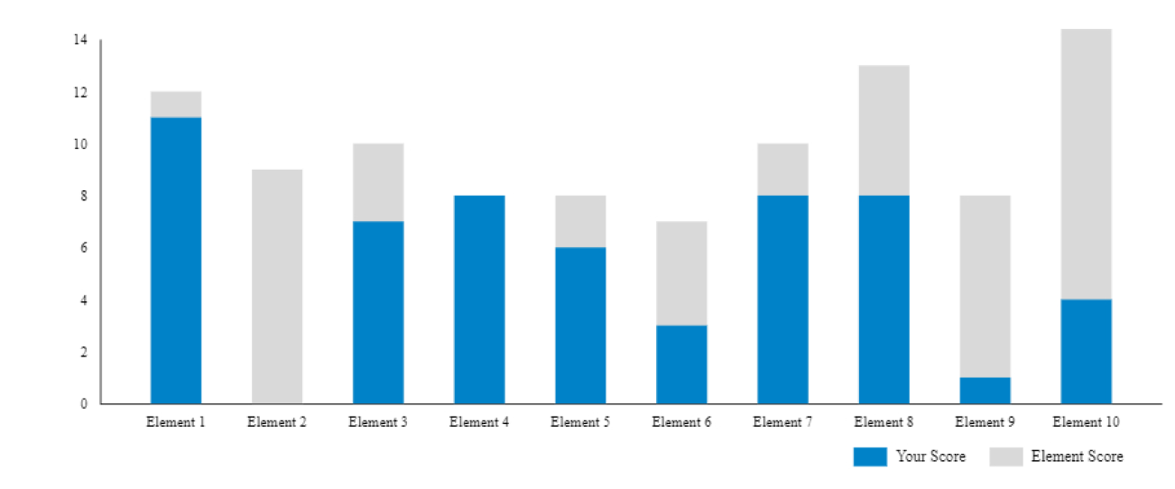
Draft + Scoring
83%
Dorchester County Complete Streets Ordinance

Slide 31
Draft + Scoring
Added specific prioritization categories
Added a performance reporting cycle
Added Work Zone detour recommendations
Added interim design guidance and required public engagement for the design guideline process
Encouraged opportunities for Complete Streets-related staff training and allowing developers to join
86%
Dorchester County Complete Streets Ordinance

Slide 32
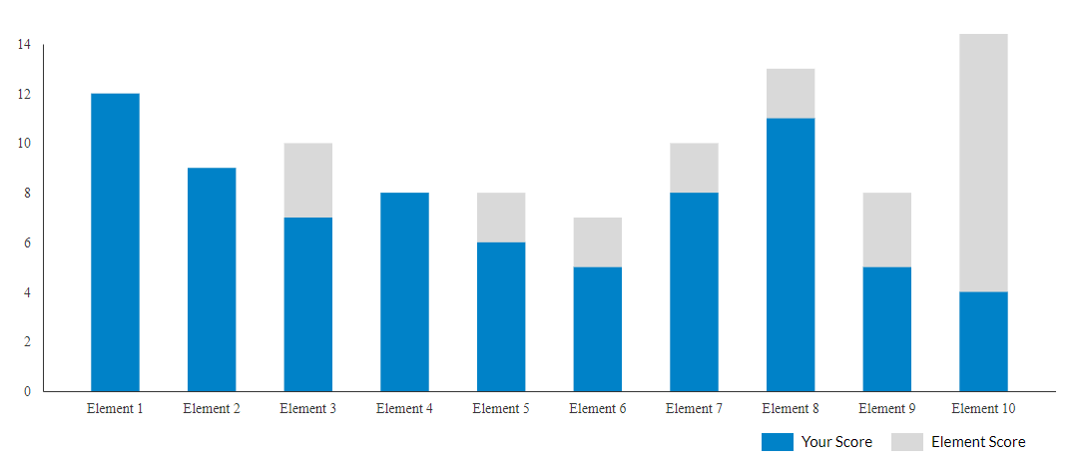
Draft + Scoring
89%
Dorchester County Complete Streets Ordinance

Slide 33
Draft + Scoring
National
Average
Initial Score
Updated Score
31
56
78
0
10
20
30
40
50
60
70
80
90
100
91%
Dorchester County Complete Streets Ordinance

Slide 34
Highest Ranking Policies
Rank | Jurisdiction | Score
1 | Howard County, MD | 100
2 | Rogersville, MO | 98
3 | El Paso, TX | 96
4 | Joplin, MO | 95
5 | Tucson, AZ | 95
6 | Rolling Meadows, IL | 88
7 | Riverside, MO | 86
8 | Wellington, FL | 80
Tied 9 | New Orleans, LA | 78
Tied 9 | Sacramento, CA | 78
97%
Dorchester County Complete Streets Ordinance

Slide 35
Contact
Kyle James
kylej@bcdcog.com
843-529-0402
CREDITS: This presentation template was created by Slidesgo and includes icons by Flaticon and infographics and images by Freepik

