Slide 1
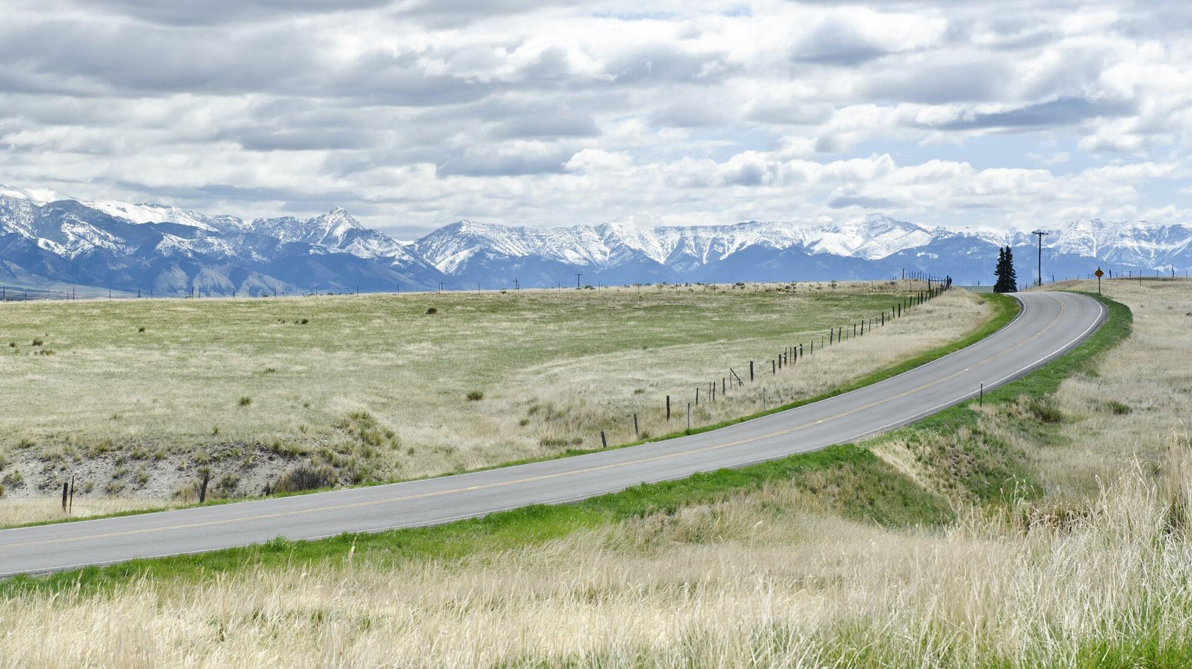

Bike/Ped Data Collection: Building a Case for Bike Infrastructure – Lessons Learned
Matthew Madsen MPH
Research Associate II
Western Transportation Institute
7/31/2024
Unless otherwise listed, all photos belong to WTI

Slide 2
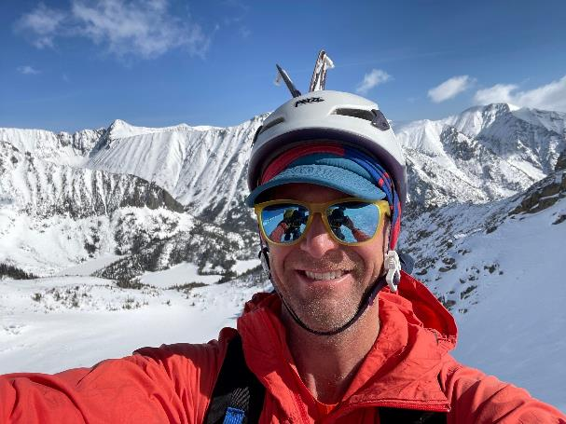


Who Am I?
Research Associate
Western Transportation Institute
MPH – Colorado School of Public Health
Certified Health Education Specialist
Built Environment & Health

Slide 3

WTI Focus Areas
Mobility & Public Transportation
Road
Ecology
Safety & Operations
Infrastructure Longevity & Sustainability
Cold Climate Operations & Systems
Workforce Development
Systems Engineering Development & Integration
Materials & Automated Evaluation of Pavements & Bridges

Slide 4
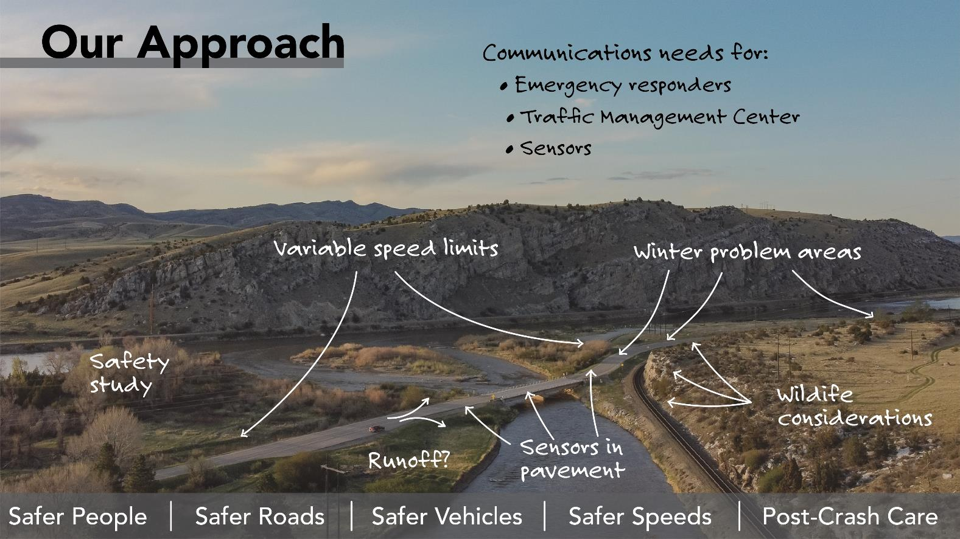

Who Is WTI?

Slide 5



Community Sectors – Who is Here Today?

Slide 6






Community Collaboration
Public Health
Planning
Planning
Engineering
Community
Engineering
Policy Makers
Public Health
Policy Makers
Notes:
Now that we are at the very end, let’s tie this all back together. Why is community collaboration so important? Because we need to work together in order to build a successful community. Think of community building like a farm: different sectors and organizations cannot do it all by themselves and should not be working in silos (for example, on the left, we have planners, engineers, public health officials, and policy makers all siloed away from each other). Instead, we all need to work together. Instead of individual silos, planners, engineers, public health officials, and policy makers can work together to build a successful community.
State: We don’t expect everyone to be an expert in everything so that is why when it comes to community building and community development, it takes folks from all different disciplines and backgrounds to be involved in the process from the beginning and not just as an after thought.

Slide 7
What Impacts Our Health?
Genes & Biology
Health Behaviors
Clinical Care
Physical Environment
Social & Economic Factors

Slide 8

What Impacts Our Health?

Slide 9
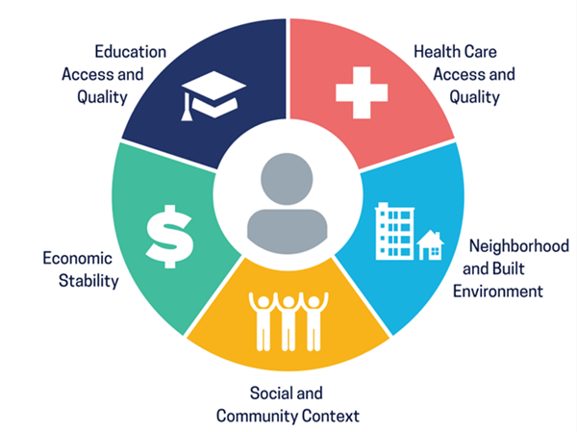
The Social Determinants of Health (SDoH)
Healthy People 2030, U.S. Department of Health and Human Services, Office of Disease Prevention and Health Promotion. Retrieved [date graphic was accessed], from https://health.gov/healthypeople/objectives-and-data/social-determinants-health
Notes:
So now that we have covered upstream factors, including specific examples, we are going to transition now to talking about the social determinants of health. The social determinants of health are the upstream factors that influence health. They are the conditions in the environments that we are born, where we live, where we work, where we play, where we worship, and where we age that affects a wide range of health. These factors influence our health including our quality of life, health outcomes, disease outcomes, and risks.
Source: Healthy People 2030
We are going to spend some time now exploring each of the different social determinants of health, explaining what each one is and then helping use examples from within our own community to work towards understanding.

Slide 10
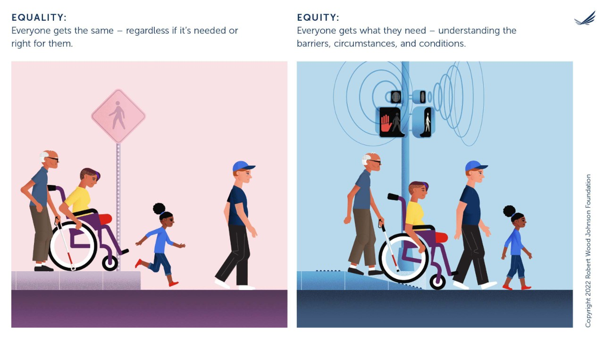
Why??

Slide 11
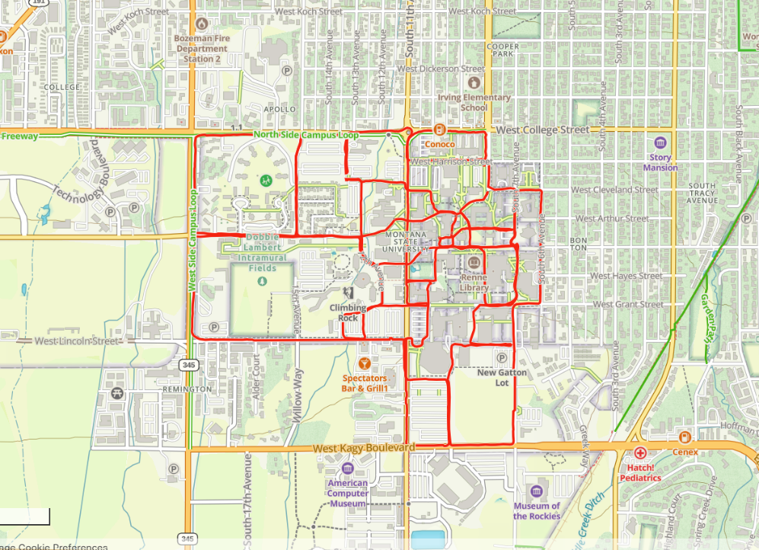

How it started

Slide 12
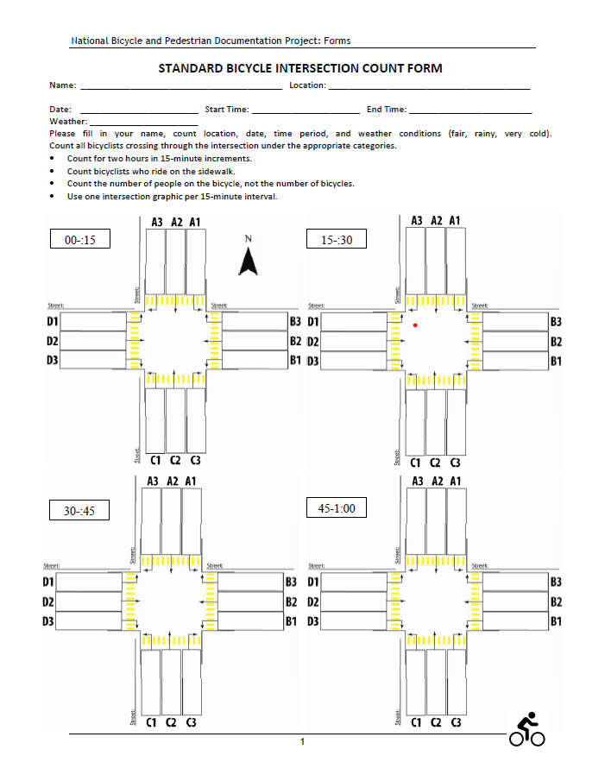
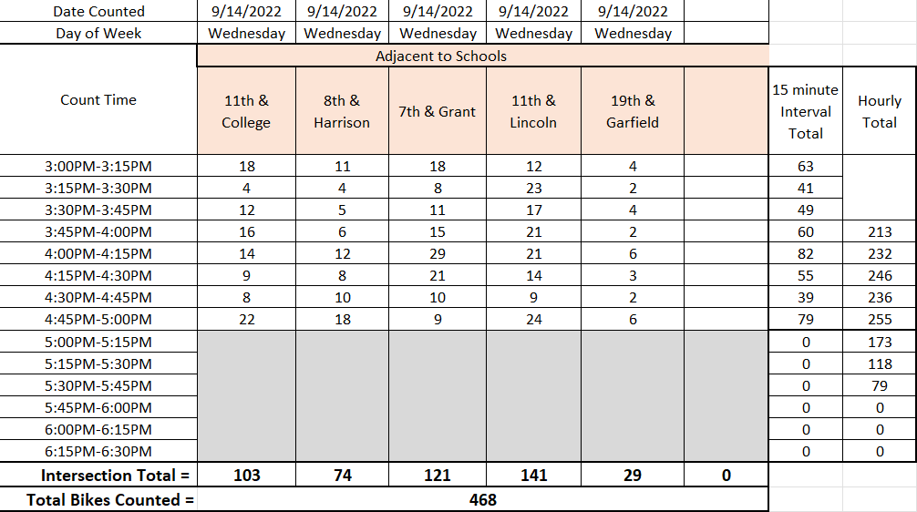
Let’s Count Users

Slide 13
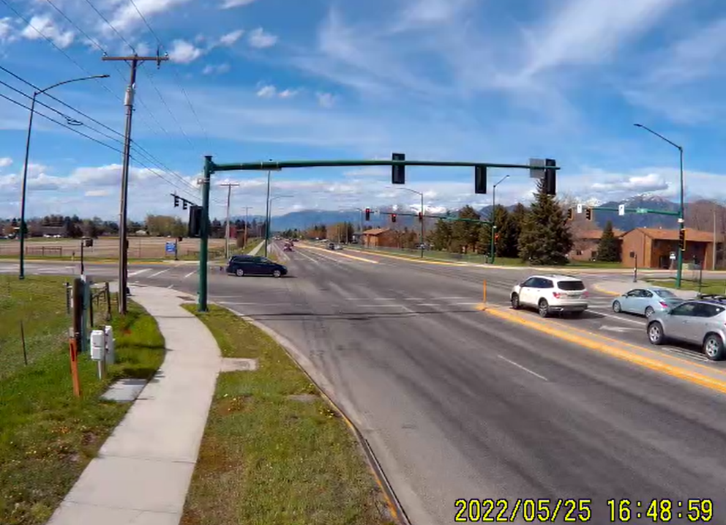

Let’s add some technology
Cameras to expand counting locations
Get some popcorn
Manual count still

Slide 14
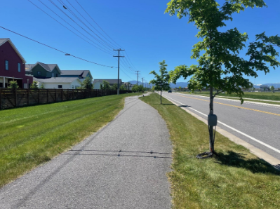
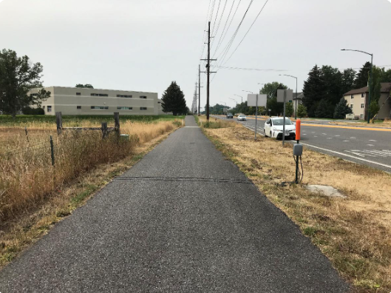
Even more technology

Slide 15
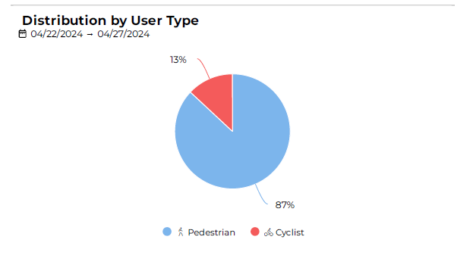
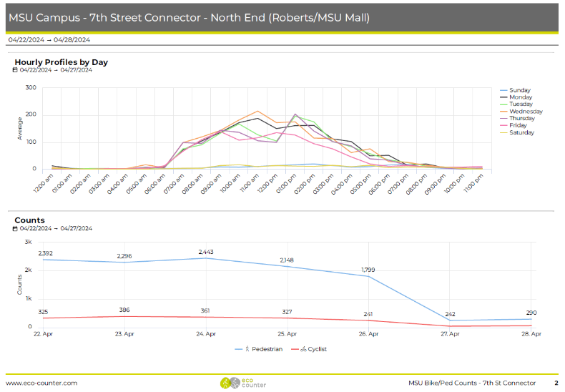
Technology can make a difference
Multiple locations
Less people power
Data analysis

Slide 16
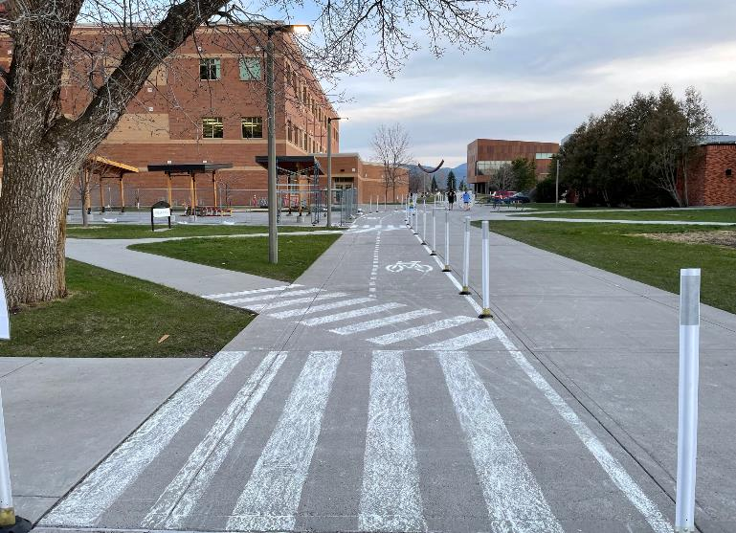
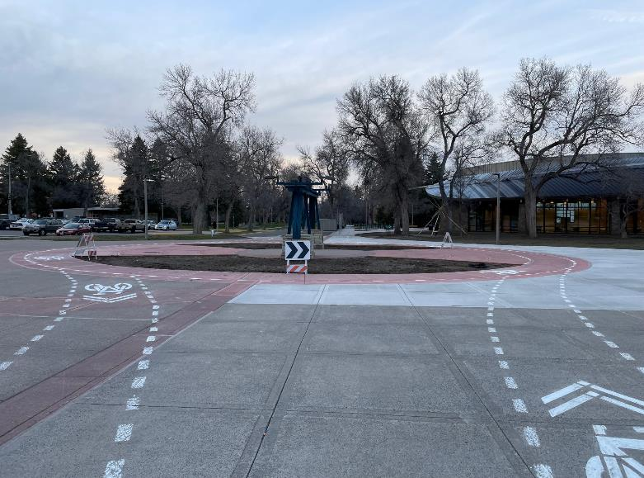
Use data to test routes
Test Infrastructure
Collect Data
Iterate

Slide 17
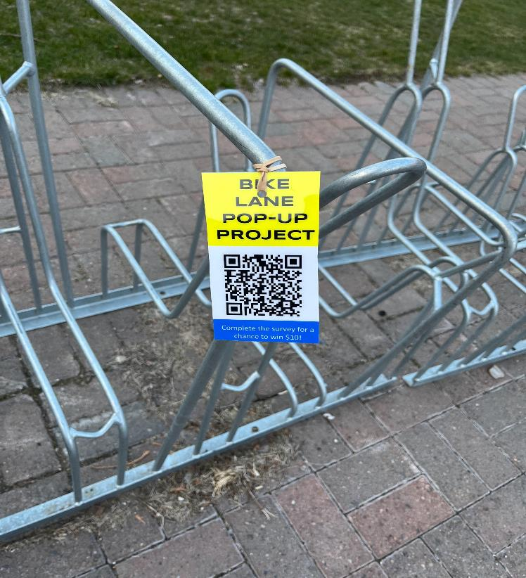
Qualitative & Quantitative
Users & non-users
Why?
And why not??
Photo Credit: Nicholas Fitzmaurice

Slide 18
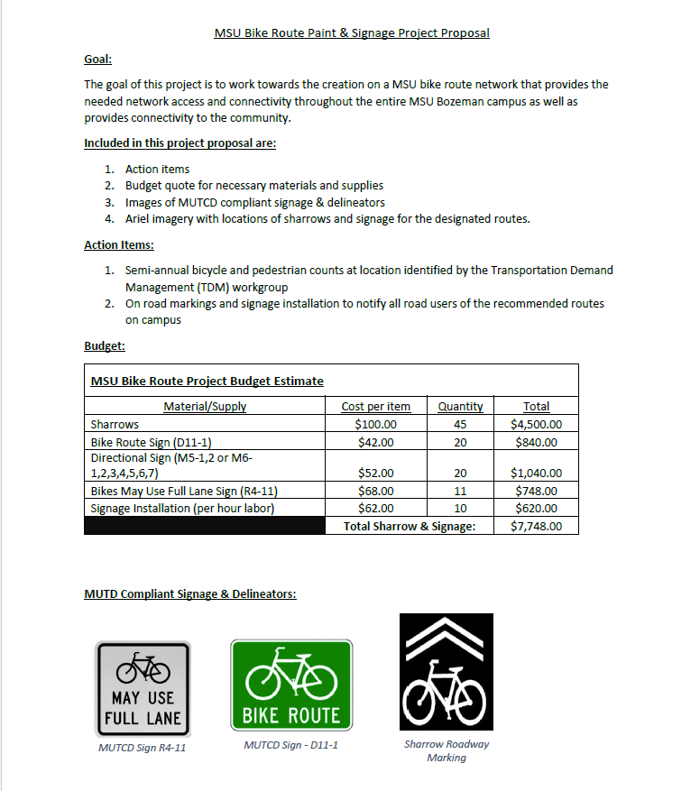
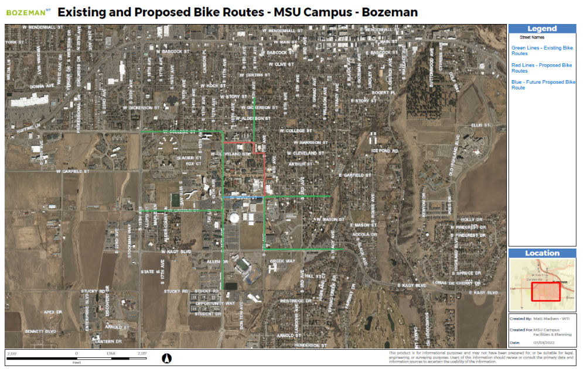
Install and mark permanent routes

Slide 19
Lesson’s Learned – Engagement & Partnerships
Coordinator
Students
Community
Data Partners
Have a plan!
Engage with partners
  Colleges/schools are great
Volunteer counts are great
  Make sure you have good training materials

Slide 20
Lessons Learned – Equipment
Hand Counts
Cameras
Surveys
Counters
Mapping Software
Use different types
Technology takes practice
Creativity is key

Slide 21
Lesson’s Learned
Continue showing up!
Change takes time
Celebrate little victories
Photo Credit: Benjamin Meyer

Slide 22

Questions
Matthew Madsen MPH
Research Associate II
Western Transportation Institute
matthew.a.madsen@gmail.com

