Slide 1
Enhancing the Movement of Goods, People, and Economic Development in Southeast Ohio

Slide 2
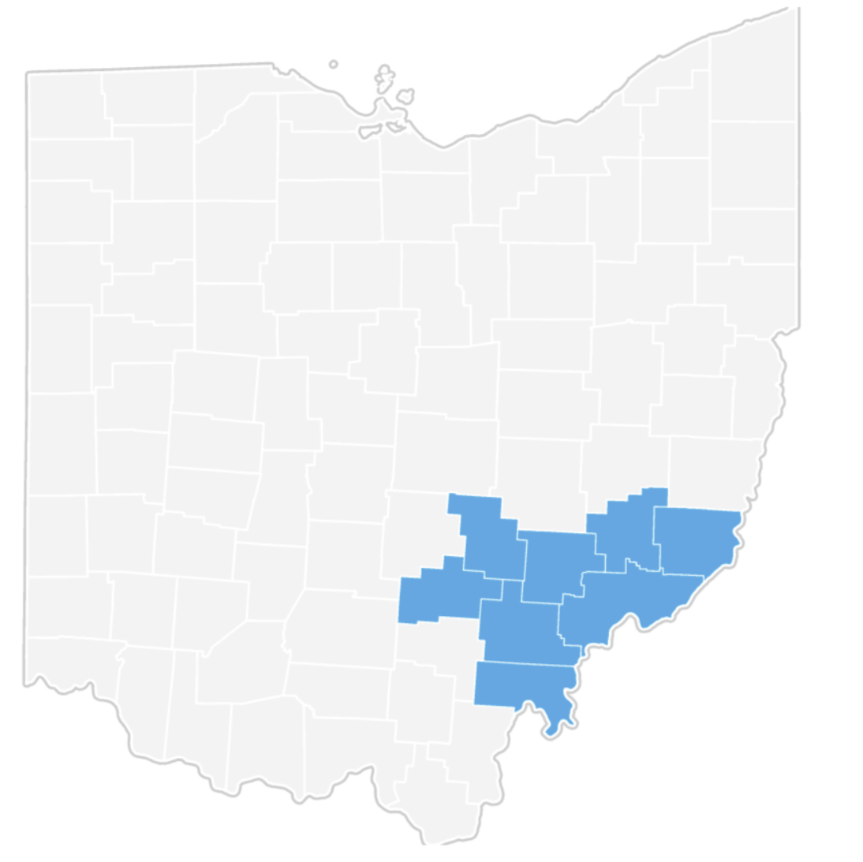
The Buckeye Hills Region

Slide 3
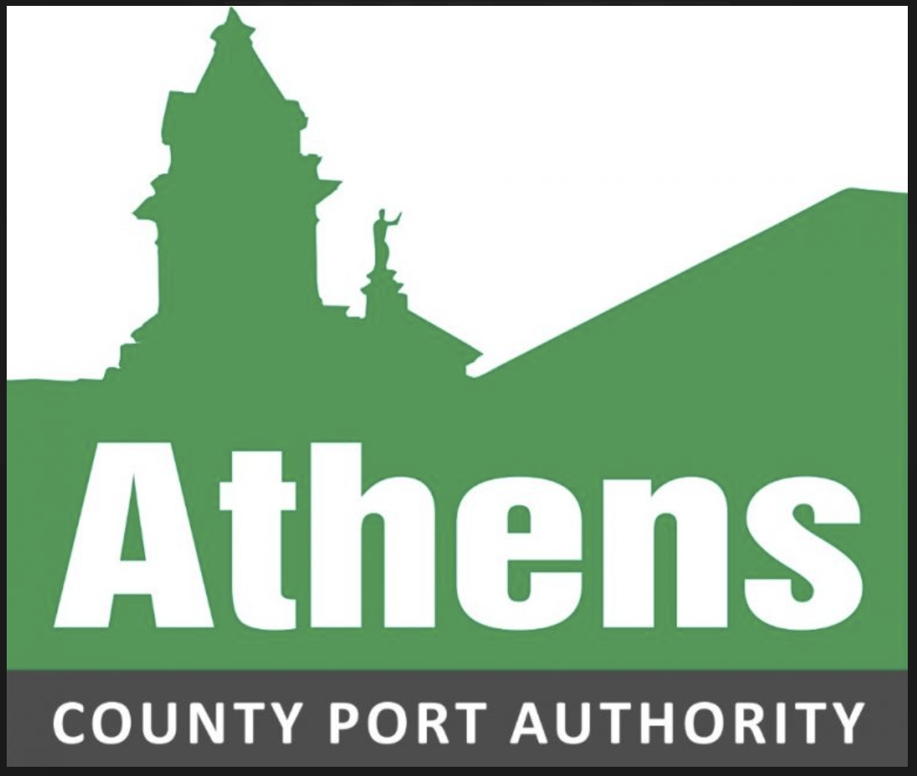
Strategic Partnerships
Partnership 1: Ohio Department of Transportation (ODOT)
Description: Primary funder, developer, maintenance, and improvement of transportation systems/infrastructure.
Impact: Improved Safety and Connectivity across Ohio and the Buckeye Hills Region.
Partnership 2: Ohio Rail Development Commission (ORDC)
Description: Collaborative efforts on rail infrastructure improvements.
Impact: Enhanced rail service, better freight access.
Partnership 3: Appalachian Regional Commission (ARC)
Description: Funding and support for transportation infrastructure in rural areas.
Impact: Boosted regional economic development.
Partnership 4: Ohio Southeast Economic Development
Description: Economic development organization that provides support for multiple industries such as manufacturing and logistics.
Impact: Improved regional coordination and job retention/expansion.
Partnership 5: County Port Authorities
Description: Joint initiatives to support local businesses and freight needs.
Impact: Strengthened local business networks, improved freight services.

Slide 4
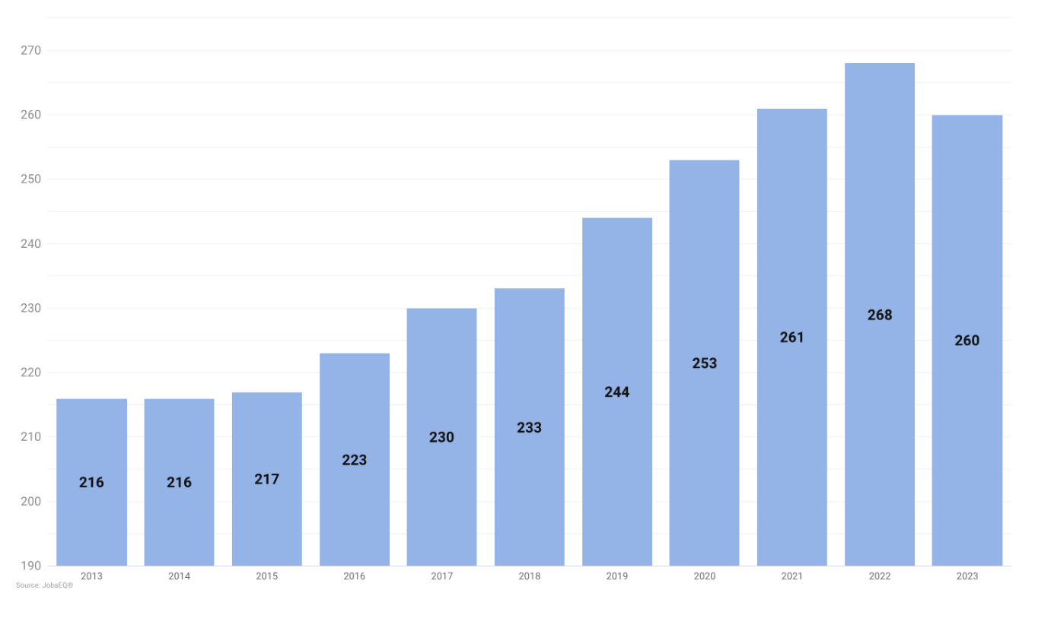
Transportation Economic Data
Transportation and Warehouse Companies in the Buckeye Hills Region

Slide 5
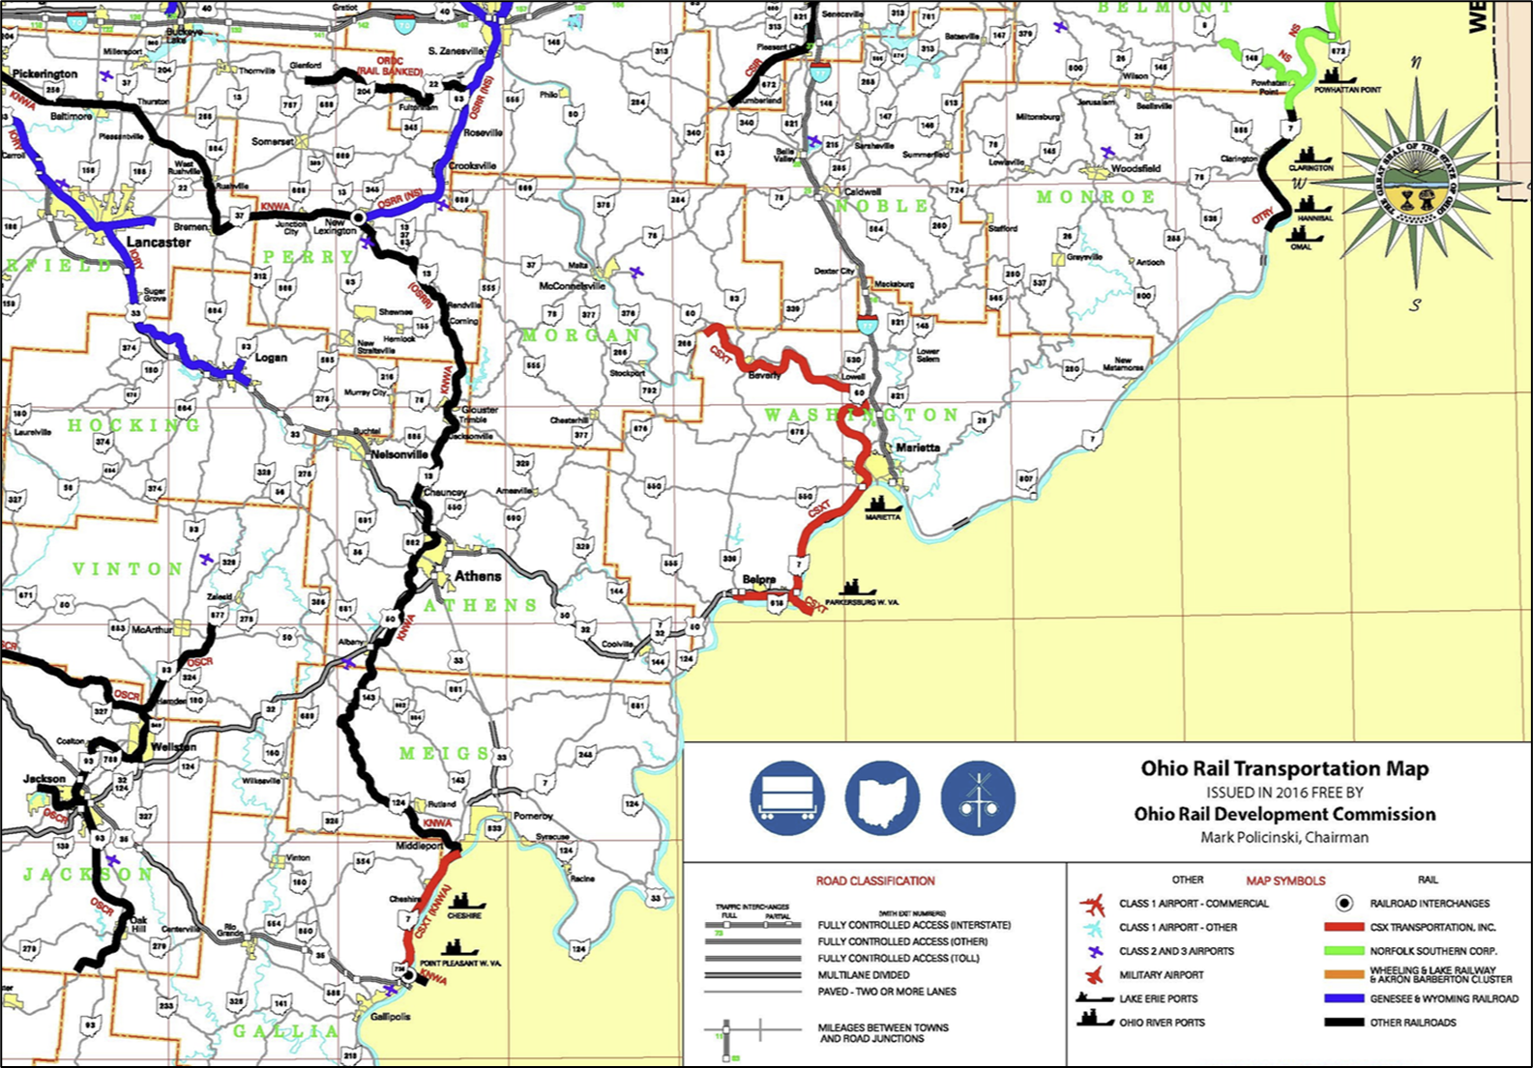
Freight Landscape in Southeast Ohio
Freight Highways: US 33, I-77, US 50, SR 7
Railroads: CSX, Norfolk Southern Kanawha River Railroad
Ports: Limited private port facilities but relevant connections with a focus on future expansion.

Slide 6
Key Freight Projects in Southeast Ohio
Project 1:
Name: US Route 33 Expansion
Description: Upgrading Route 33 to a four-lane highway.
Objectives: Enhance connectivity between rural and urban areas.
Expected Outcomes: Improved freight movement between Columbus and regional hubs.
Project 2:
Name: Washington County Public Port Feasibility Study
Description: A feasibility study on the market viability of developing a publicly owned port facility in Southeast Ohio (Washington County)
Objectives: Increase jobs, improve the local economies, and capitalize on maritime tonnage.
Expected Outcomes: Increased movement of goods through Washington County and regional hubs through rail development.
Sources: Southeast Ohio Port Authority, ODOT Project Reports,
FHWA Infrastructure Improvement Plans.

Slide 7
Upgrading Freight Facilities
Facility 1:
Name: Southeast Ohio Freight Hub
Improvements: Expanded storage, advanced logistics technology.
Benefits: Increased capacity, improved efficiency.
Facility 2:
Name: Jackson County Rail Terminal
Improvements: Modernized rail facilities, enhanced loading/unloading infrastructure.
Benefits: Better rail connectivity, reduced handling times.
Facility 3:
Name: Athens County Port Authority Speculative Building
Improvements: Upgraded warehousing, automated systems.
Benefits: Streamlined operations.
Sources: ODOT Facility Improvement Plans, Local Economic Development Reports.

Slide 8
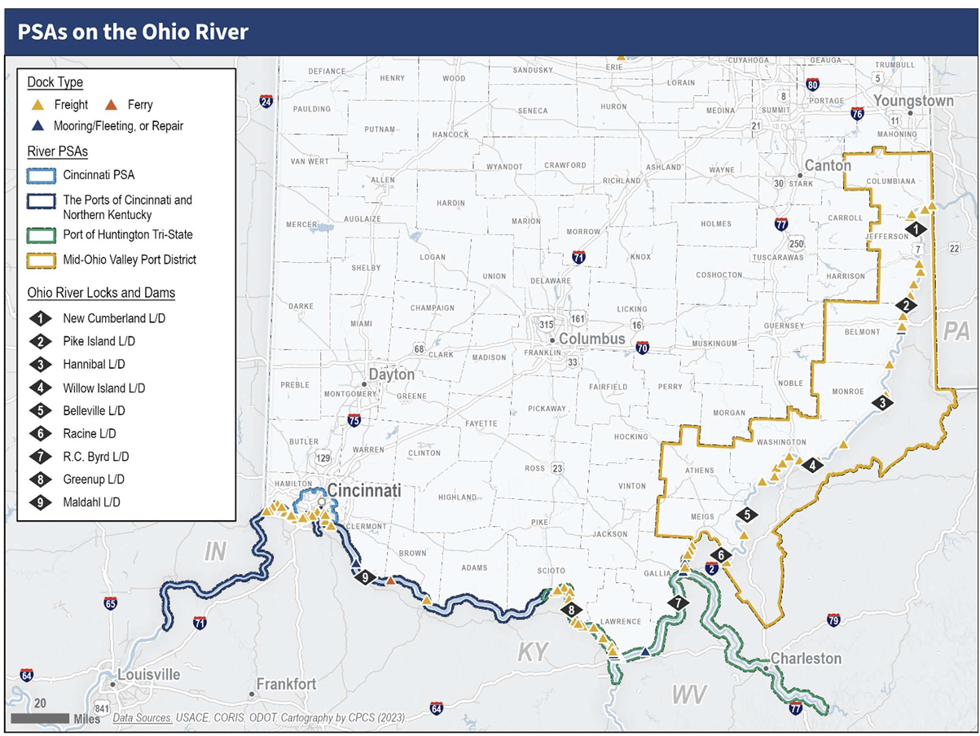
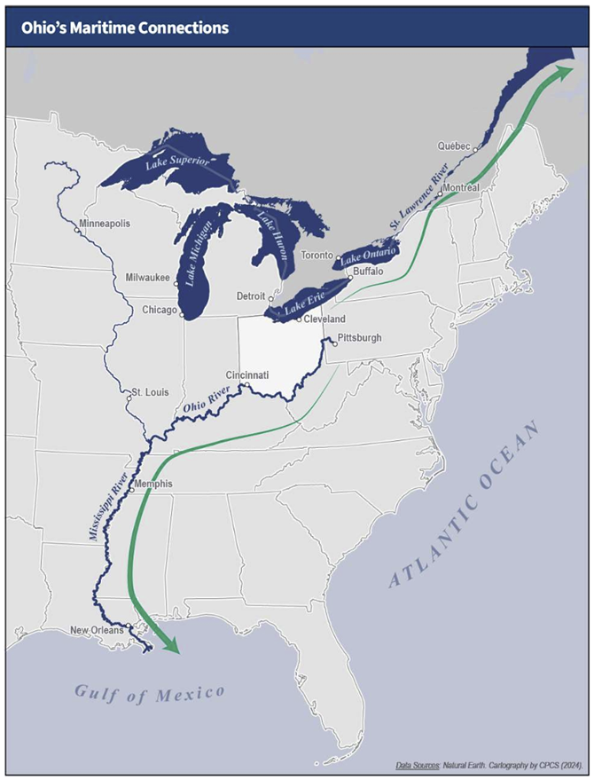
Maritime Connections

Slide 9
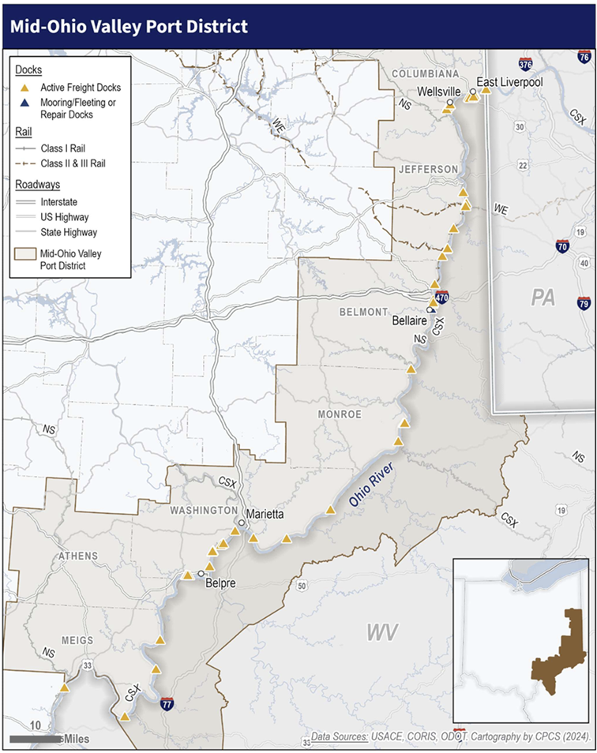
Mid Ohio Valley Statistical Port (PSA)
Newest PSA in Ohio
Includes 16 counties, seven of which are in Ohio: Meigs, Athens, Washington, Monroe, Belmont, Jefferson, and Columbiana
District includes five locks and dams: Belleville, Willow Island, Hannibal, Pike Island, and New Cumberland
54 active freight docks in Ohio
Athens the only MOV PSA county without a dock
The PSA supports the trade of coal, lignite, sand, gravel, and other energy products.
All freight docks in the BHRC are privately owned.

Slide 10
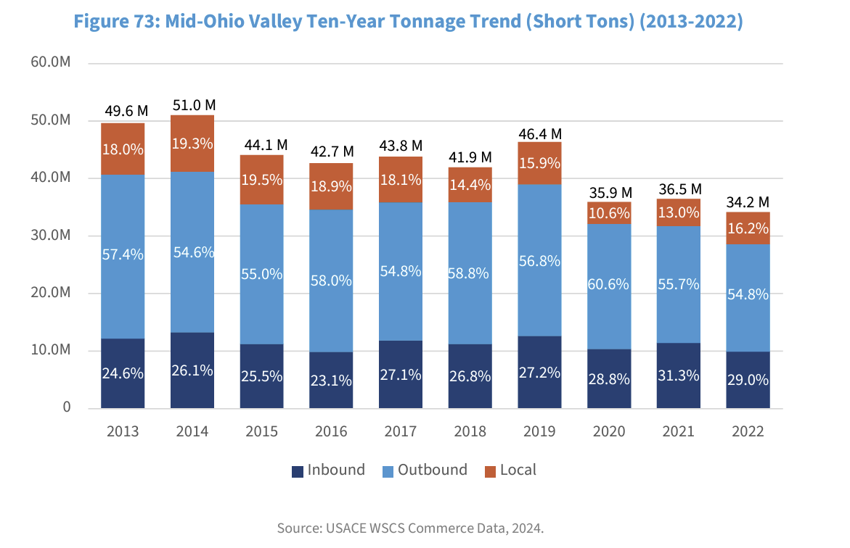
Mid Ohio Valley PSA Data

Slide 11
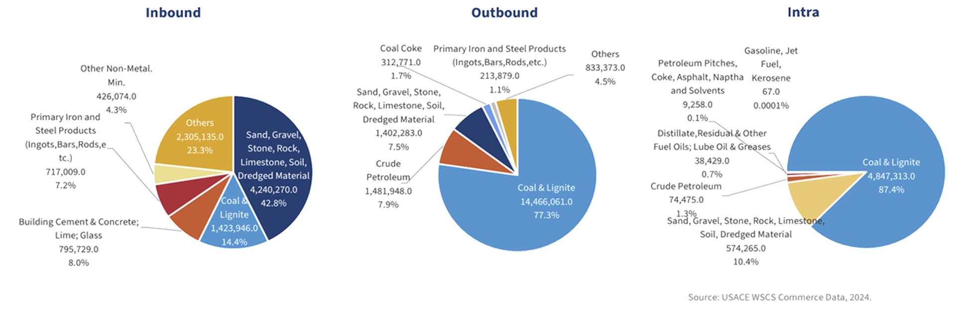
Mid Ohio Valley PSA Data
2022 Mid-Ohio Valley Commodity Composition (Short Tons)

Slide 12
QUESTIONS?
Melissa Zoller
Planning Director
mzoller@buckeyehills.org
740-376-1027

