Slide 1
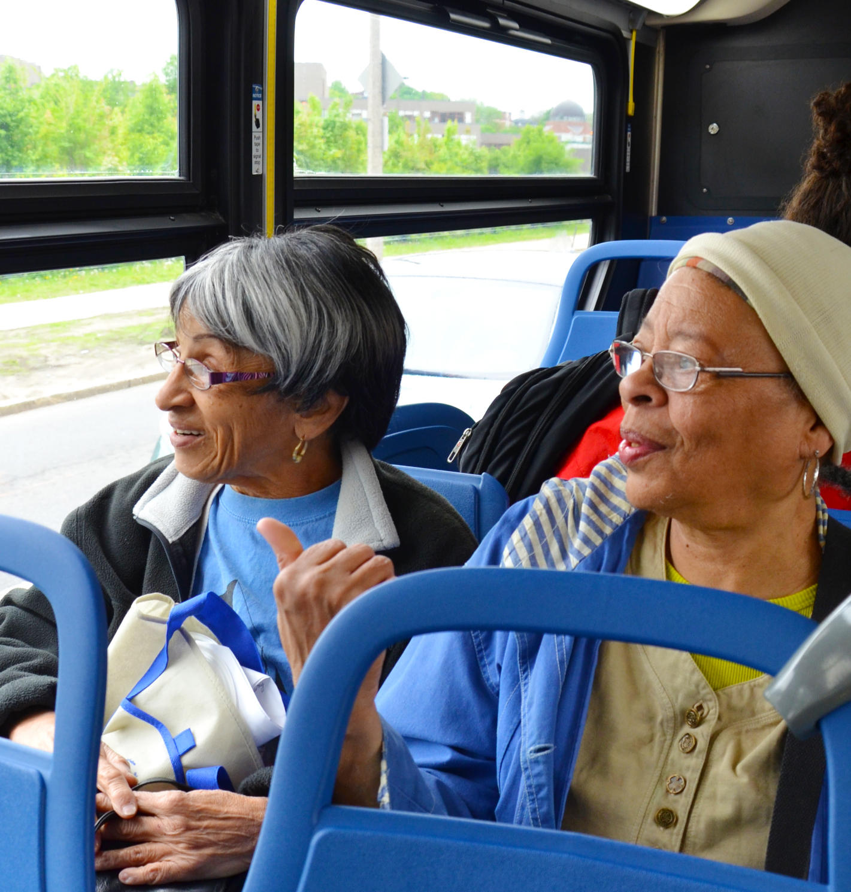

Enhanced Planning Efforts Through Inclusive Outreach
NADO Regional Transportation Conference
July 31, 2024
Photo: City of Boston’s Commission on Affairs of the Elderly
Notes:
MG

Slide 2


  Mission – The Why
National Aging & Disability Transportation Center
Our Mission:
To promote the availability of accessible transportation options that serve the needs of Older Adults, People with Disabilities, Caregivers, and Communities.

Slide 3
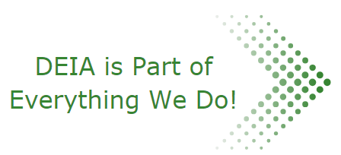
National Aging & Disability Transportation Center
What We Provide:
Technical Assistance & Training
Publications & Resources
Partnership Coordination
  Educational Opportunities
  Coalition Toolkit
Community Grants & Pilots

Slide 4
NADTC’s DEIA Initiative
NADTC started an initiative in 2020 to understand the transportation challenges that specifically impact diverse older adults, people with disabilities and caregivers. This effort encompassed:
Gathering information – 2,435 responses, all 50 states
Sharing what we learn – Reports and Publications
Creating learning opportunities – Events and Webinars
Improved how we provide technical assistance and support to communities, providers and stakeholders
NADTC Diversity, Equity and Inclusion Initiative- https://www.nadtc.org/diversity-equity-inclusion-initiative/
Notes:
MG
conducted a nationwide survey of older adults, younger adults with disabilities and caregivers in 2021. A total of 2,435 diverse individuals responded, including African Americans, Asian Americans and Pacific Islanders, Hispanics, Native Americans, multi-racial individuals, immigrants, and people who identify as LGBTQ from all 50 states and the District of Columbia.
To delve deeper into the issues raised by the survey, NADTC embarked on an environmental scan consisting of focus groups with diverse older adults, younger adults with disabilities and caregivers and meetings with transportation stakeholders.

Slide 5
Assessment of Transportation Providers
“Please indicate your organization’s involvement or work on transportation diversity, equity, inclusion and accessibility (DEIA)”
2022 – 33% indicated they have not started work or were just beginning.
2023 – preliminary results, over 50% indicated they were working in one of the following:
    Diversifying staff and/or board members
    Providing materials in languages other than English
    Training staff on DEI issues
    Reviewing current practices to identify barriers that impact underserved and marginalized populations
    Integrating DEI into our communications/marketing materials
    Involving riders and/or community members in transportation planning
    Planning routes to better serve underserved or marginalized groups
Notes:
CD
How we assess where our constituents are as it relates to DEI in their work.

Slide 6
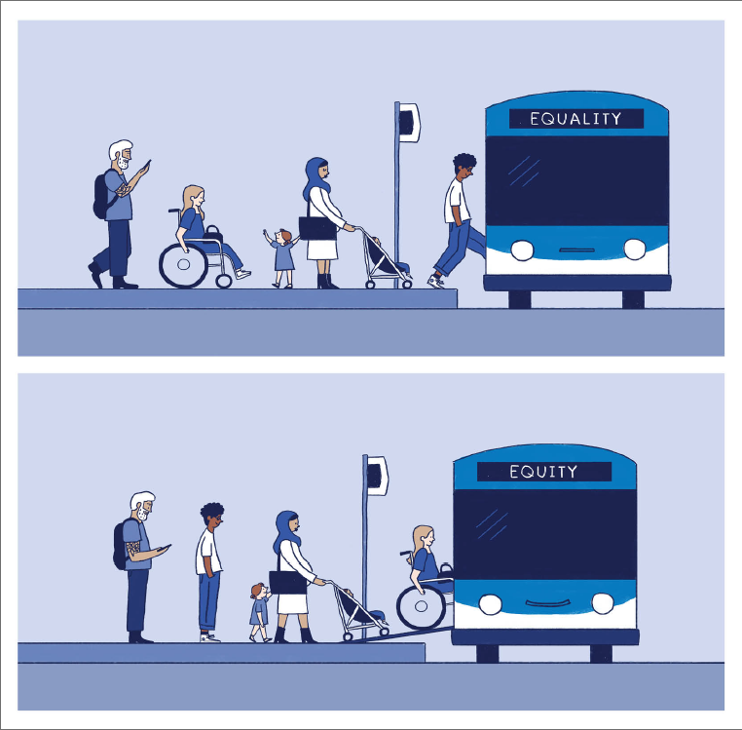
2024 Action Agenda:
DEIA Statement
“At the National Aging and Disability Transportation Center (NADTC), we are dedicated to advancing Diversity, Equity, Inclusion, and Accessibility (DEIA) across all aspects of our work. By embracing diversity, promoting equity, fostering inclusion, and ensuring accessibility, we are committed to taking a comprehensive approach in supporting transportation systems to address mobility needs of all older adults, individuals with disabilities and caregivers, especially those from marginalized and underserved communities.”
https://www.nadtc.org/diversity-equity-inclusion-initiative/
Notes:
CD
Suggestion to add for transition.

Slide 7
Lessons Learned
Not everyone has the same understanding of transportation diversity, equity and inclusion.
Some providers struggle to recognize diversity in their communities stating, “We don't focus on any community – we serve everyone.”
Stakeholders clearly want to know more about transportation DEIA and are ready to borrow ideas from others.

Slide 8
NADTC’s Community Coalition Initiative
[2022] NADTC developed a campaign to gain insights to coordination practices from around the country, specifically how challenges could affect older adults or people with disabilities.
Gathering information – Listening sessions and roundtables
Sharing what we learn – Report and Case Studies
Developing helpful resources – Coordination Toolkit
Connecting with communities – Coalition Groups (KS & MN)
NADTC Community Coalition Initiative: https://www.nadtc.org/coordination-initiative/

Slide 9
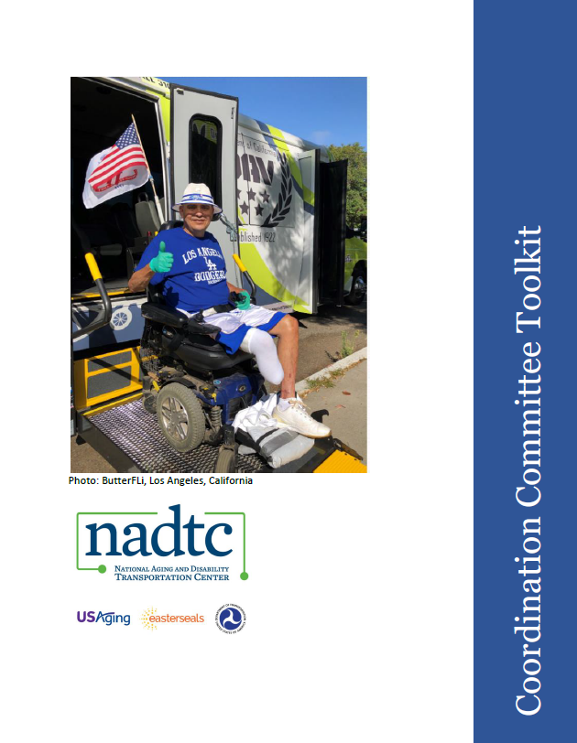
Resource:
Coordination Committee Toolkit
https://www.nadtc.org/resources-publications/resource/coordination-committee-toolkit/
Notes:
Toolkit created by CAC. Many offered suggested tools, some assisted in writing certain sections, discussion at meetings regarding what to include and how to organize, proof-reading prior to publication.

Slide 10
Coordination Committee Toolkit
Getting Ready
Needs Assessment, Readiness Assessment, Environmental Scan
Surveys
Stakeholder or Community Asset Mapping
Growing the Table
Recruitment Process Equity
Communications and Messaging
Framing
Organization and Planning
Vision/Mission Statements
Goals, Objectives, and Action Plans
Performance Measures
Structuring the Coalition
Outreach/Public Engagement
Facilitating Effective Meetings
Sustaining the Committee
https://www.nadtc.org/resources-publications/resource/coordination-committee-toolkit/

Slide 11
Coalition Groups – Kansas & Minnesota
Establish a Sense of Urgency
Create a Vision
Develop an Action Plan
  Specific, Measurable, Achievable, Relevant, Timely
Grow the Coalition
Structure the Coalition for Sustainability
2-Day, In-Person Facilitated Conversation
Monthly Follow-Up Meetings

Slide 12
Why Coordination?
Developed from guiding principles of the Coordinating Council on Access and Mobility (CCAM)
Made up of 11 Federal agencies, including:
Departments of Transportation, Education, HHS, HUD, Justice, Interior, Labor, USDA, VA, and Nat. Council on Disabilities
Focused on the coordination of funding available within each department for people with disabilities, older adults, and individuals with low income – specifically transportation.
Federal Funding Braiding Guide
https://www.transit.dot.gov/regulations-and-programs/ccam/about/coordinating-council-access-and-mobility-ccam-federal-fund
https://www.transit.dot.gov/regulations-and-programs/ccam/about/coordinating-council-access-and-mobility-ccam-federal-fund

Slide 13
Benefits of Interagency Coordination
Federal interagency transportation coordination improves the efficiency, accessibility, availability, and innovation of transportation, and benefits Americans in several ways:
Coordinated transportation improves:
Efficiency
Accessibility
Availability
Funding recipients save funds by sharing resources and reducing redundancy.
Funding recipients collaborate to provide more options.
Streamlined policies allow programs to serve more people and regions.

Slide 14
Polling question:
Does your agency have Community Outreach built into your planning process?
Yes
No
Unsure
We are working on it!

Slide 15
If you said yes:
How does your agency implement those tasks?
Itemized with clear objectives?
Assigning staff to specific tasks?

Slide 16
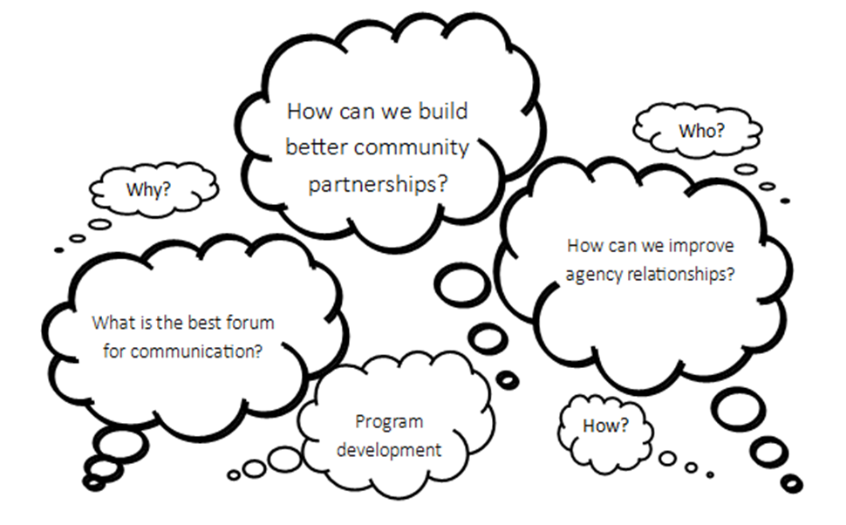

Where Do I Start?

Slide 17
Why is Outreach Important?
It’s important to align to your organization’s mission, strategies, and long-range planning
Focused on specific goals and objectives
  What steps will it take to get there?
  Community partners? MPO/RPA? DOT?
Future projects … 5 Year? … 10 Year?
Types of media (print, paid, social media, etc.)
Identify who takes the lead
Who can speak to the public or the media?

Slide 18
How does outreach relate to planning??
Commitment to your users and community organizations who support them
It’s a requirement for most FTA funded programs
Helps you meet milestones
More accurate data from actual users of your services
Always report back to your Board – especially if applying for grants or starting a new project!

Slide 19
Building an Outreach Plan
Create objectives to meet your goals:
Build relationships with partner agencies
Conduct surveys to understand gaps or barriers in current services offered
  Online, mailings, on the bus/stops, social media
  Timeline to implement/address changes
Understand the community
  Human Services meeting, presentations, social media, parades, community events.

Slide 20
Building a Plan, continued
What is the issue/concern you are trying to address?
Who are you trying to reach, develop talking points for subgroups
Who is missing from the table?
Who needs to be at the table?
Why Me? Be prepared to discuss with various groups why their involvement with the project/effort is valuable

Slide 21
Telling the story

Slide 22
Community Outreach
You need to understand what services are available in your community before promoting:
Demand Response (5310, 5311)
Fixed Route (5307, 5310)
ADA Complementary Paratransit (5307, 5310)
How does the funding work?
Volunteer services, taxi cabs, shared rides

Slide 23
Community Outreach, continued
You need to understand ‘how’ transit works before promoting to the community.
Eligibility Factors:
  Complementary Paratransit
  Non-Emergency Medical Transportation
Ride Reservation?
Where are people going, where do they need to go?
Other transportation options; taxis or shared rides

Slide 24
Community Outreach, continued
Networking is key to gaining trust and building partnerships.
Go to where the people are
  Community centers, meal sites, living facilities
  Ride the bus!
Attend meetings, join coalitions or task forces
Give presentations at meetings and conferences
Invite community partners to your meetings
Life starts before Point A and after Point B.

Slide 25
Know Your Audience
Who
General Public
Agencies & Organizations
Transportation Providers
Government
or Elected Officials
Talking Points:
Who are you, why are you there?
Transit services offered
Unmet needs
Projects
Important deadlines and
upcoming events

Slide 26
Engage Your Audience
Grow the Network: build relationships with organizations, cross-promote using their mailing lists to reach to a wider audience. (Service changes, promotions, events).
You should do the same for them!
Message Development: Emphasize the cost savings or value added to individuals using your services. Each subgroup should have a clearly defined and targeted message that outlines “what’s in it for me?”

Slide 27
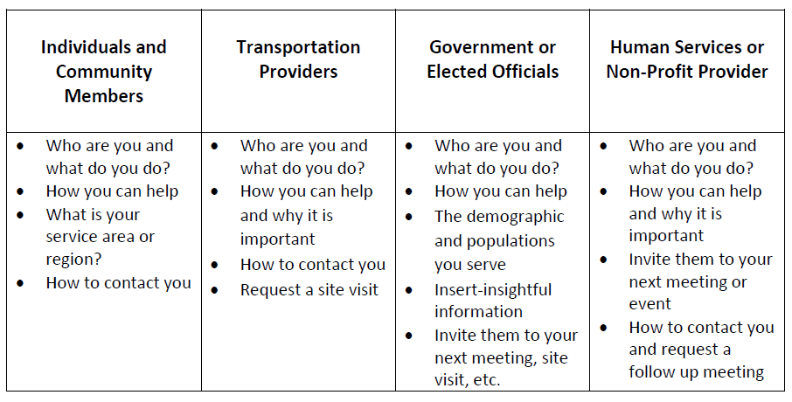
Talking Points: Sample Worksheet
Prepare talking points for your next discussion,
organized by audience and topic area
Notes:
Talking points:
Transit
The area I serve has: 2 public transit, 1 private taxi, 1 Uber driver, 2 faith-based transportation services, and five specialized transportation service providers for seniors and individuals with disabilities.
Transit services are struggling to meet all the needs in the community due to:
Funding
Lack of drivers
Lack of vehicles, maintenance parts, etc.
Technology
Transit assisted EMA with the state spring blizzard disaster recovery getting individuals to the document processing centers for claims. This is the first disaster recover project where there were claims of missing assistance due to lack of access to the facilities.
Residents
Our biggest unmet needs right now are:
Access to medical facilities
More services for individuals with disabilities
Employment transportation
Veterans need transportation for more than just medical
Individuals are losing their freedom or children to the court system because of transportation to appointments
Regulations or services that hinder the freedom of mobility for individuals.
Mobility Management Program
More individuals are being helped in the communities I serve. Last month I tracked that # of individuals were referred to available transportation services and that’s up by _% from last year.
List the 3 top achievements the program did this year:
Example: we developed a partnership with the tribal transit agencies to serve more individuals, new technology was procured for the transit agency making scheduling transit services easier for the public, and we established a silver key travel training program for seniors aging out of driving privileges.
Take advantage of the opportunity for program engagement:
Have you received any transportation complaints or needs that I can explore?
What do you think are the biggest challenges to mobility are in our state or in my area?
Worksheet
Program
Info about the program
Top Initiatives (goals) and the unmet needs that they are addressing
What do you need from others?
attend upcoming meeting
funding
partnership/LOI
Transportation Providers
# of service providers
Top initiatives & needs
How to get involved
Service Area
Top unmet needs
Success stories
Resources and supports/Travel Training

Slide 28
Grow your Audience, continued
Listen to the people: begin collecting noteworthy comments from partners and/or riders, for the ability to promote your services or apply for future funding opportunities:
  Target Audience (Human Service Agency, Healthcare, workforce, meal sites, etc.)
  Pain points or barriers
  Know your annual ridership
  Know your cost per trip
  Types of services, key destinations
  Testimonials and successes

Slide 29
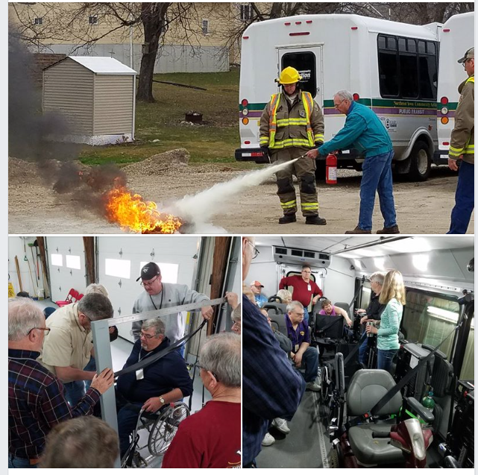
Tell the TRANSIT Story
Stories can be used to:
Share during public outreach efforts
To reflect the benefits of transportation
For funding purposes
To explain the big picture and how to coordinate services

Slide 30
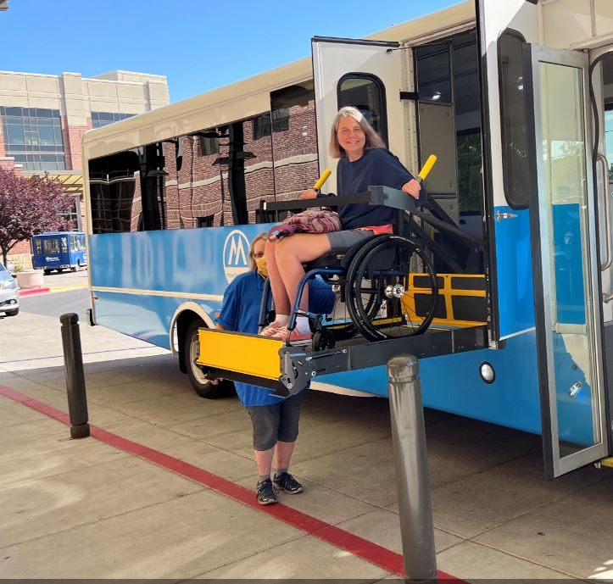
Tell the RIDER Story
Stories can be used to:
Share with stakeholders and decision makers
Portray the benefits of transportation
For funding purposes
To explain the big picture, how transit can affect the rider
Notes:
Same here- keep some raw notes on rider stories. These stories can be used to share with stakeholders and decision makers.

Slide 31
Who Can Tell The Story?
It’s important to hear the message from the person doing the work, and can easily handle Q&A
  Director / Board Member(s)
  Marketing / Communications
  Emergency Management / Safety
  Operations / Planning
  Outreach / Mobility Management

Slide 32
Where do we start?

Slide 33
Difficult Conversations
“We Already Tried That, and it Didn’t Work!”
How much time has passed? Having new staff can assist in getting a project going again!
Did they consider ______ when starting the previous service?
Why did it fail the first time?
  Was it poor planning?
  Lack of outreach/awareness
  Limited (grant) funding, is there a new funding source?
  No sustainability plan?
Notes:
Have you been in a city council meeting for a feasibility study to expand city transit to a growing suburb, and the mayor says to your request “we tried to put bus stops in back in the 80’s and nobody used transit so we tore them down. What makes you think it’ll work this time?”.
How do you answer the question
It’s been tried before, what make you think it’s going to work this time?
It’s good to prepare for these kind of questions because you’re going to be challenged. And for good reason- we have individuals who need well thought out programs. It’s the job of our government officials to ask the hard questions.
Think about asking clarifying questions back or exploring the reason in their previous claim.
Did the service consider (enter points here) all factors when establishing the previous service?
Why did it fail?
Ridership wasn’t there- (the problem isn’t the ridership- there’s another factor when this happens – poor planning, service didn’t meet needs, etc.
this could be because of failed marketing, poorly planned service that was not receptive to needs- just placed to put a “band aid on a bullet wound”
So, how can we learn from this and not make the same mistakes this time around?
Is there an opportunity to learn from past mistakes? ---- this could be a question to ask in order to get them to buy in.
Always be prepared for hard conversations!

Slide 34
Difficult Conversations with Partners
What’s in it for them?! (use your talking points!)
Unwilling to coordinate services? Refer to FTA’s federal regulations on coordination (CCAM)
Provide regular updates, and not each year when you are updating planning documents
They wear lots of hats too – keep meetings productive!
  Agenda, meeting notes, clear objectives

Slide 35
Let’s Try That Again!
Be thoughtful to integrate diverse community voices
New partners at the table can bring different perspectives
Clear and consistent goals, objectives and priorities
  Hint: this really helps when applying for grants!
Mobility, outreach or marketing efforts
Roundtables, listening sessions, public meetings

Slide 36
Planning & Implementation, just a reminder!
All FTA grants must be included in local planning efforts to be considered for funding:
  Transportation Improvement Program (TIP) or State TIP
  Human Services Transportation Coordination Plan
  Managed by MPO, State DOT or Direct Recipient
  Do you know who to contact? It varies by location/state…
FTA 5310 Circular, 9070.1G (chapter 5.2)
https://www.transit.dot.gov/sites/fta.dot.gov/files/docs/C9070_1G_FINAL_circular_4-20-15%281%29.pdf

Slide 37

Planning & Implementation
Do you know the true needs of your region?
  Go where the people are
  Regular advisory groups
  Attending meetings / conferences
  Surveys
  Focus Groups
  Ride Along

Slide 38
Planning & Implementation, continued
Transit Advisory Groups or Coalitions
  Brings human services providers to the table and discuss transportation issues from their perspective
  Great way to develop relationships and build a trusted network of community providers
  When funding becomes available, you should be ready to develop a project and submit the application quickly!

Slide 39
Time to engage

Slide 40

Don’t Assume They will Come to You
Public Meetings
Listening Sessions
Training / Education
Surveys
Events
Newsletters
Social Media

Slide 41
Public Meetings
FTA/DOT requires us to solicit input but doesn’t provide guidance HOW to gather input.
Time and Place
  Located on bus route and during service hours?
  Multiple options for working shifts
Accessibility
  Buildings (ramps, elevators, restrooms, animal relief area, etc.)
  Meeting Room (ample space, podium, mic, stage, etc.)
  Documents (large print, Braille, interpreter)

Slide 42

Listening Sessions
Understand the needs of the community
Gain Trust
Gather Data
Senior centers, public health, independent living, worksites

Slide 43
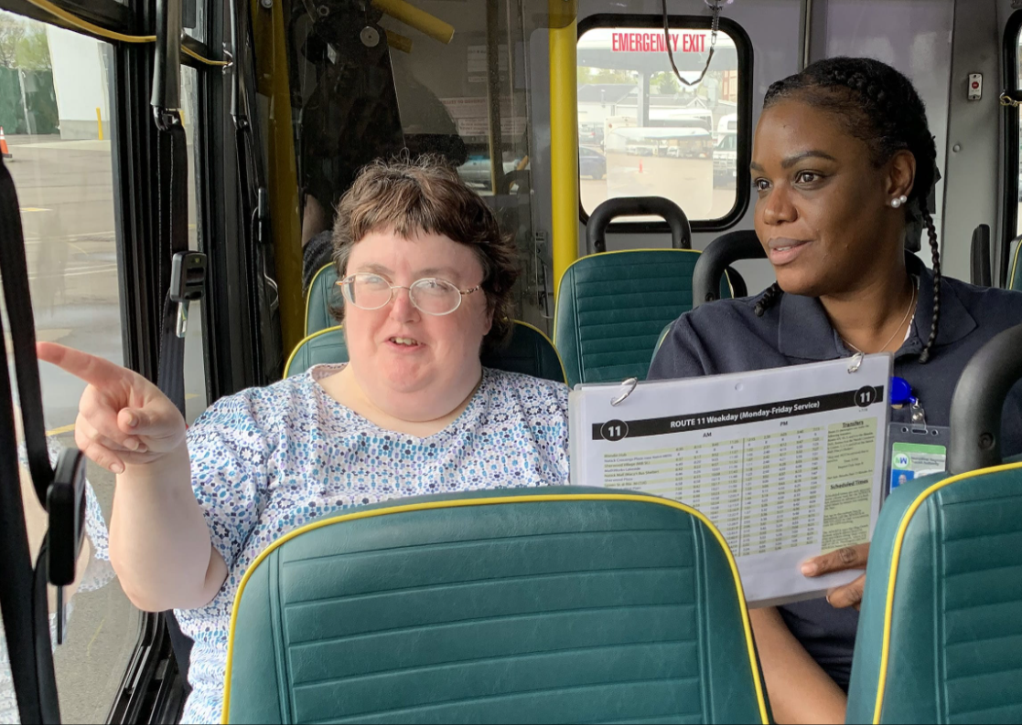
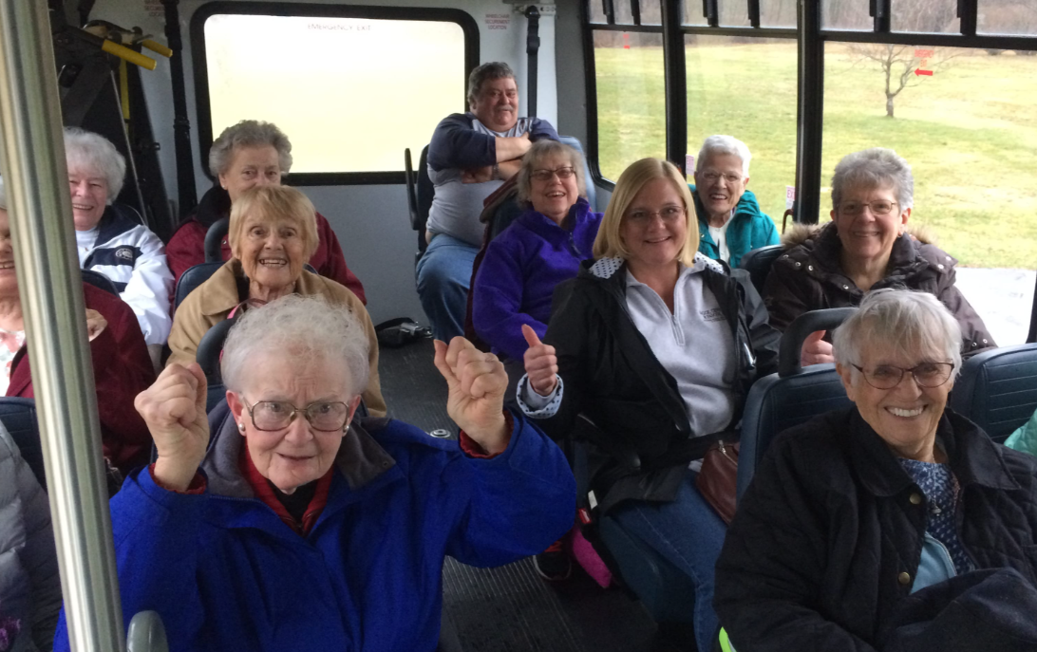
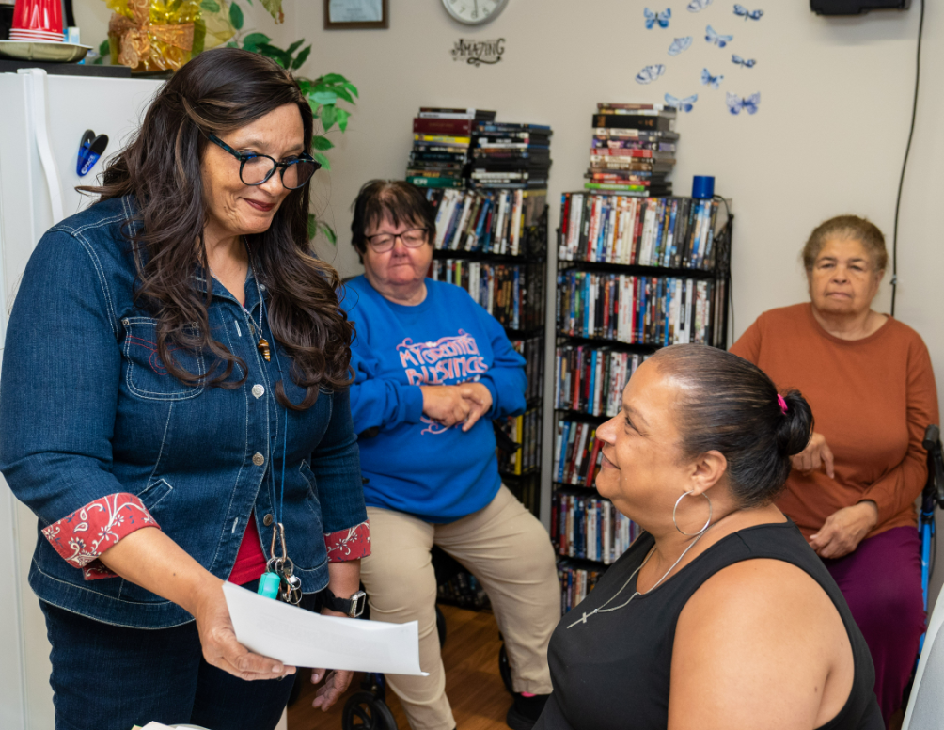
Educate the Community!

Slide 44
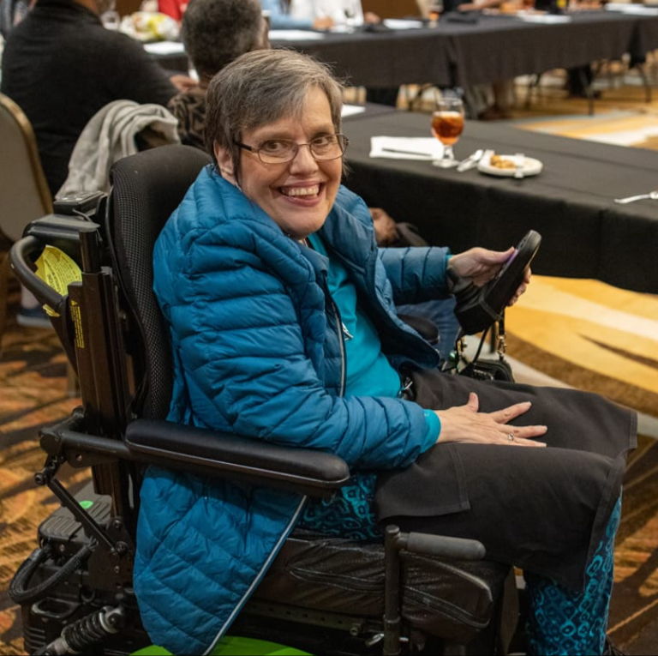
Conference Presentations or Booths
Tell Your Story
Networking
Form Partnerships
“You never know who you might be sitting next to…”

Slide 45
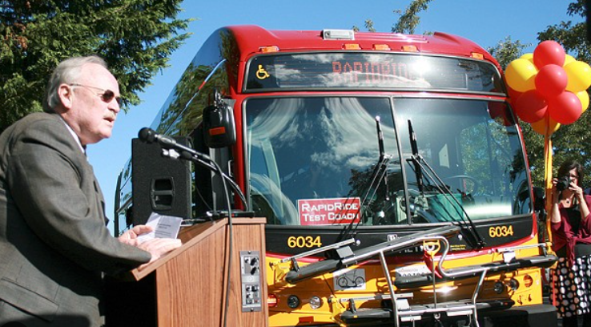
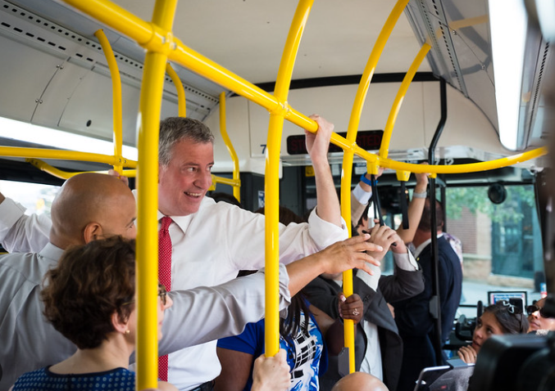
“Try Transit” Events
Get elected officials and community leaders involved!

Slide 46
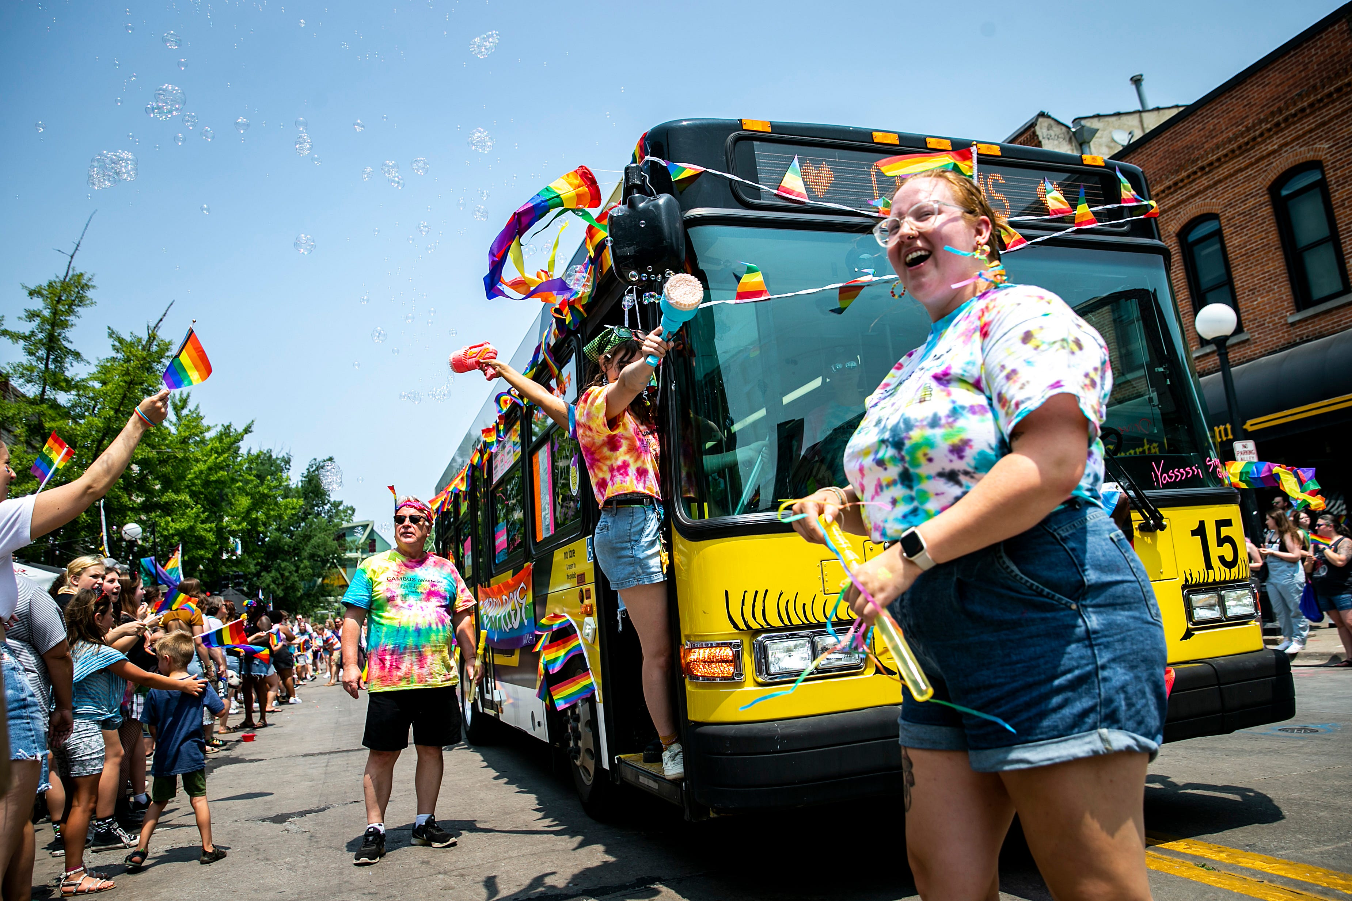
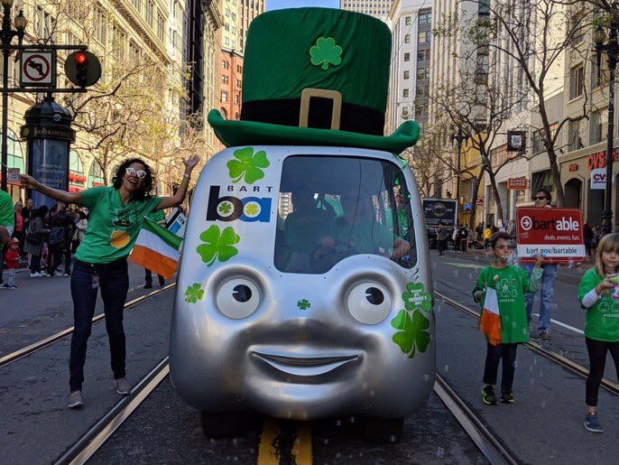
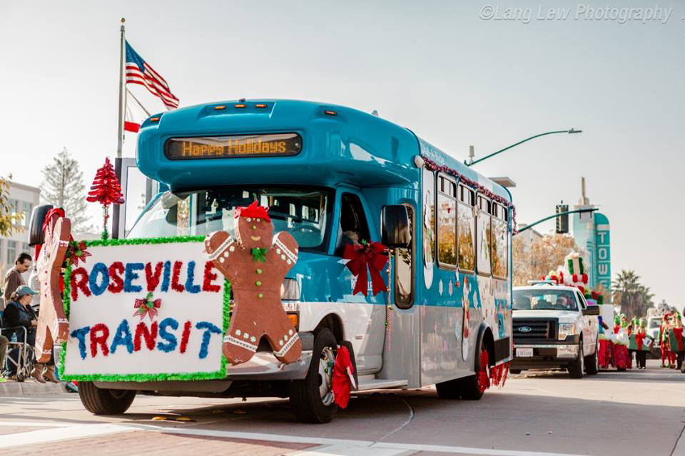
Community Events

Slide 47


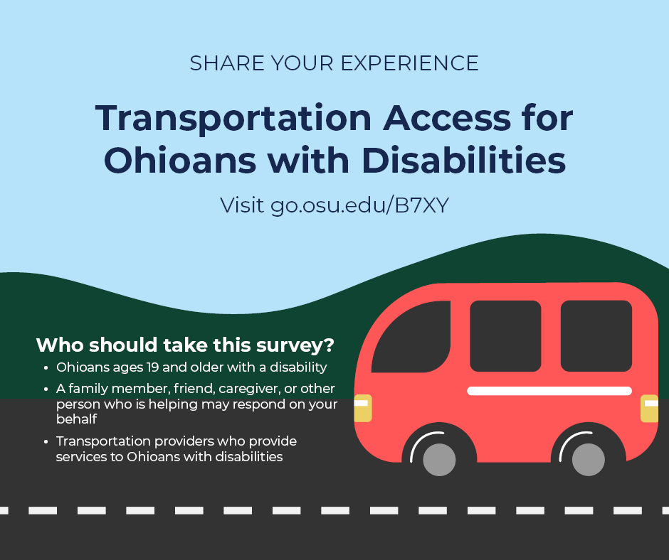
Surveys

Slide 48
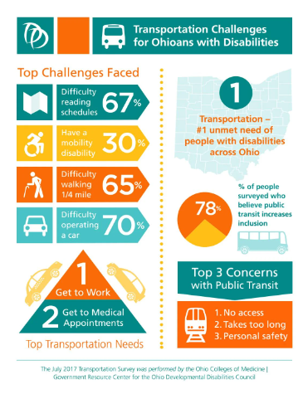
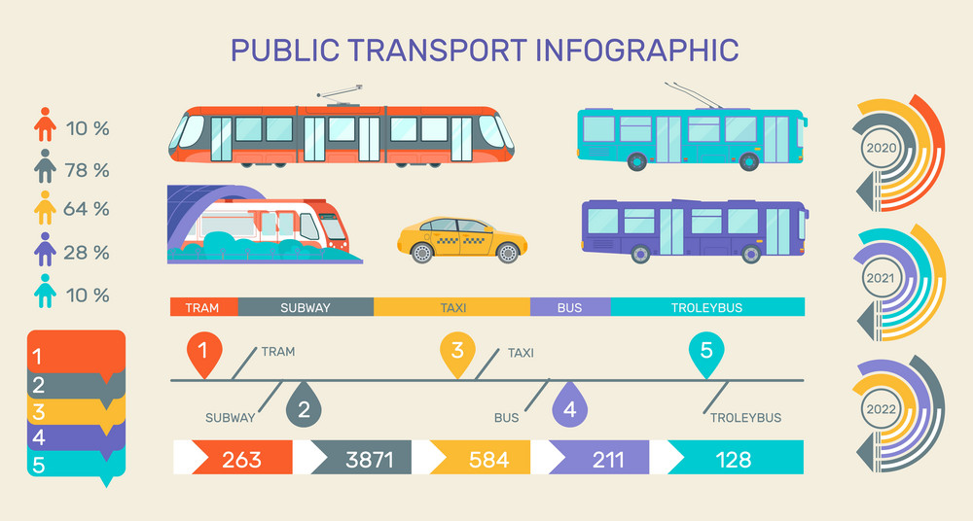
Report Back to the People.
Don’t leave them wondering what happened!

Slide 49
Newsletters and Notifications
Think back to your ‘Goals and Objectives’
Plain and easy to understand, different languages?
Short and sweet
e-mail or external service?
  Constant Contact, Word Press, MailChimp, HubSpot
Graphics are colorful and on-brand
Contact information (general, project lead, etc.)
Do your links work? (You’d be surprised!)

Slide 50
A few resources

Slide 51
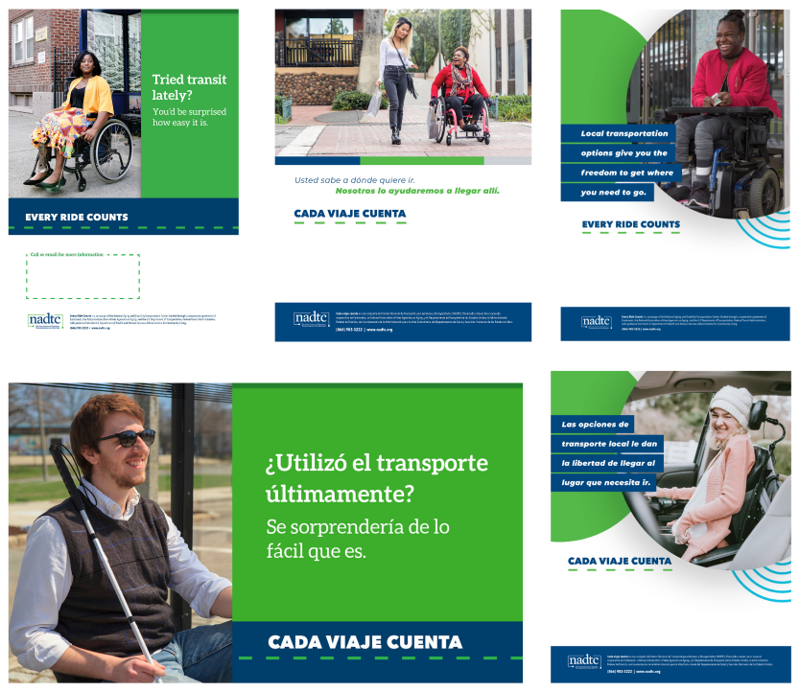
NADTC: Every Ride Counts
Build your own campaign
Customizable
Marketing templates
Social media graphics
Infographics

Slide 52
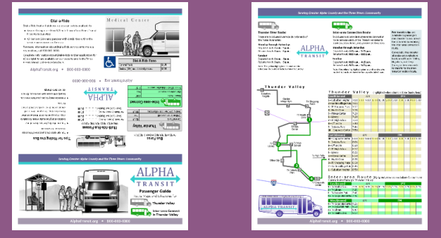
National RTAP: Marketing Toolkit
Build your own campaign
Customizable
Marketing templates
Social media graphics
Infographics

Slide 53

Questions and Discussion

Slide 54
Discussion Questions
What challenges have you faced with outreach?
Who are your most unique community partners?
What strategies are you using to recruit new partners?
What strategies are you using to increase attendance at regular meetings?
What strategies are you using to get members involved in projects, working in-between meetings?

Slide 55
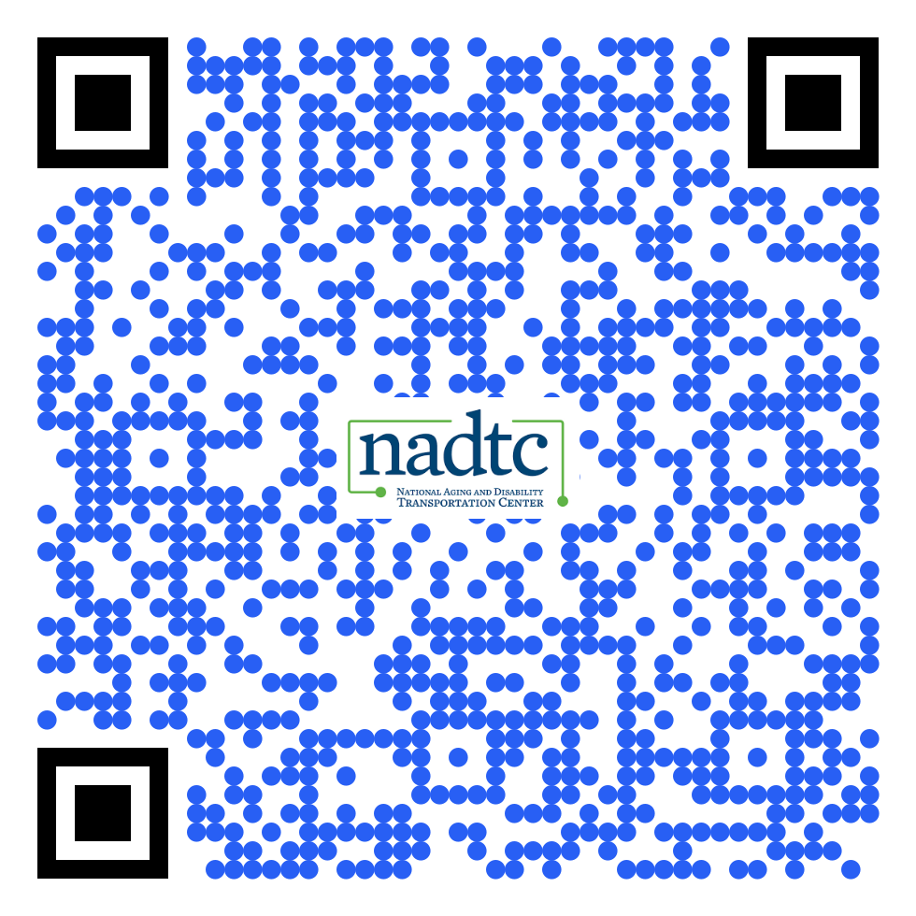
National Aging & Disability Transportation Center
Where to Find Us:
Website / www.nadtc.org
Monthly eNews →
Social Media
  LinkedIn
  Facebook
  X/Twitter
  YouTube
Join our Mailing List!
Notes:
The where to find us
Visit our website for the latest information

Slide 56

Contact Information
Call toll-free: 866.983.3222
Email: contact@nadtc.org
Web: http://www.nadtc.org
Find us on Facebook, X/Twitter, YouTube & LinkedIn

Slide 57
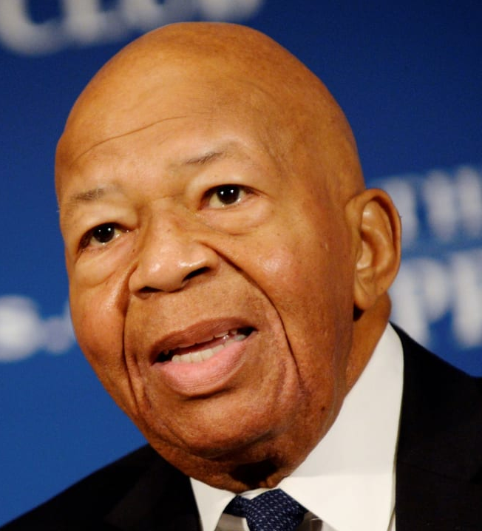
Elijah Cummings Quote
“Our decisions about transportation determine much more than where roads or bridges or tunnels or rail lines will be built.
They determine the connections and barriers that people will encounter in their daily lives - and thus how hard or easy it will be for people to get where they need or want to go.”
Elijah Cummings
U.S. House of Representatives and
Civil Rights leader
Notes:
MG
This quote is especially true for older adults and people with disabilities. These populations often face great barriers to accessing transportation and when you consider those from marginalized communities, the challenges can be even greater.
Accessible transportation is a civil rights issue.
Affordable and reliable transportation allows older adults and people with disabilities access to important opportunities in education, employment, health care, housing, and community life. Because our nation’s investments in transportation infrastructure have disproportionately favored cars and highways, those who cannot afford cars or do not drive cars often lack viable transportation options. Older adults and people with disabilities—particularly in rural areas—need accessible, affordable transportation options that bring employment, health care, education, housing, and community life within reach.”
Source: AAPD — https://www.civilrightsdocs.info/pdf/transportation/final-transportation-equity-disability.pdf

