Slide 1
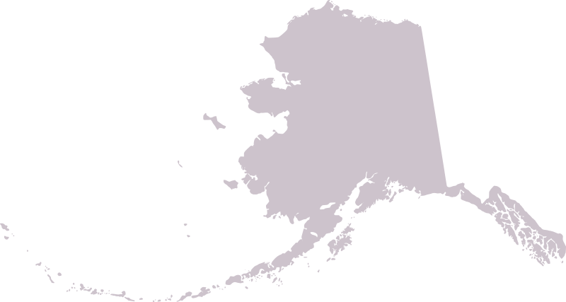
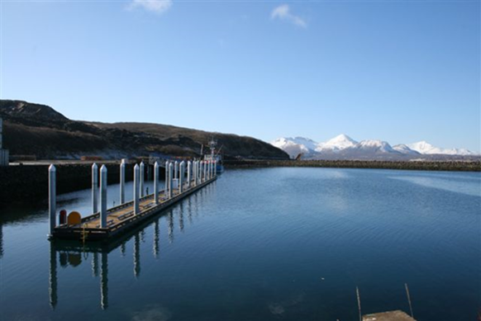
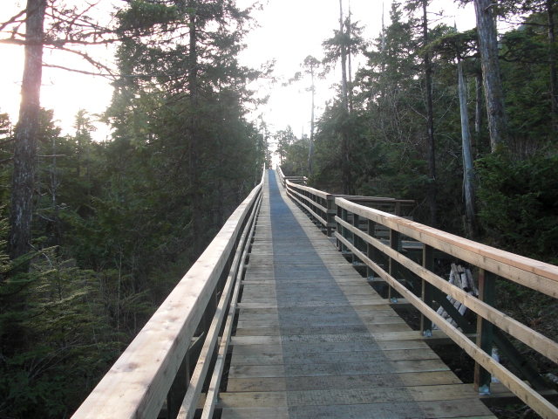
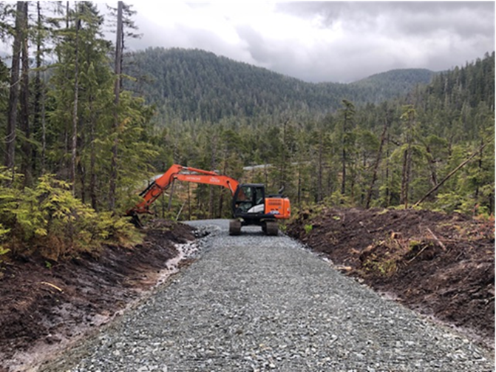
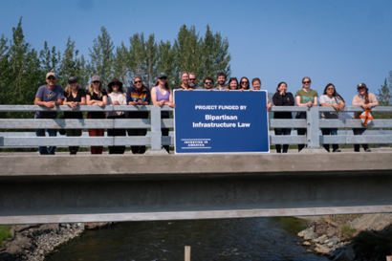
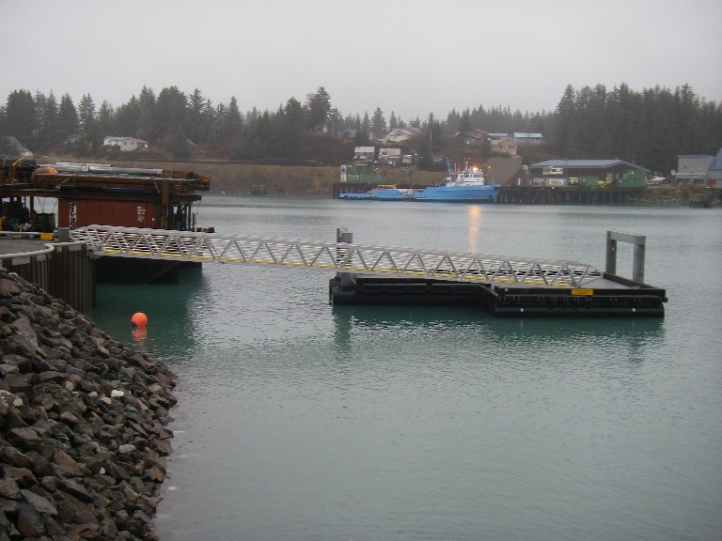
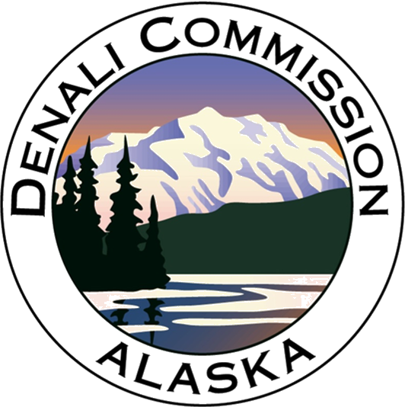
Planes, Boats, and Automobiles: Denali Commission’s Transportation Program
July 31, 2024
NADO 2024 Regional Transportation Conference

Slide 2
Roadmap
Introduction to the Commission
Transportation context in Alaska
Supporting regional transportation challenges

Slide 3
An Independent Federal Regional Commission
In 1998, Congress created the Denali Commission.
Place-based, intergovernmental, and multifaceted in programmatic orientation
Address Alaska’s unique infrastructure needs
Mission: Promote economic development with a focus on critical infrastructure and workforce training for rural communities in Alaska.
Notes:
Commission’s Mission in Alaska

Slide 4
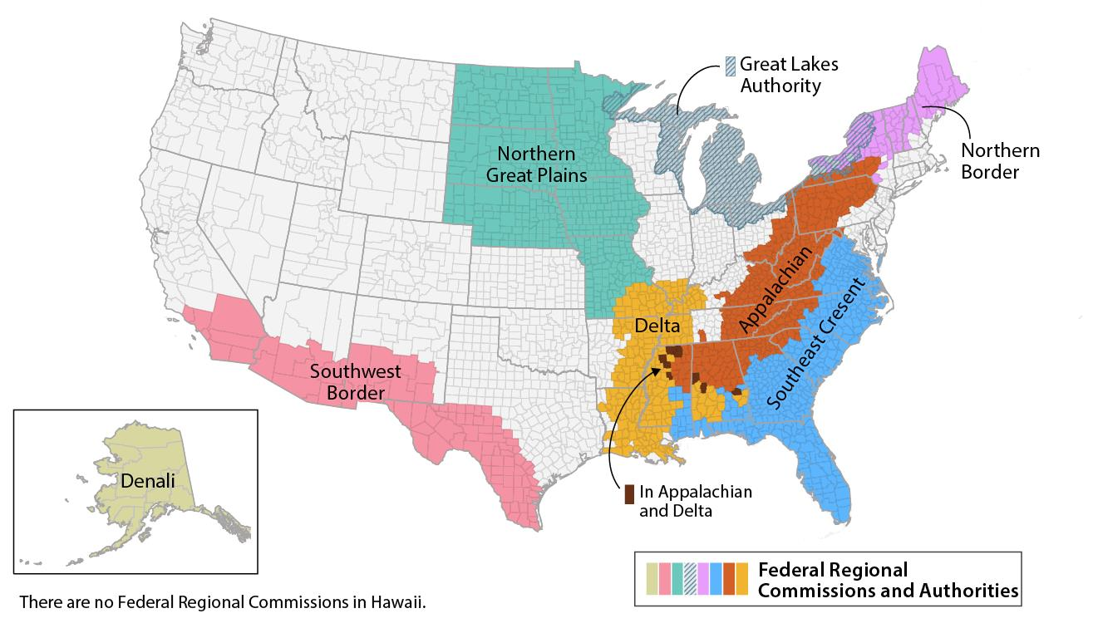
An Independent Federal Regional Commission
Federal-state partnerships that seek to address economic distress in the regions they serve.
May use congressional appropriations, state contributions, or other funding sources for grants.
Notes:
How many have heard or interacted with your Commission?
Based off existing blueprint –
Only state-based regional commission

Slide 5
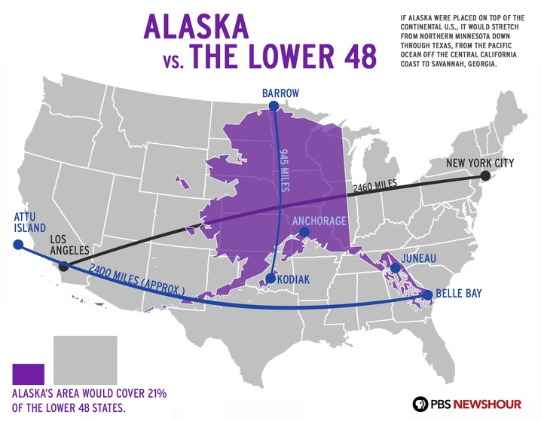
Across the State, there are:
733,000 Population
144 Cities
19 Boroughs
229 Federally Recognized Tribes
1 Federally Incorporated Reservation
Regional, local, and tribal governments and regional tribal non-profits
Notes:
Why only one Commission in Alaska? Geography we cover

Slide 6
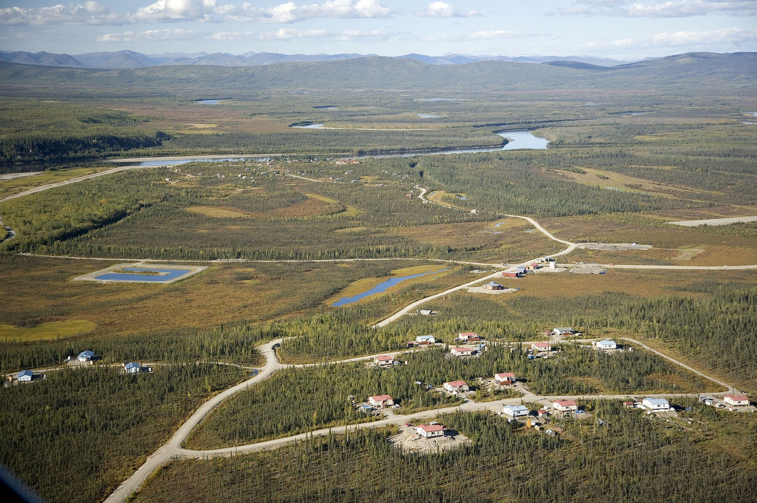
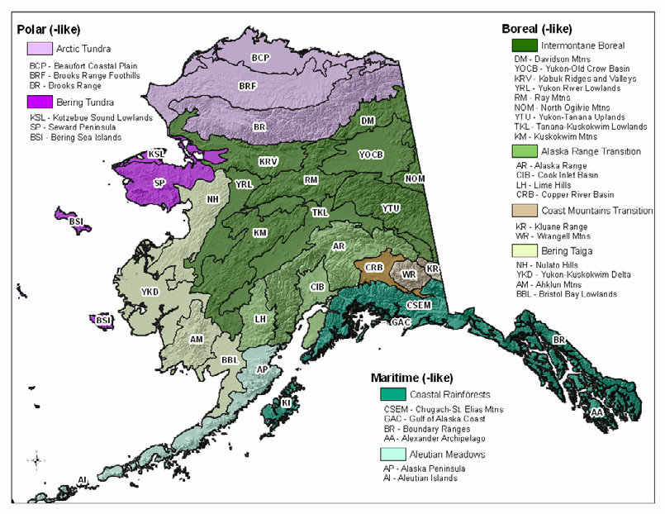
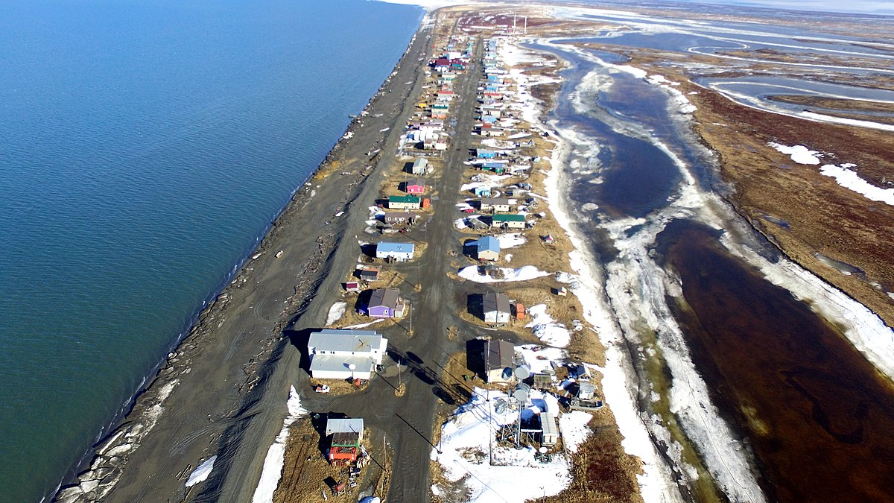
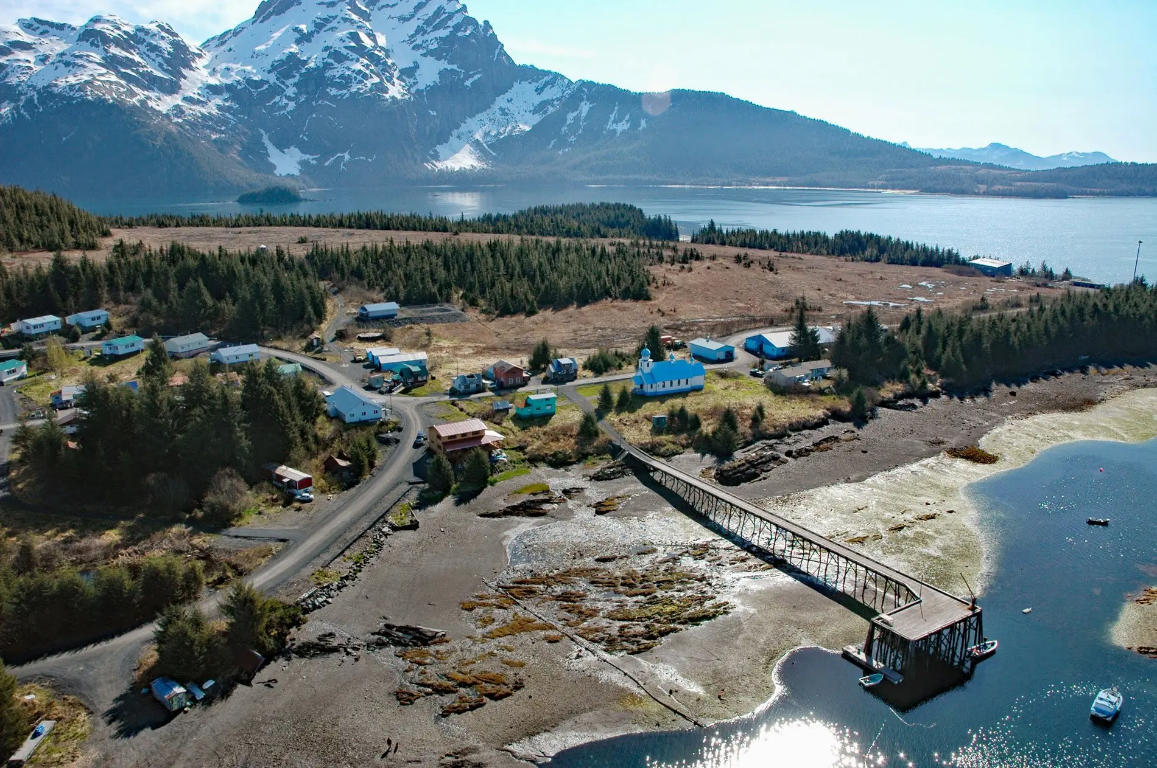
Allakaket
Shaktoolik
Diversity of Landscape
Tatitlek
Notes:
Climate diversity

Slide 7
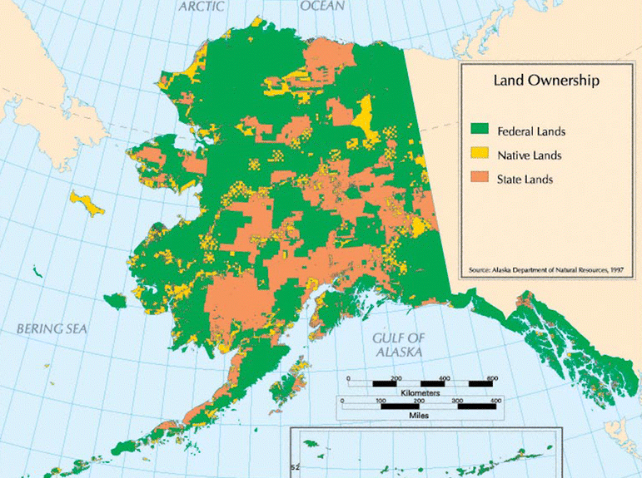
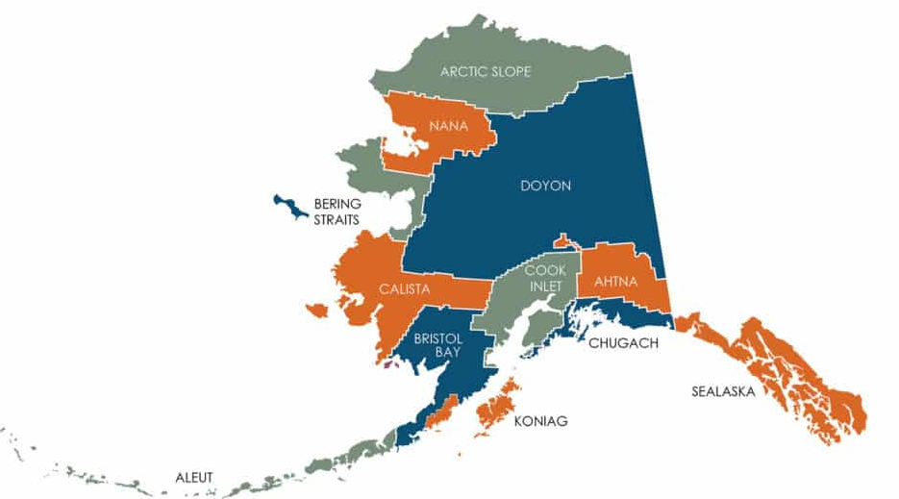
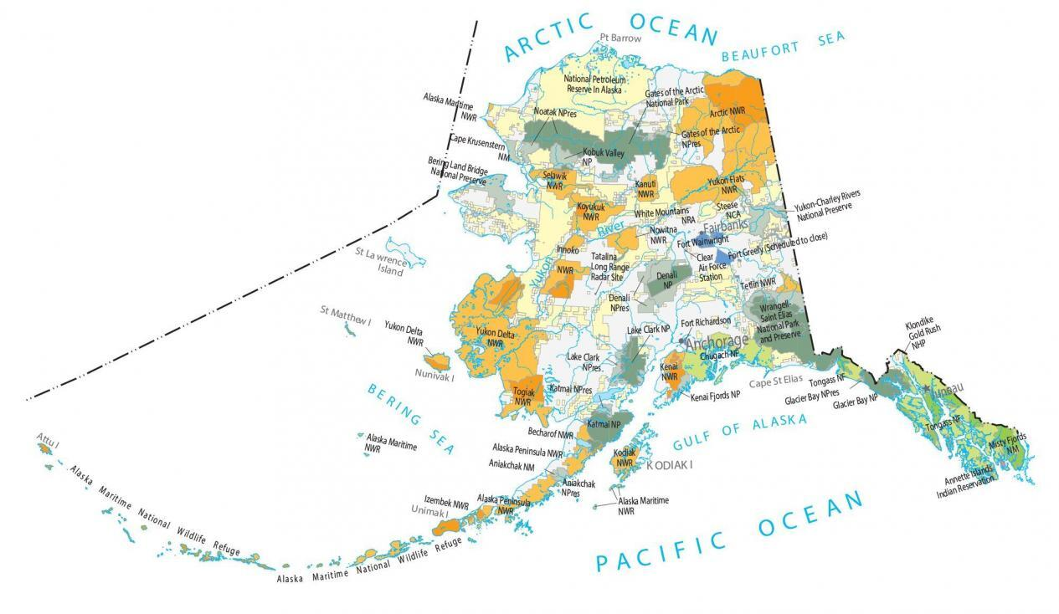
Geography of Alaska Native Communities
Land Ownership
ANSCA Regional Corporations
Federal And Management Agencies

Slide 8
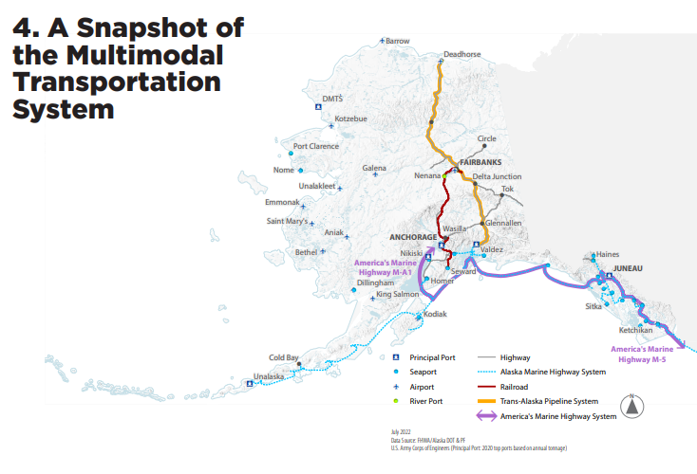
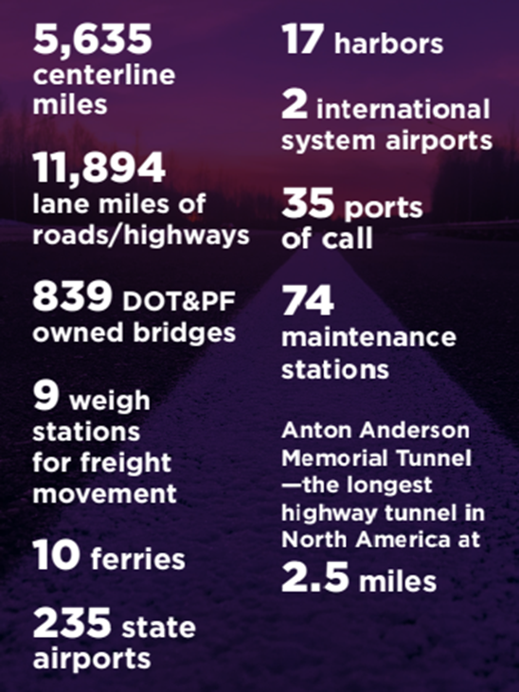
Transportation Infrastructure in Alaska
Source: AKDOT&PF LRTP
Notes:
Existing Assets

Slide 9
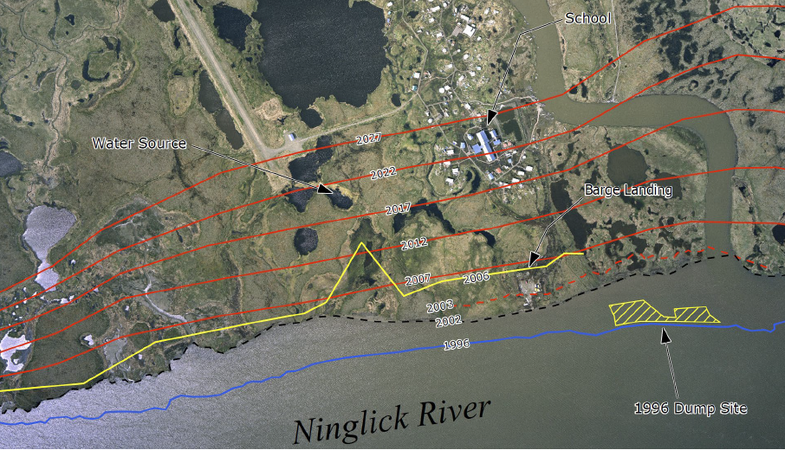
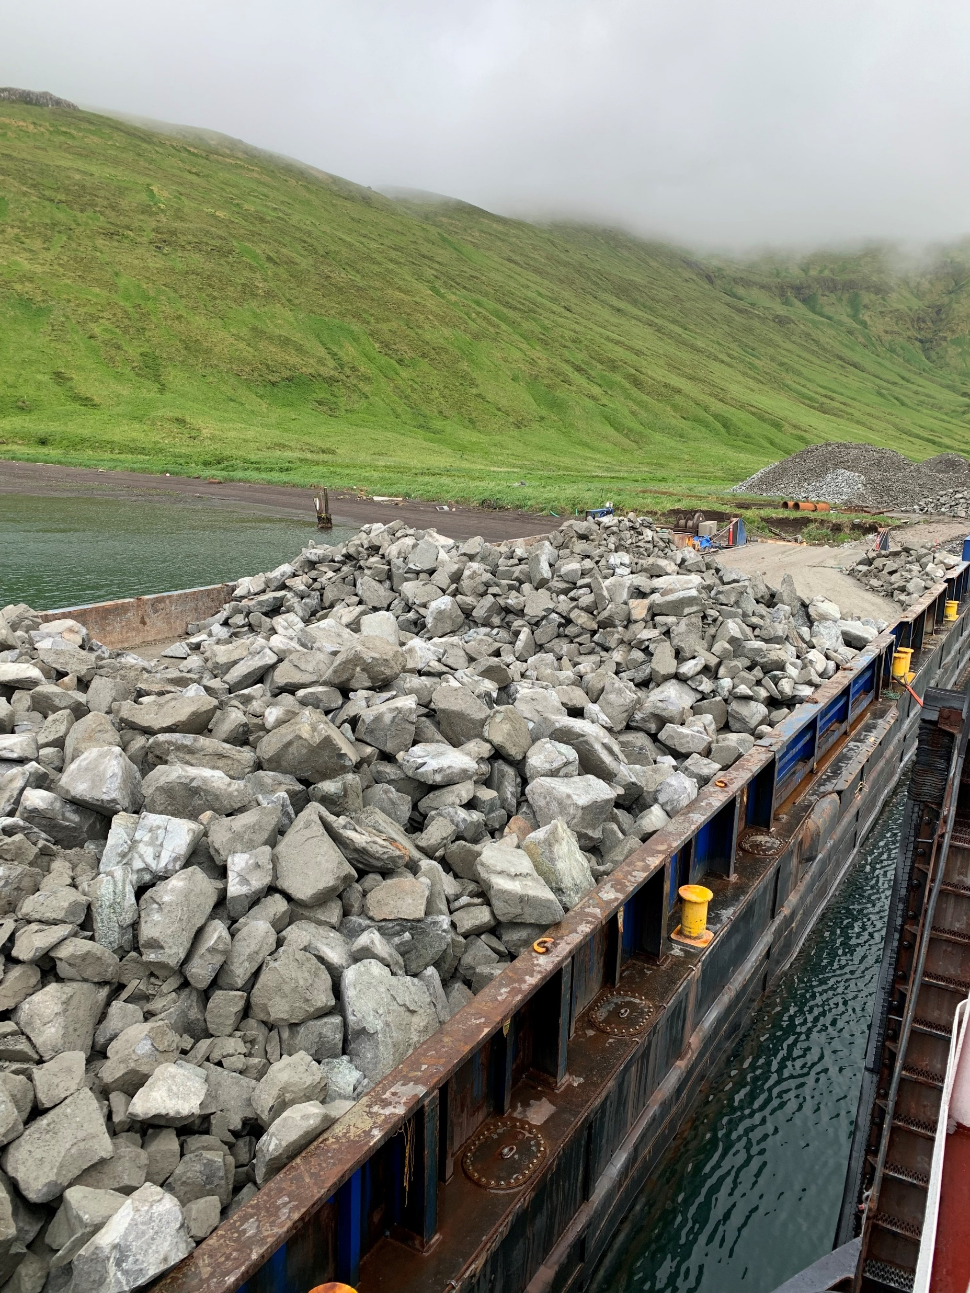
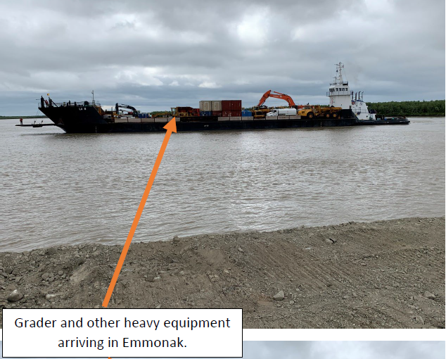
Rural Transportation Project Considerations
Weather and Changing Climate
Geography
Short construction window
Ice-free travel and barging
Gravel Resources and equipment
Local workforce and other projects
High costs
Who pays?
Who maintains?
Notes:
Factors

Slide 10
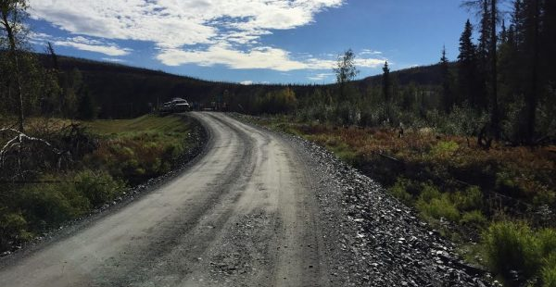
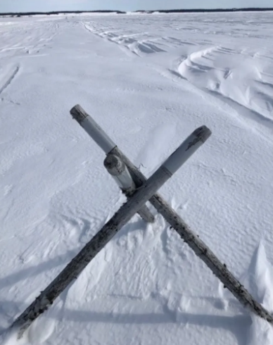
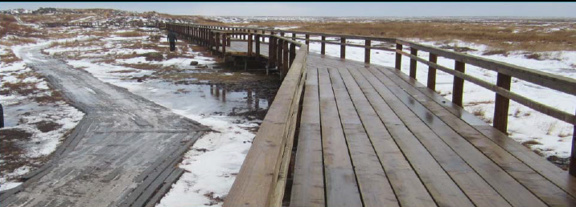
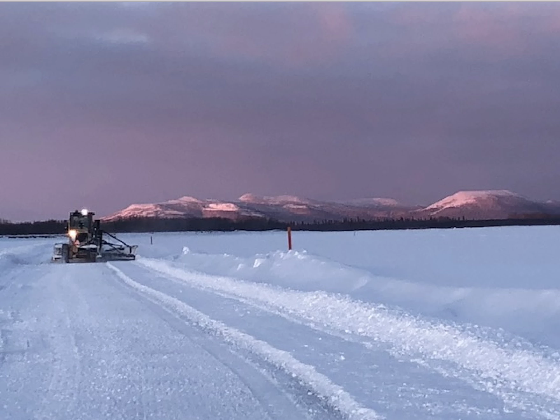
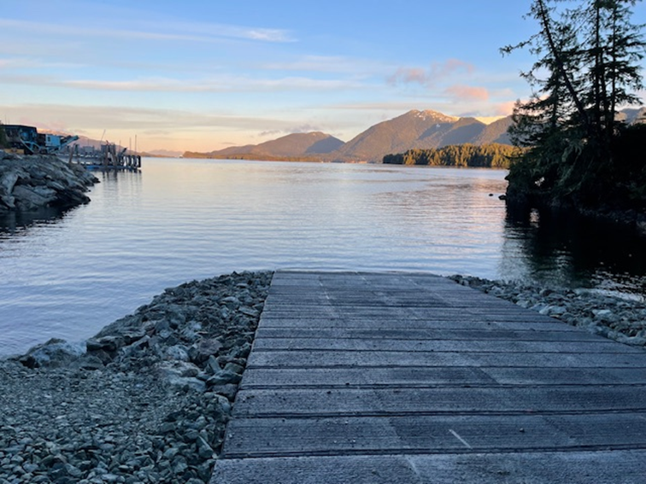
Variety of Solutions
Air Travel
Gravel roads
Waterfront improvements
Seasonal uses
Ice roads
Winter and snowmachine trails
ATV Routes

Slide 11
Commission’s Role & Investments
Programs
Investments
$1.7 billion invested in over 230 communities over 25 years – In form of Grants
Needs-based priority lists and competitive funding opportunities
Complement, but not duplicate the work of other Federal and State agencies
Includes maintaining, sustaining, and protecting existing infrastructure
Partnerships to leverage or unlock future funding
Energy
Health Facilities
Transportation
Village Infrastructure Protection
Sanitation and Solid Waste
Workforce& Economic Development
Broadband
Housing, Health, & Wellness

Slide 12
Special Tools
Transfer and Gift Authority
Authority to accept funds from non-federal and federal sources
Registers funds as expended, eliminating risk of “sweep-back”
Becomes Commission funds with statutory flexibility
Non-Federal Cost Share Match
Ability to match funds with other federal agencies
Acts like private or state funds
No-Year Funds
Does not expire at end of fiscal year
Allows for long-term capital “banking”

Slide 13
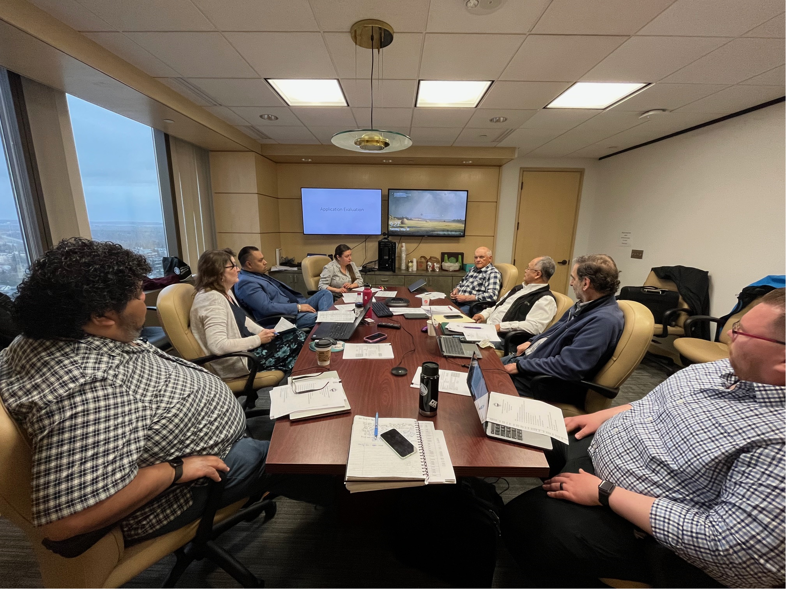
Denali Access System Program
Transportation Program covers Surface & Waterfront
Funded >$125 Million in FY2006 – 2017
USDOT, FHWA, FTA, BIA, MARAD w/$400 Million match
Over 112 surface projects, 124 waterfront projects, 140+ communities
Transportation Advisory Committee
Stipulated by Statute, represent regions
Appointed by the Governor of Alaska
Advise on transportation needs of rural communities
Provide project recommendations and priorities
Notes:
Overview of Transportation Program Specifics

Slide 14
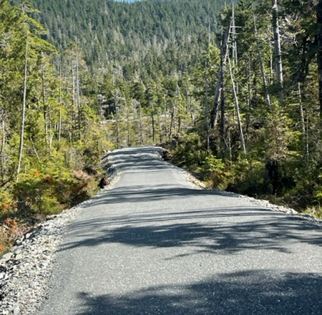
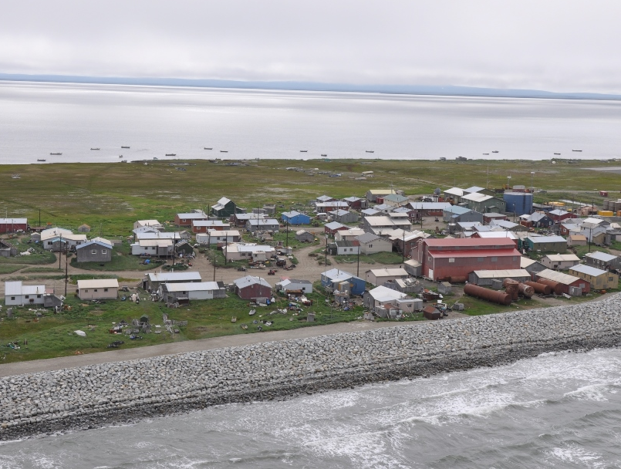
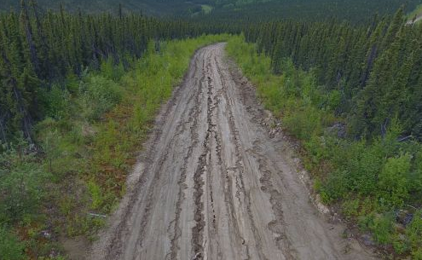
Surface Transportation
Project Examples
Improvements to community roads and streets
ATV board roads and boardwalks
Trails
Bridge rehabilitation, drainage and/or drainage structure development or improvement
Shishmaref Sanitation Road Erosion Control
Native Village of Shishmaref
Cross Trail Connector
Sitka Trail Works
Ruby Slough Road
Native Village of Ruby
Photo Courtesy of DCCED
Photo Courtesy of Sitka Trail Works.
Photo Courtesy of DOT&PF.
Notes:
Repair and Maintenance of 1.7 mile boardwalk and ATV Trail in Tununak that connects Tununak to Toksook Bay with geoblocks.
Program Partners – Federal Highway Administration, Bureau of Indian Affairs, Alaska Department of Transportation and Public Facilities, The united States Corps of Engineers.

Slide 15
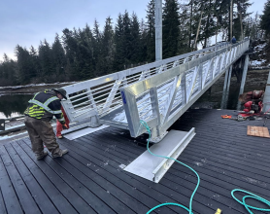
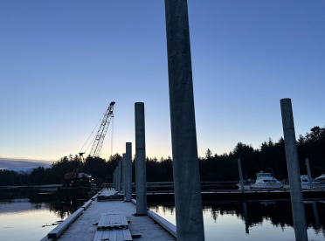
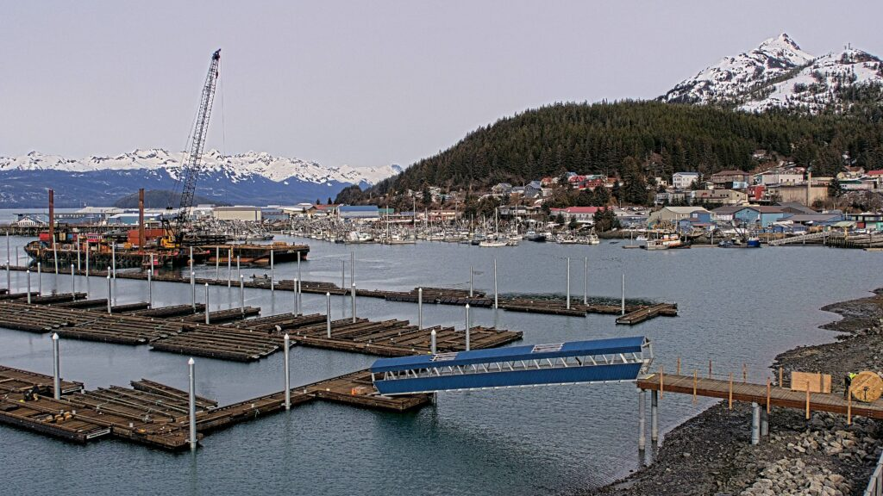
Annette Bay Emergency Boat Launch
Metlakatla Indian Community
Angoon Harbor Reconstruction
City of Angoon
Waterfront Transportation
Project Examples
Small Ports and Harbors
Community Docks
Barge Landings
Photo Courtesy of MIC.
South Harbor Reconstruction Project
City of Cordova
Photos Courtesy of City of Angoon.
Photo from City of Cordova.
Notes:
Repair and Maintenance of 1.7 mile boardwalk and ATV Trail in Tununak that connects Tununak to Toksook Bay with geoblocks.
Program Partners – Federal Highway Administration, Bureau of Indian Affairs, Alaska Department of Transportation and Public Facilities, The united States Corps of Engineers.

Slide 16
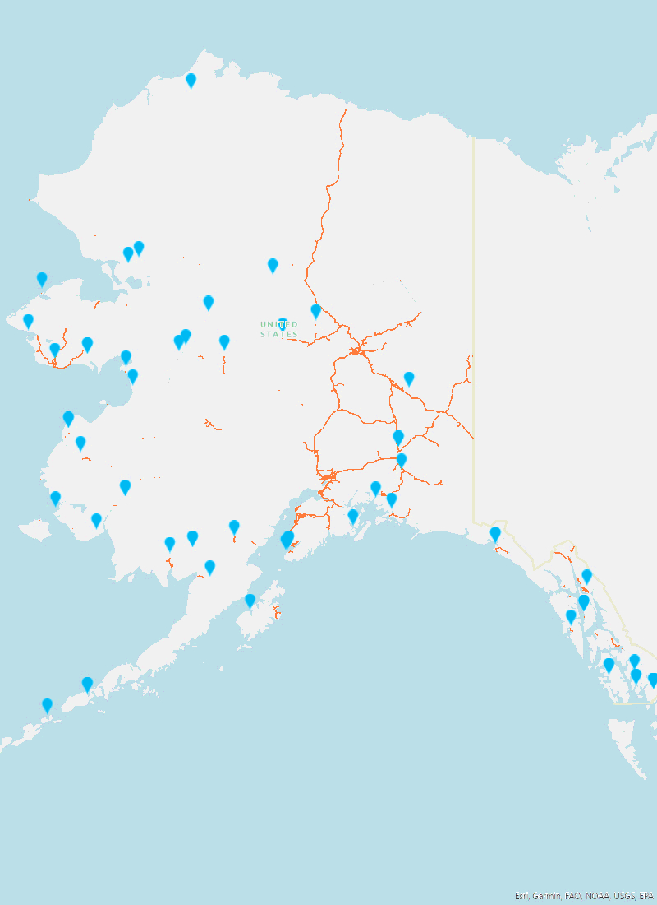
2020-2023 Transportation Projects by Location
Years 2020-2023 Total Transportation Investments
Waterfront | $12,231,549.00
Surface | $20,313,468.00
Total | $32,545,017.00
Notes:
2020-Present Projects
Current status of where these projects are at in award process
Developing resource that can be looked at

Slide 17
Supporting Regional Transportation Challenges

Slide 18
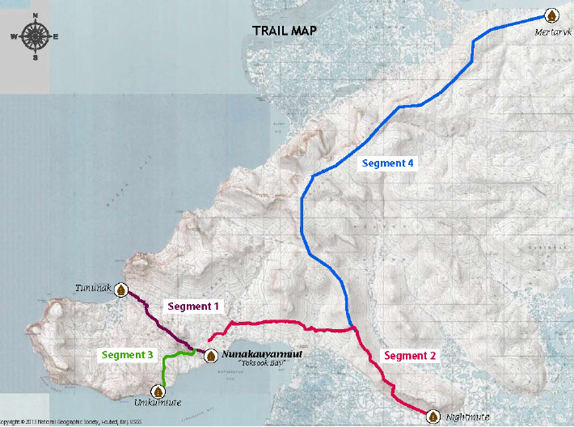
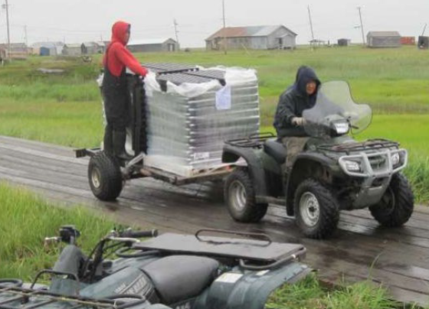
Nelson Island Trail Network
Improve access to public health facilities and emergency response
Regional Connectivity
Preserve Nelson Island tundra ecosystem

Slide 19
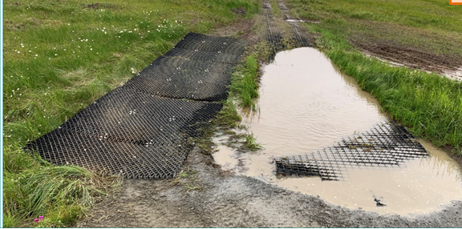
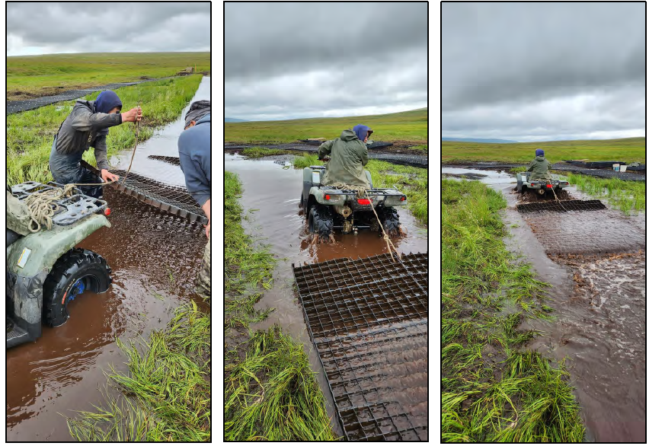
Before
Tununak Boardwalk and ATV Trail Improvements
Native Village of Tununak
After
Repair and Maintenance of 1.7 mile of ATV Trail of the 6-mile connection between Tununak to Toksook Bay with geomats.
Hardened trails, in the case of Alaska’s Yukon-Kuskokwim Delta, are typically made with a plastic surface or treated wood.

Slide 20
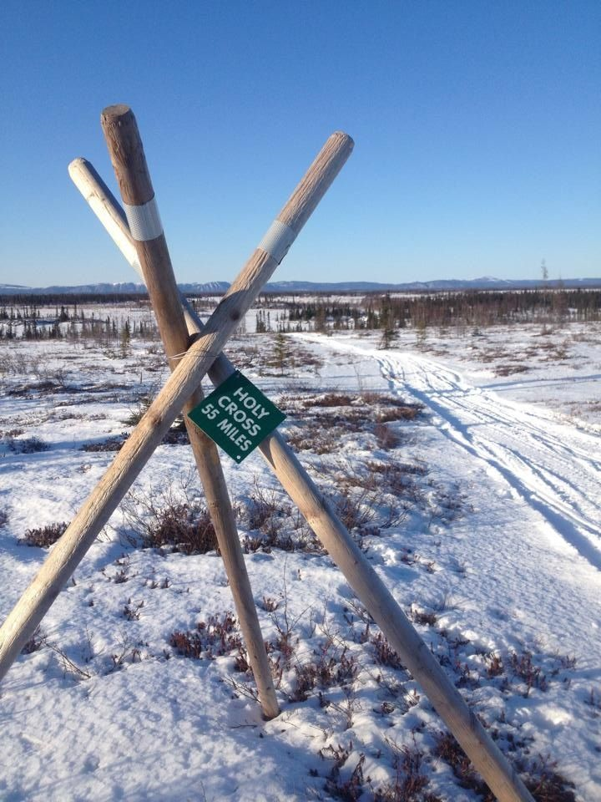
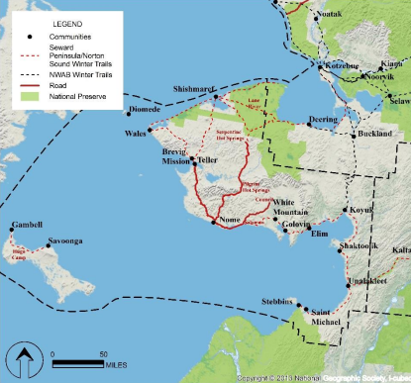
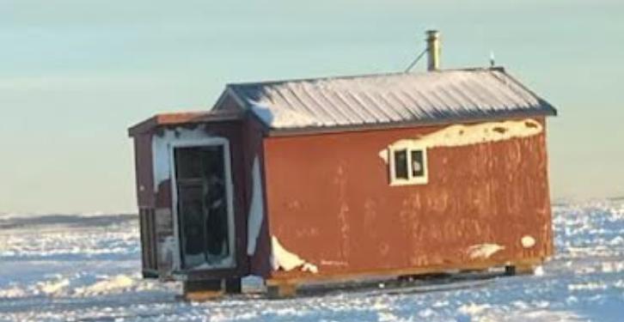
Transportation with Non-Profit Tribal Consortiums
Kawerak serving 17 communities in the Bering Straits Region
Pooled funds for planning, designing, construction and maintenance activities to address transportation needs.
Winter Trail Marking project along Nome-Teller Highway

Slide 21
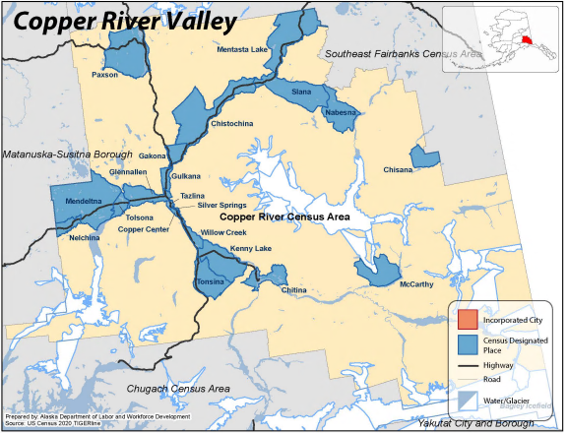
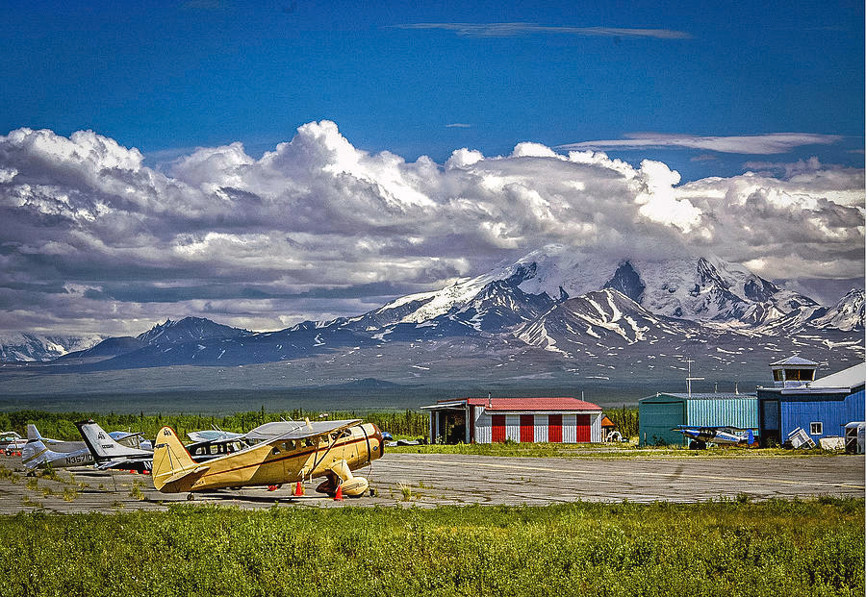
Alaska Copper Valley RPO Pilot Program
Copper Valley Development Association (CVDA), and the Alaska Department of Transportation & Public Facilities (DOT&PF)
Supports and enhances the Statewide planning process
Prioritize transportation projects in their region
Provides a forum for public participation
Insures for the regional and local input
Fostering coordination of local planning, land use, and economic development plans at state, regional, and local levels
Cooperating on the development of the Statewide Transportation Plan, and development of the STIP

Slide 22
Annual Unified Funding Opportunity
Denali Commission Programs
Energy
Rural projects and workforce/economic development programs to encourage infrastructure development in Rural Alaska
Funding Purpose
Health Facilities
Transportation
$35.8 Million - All Programs
$4.5 Million Waterfront Program
$13.5 Million Surface Program
Amount
Village Infrastructure Protection
Sanitation and Solid Waste
April 12, 2024
Workforce& Economic Development
Deadline
Broadband
Housing, Health, & Wellness
Notes:
Planning, maintenance and improvements, gap funding, funding to meet non-federal match requirements

Slide 23
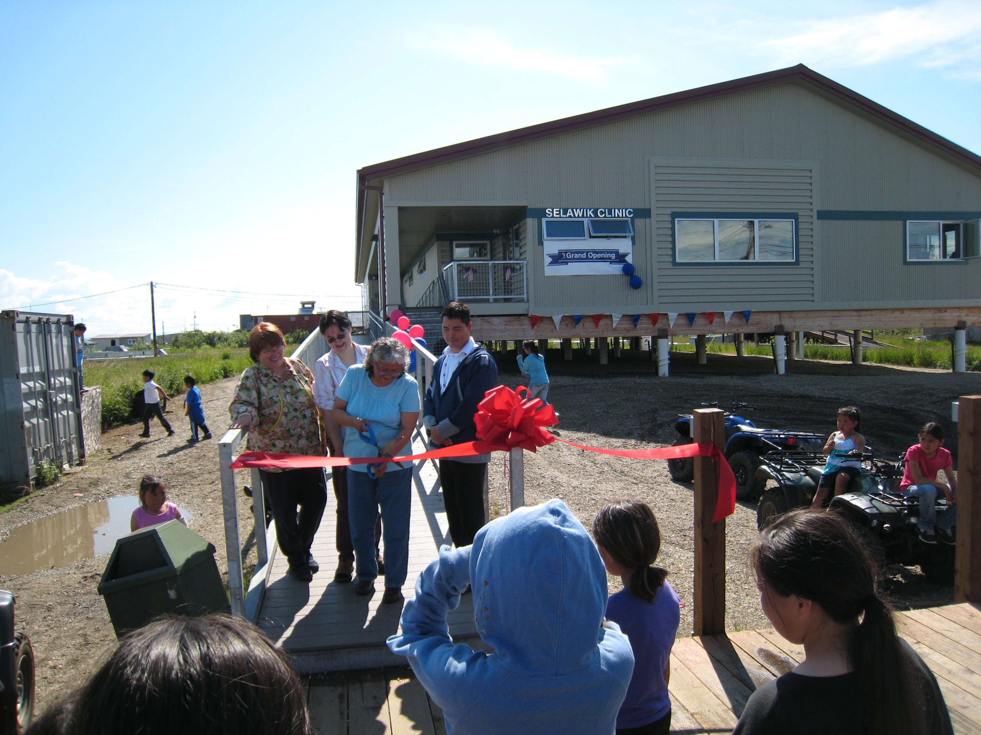
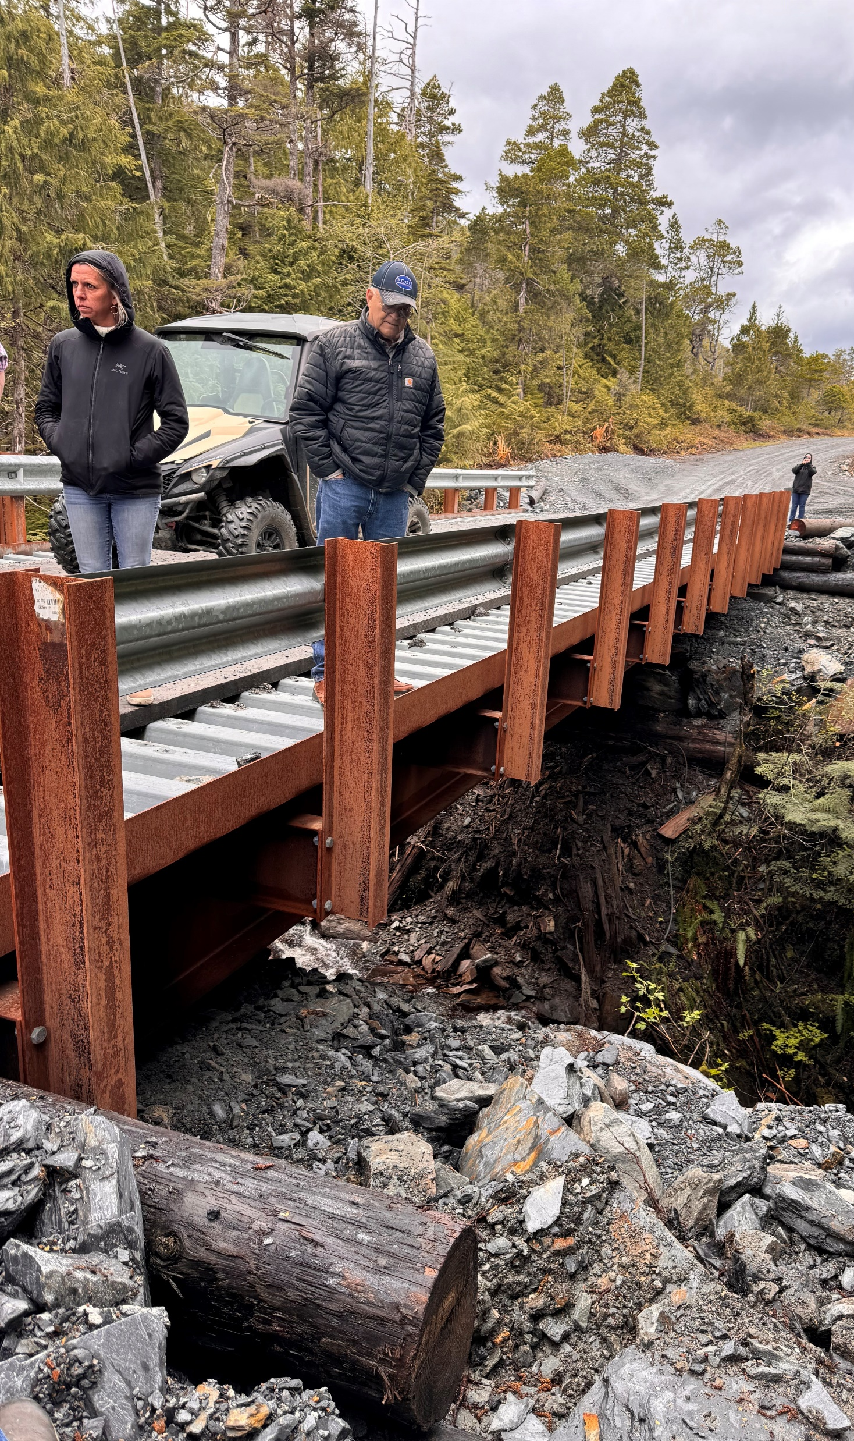
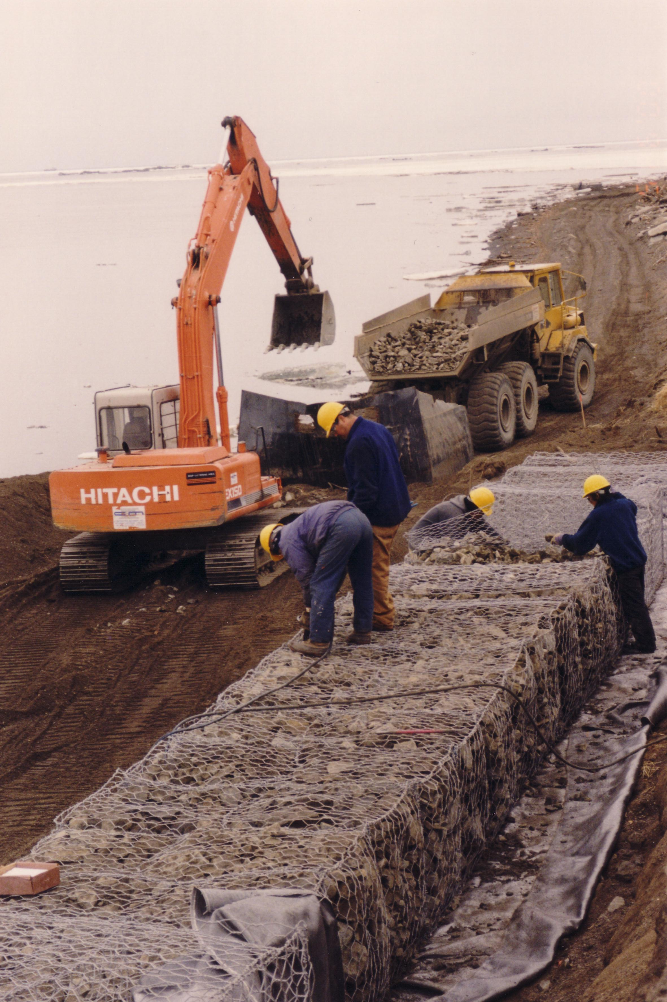
In Wraps
Rely on needs-based priority lists and competitive annual funding opportunity
Complement, not duplicate the work of other Federal and State agencies
Authority to accept funds from non-federal and federal sources
Ability to match funds with other federal agencies as non-federal cost-share match
Serve to maintain, sustain, and protect existing infrastructure while supporting workforce/economic development
Continue to build and maintain partnerships with Federal, State, Tribal Consortiums, ARDORs, and Local Tribes/Cities

Slide 24
Thank you Nikki Navio nnavio@denali.gov 907-271-1413

