Slide 1
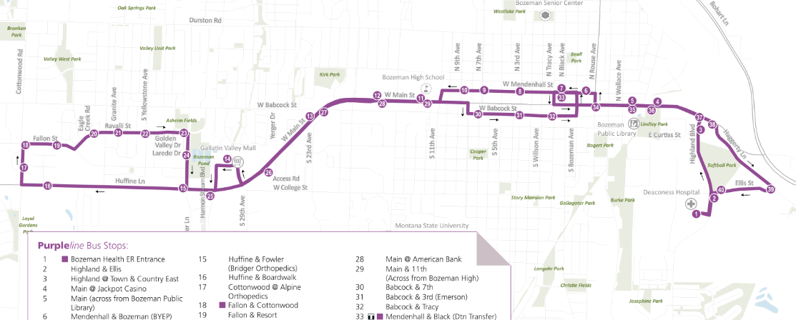
OMGTFS!
Trip Planning for Rural Fixed Route Providers
July 31, 2024
Notes:
1
*pre apology/ disclosure: there is a lot of talk about google and google products in this presentation, this isn’t intended as an endorsement but merely a reflection of the most popular platform for user interaction. Also – memes ahead.
Disclosure #2: Why am I presenting this to you? I think RDO staff (and especially those with GIS experience or technical excel inclinations are PERFECTLY suited to help transit agencies with this task. And quite honestly if you don’t help them, they may not know where to get the help to meet this requirement.

Slide 2
Quick Review!
GTFS – General Transit Feed Specification
How to get public fixed route transit stop, schedule, and route information to software applications like Google Maps, Bing Maps, Apple Maps, Moovit, TransitApp, and CityMapper.
Required for reporting to NTD starting in reporting year 2023.
Two distinct tasks: Creating data AND updating data.
Notes:
(Or an introduction if this is your first time!)
GTFS are the process and technologies used to get transit route information that riders want – in to commonly used trip planning platforms like Google maps, bing maps, apple maps, etc.
GTFS is required for all NTD reporters (FTA chapter 53 funding recipients) who operate fixed route services, not required for any other route types (as there is really no way to ‘map’ them.)

Slide 3
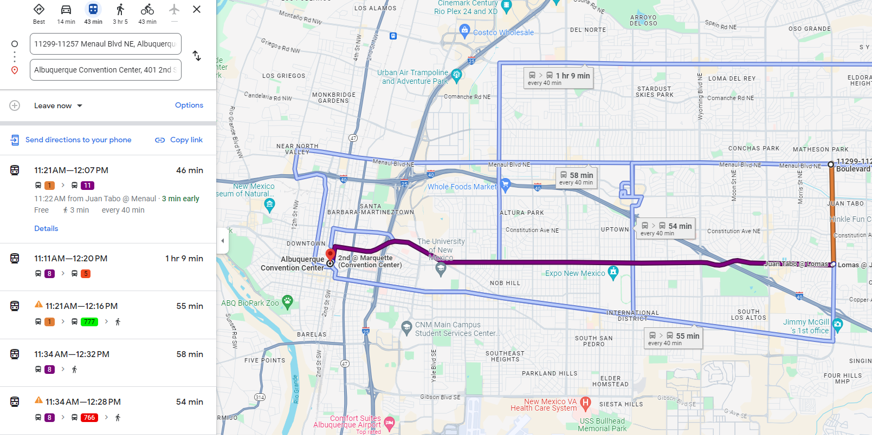
What Is It?
Notes:
**Cut to live map demo.**
https://www.google.com/maps/dir/44.9283655,-93.2394575/44.9814631,-93.279479/@44.9514166,-93.2909034,12414m/data=!3m2!1e3!4b1!4m2!4m1!3e3?entry=ttu

Slide 4
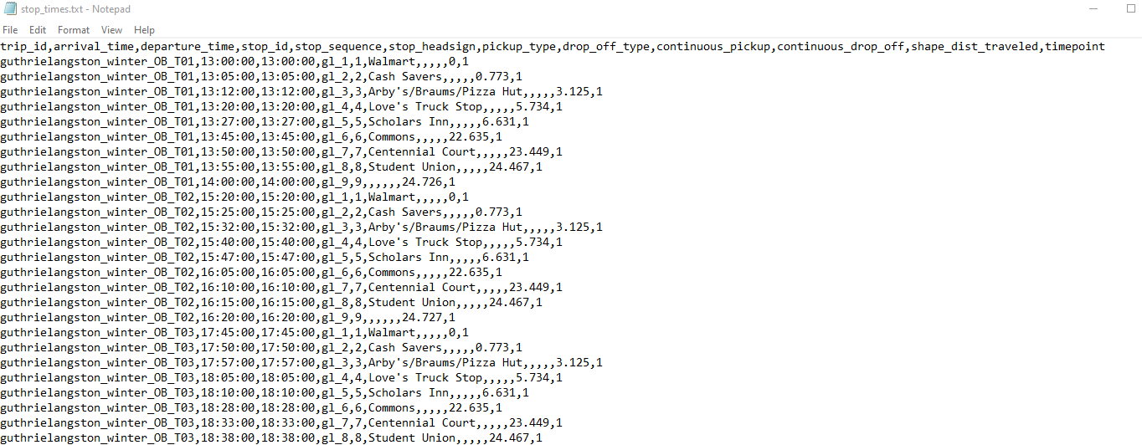
What Is It?
A data standard first developed in partnership with TriMet (Portland, Ore.) and Google in 2005.
Is made up of seven comma delimited text files; agency, stops, routes, trips, stop times, calendar, and calendar dates.
Notes:
GTFS is made up of seven text files, there are several others that are optional if users have corresponding data like fare rules, fare attributes, areas, transfers, pathways, booking rules, etc.
Why text files? They are universally readable and creatable by any almost any computer and aren’t dependent on specific software packages.
How you create the text files needed is where the fun starts!....
The final text files must be compressed in to a .zip file, and hosted on a publicly available website – where a link to the files can be followed. (This public link is where the route planning platforms will consume the data for inclusion in their software.)

Slide 5
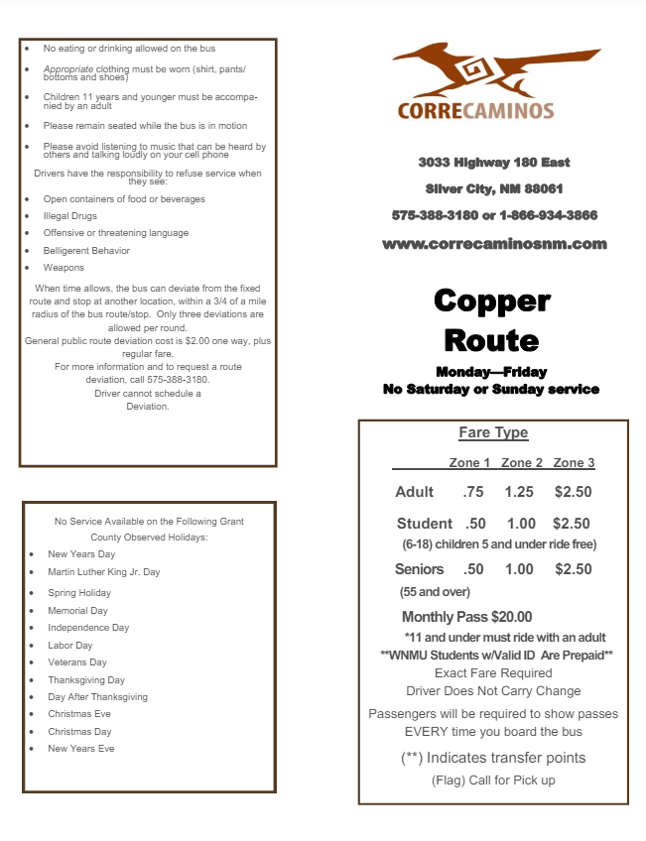
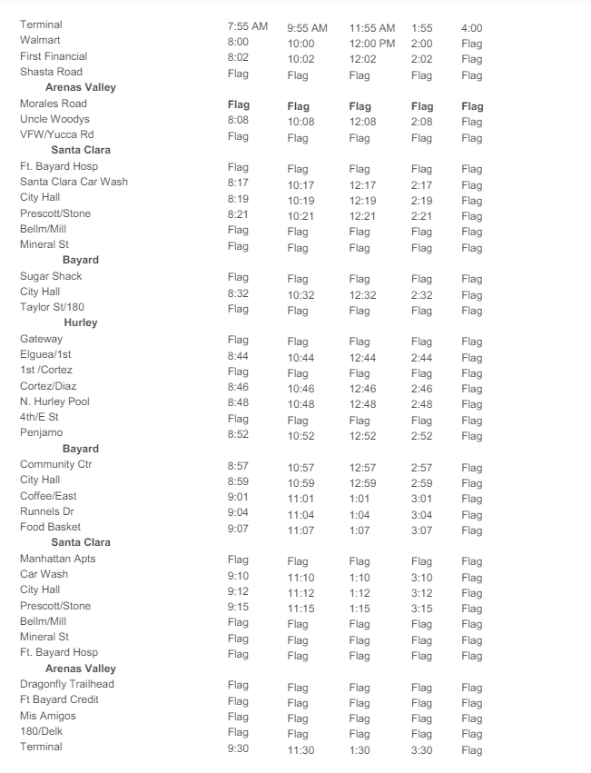
What Is It?
Stops
Stop Times
Agency Info.
Route
Trips
Fare Info.
Calendar
Notes:
This is a flyer for a rural transit system, this type of flyer is commonly distributed to riders, and it has most of the information that you would need to create GTFS data for this particular route.

Slide 6
How To Get It?
Pay someone to do it.
Make it yourself.
Notes:
There’s no shame in letting someone help your or even do it for you if you have the resources. There is a large support community out there and they can get you going as quickly as you can afford, ha.
Guess which one we are going to do?

Slide 7
How To Make It?
National RTAP GTFS Builder
https://www.nationalrtap.org/Technology-Tools/GTFS-Builder
Notes:
Make friends with National RTAP!
They have a GTFS guidebook. **Show the guidebook**
GTFS Builder Spreadsheet (macro enabled)
Video library showing each step in the builder process **Show the video page.**
Office hours for live support – Thursdays 1-130pm ET
There are also many other tools out there to help, and organizations who can help as well.

Slide 8
Getting Started
Create a National RTAP Account
Free hosting of completed GTFS data!
https://rapid.nationalrtap.org/GTFSFileManagement/UserUploadFiles/#####/abcd_gtfs.zip
Google Earth and Google Account for Map Creation
Create a Google Transit Partner Account**
** You may wish to consult with legal counsel during this process.
Notes:
For NTD purposes, they are requesting the link to the hosted GTFS files – which NRTAP can do for free. The link above is just an example of what that link will look like. You will share this link with the trip planning platforms so they can access and consume your data in their software.
The google account creation really doesn’t happen until you’ve got some GTFS data ready for them to evaluate, but I wanted to mention it now in case it was a roadblock for anyone. During the google transit partner account creation process, there is a license agreement that will need to be executed. This has been concerning/confusing for some agencies, proceed accordingly. Your data cannot be on google maps without this agreement.

Slide 9
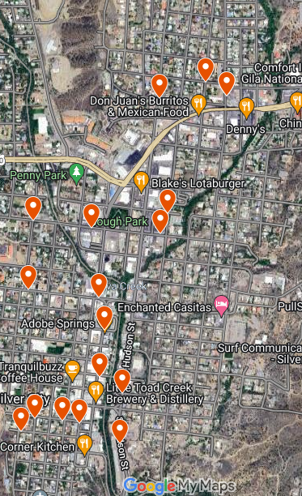
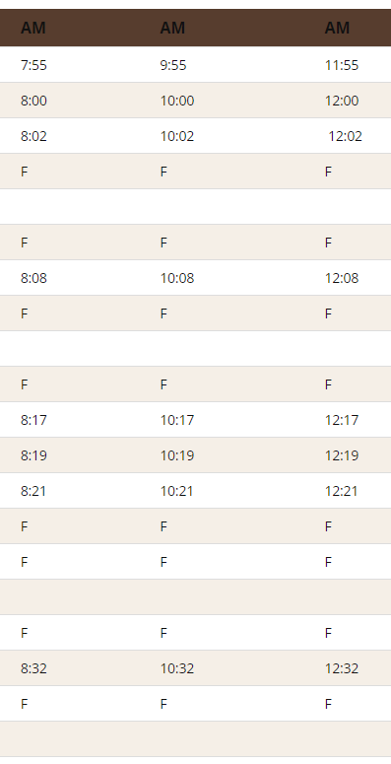
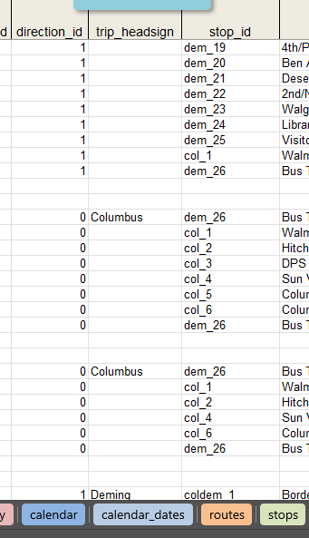
NADO Member Regional Development Organizations
1. Stop Locations
2. Schedule
3. Enter
Notes:
9
**Go to GTFS builder spreadsheet to show the data as entered.**
Entering the information into the GTFS builder sheet can highlight issues you may have missed:
Stop timing issues. (Driver breaks, departure time vs arrival time)
Stop order issues.
Stop naming issues. (There is a level of precision required for the GTFS data entry that isn’t always needed for rider level information, especially in a deviated route mindset. Give White Earth naming examples.)
Boarding status. (ie – can folks board and depart at the ‘terminal’ or ‘garage’, etc.)
Flag stop status.
Other common challenges:
- Route shapes, stop distances from road. (These are both well covered in the GTFS guidebook and videos, be prepared to review them multiple times.)

Slide 10
NADO Member Regional Development Organizations
4. Validate
5. Post
Notes:
10
**Show GTFS validator.**
https://gtfs-validator.mobilitydata.org/
You’ll need to address any ‘errors’ that are identified by the validator before finalizing, ‘warnings’ can be addressed on a case-by-case basis, but often don’t hinder the submission and acceptance of data.
Post: FTA requires a link to the zipped GTFS files for your agency as part of NTD reporting. NRTAP provides free hosting for these files.

Slide 11
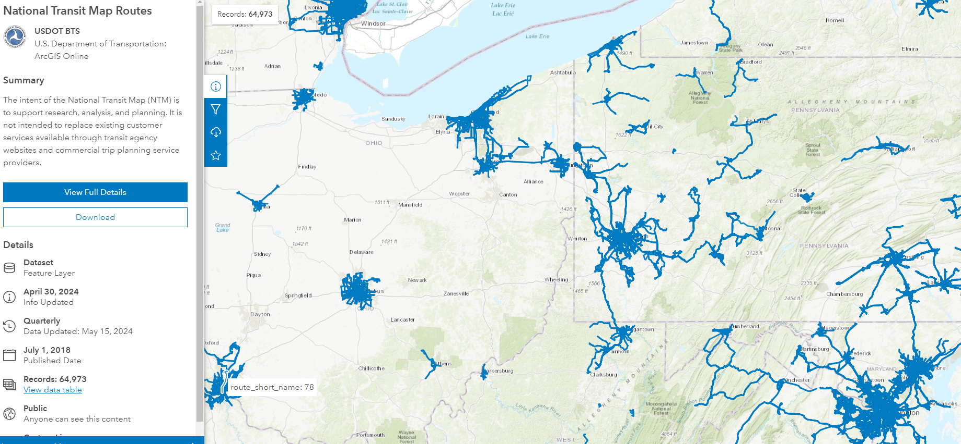
NADO Member Regional Development Organizations
https://www.bts.gov/national-transit-map
Notes:
11
All of this data is cataloged in the national transit map. (Including ESRI services you can consume in your mapping project!)
https://www.bts.gov/national-transit-map
There are over 64,000 routes mapped in this data as of April 2024.

Slide 12
NADO Member Regional Development Organizations
Editing
Service dates
Service times
Add/Delete Stops
Add/Delete Routes
Creating
Image by rawpixel.com on Freepik
Notes:
12
After doing this a few times I’ve learned GTFS feels like this: there is a lot to do to go from nothing to version 1 of your data. Once you get there, you are really just doing maintenance going forward. Bigger changes to your service offerings/service patterns will necessitate bigger changes and edits to your GTFS information. If routes and stops are static/steady, really all you are doing on an annual basis is updating the service calendar (holidays) and times.

Slide 13
NADO Member Regional Development Organizations
By J. Howard Miller - U.S. National Archives and Records Administration, Public Domain, https://commons.wikimedia.org/w/index.php?curid=80242715
Bret Allphin
Senior Program Manager
ballphin@nado.org
Notes:
13
As a regional partner there is a significant level of assistance that you could probably provide to your transit providers who may be struggling with this. I’d encourage you to speak with them to see if they are struggling with this – if so you may be able to save the day!

