Slide 1
Safety Analysis to Develop a High Injury Network
Paul LaFleur, paul.lafleur@dot.gov
July 31, 2024
2024 National Regional Transportation Conference
Notes:
Thanks for having me
Short intro/bio
Here to speak to you today about a portion of an upcoming publication titled Systemic Safety User Guide. This publication is due out any day, in fact it might have been published today.

Slide 2
Disclaimer
Except for any statutes and regulations cited, the contents of this presentation do not have the force and effect of law and are not meant to bind grant recipients in any way. This presentation is intended only to provide information and clarity on existing requirements under the law or agency policies.

Slide 3
Safety Analysis Overview

Slide 4
Safety Analysis Overview
Step 1: Systemic and specific safety needs analysis
High risk road features
Relevant road users
Analysis of the built environment
Demographics
Structural issues
Etc.
Step 2: Develop High-Injury Network (or equivalent)
Based on analysis of higher-risk locations
Notes:
The road safety management process is generally a six-step cycle, consisting of the following (AASHTO, 2010):
Network screening – scanning the transportation system to identify sites with the potential or need for safety improvement.
Diagnosis – reviewing the conditions and crash data at a site or across a system to identify specific safety issues and contributing factors.
Countermeasure selection – identifying possible countermeasures to treat or mitigate the previously-identified safety issues and contributing factors at the site.
Economic appraisal – reviewing the potential economic benefits of the proposed countermeasures at a site.
Project prioritization – comparing estimates of economic, safety, and other data to develop a portfolio of projects that maximizes the benefits of available funding.
Safety effectiveness evaluation – evaluating the safety and economic performance of safety projects, countermeasures, and programs, at specific locations and across the system, to quantify benefits and inform future investments.
Safety management is cyclical, with one step feeding into the next, including evaluation of results feeding back into future cycles
An effective safety management program includes a combination of both reactive and proactive safety projects focused on reducing the frequency of crashes which result in severe injuries, including fatalities.
The reactive component—site-specific—is built from traditional network screening approaches as characterized in Part B of the Highway Safety Manual (HSM). Agencies can be proactive using two approaches – systematic and systemic. A systematic approach to safety involves the installation of a safety countermeasure at all sites system-wide that meet specific criteria.
A systemic approach involves the installation of low- to moderate-cost countermeasures at locations with the highest risk of severe crashes
great for state and regional level
SA leads into HINs, or HIS
This component is to identify where and how to best remediate potential higher-risk locations. In short, your safety analysis of the existing situation is critical to developing your Action Plan.
To the extent practical, Action Plans should include analysis of all roadways within the jurisdiction regardless of ownership. This analysis of existing conditions and historical trends should include crash locations and crash severity, as well as capture crash types by relevant road users such as motorists, people walking, biking, or rolling, transit users, and so on.
A safety analysis should consider if there are data supporting system-wide safety needs and/or specific safety needs such as some of the examples shown here, like, the current built environment, existing high-risk road features, and the specific safety needs of relevant road users, such as vulnerable road users.
Data analysis results are used for a geospatial identification of higher-risk locations, referred to as a High-Injury Network or equivalent.
@Parker, Stephen (FHWA) I think we should define this based on the NOFO first, something like "The Safety Analysis is an Analysis of existing conditions and historical trends that provides a baseline level of crashes involving fatalities and serious injuries across a jurisdiction, locality, Tribe, or region. Includes an analysis of locations where there are crashes and the severity of the crashes, as well as contributing factors and crash types by relevant road users (motorists, people walking, transit users, etc.). It includes analysis of systemic and specific safety needs is also performed, as needed (e.g., high-risk road features, specific safety needs of relevant road users, public health approaches, analysis of the built environment, demographic, and structural issues, etc.). To the extent practical, the analysis should include all roadways within the jurisdiction, without regard for ownership. Based on the analysis performed, a geospatial identification of higher-risk locations is developed (a High Injury Network or equivalent)." Then the script could continue with the points you've suggested (editing for any redundancies).
Since this is a webinar, I’ve tried to summarize in the Speaker Notes instead of reading verbatim from the NOFO.

Slide 5
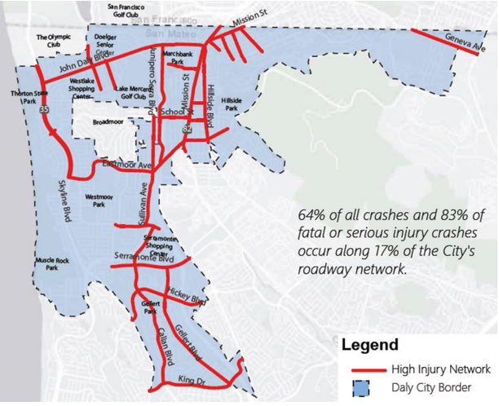
What is a HIN?
Data about-
Locations
Demographics
Crash factors
Speed
Left turns
Lack of Complete Streets facilities
Etc.
Data may reside with:
State DOT
Department of Public Safety
Department of Motor Vehicles
(Credit: City of Daly City, San Mateo County, CA)
“Lessons Learned from Development of Vision Zero Action Plans” (FHWA)
Notes:
Feeds into an LRSP, we have a DIY site for this FYI
Simply put, a High Injury Network identifies the highest concentration of traffic crashes resulting in serious injuries and fatalities within a given roadway network or jurisdiction . It is a tool that can help focus limited resources in problem areas.
Crash data, complemented or overlayed with demographic data, can inform next steps.
As Recipients develop an Action Plan, they should consider limiting the data to crashes that resulted in fatality or serious injury for a 5-year annual average. Limiting the analysis to killed or seriously injured crashes helps identify the conditions that lead to the most severe crashes.
However, some jurisdictions may not have robust data; but, that should not inhibit the development of a successful Action Plan. Agencies can use auxiliary data, such as traffic citations, census data, public health records and public input. As an example of public input, one locality posted an interactive map of their community online and allowed residents to comment.
Local agencies can also use free mapping software, such as Google Maps and Google Fusion Tables, to perform spatial analysis and generate heat maps. Agencies can use this software to perform quick visual inspections of conditions under which crashes occur. The results of these inspections can inform more detailed analysis and investigation.
Where data sets are more robust, advanced analytics such as spatial representation of crashes, and coding roadway characteristics - for example, tracking whether the pavement was wet or dry or whether the sky was light or dark at the time of a crash - can inform the Action Plan.
Suggest we keep to the language of the NOFO for this.

Slide 6
HIN Development

Slide 7
Identify Focus Areas and Risk Factors
Data Elements to consider:
Crash severity
Manner of collision
First harmful event
Speed-related
Alcohol involvement
Drug involvement
Light conditions
Sequence of events
Data Elements to consider:
Segment vs intersection.
Geometry.
Traffic control.
Number of lanes.
Median type.
Area type.
Functional class.
Risk factor data can include:
Infrastructure characteristics
Operational data
Asset management data
Community and contextual data
Socioeconomic data
Crash data
Notes:
The first step of the systemic safety process is to identify focus crash types, focus facility types, and risk factors.
Key changes from the original code include explicit descriptions of multiple methods to performing each task as well as examples of each approach.
Focus Crash Types: Systemic safety analysis begins with the selection of the focus crash type(s). Focus crash types are typically those that represent the highest frequency of severe crashes or highest potential of a severe crash on the system.
Focus Facility Types: Once an agency has identified focus crash types, it is important to identify where those crashes are occurring. The focus facility type will be whittled down from the whole network. Consider starting generally, looking at area type (rural or urban), then facility type (segment or intersection), followed by more detailed characteristics, such as number of lanes, functional class, geometry, and traffic control.
Risk Factors: Task 3 identifies the factors most associated with an increased risk of a severe focus crash type on a focus facility type.

Slide 8
Screen & Prioritize Candidate Locations
Segment ID | Route Number | Segment Start | Segment End | Length (mi) | Average Daily Traffic [ADT] (veh/day) | Speed Limit | ADT Rural Single-Vehicle | ADT Rural Multi-Vehicle | Access Density | Curve Density | Edge Risk | Total Risk Score
17.002 | 17 | Vergas Corp Lmts | Becker County Line | 6.2 | 1,550 | ★ | ★ | ★ | ★ | ★ |  | ★★★★★
24.005 | 24 | Erhard Corp Lmts | CSAH 3 | 4.8 | 535 | ★ | ★ |  | ★ | ★ | ★ | ★★★★★
3.001 | 3 | CSAH 10 | CSAH 24 | 8.4 | 530 | ★ | ★ |  | ★ | ★ | ★ | ★★★★★
35.001 | 35 | US Trunk Highway (USTH) 59 | CSAH 82 | 5.8 | 560 | ★ | ★ |  | ★ | ★ | ★ | ★★★★★
35.005 | 35 | Underwood Corp Lmts | CSAH 1 | 6.0 | 1,070 | ★ | ★ |  | ★ | ★ | ★ | ★★★★★
Notes:
Chapter 2 details the second step of the systemic safety process; the objective of this step is to use risk to develop a prioritized list of sites for systemic safety improvements. The process includes identifying the network elements which will be analyzed, assigning a risk score to those elements, and prioritizing the elements based on the total risk scores.
Key updates include clarifying the various approaches to calculating risk, normalizing risk scores across different scoring approaches, and examples of various applications.
After completing the tasks of this chapter, agencies should have the following:
A list, map, or other set of network element data.
Calculated risk scores for each network element.
A prioritized order of network elements.
A core component of the Chapter 2 task includes the prioritization of network elements.
The task begins with a simple ranking—rank the network elements from highest risk score to lowest. Agencies can set thresholds for priority elements to help focus on a manageable number of sites or miles.
The table on the slide shows a Prioritization table for rural segments in Otter Tail County, Minnesota (Otter Tail County, 2021).

Slide 9
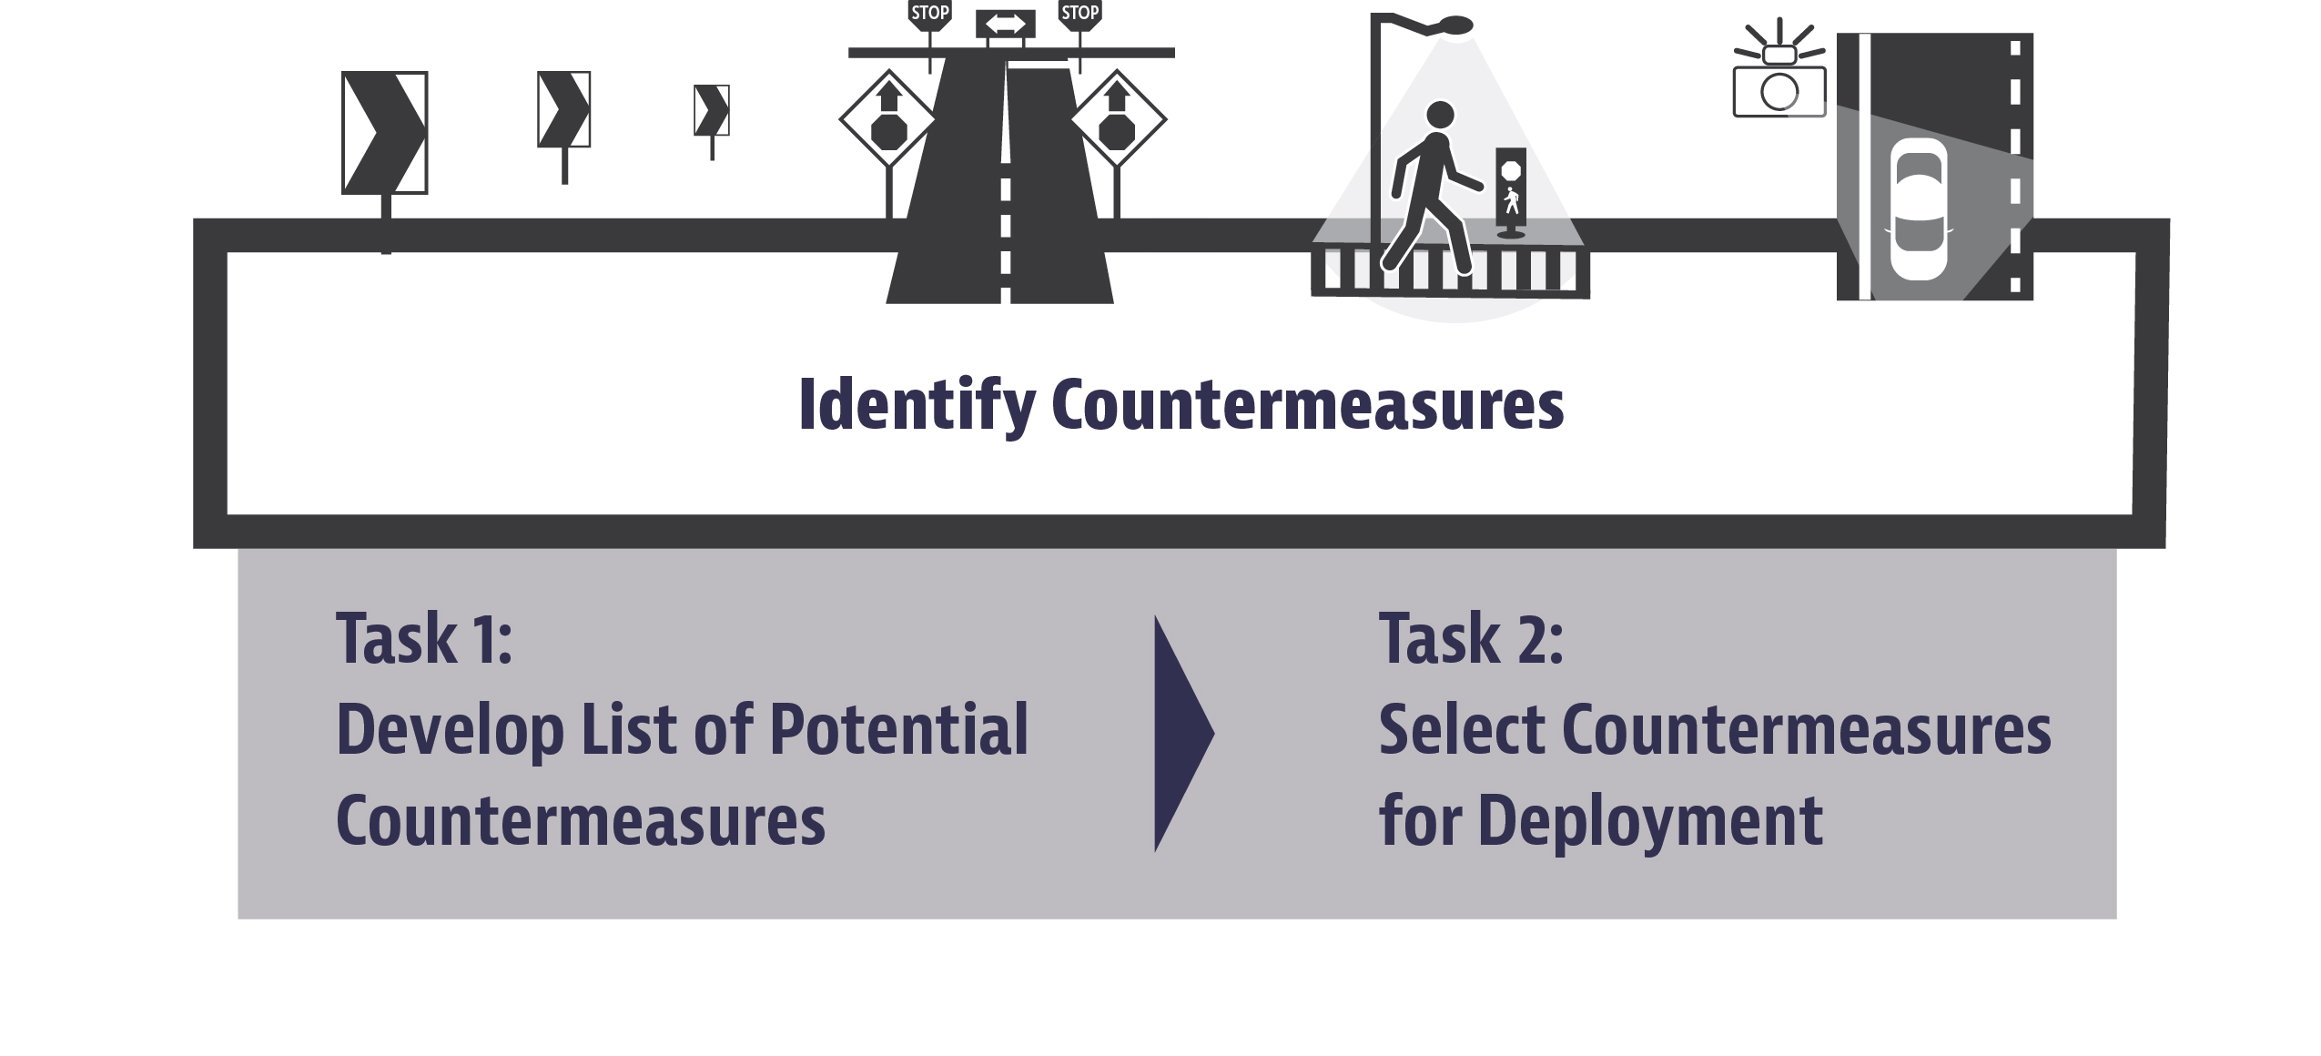
What comes next?
Evaluate Systemic Safety Results
Deliver Systemic Projects
HSIP Evaluation Guide
Project Delivery Mechanisms
Levels of Evaluation
Project-Level
Countermeasure-Level
Program-Level
Project Tracking
Plan Development
Using Evaluation Results
Improve future systemic safety efforts
Increase agency and stakeholder support
Motivate maintenance staff
Notes:
After you have created an HIN, the next steps to take this to a safety action plan are:
ID and select CM
Prioritize systemic projects
Deliver systemic projoects
Evaluate safety results

Slide 10
Case Studies

Slide 11
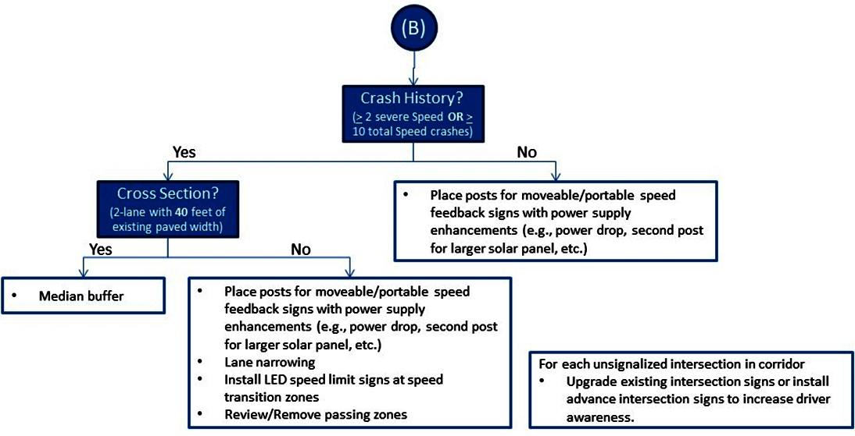
Thurston County, Washington
Notes:
The cases studies included in the Guide showcase and highlight key takeaways in systemic safety analysis. Highlighted here and on the following slides are selected key takeaways from the Guide.
Thurston County, Washington: The Washington State DOT (WSDOT) operates a County Safety Program as part of its HSIP . For counties to be eligible for funding under this program, they must document their safety issues through an LRSP . Thurston County has published several of these plans—the most recent, titled the Thurston County Transportation Safety Plan, published in 2018 and updated in 2021 . The County used systemic safety analysis to identify focus crash types, focus facility types, and risk factors to guide their safety plan. Graphic is Thurston County’s decision tree for systemic speeding countermeasure selection.
Objective
The objective of the safety plan is to achieve progress towards Washington’s vision of zero deaths and serious injuries by 2030. Per Thurston County: “The goal of the safety plan is to identify safety projects and partnerships to continue lowering deaths and serious injuries in Thurston County.”
Key takeaways from this case study include:
Systemic safety analysis is a valuable resource for supporting LRSPs.
Focus facility types can range from general (rural curves) to specific (urban streets with 35 mph speed limits).
Agencies do not need a lot of risk factors in order to conduct a systemic analysis.
Crash data can be used to refine systemic project prioritization either as part of the risk factor analysis (as a risk factor) or afterwards (this case).
Stakeholder input is valuable to refine the potential countermeasure list.

Slide 12
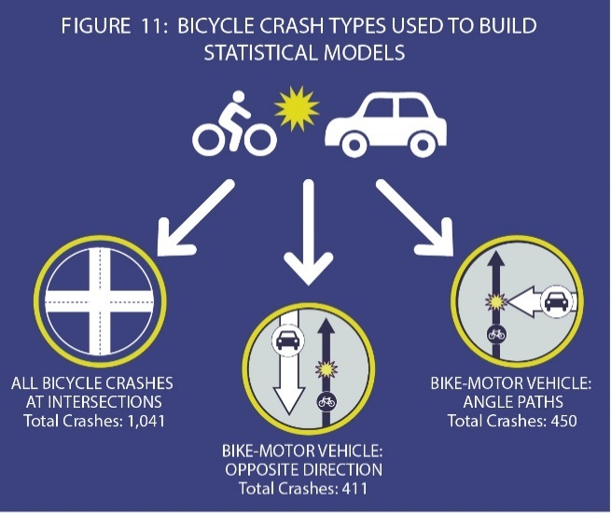
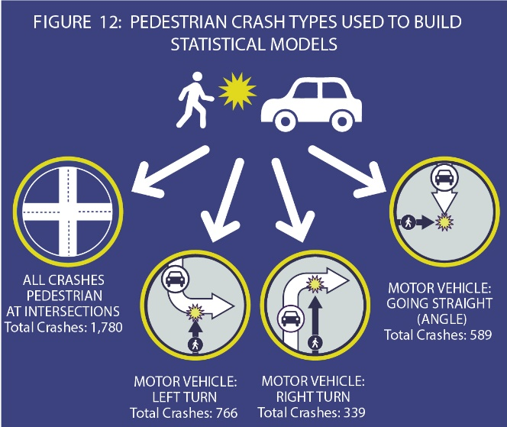
Seattle, Washington
Notes:
City of Seattle Non-motorist program: The Seattle DOT (SDOT) uses systemic safety analysis to identify high priority areas for pedestrian and bicyclist safety. This multi-phase effort included the development of pedestrian and bicycle SPFs for several specific crash types. The results of the analysis are updated periodically, and the outputs are used to identify and prioritize candidate locations. This case study shows how Seattle has used the systemic safety process as part of their Vision Zero program, with particular emphasis on three data-driven steps: identifying focus crash types, facility types, and risk factors; screening and prioritizing candidate locations; and evaluating systemic safety results. Graphics are priority bicyclist crash types used to build SPFs and Priority pedestrian crash types used to build SPFs.
Objective
Seattle’s Vision Zero program aims to end traffic deaths and serious injuries for all road users by 2030, to eliminate racial disparities in traffic safety, and to achieve 90-percent zero-emission person trips by 2030 . The Bicycle and Pedestrian Safety Analysis is one facet of the Vision Zero program; this advanced data-driven program is designed to help SDOT proactively prevent deaths and serious injuries for people walking, biking, and rolling on all of Seattle’s streets.
Key Takeaways
While the data input requirements are high, SPFs provide a data-driven way to rank and prioritize all intersections for systemic and systematic countermeasures.
Agencies can use a variety of tools, ranging from corridor-scale projects to systemwide policies (e.g., speed changes or widespread deployment of LPI), to address local safety problems.
Specifically addressing pedestrian and bicyclist safety is a key component of creating an equitable, sustainable transportation system—with safety benefits for motorists, as well.
Many systemic safety countermeasures can be implemented by city public works staff through the use of paint, bollards, and signal retiming.
Ongoing analysis and evaluation helps agencies monitor progress and keep abreast of changing patterns.
SDOT used their Vision Zero Plan and systemic safety analysis to apply for and receive a Safe Streets and Roads for All Grant .

Slide 13
Boyle County, Kentucky
Notes:
Boyle County, Kentucky: Boyle County, Kentucky developed an LRSP in partnership with FHWA, the Kentucky Transportation Cabinet (KYTC), and the LTAP at the University of Kentucky to improve transportation safety in the County. The Boyle County LRSP provided “a framework for identifying, analyzing, and prioritizing roadway safety improvements that can be used to reduce fatalities and serious injuries on the local road networks” (Boyle County, 2021 ). Graphic is Boyle County “County Collector” system for systemic analysis.
Objective
The objective of the Boyle County LRSP is to reduce fatalities on local roads. Boyle County worked towards this objective using systemic safety analysis, identifying focus facilities, risk factors for those facilities, a prioritization process, and proposing countermeasures for the candidate sites.
Key Takeaways
Systemic safety analysis can be performed even with limited data.
Local knowledge is useful for assessing safety risk.
Agencies can combine risk data and crash data to prioritize network elements for systemic safety improvements.

Slide 14
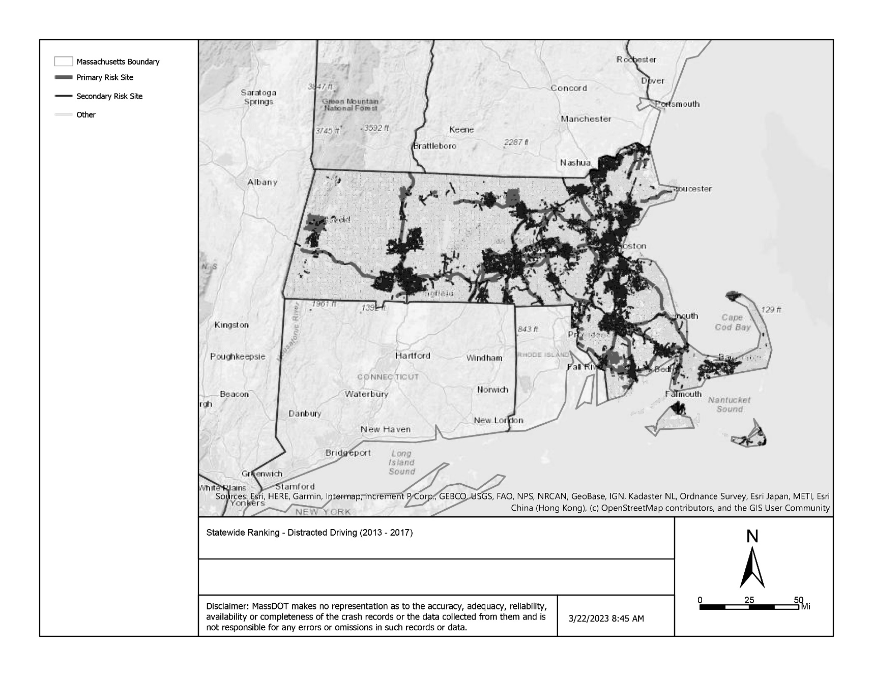
Massachusetts DOT
Notes:
MassDOT Behavioral Crash Analysis: Agencies typically employ systemic safety analysis to plan infrastructure improvements. However, the process can also be used to plan and prioritize non-infrastructure improvements. The MassDOT used systemic safety analysis to prioritize locations for behavioral safety campaigns. This case study describes MassDOT’s systemic safety analysis of impaired driving, distracted driving, and occupant protection crashes. Graphic is a Statewide ranking map for Distracted Driving.
Objective
MassDOT used systemic safety analysis to prioritize locations for distracted driving, impaired driving, and unbelted occupant countermeasures.
Key Takeaways
Systemic safety analysis is a useful process for behavioral crash analysis.
Systemic safety analysis can use a mix of risk factor identification methodologies and risk score weighting methods.
Systemic safety analysis can be applied to geographic areas (such as cities and towns), not just roadway elements.
Visualizations can help communicate the highest risk components of the network to stakeholders and the public.

Slide 15
Resources

Slide 16
FHWA Resources
COMING SOON!!! Systemic Safety User Guide
Will update the Systemic Safety Project Selection Tool
Systemic Safety Project Selection Tool
This tool describes the systemic safety analysis process beginning with Identifying Focus Crash Types and Risk Factors.
Quick Start Guide to Systemic Safety Analysis
Contains tips and strategies for using resources your agency already has to perform systemic safety analysis.
Proven Safety Countermeasures (FHWA)
Highlights when and where certain processes, design techniques, or safety countermeasures should be used.
Local Road Safety Plan: Your Map to Safer Roadways (FHWA)
This ‘do-it-yourself’ tool includes steps involved in developing a local road safety plan.
FHWA - Center for Local Aid Support - LTAP (dot.gov)
FHWA supports local and rural road agencies by providing training, technical assistance and technology transfer services to help them manage and maintain their roadway systems.
Systemic Approach to Safety Resources
Notes:
The two pubs from matt are pending publication any day!
The current training includes examples and activities to help learners practice various aspects of the systemic approach. These examples and activities will be reviewed to reflect changes to the process or components in the updated guide or changed if new real-life case studies are identified.
Additionally, these are just a few of several resources which can assist with your agency implementing the systemic approach to safety.

Slide 17
Questions?
Primary Contact:
Matt Hinshaw
Matthew.Hinshaw@dot.gov
360.619.7677
Contact:
Paul LaFleur
Paul.lafleur@dot.gov
515.233.7308
Notes:
Thank you participating in the Systemic Safety: An Update to the Systemic Safety Project Selection Tool presentation. The updated Systemic Safety Project Selection Tool can be found here:
Contact information for questions or concerns on the Project Selection Tool are on the slide and can be found here:

