Slide 1
Thriving Communities Network
2024 National Regional Transportation Conference Greenville, SC July 30, 2024

Slide 2
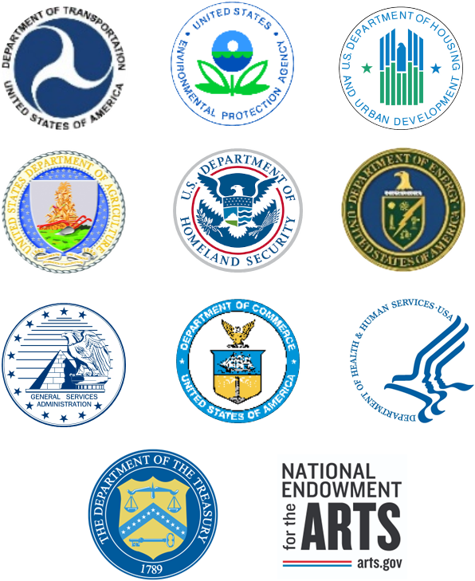
What is the TCN?
The Thriving Communities Network (TCN) is a federal interagency effort that coordinates place-based technical assistance (TA) and capacity-building resources for urban, rural, and Tribal communities experiencing a history of economic distress and systemic disinvestment.
These federal resources include grant and financial management support, pre-development assistance, community engagement, planning, and project delivery support.
Notes:
TCN is a whole-of-government approach that coordinates TA and capacity building resources for urban, rural, and Tribal communities to help them identify, coordinate, and obtain TA to successfully compete and utilize the unprecedented and historic BIL and IRA investments that are helping address communities' economic, climate, and infrastructure needs.
This includes TA support in grant and financial management, pre-development assistance, community engagement, and overall planning and project delivery support.

Slide 3
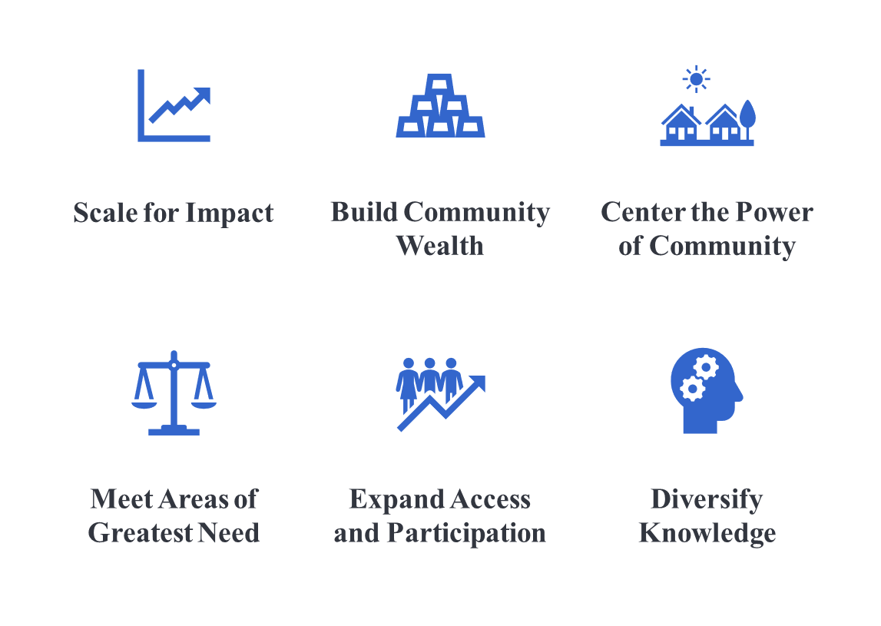
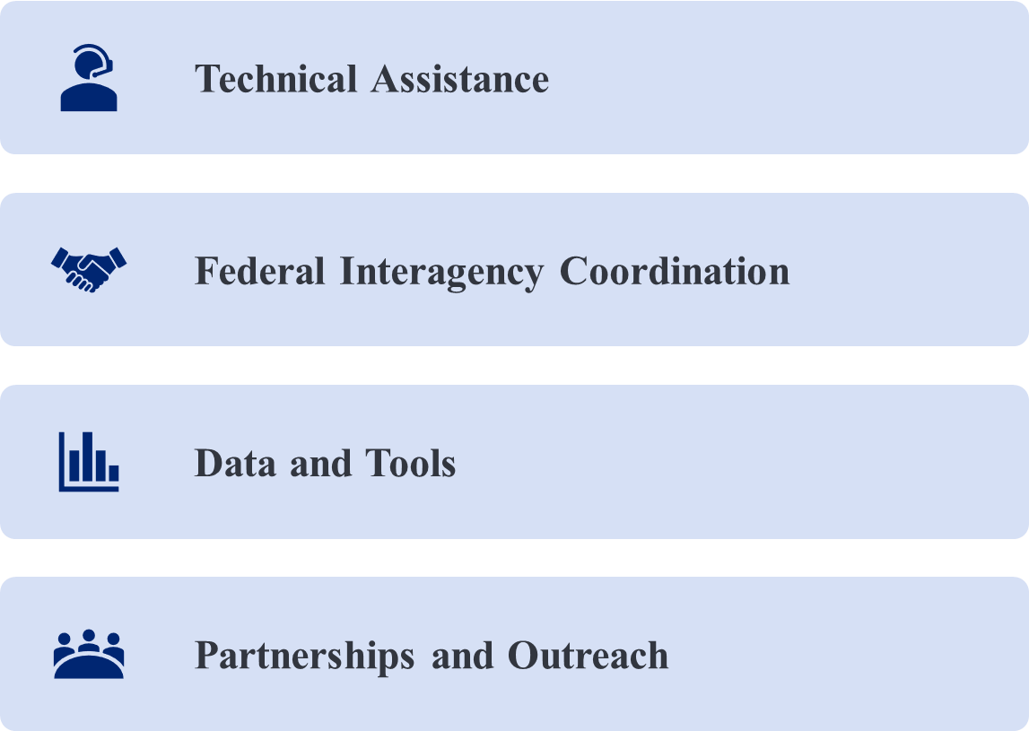
How does TCN work?
Theory of Change
Shared Principles
Four key strategies to support and connect communities:
TCN Partner Agencies commit to collectively supporting the following shared principles:

Slide 4
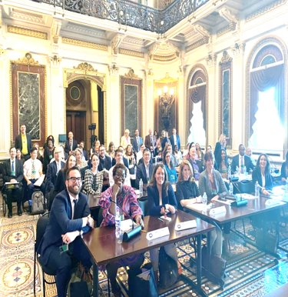
TCN White House Capacity Builder Convening Washington, D.C. September 15, 2023
Full day event hosted by the White House for federally-funded TCN capacity builders, selected philanthropic organizations, and federal partners on September 15, 2023.
Senior White House leaders provided details about the Administration’s priorities and resources on climate, transportation, economic and environmental justice.
Participants had the opportunity to learn about the breadth of capacity building resources now available to communities and the historic investments now being deployed.
White House released a Fact Sheet highlighting a number of resources and programs from federal partners, states, and philanthropy and an updated Technical Assistance Resource Guide providing comprehensive information for more than 100 federal TA programs that can support efforts to win Federal funding and deploy it in communities across the nation.

Slide 5
TCN Regional Convenings
TCN New England Convening
Date: July 29, 2024
Location: St. Anselm College, New Hampshire
TCN Okanogan County Convening
Date: September 11 – 12, 2024 (TBA)
Location: Omak 12 Tribes Hotel, Washington
TCN & TCP FY 2023 TA Provider Convening
Date: October 9 – 11, 2024 (TBA)
Location: DOT Headquarters, Washington, D.C.
TCP FY 2022 TA Provider Convening
Date: December 10 –11, 2024 (TBA)
Location: DOT Headquarters, Washington D.C.

Slide 6
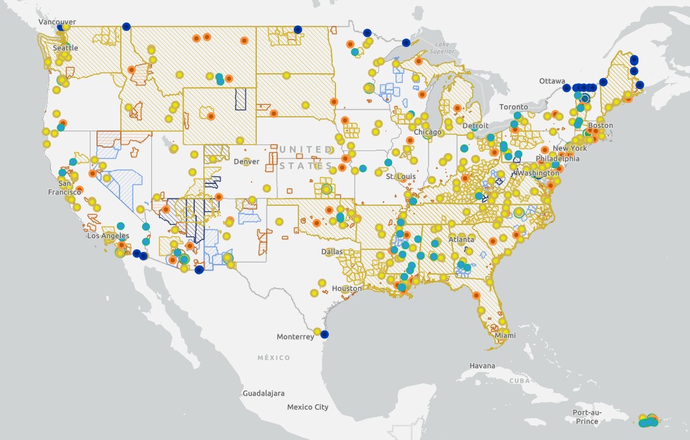
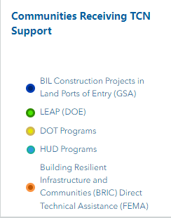
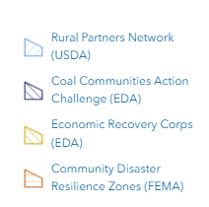
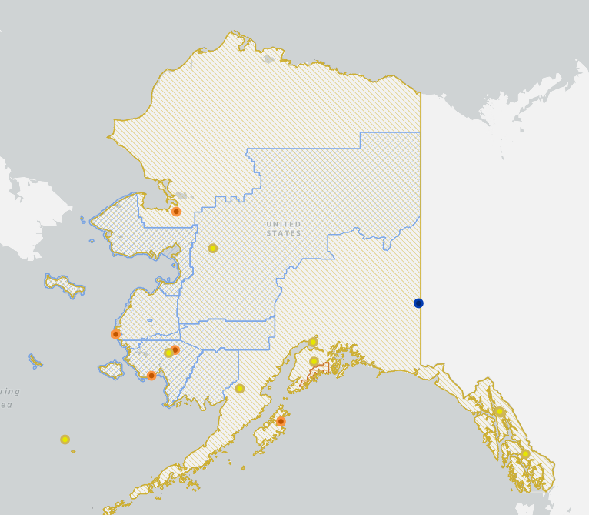
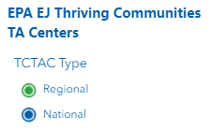
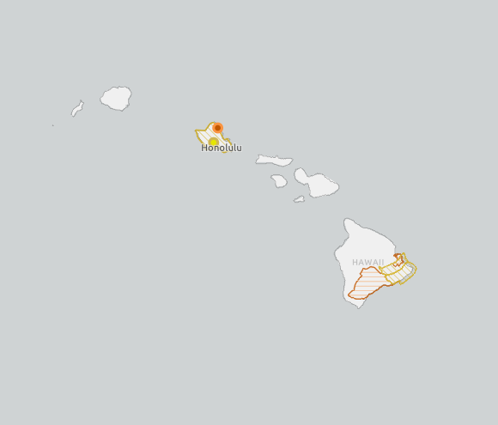
TCN Map

Slide 7
Stay Up to Date with the Thriving Communities Network!
Check out the TCN webpage for more information on TCN federal agencies, as well as TCN TA programs and resources: www.transportation.gov/thriving-communities-network-tcn
Stay up-to-date with TCN updates and events by subscribing to the TCN newsletter.
To subscribe, please email ThrivingCommunitiesNetwork@dot.gov
TCN Community of Practice Learning Sessions: Monthly virtual series where TA providers, capacity builders, and federal staff convene to learn more about specific topics and discuss and share best practices and observations.
If you're interested in attending these sessions, please email ThrivingCommunitiesNetwork@dot.gov

Slide 8
Thank you!
Sharece Tyer
sharece.tyer@dot.gov

Slide 9
RURAL OPPORTUNITIES TO
USE TRANSPORTATION FOR ECONOMIC SUCCESS
Amanda Rogers – US DOT
July 30, 2024
Contact Us!
Rural@dot.gov
www.transportation.gov/rural
ROUTES

Slide 10
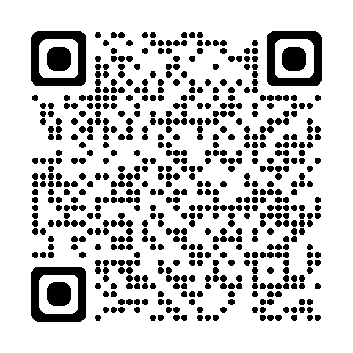
About the ROUTES Initiative
The Rural Opportunities to Use Transportation for Economic Success (ROUTES) Initiative aims to address disparities in rural transportation infrastructure and improve safety, mobility, and economic competitiveness nationwide.
The ROUTES Office seeks to:
Engage Rural Communities through a series of events to better understand the needs and priorities of rural communities and collect essential data from stakeholders representing different communities, groups, workers, and industries to identify solutions.
Harmonize DOT Programs to implement rural policy by establishing the ROUTES Council to lead and coordinate Departmental activities to implement the Bipartisan Infrastructure Law and better align new and existing funding, financing, and technical assistance programs with the needs of rural and Tribal communities.
Utilize a Whole-of-Government Approach by partnering with other rural-focused federal agencies to expand DOT’s presence in rural America, better promote Departmental resources to their customers, and capitalize on synergies between federal funding programs.
Notes:
The ROUTES Initiative was established to be DOT’s front door for rural communities
And address the disparities in transportation infrastructure that negatively impact rural areas
We work in three main ways
First we engage with rural communities to understand the challenges they face in improving transportation infrastructure
Second, we work with DOT leadership to implement policy solutions that address these challenges
And third, we work across the federal government to enlist resources from other agencies to maximize our impact

Slide 11
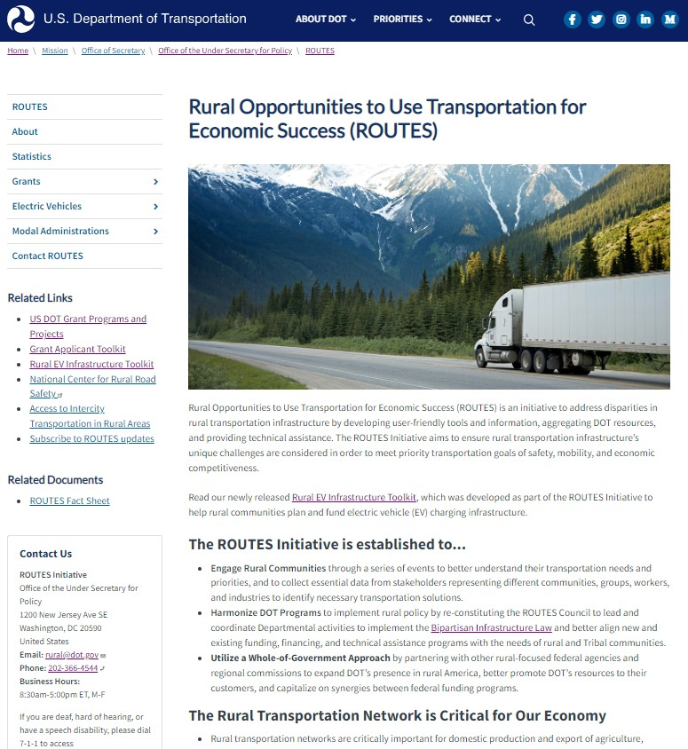
One-Stop-Shop for Rural Resources
Webinars
Benefit Cost Analyses for Rural Projects
TIFIA Rural Projects Initiative
Transit Resources
National Roadway Safety Strategy
Tools and Toolkits
Rural Eligibility Map
Point of Contact Map
Grant Applicant Toolkit
Rural EV Infrastructure Toolkit
Funding Opportunities
Active & Upcoming NOFOs
Links to Past Awards
Modal Specific Landing Pages
Monthly Newsletters

Slide 12
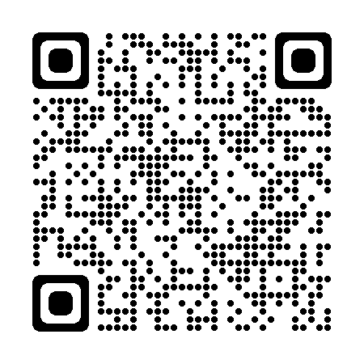
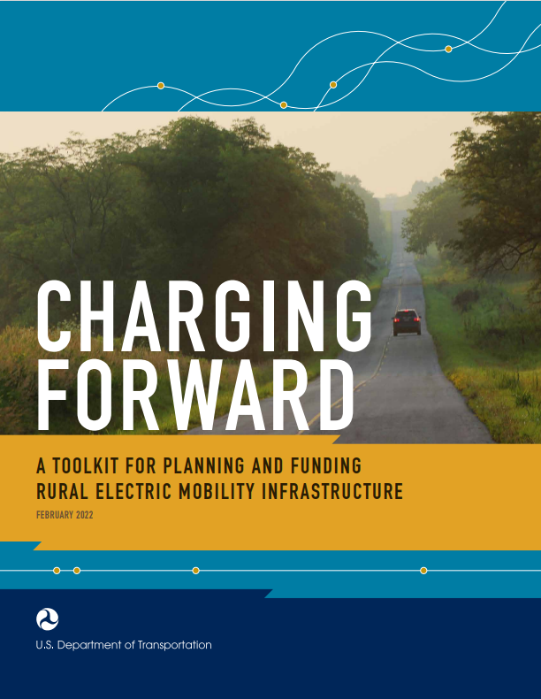
Rural EV Infrastructure Toolkit
Charging Forward: A Toolkit for Planning and Funding Rural Electric Mobility Infrastructure helps rural stakeholders scope, plan, and fund electric vehicle charging infrastructure.
TABLE OF CONTENTS
Electric Vehicle Basics
Benefits and Challenges of Rural Vehicle Electrification
Partnership Opportunities
EV Infrastructure Planning for Rural Areas
EV Infrastructure Funding and Financing for Rural Areas
INCLUDES
Planning tools and resources
Expanded content on
Transit vehicles
School buses
Micromobility
Accessible design
Bipartisan Infrastructure Law (BIL) funding programs
National Electric Vehicle Infrastructure Formula Program ($5 billion)
Discretionary Grant Program for Charging and Fueling Infrastructure ($2.5 billion)
Clean School Bus Program ($5 billion)

Slide 13
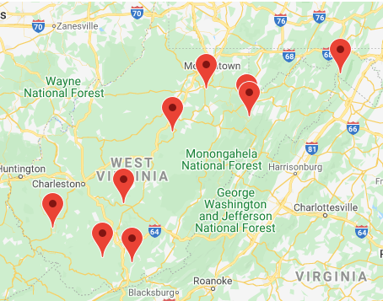
Success Story: Charging at WV State Parks
State parks in West Virginia attract visitors, shoppers, and diners through complimentary EV charging.
CHARGING AT STATE PARK LODGES IN WEST VIRGINIA
In West Virginia, EV charging stations are available at 9 of the 10 State park lodges in the State. Drivers can charge their vehicles for free, but lodge owners noted that while people are charging their vehicles they spend money at the lodges, including in gift shops and restaurants and for overnight stays.
Map of state lodge locations (top) and parking spot for EV charging (bottom) (source: West Virginia State Parks, 2022)
Notes:
To highlight a site host partnership success story:
West Virginia State Parks collaborated with the West Virginia Clean Cities Coalition to install Level 2 chargers at 9 park lodges throughout the state.
Park staff quickly found that providing free Level 2 charging boosted visitorship across the parks, and the folks using the chargers spent more time in gift shops, dining at park lodge restaurants, and even booking over night stays in lodge rooms and cabins.
All of which generated more than enough funds to make up for the costs associated with hosting Level 2 EV charging.

Slide 14
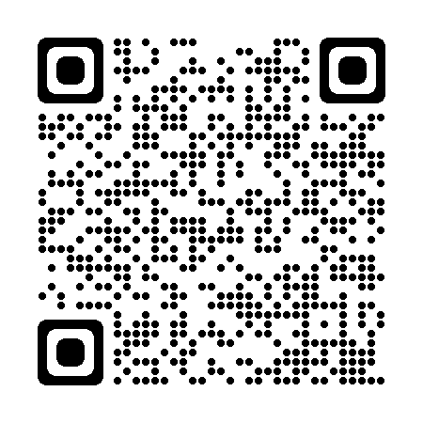
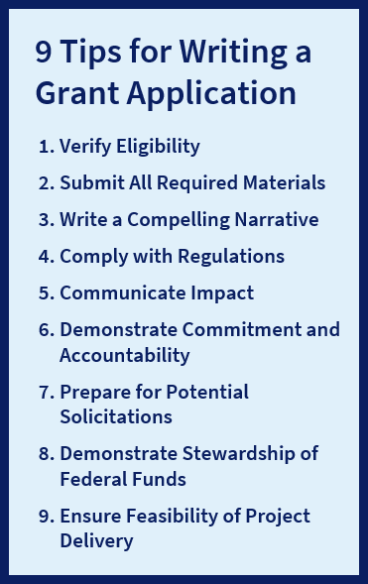
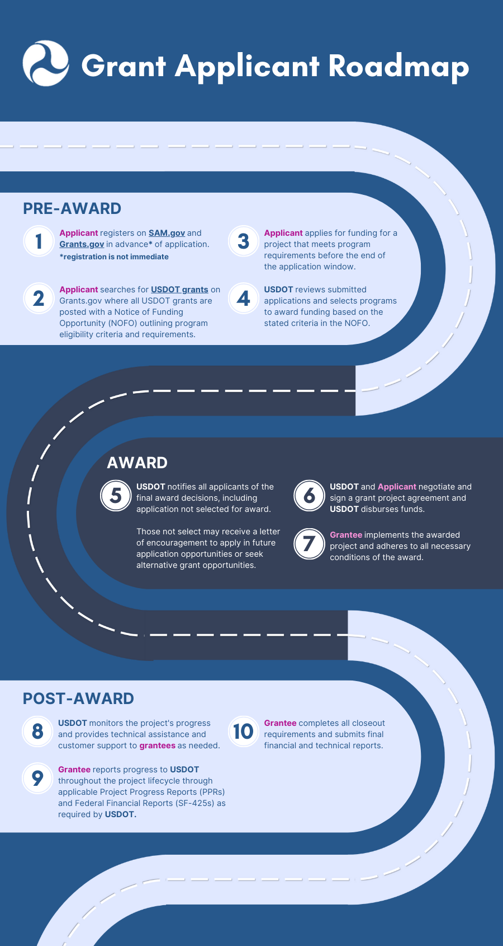
Rural Grant Applicant Toolkit
Overview of the Toolkit
Developed to help rural applicants understand the discretionary grant process and apply for opportunities​
Identifies funding opportunities across modes and project lifecycle of interest to rural communities​
Designed for all levels of grant applicant experience
2023 Revisions/Additions
Major enhancements in this revision include:
Update to add new BIL programs
Expansion to non-DOT federal grants, regional commissions
Upgrade the static directory of grants to a live, searchable database: DOT Discretionary Grants Dashboard
All elements coordinated with and reviewed by OAs and the other federal agencies.
Notes:
Table of Contents
The Critical Role of Rural Communities in the U.S. Transportation System
Federal Funding and Financing
Who Is Eligible to Apply for Discretionary Grants?
The Grant Application Process
Maximizing Award Success
USDOT Discretionary Grant Programs
Non-USDOT Discretionary Grants

Slide 15
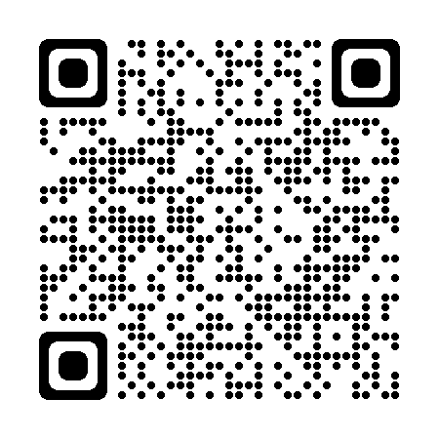
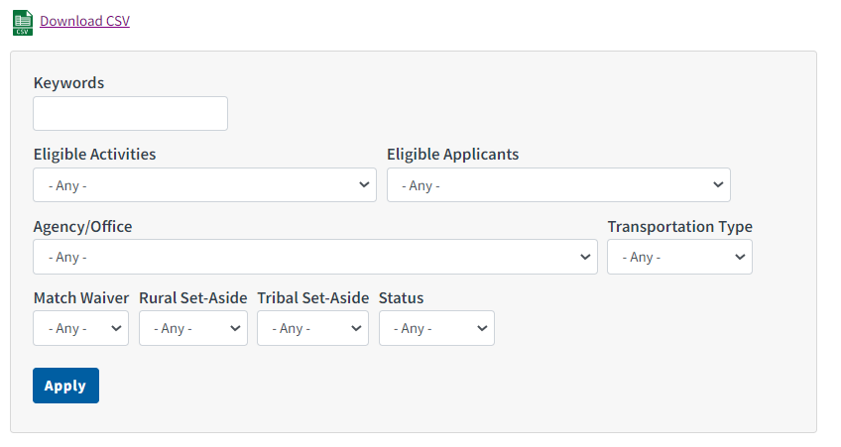
DOT Discretionary Grants Dashboard
HIGHLIGHTS
90+ grant programs
Covers DOT and Non-DOT Agencies
8 DOT Agencies
10+ Non-DOT Agencies
Multiple search filters
Keyword
Eligible Activities
Eligible Entities
Transportation Type
Match Waiver
Status (Open/Closed)
Customized features for Rural and Tribal communities
Save results as Excel csv file
Notes:
***Add picture of a grant page from the next slide if the next slide is not included in your presentation***
The dashboard provides an interactive way to search and filter through federal discretionary grant opportunities, based on your specific needs.
It includes over 90 grant programs across DOT and Non-DOT agencies
Ability to search and filter through grants by criteria such as activity, applicant, and transportation type,
It includes filters specially designed for rural and Tribal communities, so you can quickly identify programs that could have a match or set-aside benefit.
Finally, there’s also a function that allows you to download your results as an Excel CSV file, so you can then attach it to an email and share what you find with others.

Slide 16
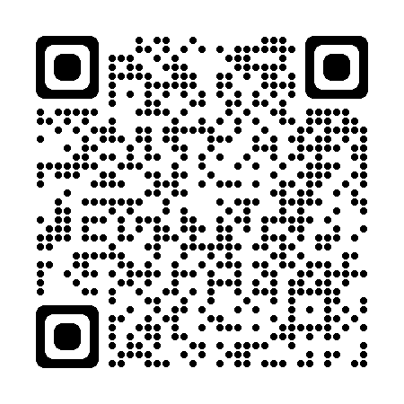
RAISE Grants
Rebuilding American Infrastructure with Sustainability and Equity
Discretionary grant program that supports road, rail, transit and port projects that fulfill national objectives
50% rural and 50% urban
162 projects awarded over $2.2 Billion in FY23
FY24 South Carolina award
Sans Souci Connecter, Greenville County--$20,335,170
Construct ~2.2 miles of shared-use path with approximately five grade separations and e-bike charging stations
Expands the area's active transportation network and connects to the greater Swamp Rabbit Trail system
Improves existing rail infrastructure to create grade separated bridge segments and grade crossings at several roads
FY25 NOFO expected to be released in fall 2024.

Slide 17
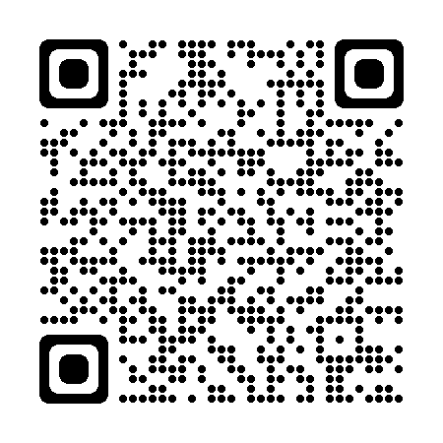
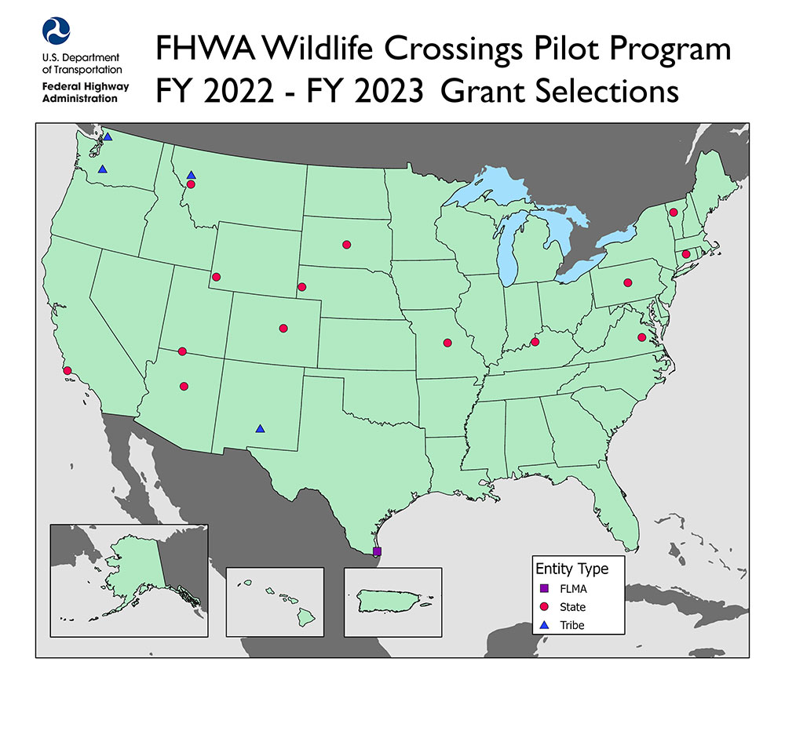
Wildlife Crossings Program
Wildlife Crossings Pilot Program
Goal of reducing Wildlife Vehicle Collisions (WVCs) while improving habitat connectivity.
Construction & Non-Construction Projects are eligible for funding
FY22&23 Awards include:
Kentucky's Wildlife Vehicle Collision Reduction Plan (US-60/I-64 Corridor Study), Kentucky, $1,200,000
US-89 Wildlife Safety Corridor Project, Utah, $5,497,000
Missouri Statewide Wildlife Vehicle Collision Anlysis and Feasibility Study, Missouri, $320,000
FY24&25 NOFO is open now and due September 4, 2024
Notes:
Missouri statewide wildlife vehicle collision reduction analysis and hotspot mitigation measure feasibility study Missouri Department of Transportation Statewide MO $ 320,000 The Missouri Department of Transportation (MoDOT) will receive $320,000 to collaboratively develop a statewide plan to identify hot spots and mitigation measures. MoDOT will perform a WVC hotspot analysis to identify high WVC road segments, then rank priority areas and conduct feasibility studies to develop sitespecific recommendations for cost effective WVC mitigation recommendations to ensure the safety of the traveling public and help promote habitat connectivity in the State.

Slide 18
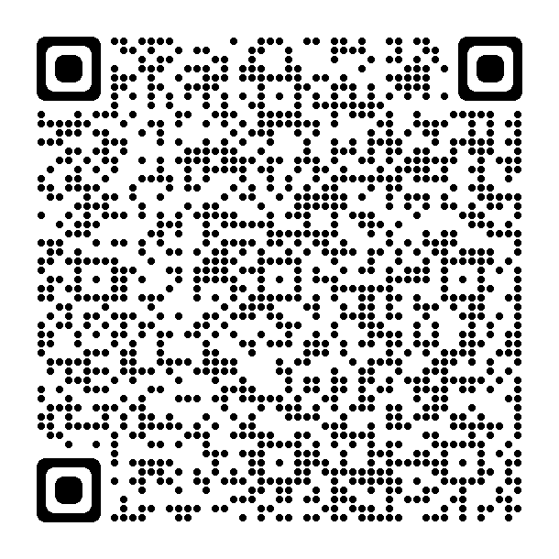
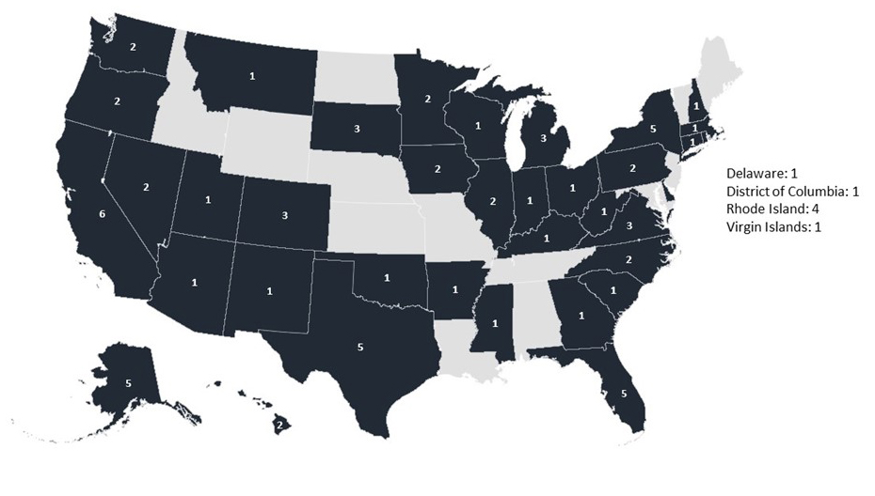
PROTECT
PROTECT (Promoting Resilient Operations for Transformative, Efficient, and Cost-Saving Transportation)
To plan for and strengthen surface transportation to be more resilient to natural hazards.
Planning, Resilience Improvement, and Community Resilience and Evacuation Routes grants available
FY22/23 South Carolina Award
Lowcountry Transportation Resilience Improvement Plan, $352,338
Lowcountry COG will create a Resilience Improvement Plan that focuses on flooding and erosion of roadways due to hurricanes, storm surges, high tides, and rising sea levels. The plan will identify priority projects aimed at improving the region’s ability to respond to extreme weather events and natural disasters and to be prepared for changing conditions.
FY24 NOFO anticipating to be released summer 2024
Notes:
SC
Lowcountry Council of Governments
Lowcountry Transportation Resilience Improvement Plan
The Lowcountry Council of Governments will receive over $350,000 to create a Resilience Improvement Plan that focuses on flooding and erosion of roadways due to hurricanes, storm surges, high tides, and rising sea levels. The project area is the southeastern corner of South Carolina, including the counties of Beaufort, Colleton, Hampton, and Jasper. The plan will identify priority projects aimed at improving the region’s ability to respond to extreme weather events and natural disasters and to be prepared for changing conditions.
$352,338
Planning

Slide 19
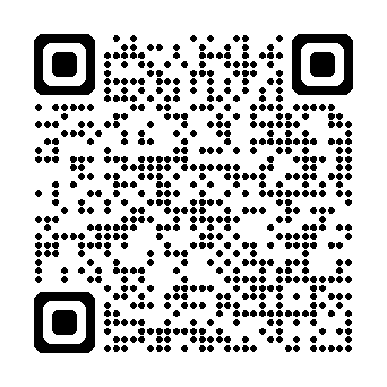
Active Transportation Infrastructure Investment Program
The Active Transportation Infrastructure Investment Program (ATIIP) is a new competitive grant program to construct projects to provide safe and connected active transportation facilities in active transportation networks or active transportation spines.
ATIIP will award two types of grants: Planning and Design grants and Construction grants
Both types of grants can go towards active transportation networks and active transportation spines
Active transportation networks connect between destinations within a community or metropolitan region, including schools, businesses, recreation areas, medical facilities, etc.
Active transportation spines connect between communities, metropolitan regions, or states
FY23 NOFO closed on July 17, 2024—Prepare now for the next round of applications!
80/20 cost share maximum, unless the eligible project will be serving communities with a poverty rate of 40%+ in which case, the Secretary may increase the federal cost share up to 100%
Notes:
What factors will be considered when reviewing ATIIP grant applications?
Whether the project is likely to provide substantial additional opportunities for walking and bicycling, including effective plans to create an active transportation network connecting destinations within or between communities, including schools, workplaces, residences, businesses, recreation areas, and other community areas, or an active transportation spine connecting two or more communities, metropolitan regions, or States; and to integrate active transportation facilities with transit services, where available, to improve access to public transportation.
Whether the applicant demonstrates broad community support through the use of public input in the development of transportation plans and the commitment of community leaders to the success and timely implementation of the project.
Whether the applicant demonstrates how investment in active transportation will advance safety for pedestrians and cyclists, accessibility to jobs and key destinations, economic competitiveness, environmental protection, and quality of life.

Slide 20
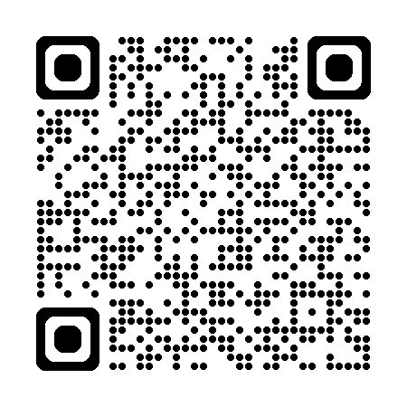
Railroad Crossing Elimination (RCE) Program
The Railroad Crossing Elimination (RCE) Grant Program funds safety-focused highway-rail or pathway-rail grade improvement, relocation, and installation projects.
Awarded more than $570 million in funding to projects in 32 states for FY22
Eligible Activities
Grade separation or closure that may use a bridge, embankment, tunnel, or combination thereof
Track relocation projects
Safety improvements related to separation, closure, or track relocation projects
Planning, environmental review, and design of an eligible project type
FY24 NOFO is open now with $1,148,809,580 available, applications due September 23, 2024

Slide 21
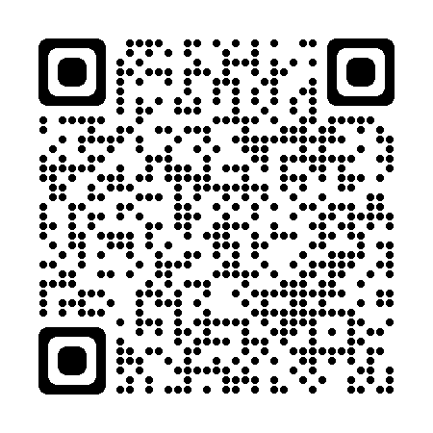
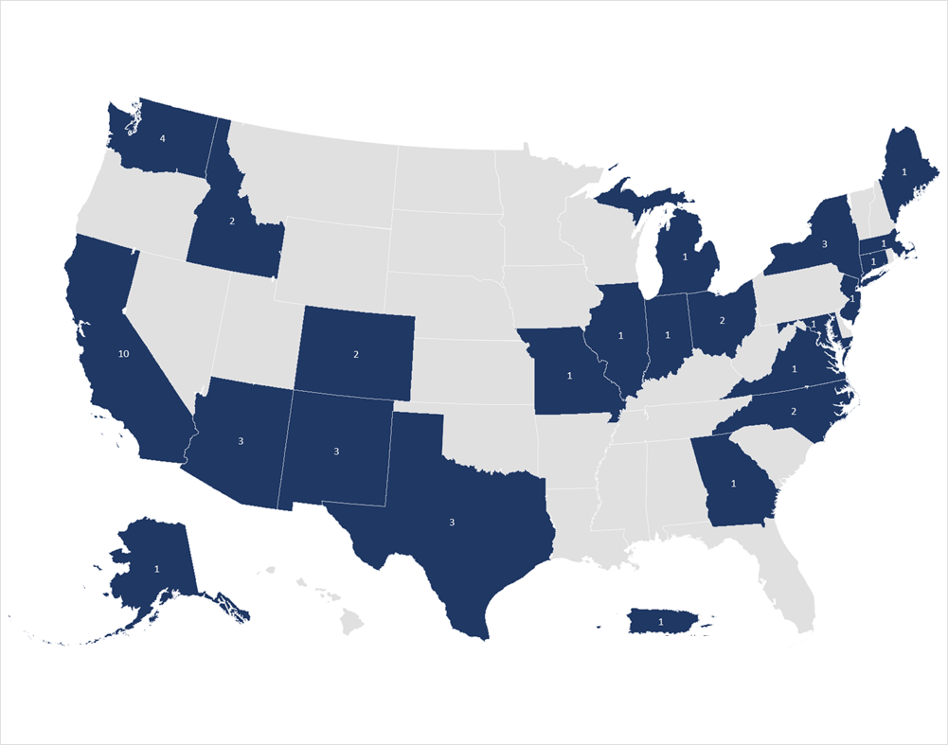
Charging and Fueling Infrastructure (CFI)
To strategically deploy publicly accessible EV charging and other alternative fueling infrastructure in communities and along designated Alternative Fuel Corridors (AFCs)
Community Program grants provide funding to projects located on any public road, parking facilities at public buildings, public schools, public parks, or in publicly accessible parking facilities owned/managed by a private entity.
Corridor Program grants provide funding to support the buildout of charging or other alternative fueling infrastructure along designated AFCs.
FY24 NOFO is open now with ~$1,300,000,000 available, applications due August 28, 2024

Slide 22
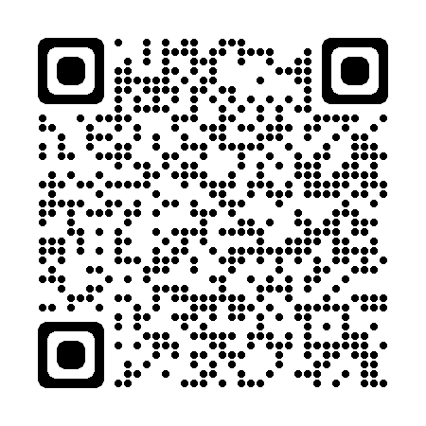
Safe Streets and Roads for All (SS4A)
Purpose: To prevent deaths and serious injuries on our roadways.
Focus is on comprehensive safety action planning and implementing those plans.
Over $1.7 Billion has been awarded to over 1,000 communities in FY22 & FY23
FY24 funding
August 29, 2024, 5 p.m. (EDT): Deadline #3 for Planning and Demonstration Grants. NOFO closes
First round of FY24 funding has been announced—99 communities were awarded $64M
Notes:
In FY23 304 awards were made to rural communities totaling $189,054,161 (~1/2 of all award recipients).
Next Notice of Funding Opportunity is expected in February 2024.
City of Globe, Arizona (population 7,162)
Received $124,846 to develop comprehensive safety action plan and use temporary solar-powered pedestrian beacon installations, crosswalk surface treatments, signing, pop-up bike lanes, narrowing corridor treatments with surface treatments, curb extensions (bulb-outs) with landscaping elements with recycled materials planters, and plastic delineators.
City of Thomasville, Georgia (population 18,867)
Received $175,000 to conduct a demonstration project on the West Jackson corridor to test proposed safety measures such as buffered bike lanes, on‐street parking, landscape planters, mid‐block crossings, and curb extensions.
City of Decorah, Iowa (population 7,747)
Received $283,286 to develop a comprehensive safety action plan and supplemental planning to update the ADA Transition Plan and an evaluate the streetlights.

Slide 23
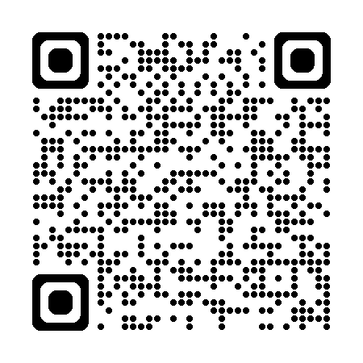
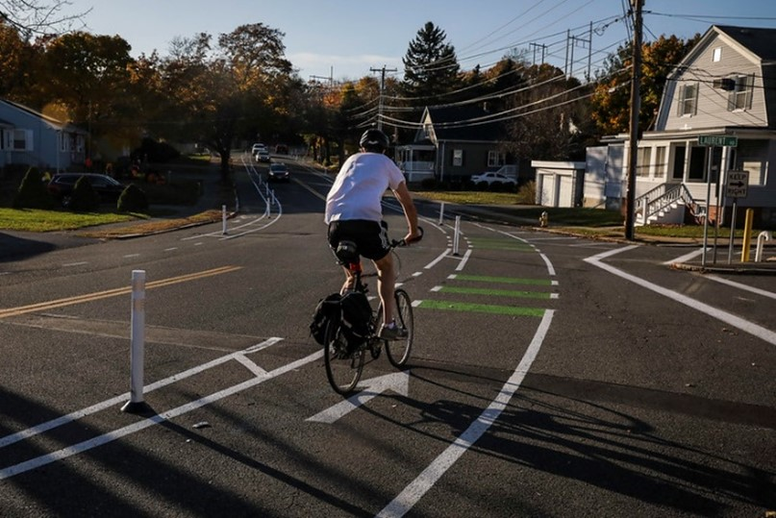
Planning and Demonstration Activities
Action Plan
Develop, update, or complete a Comprehensive Safety Action Plan
8 components to an Action Plan
Supplemental Planning
Topical safety plans
Road safety audits
Additional safety analysis and data collection
Targeted equity assessments
Stakeholder engagement and collaboration
Demonstration Activities
Feasibility studies using quick-build strategies
Pilot programs for behavioral or operational activities
Pilot programs for new technology
Manual on Uniform Traffic Control Device (MUTCD) engineering studies
Temporary safety improvements that inform Action Plans by testing proposed project and strategy approaches
Demonstration activities do not involve permanent roadway reconstruction
Quick Build Example
Source: Solomon Foundation
Notes:
Planning and Demonstration grants can be used for a variety of activities, including developing or updating an Action Plan, conducting supplemental planning, or completing demonstration activities. Communities that do not already have a qualifying Action Plan should apply for funds to develop an Action Plan and may include supplemental planning and/or demonstration activities in their application.
First let’s talk about Action Plans. There are eight main components to it. Planning uses data and analysis to identify a community’s safety problems. The community also engages the public and other stakeholders in a process-oriented approach, and based on all that information a list of projects and strategies are developed to address the identified safety problems. The NOFO and the Action Plan webinar give more detail about what constitutes a “comprehensive safety action plan” than in this presentation, but that’s the quick version.
Note that project-level planning such as environmental reviews such as NEPA, as well as preliminary engineering and design, for specific projects in an Action Plan are not considered supplemental planning nor demonstration activities and cannot be funded using a Planning and Demonstration Grant. NEPA and project engineering design is an eligible activity for Implementation Grants, however.
Let’s talk through supplemental planning and demonstration activities next.
Supplemental planning updates or further elaborates on the components of an Action Plan. It can be updating an existing plan, or adding bells and whistles, or taking deeper dives based on the identified needs of a community.
Topical safety sub-plans could be speed management, vulnerable road users, accessibility for individuals with disabilities, Americans with Disabilities Act of 1990 (ADA) transition plans, health equity, safety-focused Intelligent Transportation System implementation, lighting, or other relevant safety topics.
Maybe there’s a high injury network series of roads that you want to do road safety audits on, or additional data analysis to identify contributing factors.
You can also further engage your community, or assess how different groups such as kids, older adults, or communities of color should be considered in the implementation of projects and strategies.
Demonstration activities:
Demonstration activities are temporary in nature and meant to test changes that will advance safety before you spend millions on projects and strategies.
Demonstration activities tie back to information the Action Plan, especially the list of projects and strategies.
Here are a few examples, which I’m going to go into more detail because last time around we got a lot of questions, and I want to provide some examples.
Quick-build strategies also known as tactical urbanism, that inform permanent projects in the future. For example, say you want to re-allocate road space to test out a new separated bike lane. You use paint and plastic bollards to see if it works before making permanent changes. The picture on this slide shows an example.
Pilot programs for behavioral or operational activities. For example, maybe you want to test out a new education campaign’s messaging at a small scale and do some focus groups before rolling out a big campaign.
Pilot programs that use technology to enhance safety benefits. These need to be technologies not already adopted in your community. For example, maybe you want to test out variable speed limits on one of your major arterial roads to how well it works before rolling out across your system.
Engineering studies that further the safety applications of the Manual on Uniform Traffic Control Devices. An example of this is testing out high-visibility crosswalk markings before rolling them out across your road system.
One question you might have is the difference between implementing projects and strategies and doing demonstration activities. Well, demonstration activities are temporary and smaller scale and must get assessed for their benefits. That assessment informs the Action Plan and your list of projects and strategies in that plan and possibly the prioritization of those projects and strategies. Implementing projects and strategies can be permanent construction and long-term solutions, and they’re on your Action Plan’s to-do list.

Slide 24
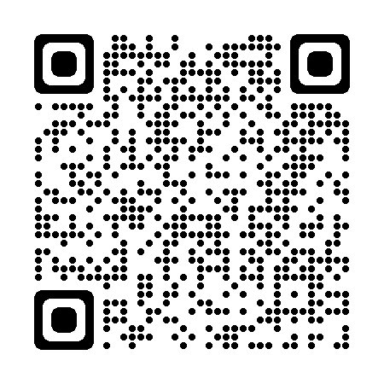
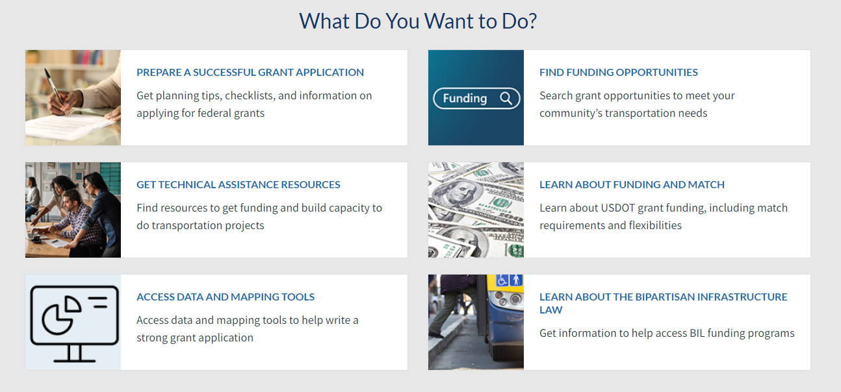
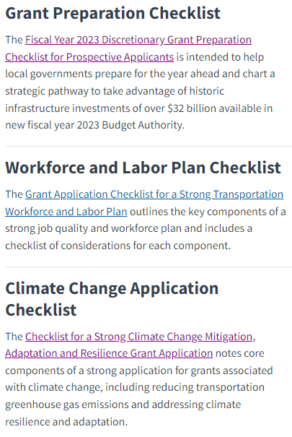
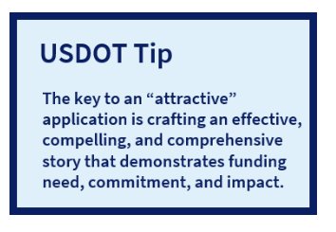
DOT Navigator

Slide 25
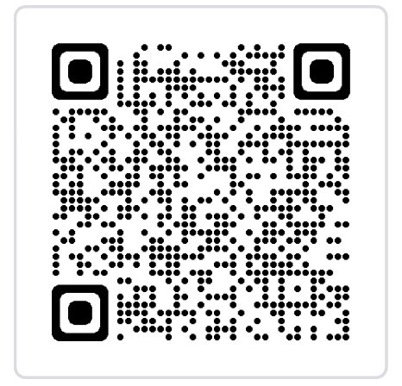
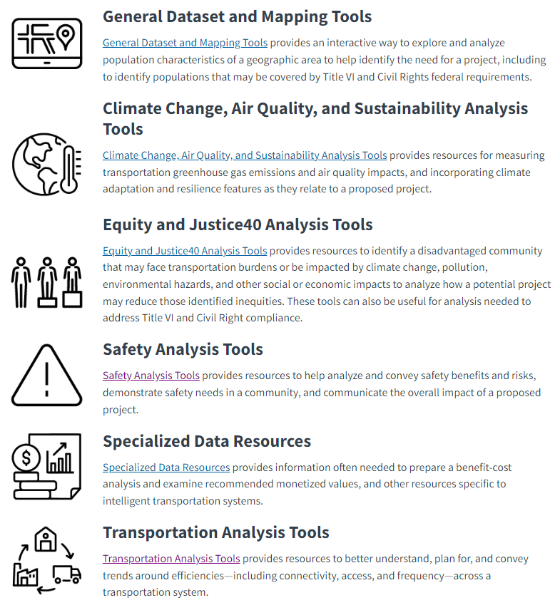
Use Data to Tell a Compelling Story
Disclaimer: This curated list of federal data and mapping tools is maintained on the DOT Navigator website as a secondary source and does not supersede primary materials issued by each USDOT Operating Administration. USDOT does not promote one resource over another. Accordingly, please work directly with the USDOT Operating Administration managing the BIL discretionary grant program for specific guidance.

Slide 26
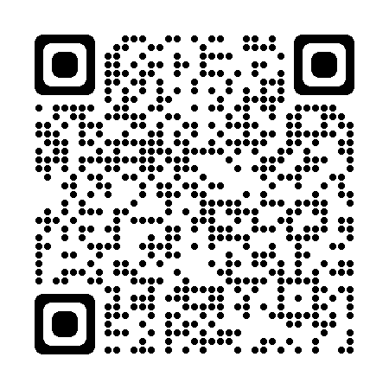
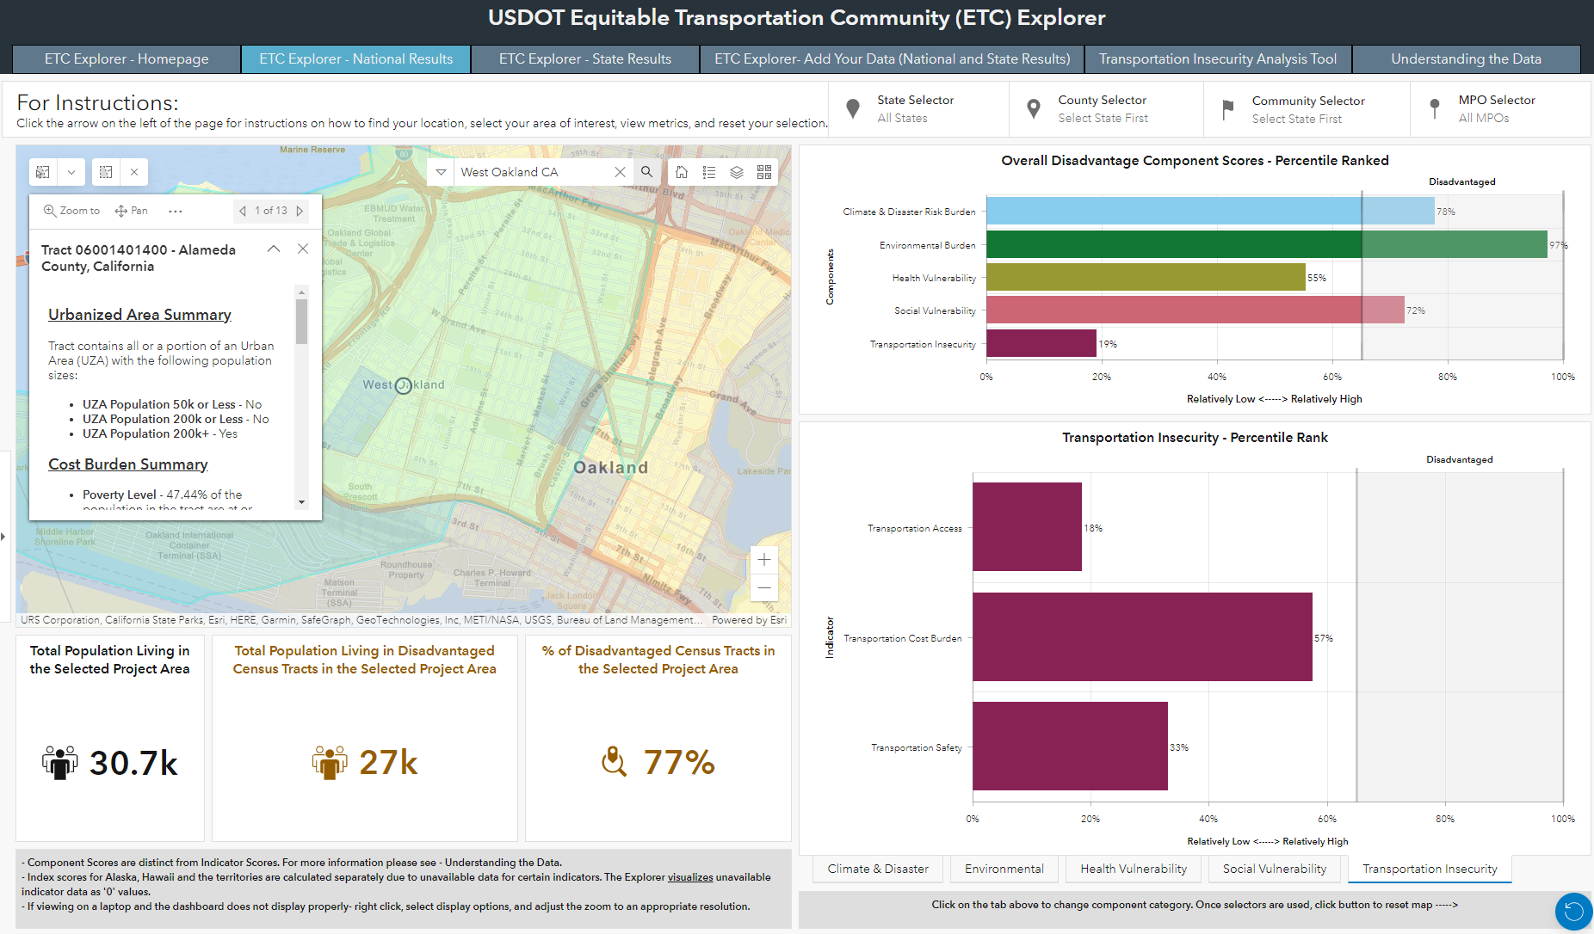
Equitable Transportation Community (ETC) Explorer
OVERVIEW: USDOT creates the first-of-its-kind transportation-specific tool, harnessing the latest census tract data across federally available data sources to provide users a centralized, easy-to-use platform that creates visibility into drivers of transportation disadvantage.
Transportation-specific disadvantage index Incorporates 40+ data elements across 5 categories of disadvantage: Transportation Insecurity, Health Vulnerability, Climate/Hazard Risk Component, Environmental Burden, Socioeconomic Vulnerability Transportation Insecurity & Access Tool (TIAT)* Visually displays the raw data for a select group of indicators related to cost, access, and safety at the state or national level, that reflect transportation insecurity. Latest Census Tracts Incorporates 2020 U.S. Census Tracts and data from sources including NOAA, USDOT, FEMA, EPA, Census Bureau, BIA, MRLC, DHS, CDC, DOI, and Esri.
KEY FEATURES & DATA
CORE USERS
USDOT Support agency-wide priorities and metrics for covered program impacts, distributional equity, and overall effectiveness Applicants Support program scope and application development based on transportation disadvantage insights about communities State Planners/MPOs Understand localized impacts within immediate region to support funding decisions and provide visibility into community impact.
*This is a tab within the ETC Explorer

Slide 27
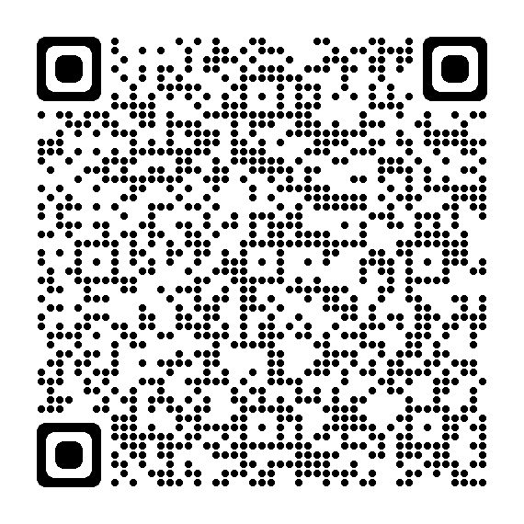
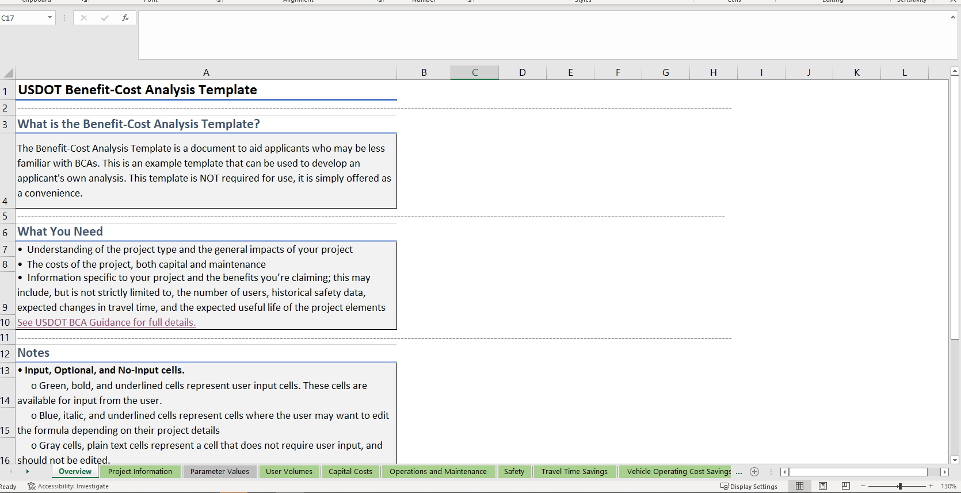
DOT BCA Spreadsheet Template
Developed by DOT as an optional template to aid applicants in structuring their BCA and performing certain calculations common to all analyses
Designed as an open-ended template to handle any project type
Contains the basic framework to organize a BCA and is designed to be open-ended enough to be customized to almost any transportation project type
Automatically performs certain calculations common to all BCAs, such as discounting, net present value, and the benefit-cost ratio
Project information, benefit, and cost categories are on their own sheets.

Slide 28
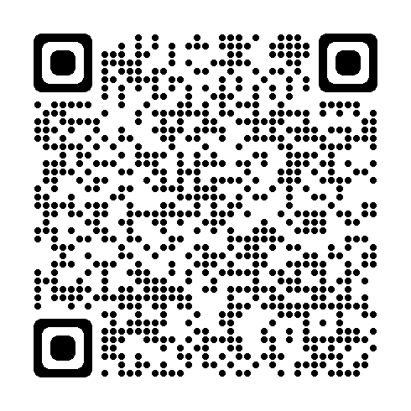
Rural Safety Countermeasures
Coming soon:
NHTSA Rural Countermeasures that Work
Proven Safety Countermeasures in Rural Communities

Slide 29
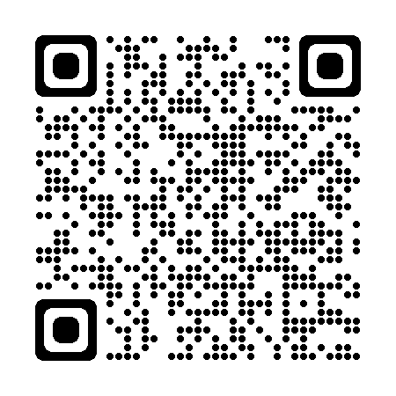
Subscribe to the ROUTES Newsletter --->
OR
Contact Us!
Rural@dot.gov
www.transportation.gov/rural
Notes:
QR code takes you to the subscribe page for routes.

