Slide 1
Funding & Financing Regional Transportation
National Regional Transportation Conference
July 30, 2024

Slide 2
U.S. Department of Transportation
Office of the Secretary
Office of the Under Secretary for Transportation Policy
Build America Bureau
Operating Administrations
Federal Highway Administration
Federal Transit Administration
Federal Railroad Administration
Federal Aviation Administration
Maritime Administration
Regional staff, liaisons
Grant money
Planning, environment, construction experts
Notes:
The Build America Bureau is housed in the Office of the Secretary, directly under the Office of the Under Secretary for Transportation Policy. We are outside of the operating administrations you are likely more familiar with, but we coordinate with them on projects that are financed or funded through the Bureau.

Slide 3
Build America Bureau Structure
Build America Bureau
Innovative Finance & Delivery
Credit Programs
Community Solutions
Outreach & Project Development
Risk Management
Outreach
Technical Assistance
Grant Management
Project Development
Underwriting
Portfolio Management
Notes:
The Build America Bureau was started under the Obama administration to increase infrastructure investment to increase partnerships with the states and private sector, and to put existing federal credit programs to greater use. Our office has been around 8 years, focused on extending lending for primarily large-scale transportation projects. Until recently, Bureau staff supported only our project development and credit programs, working with entities interested in pursuing our financing programs for their projects. The Bipartisan Infrastructure Law gave the Bureau a couple of new grant programs to manage, and so we have expanded to include a Technical Assistance arm.

Slide 4
Technical Assistance Grant Programs
Thriving Communities
Regional Infrastructure Accelerators
$25 million in FYs 2022 and 2023 ($50 million total)
Support disadvantaged and lower-capacity communities across project planning and scoping, development and design, and delivery
$34 million awarded to 24 recipients
Build capacity to incubate good projects and accelerate delivery through innovative approaches
Assistance in project planning, revenue forecasting, preliminary engineering and design, and statutory and regulatory compliance analyses
Rural and Tribal Assistance
Innovative Finance and Asset Concessions
5-year pilot program ($10 million total)
$3.4 million awarded to 13 communities, including 7 Tribes
Advance early project development by funding technical, legal, and financial activities
Additional $25 million for FY 24
5-year program ($100 million total)
Help project sponsors identify underutilized assets with potential to generate economic development
Increase capacity to utilize innovative financing and project delivery and form partnerships with private sector
Notes:
These are our current grant programs, and I will talk about Rural and Tribal Assistance and Regional Infrastructure Accelerators in a second. Sharece will discuss Thriving Communities during her presentation. I think that these 3 programs are the most relevant to this audience. The 4th program here, Innovative Finance and Asset Concessions, is for communities that are likely to pursue our credit and financing offerings and have, or think they may have, one or more underutilized assets, such as a surface parking lot, that they are interested in marketing to or partnering with a private developer to create a better use, like a parking structure with municipal offices and a transit station. The program offers 2 types of grants: 1. advancing a program of existing assets- an asset inventory, if you will, and 2. studies and analyses of a specific asset for public-private delivery. The first NOFO for this program was for $57.72 million, which was 3 years of funding. That NOFO was released earlier this spring and we are currently reviewing applications. The next NOFO for the program should come out around next spring.

Slide 5
Rural and Tribal Assistance Pilot Program

Slide 6
Rural and Tribal Assistance Pilot Program
$10 million over 5 years Additional $25 million funding in FY24 = $27 million for Round 2 No local match!
Notes:
The Rural and Tribal Assistance Pilot Program is one of the newish Bipartisan Infrastructure Law grant programs. The BIL language stated that $10 million of funding would be available over five years to advance infrastructure projects in rural and tribal communities. Funding increases with each year, with 2026 offering $2.4 million in grants.
Our first NOFO came out last year and offered 2022 and 2023 funding together. This year, we unexpectedly received an additional $25 million through the FY24 budget, and so when the next NOFO is released in the next couple of months, we’ll have $27 million to award.
We set aside funding for tribes during the first round and expect to again, to ensure tribal projects are adequately represented amongst the projects awarded.
There is no local funding match required to participate in this program.

Slide 7
Grants for technical, financial, or legal support
Technical
Financial
Legal
Feasibility studies
Project planning
Preliminary engineering/design
Environmental review
Property development and land use feasibility analysis
Public outreach
Cost estimation
Public benefit studies
Revenue forecasting
Economic assessments and cost-benefit analyses
Value for money analysis and procurement options
Evaluating opportunities for private financing and project bundling
Financial feasibility analysis; funding/financing options analysis
Evaluation of costs to sustain project (such as operations and maintenance costs)
Statutory and regulatory analysis
Drafting and negotiation of concession agreements
Drafting and negotiation of interagency agreements
Procurement support
Notes:
This program aims to assist rural and tribal communities with advancing transportation infrastructure projects by funding design phase activities to better position these projects in pursuing other funding or financing programs for construction. The grants can be used to hire staff or retain technical, legal, or financial advisors and consultants.
These lists show suitable tasks for this grant program.

Slide 8
RTA grant eligibility
Eligible applicant with an eligible project
Applicant
Local government with or State government on behalf of a project:
- Not in a Census Bureau 2020 designated urban area.
- OR – In a Census Bureau 2020 designated urban area with a population of 150,000 or less.
Federally recognized Indian tribe
Department of Hawaiian Home Lands
Project
Must be reasonably expected to be eligible for one or more of the following funding programs:
- TIFIA
RRIF
INFRA
Mega
RAISE
National Culvert Removal, Replacement & Restoration
Notes:
In order to be eligible to receive an award from this Program, applicants must be considered an eligible entity with an eligible project. The left column shows the list of eligible applicant types. For local government or state applicants, the location of the project must be a location that is deemed rural, meaning the location is not in a census designated urban area, or if it is, that urban area must have a population of 150,000 or less.
The project the applicant is applying with must be reasonably expected to be eligible for one of the funding programs in the right column. This does not mean they have to apply to one of these programs, just that their project would be eligible. That determines the eligibility for the Rural and Tribal Assistance Program.

Slide 9
Eligibility
Local governments or political subdivisions located outside of an urbanized area with a population less than 150,000 residents
State governments applying on behalf of a project in an area outside an urbanized area less than 150,000 residents
Federally recognized Indian Tribes
Department of Hawaiian Home Lands
Town/ Township/ Parish/ City/ Borough/ County
Local public authority (including transit agency)
Special district
School district
Council of governments/ Planning district commission/ Metropolitan planning organization/ Rural planning organization
Notes:
The list at the right shows the types of entities that are considered either a local government or a political subdivision.

Slide 10
Eligibility
Local governments or political subdivisions located outside of an urbanized area with a population less than 150,000 residents
State governments applying on behalf of a project in an area outside an urbanized area less than 150,000 residents
Federally recognized Indian Tribes
Department of Hawaiian Home Lands
In addition to the 50 states, also includes:
Puerto Rico
U.S. Virgin Islands
Guam
American Samoa
Northern Mariana Islands
Notes:
We have also been asked about territories and other entities being considered eligible applicants, and the answer is “yes”, with the caveat that also applies to other states about the project needing to meet the rural or urbanized area requirement. The list on the right shows the list of other entities that are included in the “state governments” definition for this Program. For the local government and political subdivision eligibility discussed on the previous slide, that would also apply to any of those local governments or political subdivisions in the locations shown here.

Slide 11
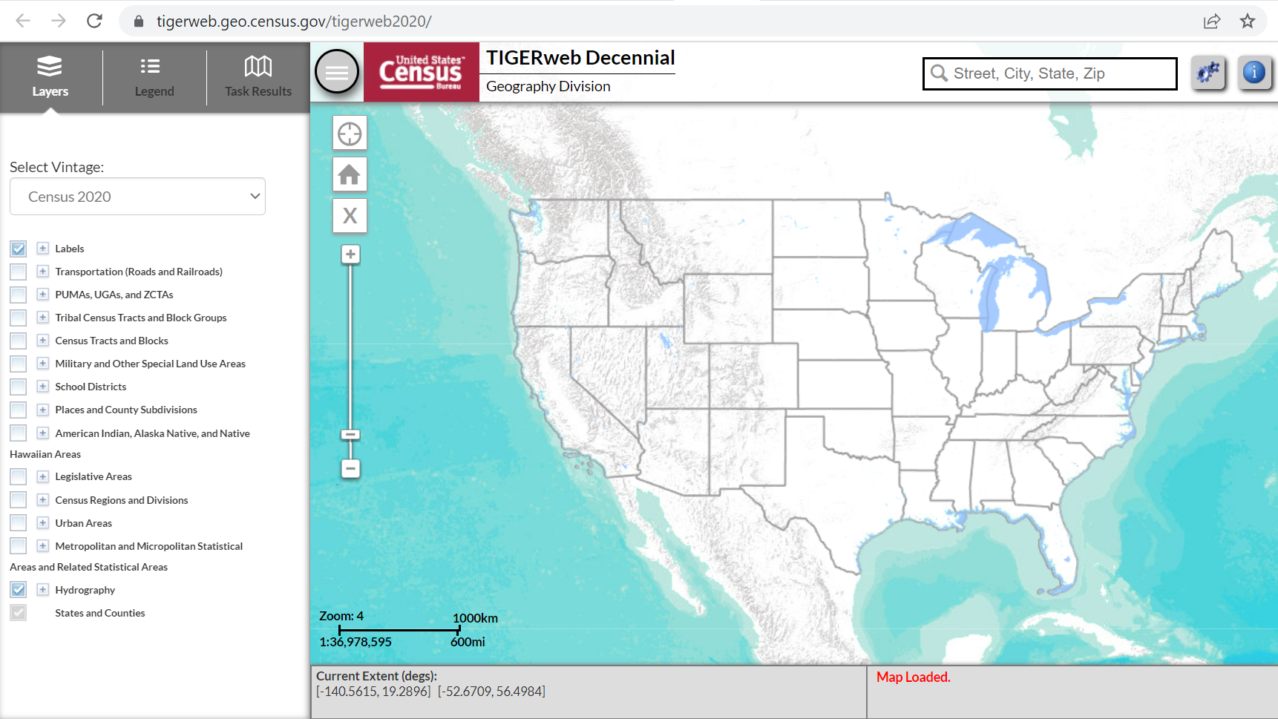
Notes:
TIGERweb is what we recommend using to check for applicant eligibility, to see if the project is in a location that is rural. You have to have an address to use the tool, which is where Google Maps can come in handy to give you the address of a location near your project.

Slide 12
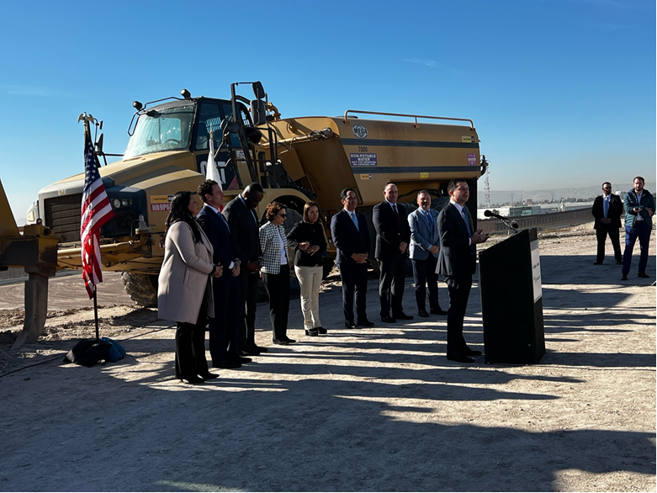
Sample Categories of Projects
Highway projects, bridges and tunnels
Public transportation projects
Freight rail projects
Airport projects
Wildlife crossing projects
Highway-railway grade crossing or grade separation
Surface transportation project within the boundaries / functionally connected to an international border crossing
Notes:
In looking through the list of eligible projects to the grant programs shown on the previous page, we put together a short list of project types that would be eligible for RTA.

Slide 13
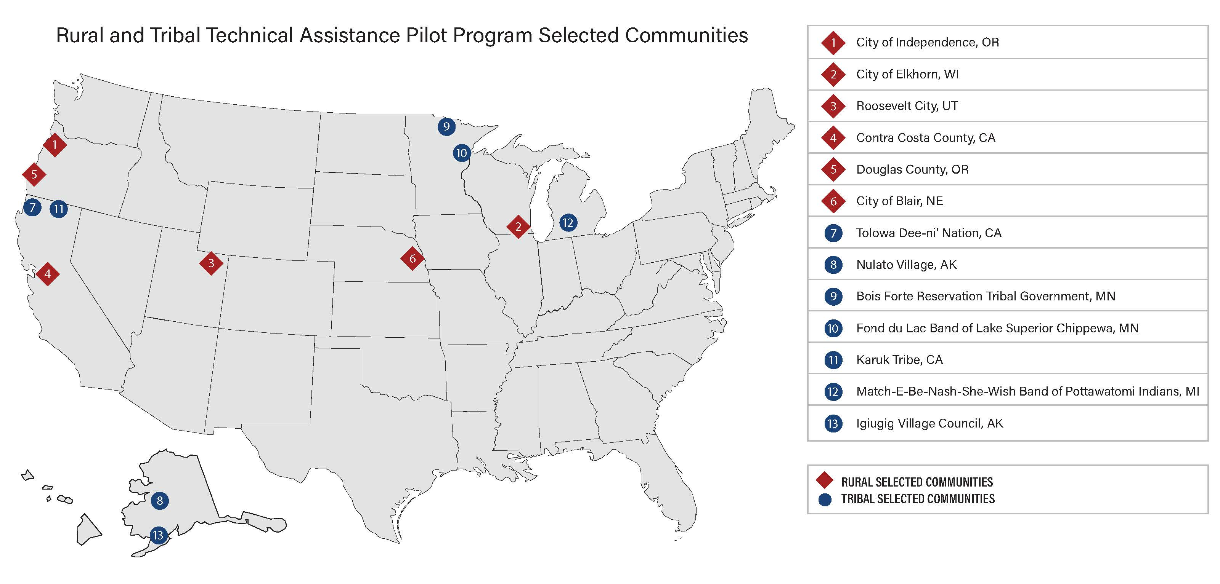
Notes:
I haven’t said it up till now, but this program is first-come, first-served, meaning awards are given out to eligible applicants in the order applicants are received. During the first round, we received 405 applications and awarded just 13 projects, 6 to rural communities and 7 to tribes. This map shows the Round 1 awardees.

Slide 14
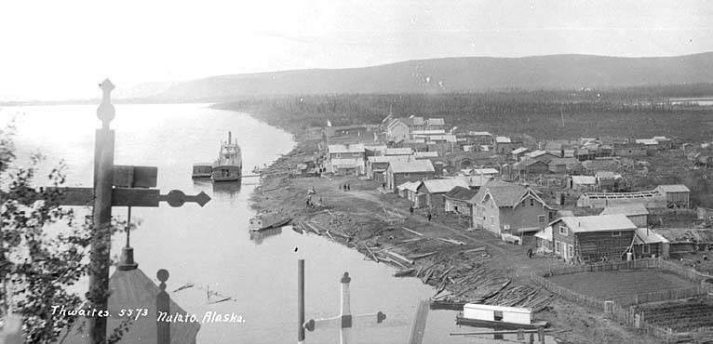
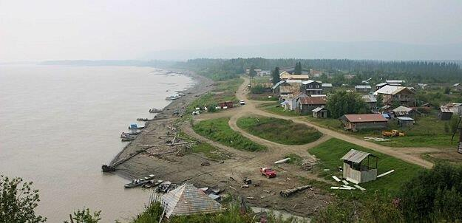
Examples of selected projects
New bridge
Street reconstruction with added bike lane
New road
Enhancement and expansion of an existing barge facility
Separated pedestrian pathway and lighting
Small port development
Secondary evacuation route
Trail connection
Transit feasibility study
Integrated breakwater and barge landing
Notes:
This is a list of some of the projects that received RTA funding during Round 1. It includes new road alignments, port projects, pedestrian projects, and a transit study.

Slide 15
Application process
First come, first served
NOFO issue date not yet determined
Copy of application will be viewable on program website
Funding may be fully committed before the open period concludes
$27 million available in 2024
https://www.transportation.gov/buildamerica/RuralandTribalGrants
Notes:
We expect to release the Round 2 NOFO in the next couple of months. Like last round, where the application was just 13 questions, we expect this application to again be simple. We plan to host it on our Program’s webpage, so there is no need to go through grants.gov.
The application questions will be made available when the NOFO is issued, to give applicants a chance to craft their answers and be ready when the application portal opens.
We plan to offer 2 types of grants this time: 1 for single project applicants, and one called multi-community, which supports at least 3 communities with 1 project each. We are still finalizing what the minimum and maximum award amounts will be.
The last application had 2 criteria questions that were reviewed and rated as either “meets” or “does not meet” the criteria. We wanted to know what the applicant’s experience and process is for consultant procurement or hiring staff, and if the applicant had received a bid/quote/estimate for the proposed work. We also wanted to know what activities the applicant expected to complete with program funding and what, if any, project related tasks or data collection had been done. We expect the questions to be similar for this round, with an added one related to USDOT’s strategic goals of safety, climate change and sustainability, equity, and workforce development, job quality, and wealth creation.

Slide 16
Regional Infrastructure Accelerators

Slide 17
Regional Infrastructure Accelerators (RIA)
$34 Million in Grants to 21 entities over 3 rounds of funding
TIFIA eligible projects
Regional Infrastructure Accelerators:
Serve defined geographic region
Resource to the region
Regional Infrastructure Accelerators
Established to assist entities in developing improved infrastructure priorities and financing strategies for the accelerated development of projects. Assistance can be in the form of:
Project planning
Studies and Analysis
Including feasibility, market analysis, project costs, value for money, public benefit, environmental reviews, etc.
Revenue Forecasting
Preliminary Engineering and Design Work
Statutory and regulatory compliance analyses
Notes:
Regional Infrastructure Accelerators provides funding to entities to develop improved infrastructure priorities and financing strategies with the goal of accelerating project development. Grantees are regional entities that partner with other agencies or governments in their community to advance infrastructure projects that would be eligible for project financing.
The Program has had 3 rounds of awards, with the 4th NOFO expected in the next couple of months. Award amounts during the 3rd round were $2 million each.

Slide 18
Regional Infrastructure Accelerator Recipients
Notes:
This is a map of all 3 rounds of RIA awardees, with some receiving awards from more than one round of funding.

Slide 19
Example Recipient – Pacific Northwest Economic Region
Awarded:
$1.2 million (Round 1)
$2.0 million (Round 3)
Goal: Convene, connect, match-make for multi-state transportation projects that:
Ease Supply Chain Disruptions
Reduce Transportation-Related Pollution
Increase Community Safety, Economic & Environmental Justice
Infrastructure Challenges:
Lack of multi-state coordination and regional transportation planning across modes, and a clear need for a region-wide, corridor-focused strategic investment plan.
Region not fully leveraging the potential of Public-Private Partnerships (P3s) and other innovative financing mechanisms.
Important projects without a clear “champion” will often go unfunded for several years
rianorthwest.org
Notes:
PNWER is a statutory public/private non-profit created in 1991 by the states of Alaska, Idaho, Oregon, Montana, and Washington, and the Canadian provinces of British Columbia, Alberta, Saskatchewan, and the Yukon and Northwest Territories. They have received funding during Rounds 1 and 3 of RIA with the goal of advancing projects that ease supply chain disruptions, reduce transportation-related pollution, and increase community safety and economic and environmental justice.

Slide 20
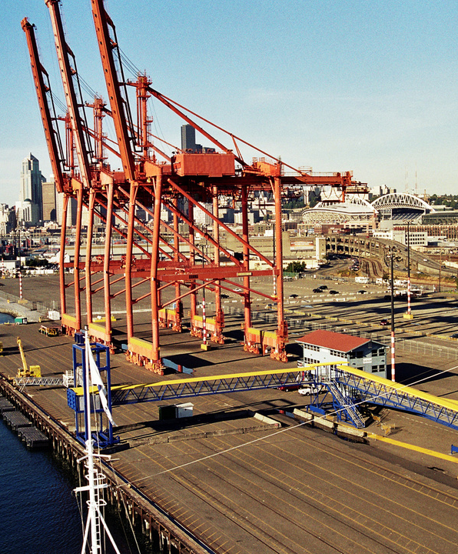
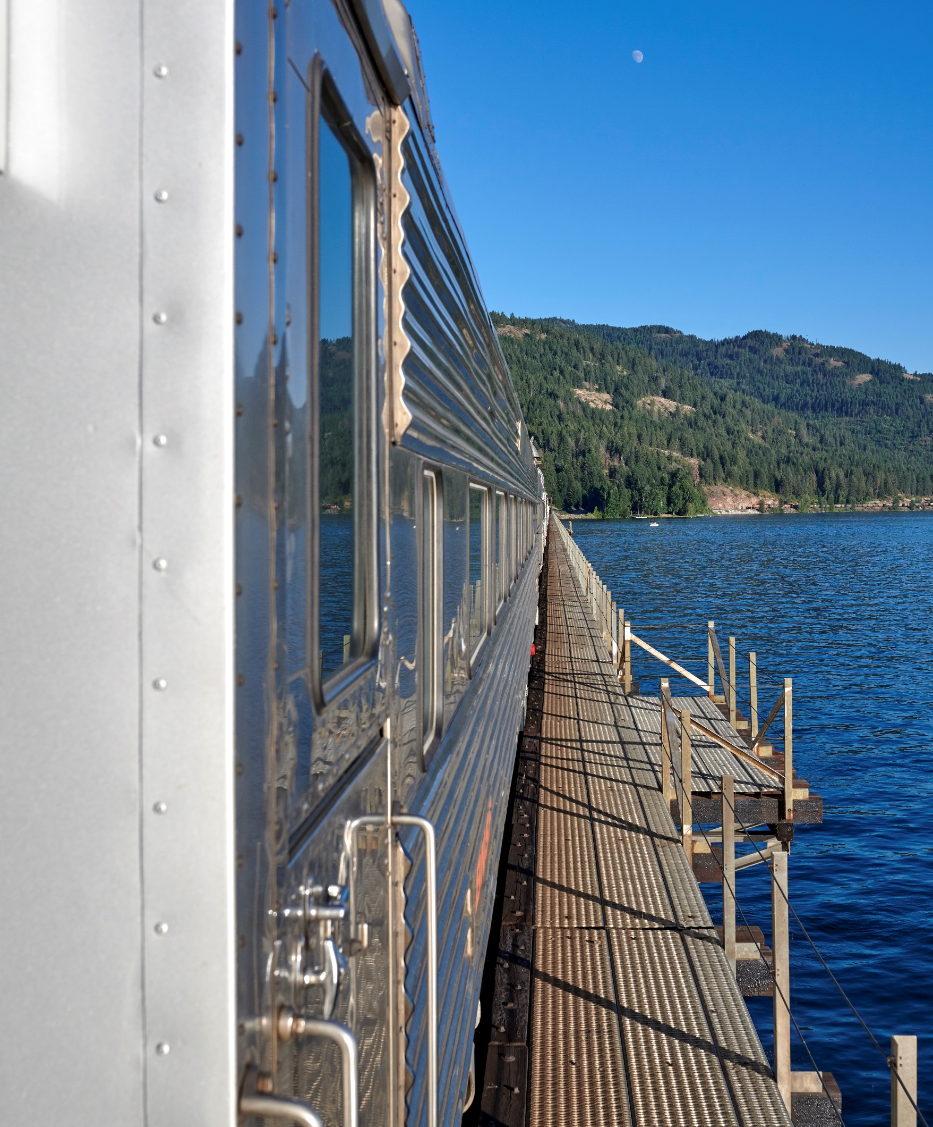
PNWER Round 1 Activities
Highway-Rail Grade Separation
Drayage Emission Reduction
Center of Excellence
Assist the rural community of Spokane Valley, WA to accelerate funding for community safety at Pines Road and along rail corridors
Establish a viable pathway for sustainable CO2 emission reduction in the Port areas of Seattle and Tacoma via drayage truck decarbonization
Develop capacity within PNWER RIA states to help states better understand and navigate federal credit & financing programs
Notes:
Some of the specific projects they are pursuing to address their infrastructure challenges include a highway-rail grade separation, studying truck decarbonization as a way to reduce CO2 emissions around their ports, and developing a Center of Excellence, in a way becoming experts on the Build America Bureau’s and DOT offerings to fund and finance critical infrastructure projects.

Slide 21
TIFIA- Rural Project Initiative

Slide 22
TIFIA and RRIF Eligible Project Types and Borrowers
Eligible . . . | TIFIA | RRIF
Project Types | Roadways and bridges Transit vehicles and facilities Bicycle and pedestrian infrastructure Intelligent transportation systems Transit-oriented development Intermodal connectors Intercity rail and bus vehicles and facilities Commercial seaports Airports | Freight rail facilities Freight transfer facilities Passenger rail vehicles, stations, and equipment Transit-oriented development Intermodal equipment or facilities
Borrowers | State, tribal, county, municipal governments State infrastructure banks Private entities Special purpose authorities Transportation improvement districts | Railroads State and local governments Government-sponsored authorities and corporations Interstate compacts Joint ventures
Notes:
TIFIA is one of the Bureau’s original programs and offers financing to assist with project development. Pretty much any type of transportation project is eligible for TIFIA financing. Borrowers can be of many types, including local governments and special purpose authorities.

Slide 23
Major Federal Requirements
National Environmental Policy Act (NEPA)
Buy America
Federal environmental review and final determination (i.e., CE, FONSI, or ROD)
Domestic sourcing of steel, iron, manufactured goods, and construction materials
Uniform Relocation Assistance and Real Property Acquisition Act (URA)
Davis-Bacon
Just relocation assistance and compensation to persons displaced by Federally assisted projects
Prevailing wages and labor standards for contractors and subs performing on federally assisted contracts
Planning & Programming
Other Modal Requirements
All TIFIA projects consistent with RTP and/or STP, and included in TIP and/or STIP
RRIF rail projects consistent with state rail plans
Project oversight regime of modal grant programs
e.g., a transit project receiving a RRIF loans must comply with all FTA (Ch. 53) grant requirements
Notes:
TIFIA project financing does come with the same federal requirements as federal grant and funding programs, including NEPA, Buy America, and Davis-Bacon.

Slide 24
Bureau Financing Programs
 |  | TIFIA | RRIF | PAB
General Features | Program Type | Federal credit assistance | Federal credit assistance | Conduit-issued debt financing (not federal credit assistance)
 | Credit Products | Direct loans; loan guarantees; lines of credit | Direct loans; loan guarantees | Allocation of tax-exempt municipal bonding authority
 | Eligible Projects | Surface transportation and public infrastructure projects | Railroad, seaport (with rail service), and economic development projects | Highway or freight transfer projects that meet the IRS’ private use test
 | Interest Rate | U.S. Treasury rates | U.S. Treasury rates | Market rates
Program Requirements | Cost Parameters | Min. project cost: > $50 M; > $15 M for ITS; > $10 M for TOD and local Max. project cost: none Max. loan to value: 33-49% Max federal assistance (grants + loans): 80% | Min. project cost: none Max. project cost: none Max. loan to value: 75-100% | Min. project cost: none Max. project cost: none Max. loan to value: n/a
 | Credit Rating | Senior debt and TIFIA must be rated investment grade (BBB- or higher) | No credit rating requirement | n/a
 | Credit Subsidy | Appropriated by Congress | Limited appropriations; credit risk premium paid by borrower, refunded after loan is repaid | n/a
Notes:
What makes TIFIA attractive is the favorable interest rate and repayment terms, allowing projects to be completed faster, and a lot of times cheaper, than traditional methods of project construction. We offer direct loans, loan guarantees, and lines of credit. The minimum project cost is typically $50 million, but is $15 million for ITS projects, and just $10 million for projects determined to be in a rural location. TIFIA can be combined with other federal funding and grant programs, so long as the total federal share on the project does not exceed 80%. Up to 49% of project costs can be financed with a TIFIA loan, and already completed, eligible activities can be included, which can help applicants reach that minimum project cost threshold. The borrower has to have an investment grade rating of at least triple B minus.

Slide 25
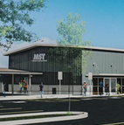
TIFIA Rural Project Initiative (RPI)
Requirements:
Rural = outside of urbanized area with a population < 150,000
Project Cost = $10 million to $100 million
Benefits:
Max. loan to value = 49% of costs
Fixed interest rate = ½ Treasury rate
Borrower advisor fees waived for project under $75 million
½ U.S. Treasury rate: 4.41% on 7/22/24
for 35-year loan
2.21%
MST O&M Facility
Monterey-Salinas, CA
RTA O&M Facility
San Luis Obispo, CA
Notes:
While regular projects receiving TIFIA financing would borrow at the treasury rate, rural projects receive financing at half the treasury rate. Last week, the treasury rate was 4.42%, so the rural rate was 2.21%.

Slide 26
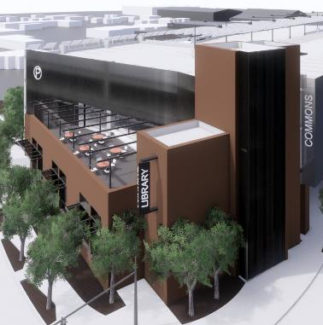
Example RPI Project – Library Commons, Mt. Vernon, WA)
Total Eligible Project Costs: $52.1 million
TIFIA Loan Request: $25.5 million (49% LTV)
Borrower: City of Mount Vernon, WA
Scope: Library, community kitchen, municipal parking, EV charging, bus stop, power generation
Public Benefits: Modernized community facilities, EV charging
Lead DOT Oversight Agency: FHWA
Notes:
This is one example of a project financed through the TIFIA Rural Project Initiative. This loan for the City of Mt. Vernon, Washington recently closed, and they received the rural rate. This is for a multipurpose government facility that will include a library, community kitchen, parking, EV charging, a bus stop, and power generation.

Slide 27
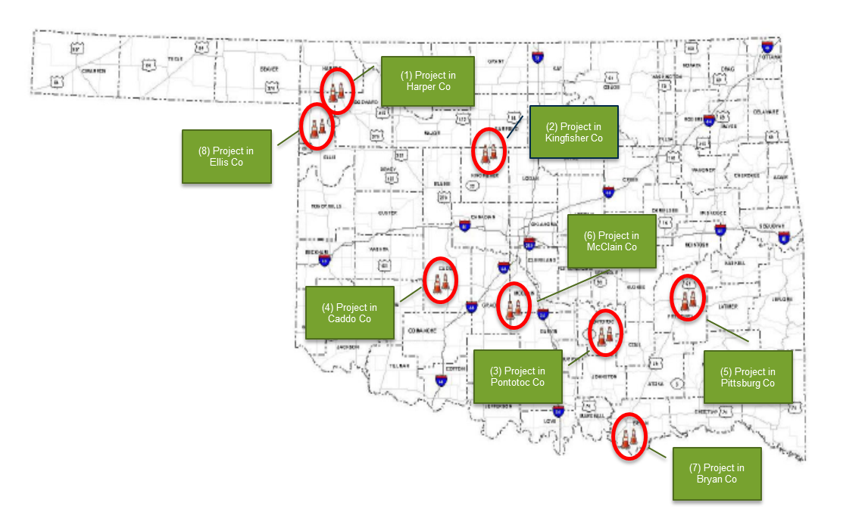
Example RPI Project – Oklahoma DOT
Rural Two-Lane Advancement and Management Plan
3 lives saved!
41 injuries avoided
29 miles of roads
improved
57 crashes
prevented
$73 million saved ($29 million project costs + $44 million crash costs)
9 years saved! Complete in 3 vs. 12 years
Notes:
We just recently closed our 3rd loan with Oklahoma DOT. They have been using TIFIA RPI to advance a safety initiative of adding shoulders to miles of rural roadways. This is a priority for the state to save lives and prevent crashes, and by borrowing funding to construct the shoulders, they are able to make these improvements faster than waiting for traditional funding to become available piecemeal.

Slide 28
DOT Navigator

Slide 29
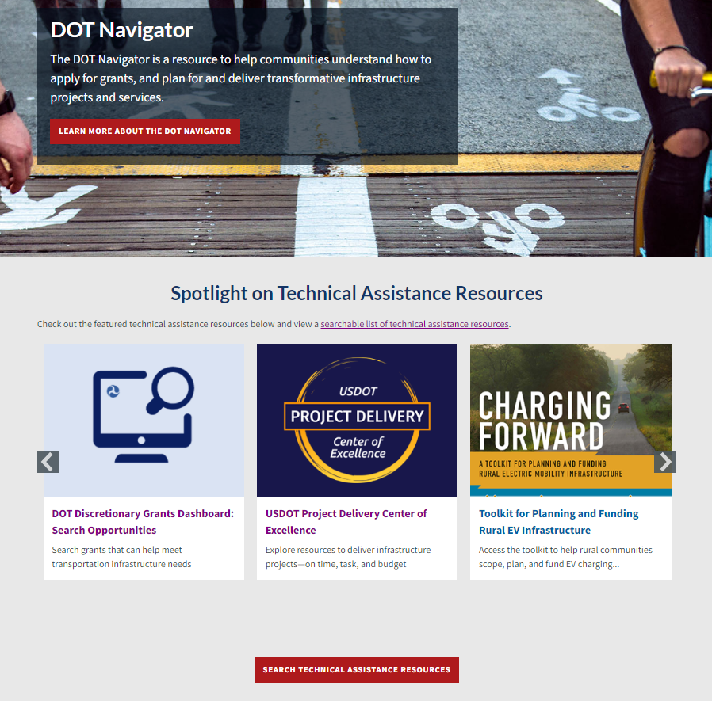
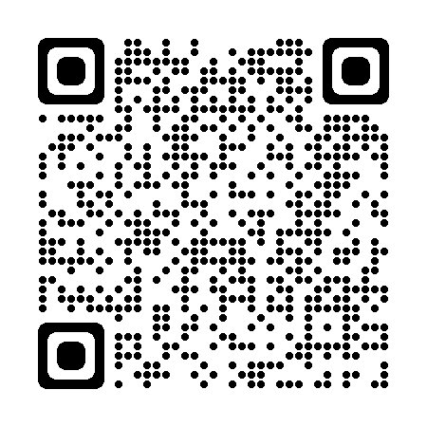
DOT Navigator
Coordinating and Improving Access to the range of DOT Technical Assistance Resources
Sample Grant Application Resources
Overview of DOT Funding and Financing
USDOT Discretionary Grant Process
Maximizing Award Success
Is Federal Funding the Right Fit for My Organization?
https://transportation.gov/dot-navigator
Notes:
Last year, DOT Navigator was launched to help communities find grant opportunities and access technical assistance. The list at the bottom is just a sample of grant application resources available on the website, but there’s also information on how to navigate grants.gov to submit an application and an explanation of understanding federal match requirements.

Slide 30
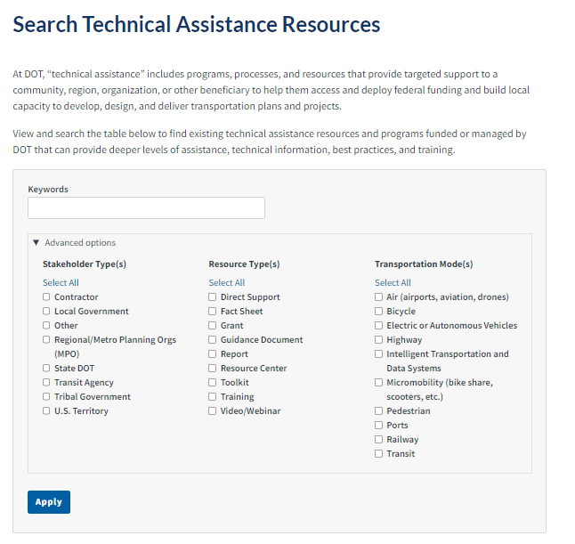
DOT Navigator (cont.)
Notes:
The DOT Navigator has a nice search feature that allows you to filter resources by stakeholder type- a local government, transit agency, etc., the type of resource you’re interested in- available grants, direct support, webinars, and the transportation mode type. Non-profits’ offerings are also included in the available resources.

Slide 31
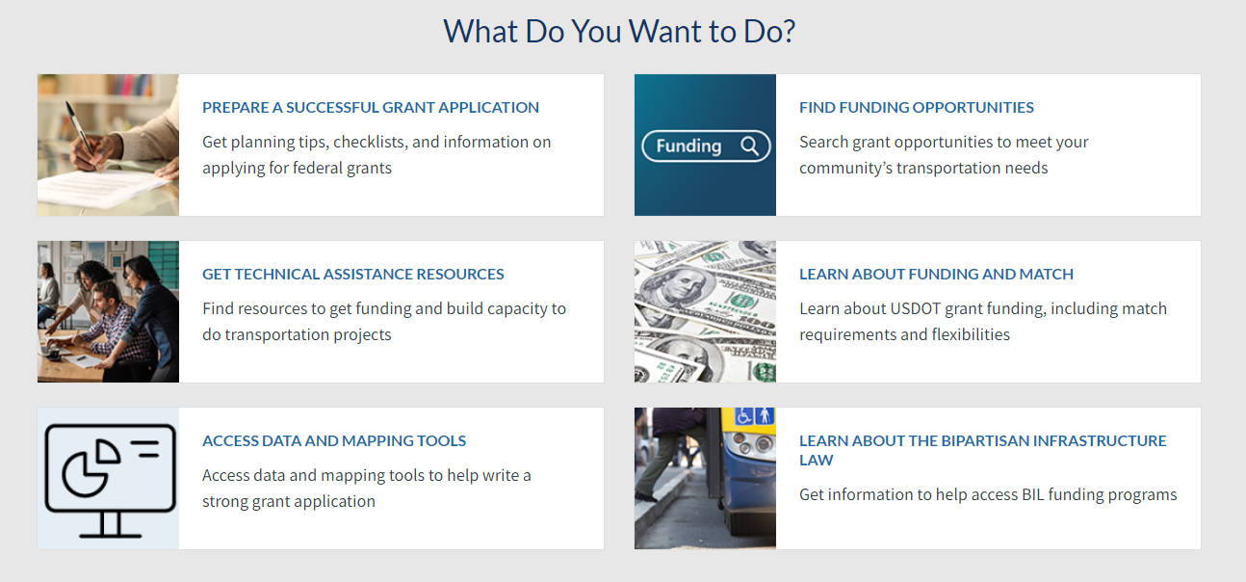
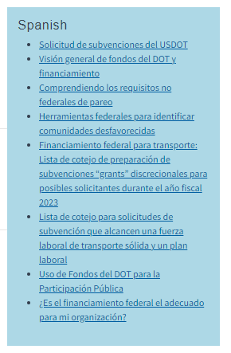
DOT Navigator (cont.)
Focus on Helping to Develop Strong Discretionary Grant Applications
Sign Up to Get Bi-Weekly DOT Navigator Email Bulletins to Stay in the Know about new technical assistance resources, trainings and funding opportunities across a range of transportation topics!
Notes:
We’ve put lots of information on the Navigator to help communities develop strong grant applications, including resources that help you find information required by a lot of grant programs, like is this project in a disadvantaged community or in an area of persistent poverty, and what is a cost benefit analysis and how do I complete one.

Slide 32
Contact us
Build America Bureau
202.366-2300
BuildAmerica@dot.gov
https://www.transportation.gov/BuildAmerica
Susan L Wilson, AICP Program Manager
Rural and Tribal Assistance Pilot Program
Email: susan.wilson@dot.gov

