Slide 1



Value Chain Mapping
SUBTITLE OR TAGLINE HERE
Notes:
Carrie

Slide 2



Principles of Wealth Creation
#1 – Create wealth, broadly defined, and aspire to do no harm.
#2 – Root wealth in local people, places and firms through local ownership, control and influence.
#3 – Build lasting livelihoods by intentionally including people and firms on the economic margins.
Notes:
Carrie
Wealth building framework has three critical goals:
Create wealth broadly defined – includes 8 capitals. Aspire to do no harm to any.
Root wealth in place – pay attention to who owns, controls and influences the wealth that’s created. Root wealth in local peoploe, places and firms through local ownership, control and influence.
Build lasting livelihoods especially for people and firms on the margins – intentionally including economically-marginalized residents.
Use a systems approach – Wealth Creation Value Chains – to build value in existing and emerging sectors.

Slide 3
#4: Tie wealth to place and connect regionally
Wealth Creation Value Chains connect local production to regional demand to bring fresh money into rural communities, defined as:
A network of people, businesses,
institutions, and non-profits
who collaborate to meet market demand
for specific products or services –
each advancing individual self-interest
while together creating greater local wealth.
Notes:
Carrie

Slide 4
Using wealth creation in economies or in project development
Start with market demand!
Choose opportunities with the greatest “wealth-building” potential
Connect community assets to real market demand
  Start by serving local demand – it may be more flexible
  Find regional customers / demand partners to bring initiative to scale
Map process and partners from input to end customer
Filling gaps creates opportunities for new entrepreneurs
Start with transportation demand!
Choose opportunities with potential to support physical mobility & social mobility
Connect to real needs from existing transportation users, then look for opportunities to grow into potential users
Map process and partners from project inputs to project implementation
Filling gaps creates a public good and supports other community and economic development or quality of life outcomes
Notes:
Carrie
Regarding transportation: ‘We want a fixed route bus system.’
We have public transportation challenges.
Who is demanding the service?
Who would utilize the service?
Who might provide the service?
Who can support the service?
Where would the service go?
When would the service operate?

Slide 5
Defining a Market Opportunity
Sector – A grouping of businesses in the economy that share related products/services.
Market Opportunity - Great potential to generate multiple forms of wealth locally
Grains – malting barley for beer
Biofuels – camelina based fuels
Tourism – rural bicycle tourism
Textiles – high end “green” Clothing production.
Notes:
Size depends on:
Small enough to be manageable but large enough to have an impact.
Narrow the focus. You can adjust focus as you go.
Geography influences focus.
Assets and Economic activity.
Manage stakeholders energy and time.
Wider area over time.
Think about scale from beginning
Balance:
Geographic area of assets/economic activity
Value chain challenges and opportunities
Stakeholder commitment and management
Identified markets.

Slide 6
Select market opportunity
Define target groups and goals
Compare market opportunities – criteria
Preliminary demand research
Stakeholder decision making process.
Notes:
Define target groups and goals - who benefits? What assets do they have? What do they need? Local ownership opportunities? Improving livelihoods?
Compare market opportunities – criteria on next slide.
Preliminary demand research – start thinking about which opportunities have demand.
Stakeholder decision making process – facilitate a discussion to make a decision.

Slide 7
Compare Market Opportunities
 |  | Rating
 | Criteria | High | Medium | Low
Relevance to target market | # of people form target group with potential to be active in the sector/value chain
 | Potential for target group to own businesses
Wealth building potential | Market demand with potential for growth
 | # of new jobs or businesses that can be created.
 | Potential to increase ownership & control over local assets
 | Potential to build multiple forms of community wealth.
Feasibility | Demand partners identified
 | Willingness of market players to adopt new practices
 | Prospects for attracting investment

Slide 8
Preliminary Demand Research
Talk with businesses
What are other sources of demand – scale, buyer types, added value, replacing imports.
Talk with current and potential buyers (demand partners)
Notes:
Once you’ve narrowed down opportunities.
Needs and desires vs. market demand.
Desire to buy a product and an ability pay for it.
What are existing businesses selling to whom at what prices? What other markets have they tried in the past? Other market opportunities they haven’t seriously considered.
Other sources of demand – scale, buyer types, added value, replacing imports.
Talk with current and potential buyers (demand partners) – what do they want? Challenges and opportunities with regional businesses? Potential business partners?
Secondary info on sector.

Slide 9
Connecting a Value Chain
Demand: Final consumers/end market - Buyers
Functions: Those things that have to happen to deliver the product or service
Transactional partners: Those people, businesses, or organizations that play a direct role in sourcing, aggregating, distributing, processing, purchasing the product, etc.
Support partners: Those people, businesses, or organizations that provide the infrastructure, technical assistance and support that helps the transactional partners to produce
We are really talking about a Value Chain System!

Slide 10
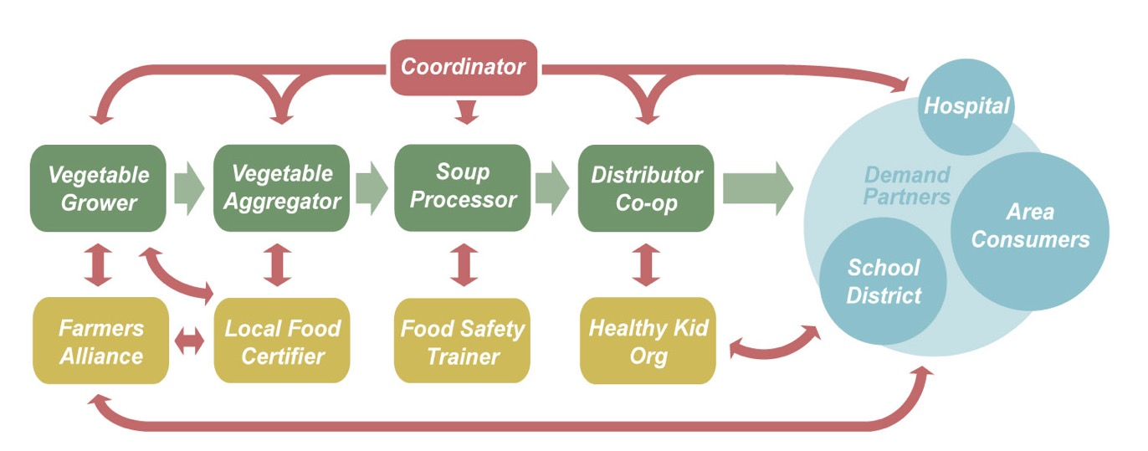
Value Chain Example

Slide 11
Notes:
Gaps are outlined. At a workshop, gaps were prioritized – these have red dots. Working groups were developed for these priorities.
Assets are identified.

Slide 12
Network Map (Tourism)
Individual tourists
Recreation Clubs
Special Interest Groups
Festivals/
events
Lodging
Guide businesses
Restaurants
Ranch/Farm Stays
Artists
Local food producers
Farmers Markets
Tourism Bureaus
Econ. Dev. Agencies
Financial institutions
Land Use Regulations
Building codes
Food Safety
Employment Laws

Slide 13
Mapping and Analyzing a Value Chain
E
Step 1
Identify product or service
Step 2
Demand partners
Step 3
Core functions and players behind those core functions.
Step 4
Support partners
Step 5
Rules/regulations and/or potential investors

Slide 14

Gaps and Opportunities
Gaps represent opportunities for local businesses to expand or new businesses to fill a function.
What gaps, if addressed, will have the most impact?
Which challenges if addressed will have the greatest ripple through the chain?
Which gaps/opportunities are feasible to address?
Where is the energy/excitement?
Notes:
Carrie - Market opportunities are in the gaps or bottlenecks that private industry might provide, and projects fulfill the same role, but with a public benefit rather than a private sector role.
Feasibility for market opportunities will mean things that can be accomplished, even if you start small, and that you can align inputs and investments to accomplish. For public sector-supported projects, feasibility will include support from the public and leaders, availability of grant funding and match, environmental impact, or other factors.
Projects.
Investigate the underlying case of the challenge.
Determine what stakeholders need to be involved.
Gaps represent opportunities for local businesses to expand or new businesses to fill a function.
What gaps, if addressed, will have the most impact?
Which challenges if addressed will have the greatest ripple through the chain?
Which gaps/opportunities are feasible to address?
Where is the energy/excitement?
Support stakeholders to develop solutions.
Make decisions based on goals and wealth creation principles.

Slide 15
Remember our Goal
Build rooted wealth, community prosperity,
lasting livelihoods.
Look for ways to build wealth by…
Filling a gap in the value chain (e.g., creating a waste oil recycling business)
Removing a barrier (e.g., providing GAP certification to minority farmers)
Building multiple capitals that are rooted in place (e.g., creating a green building program at the community college)
Finding ways to include residents on the economic margins in the activity (e.g., providing entrepreneurial training to self-employed, low income contractors to build green houses)
Notes:
Gaps - Which functions are already in place and which are not? How can you fill the gaps and produce multiple forms of wealth at the same time?
Barriers/Bottlenecks - Sometimes bottlenecks do not become apparent until you try to operate the value chain, but sometimes they are clear at the start.
Underutilized Resources including people on the margins - In mapping your value chain, you will begin to identify resources relevant to it, and some of them will likely be underutilized.

Slide 16
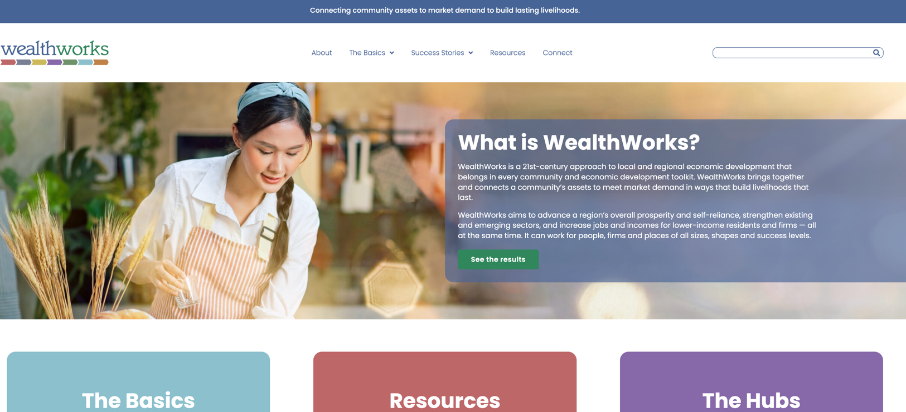
WealthWorks Website - www.wealthworks.org
Notes:
Carrie

Slide 17
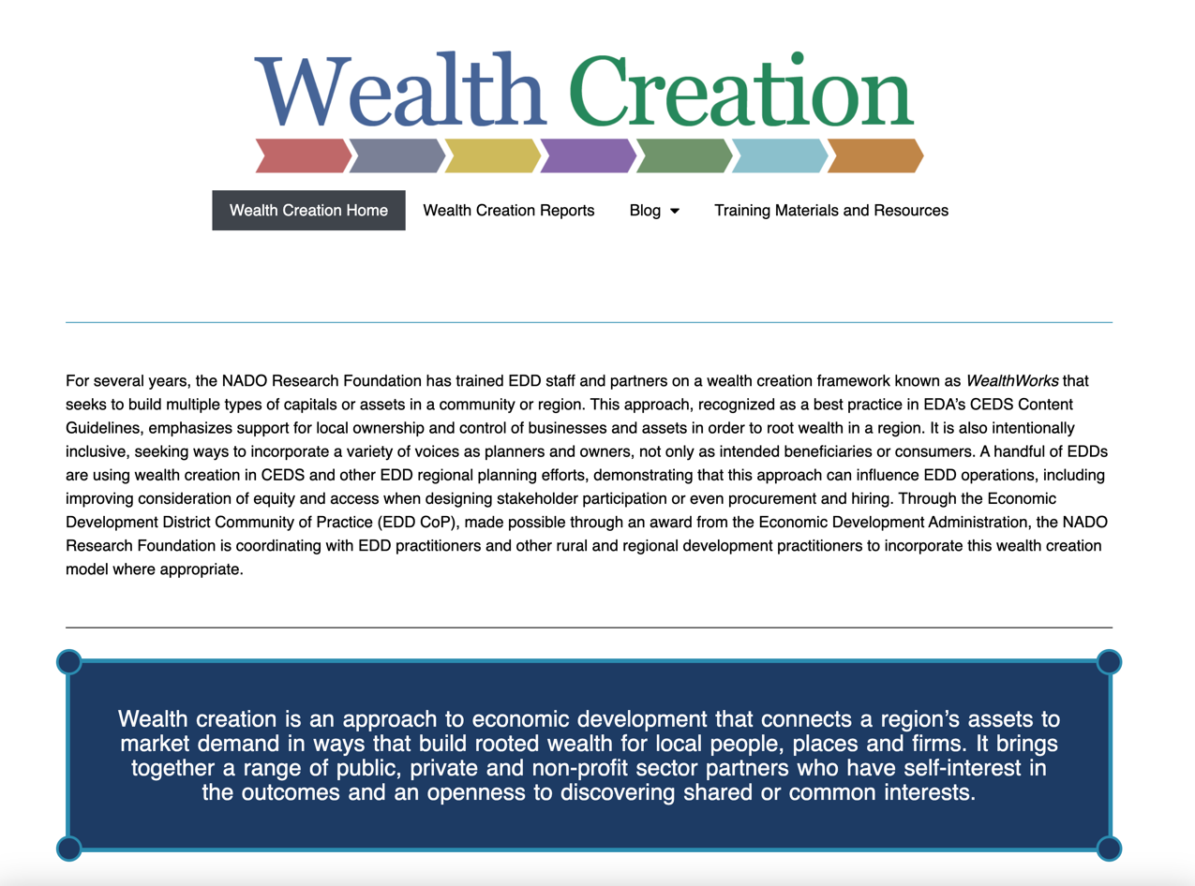
NADO Wealth Creation Website – www.nado.org/wealthcreation
Notes:
Carrie

Slide 18
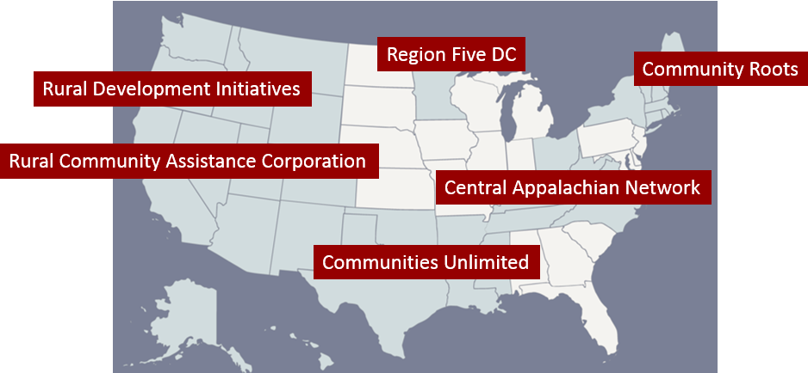
WealthWorks Regional Hubs
http://www.wealthworks.org/connect/hubs
Notes:
Carrie

Slide 19

For More Information
Melissa Levy
NADO
mlevy@nado.org
www.nado.org
Carrie Kissel
NADO
ckissel@nado.org
www.nado.org
Notes:
Carrie

