Slide 1
Bike and Ped Count Data Usage
Vineesh Das Kodakkandathil Planner II Toole Design Group
Notes:
Hello everyone,
My name is Vineesh Das Kodakkandathil, a planner at Toole Design, currently based in Spartanburg, SC.
I mainly focus on bicycle and pedestrian projects, as well as safety initiatives at Toole Design. Today, I'll provide an overview of how we utilize bike and ped count data, particularly in trail and bike improvement projects.
Let's take a look at today's topics for quickly,

Slide 2
Contents
Understanding the Context
Methods of Data Collection
Key Considerations for Analyzing Data
Analysis Examples
Potential Use & Visualization
Case Study
Resources
Notes:
To start, we'll delve into the context behind why and how we use bike and pedestrian count data.
Next, we'll explore the various methods of data collection.
Then some key consideration
then we'll look at some examples of how we analyze the data
Then will cover the potential applications and how we visualize it to communicate findings effectively.
Finally, we'll go through a case study that illustrates the practical application of count data in a real-world project.
This will provide a comprehensive view of the entire process from data collection to analysis and implementation.

Slide 3
Understanding the Context
What data we need ?
Purpose
Pedestrian
Bicycle
Micro-mobility or wheeled
All
Before and After study
Future construction planning
Volume change
Area Context
Final Product
Rural, sub-urban or city
Facility type
Sidewalk
Network
Intended audience
Report
Data visualization and storytelling
Improvement plan
Notes:
To start with understanding the context,
here are four major points to check and understand when planning a count survey or count-based project. These points will guide us in effectively collecting and using the data’.
First, identify what data needs to be collected or is already collected. Determine if you need bicyclist data, pedestrian data, both, or data from other wheeled users like micro-mobility devices and skaters.
Second, understand the area context. Identify the location of data collection—whether it's urban, rural, etc. Know the type of facility, such as a bike lane or trail, and assess how the collected data will benefit the overall network, depending on different project types.
Third, consider the purpose of data collection. Are you collecting data for future construction planning, conducting before and after counts, analyzing the impact of events, or for a broader network use analysis?
Finally, determine the desired final product and intended audience. Who will use this data and in what form? Will it be a report, data visualization, hard numbers, or for adjusting construction plans? Knowing this helps in deciding how to present the data effectively.
These key topics will help us better understand and utilize the data we collect.

Slide 4
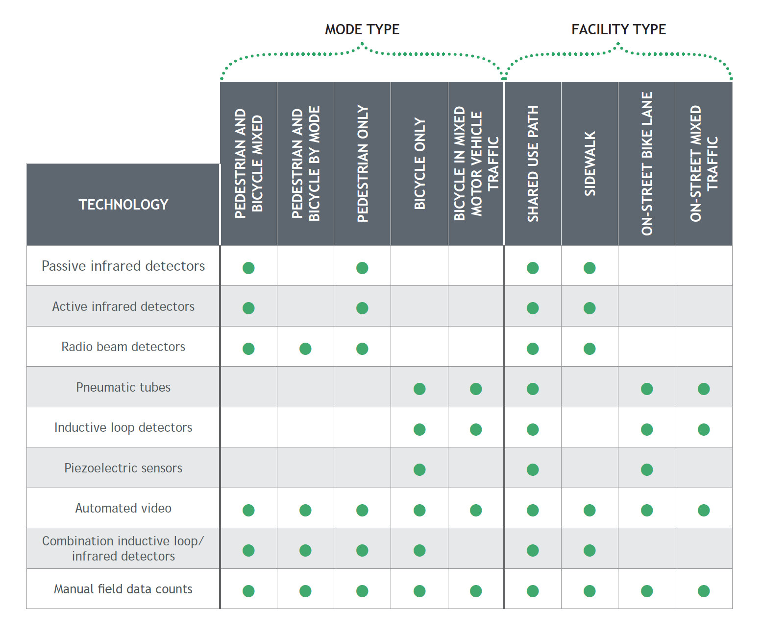
Methods of Data Collection
Traditional
Methods
Technology
Based Methods
Permanent
Permanent
vs
Short Duration Counts
Duration
Short
Duration
Source: Colorado DOT Non-Motorized Monitoring Program Evaluation and Implementation Plan
Notes:
Selecting the appropriate counting technology is dependent on factors such as budget, facility type, and duration of count.
There are traditional methods and technology based methods
This table on the right , helps determine which count technologies are best suited based on duration and facility user.
Permanent vs. Short Duration Counts
Permanent counts gather continuous data over long periods, offering insights into long-term trends and project impacts.
Short duration counts capture data for a few days or weeks, providing a snapshot of activity for quick assessments and temporary studies.
Both methods have unique benefits and can be chosen based on your project's needs.

Slide 5
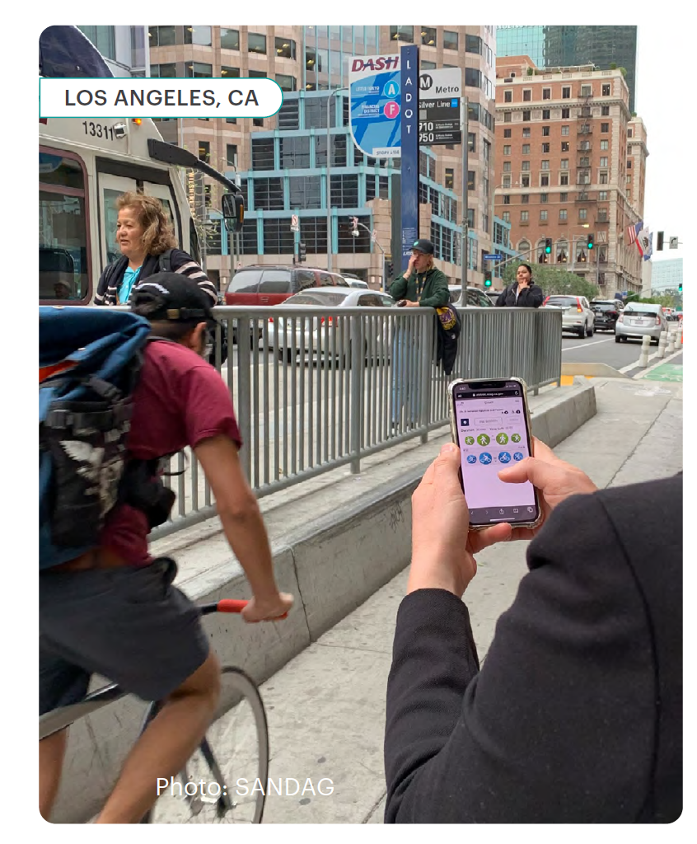
Key Considerations for Analyzing Data
Variability of Active Transport Data
Impact of Potential Events
Community Context
Data Errors
Source: MnDOT and NACTO
Notes:
When analyzing active transport data, several factors must be considered:
Variability of Active Transport Data: Data can fluctuate due to weather, seasons, and daily changes. Recognizing and accounting for these variations is crucial.
Impact of Potential Events: Events like festivals, holidays, or roadworks can temporarily affect data. It's important to consider these factors to avoid skewed results.
Community Context Understanding: Local demographics, infrastructure, and cultural practices can influence trip patterns. These factors should be considered for accurate analysis.
Data Errors Preparedness: Data errors can occur any time. We need strategies to identify and correct these errors, ensuring our data remains accurate and reliable.
These considerations are essential for a thorough and accurate analysis of active transport data.

Slide 6
Analysis Examples
Average Annual Daily Pedestrians (AADP)
Summer vs. Winter
Average Annual Daily Bicyclists (AADB)
Time
Period
Analysis
Weekday vs. Weekend
Actual and Percent Change
Recreation vs. Utilitarian
Facility Type Use Analysis
Source: MnDOT, Colorado DOT
Notes:
Regardless of how you intend to use your data, breaking it down into more digestible and relatable formats is crucial. For instance, it’s easier to understand "a sidewalk sees 50 walkers a day" rather than "this sidewalk sees 5000 walkers per year." Simplifying data in this way makes it more comprehensible and impactful.
Here are some key methods for breaking down and analyzing bike and pedestrian data:
Average Annual Daily Bicyclists (AADB) and Pedestrians (AADP): Calculating daily averages helps people grasp the data better.
Weekday vs. Weekend Counts: This analysis can differentiate between recreational and utilitarian use, providing insights into how spaces are used for commuting versus leisure.
Seasonal Comparisons (Summer vs. Winter): Understanding how usage varies between seasons, especially in areas with significant weather changes, can be very informative.
Time Period Analysis: Analyzing data over specific time periods and visualizing trends through graphs can highlight patterns, peaks, and dips.
Percent Change: Tracking changes over time, particularly for sites revisited regularly or with permanent counters, helps identify trends and impacts.
Facility Type Use Analysis: Comparing usage across different facility types, such as bike lanes versus trails, can provide deeper insights into how various infrastructures are utilized.
Presenting data in these ways makes it more understandable and useful, ensuring that your findings are clear and actionable for your audience.

Slide 7
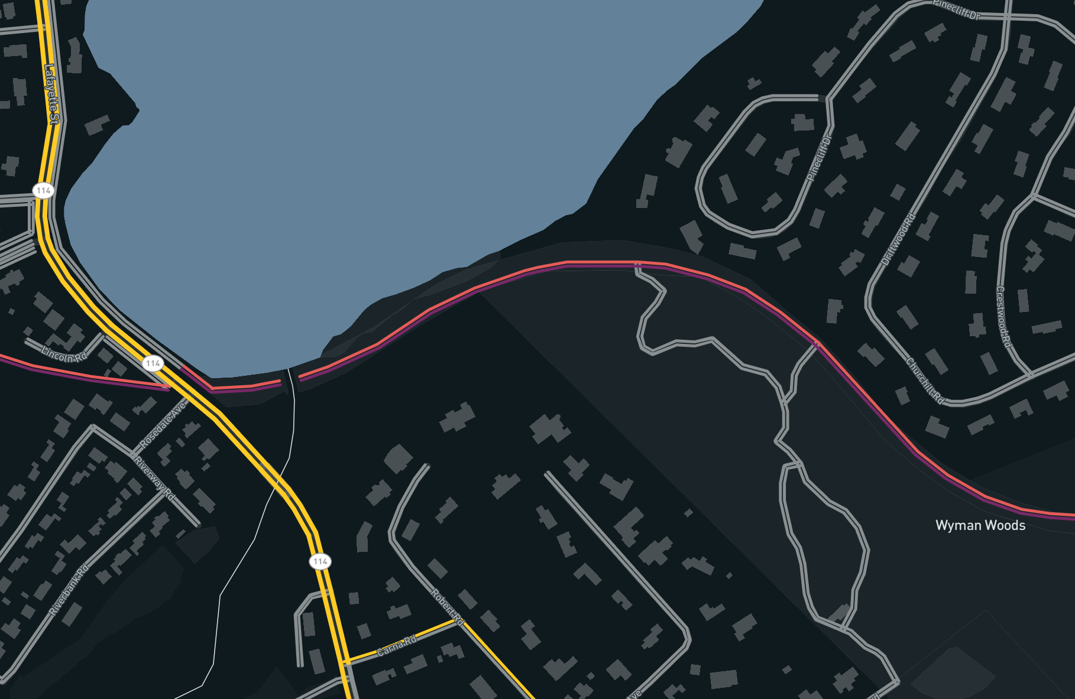
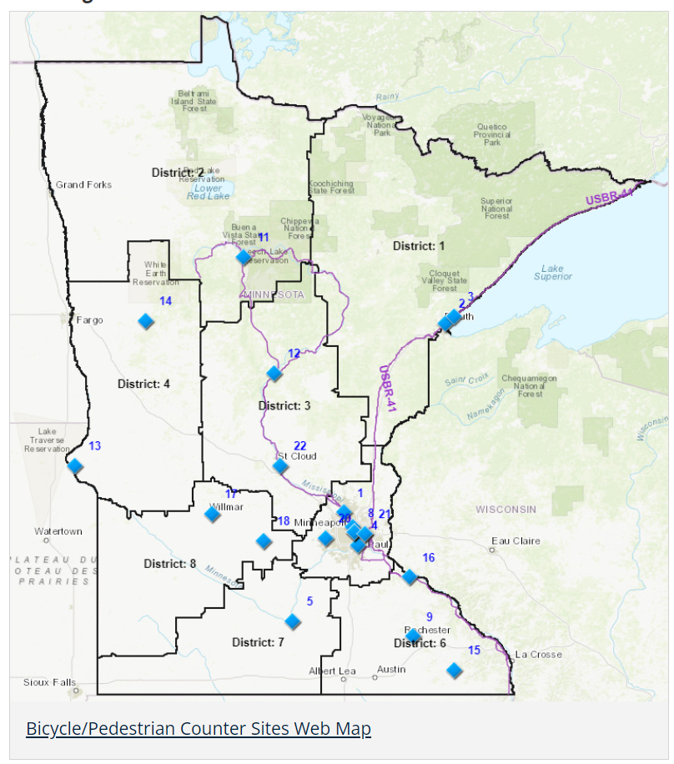
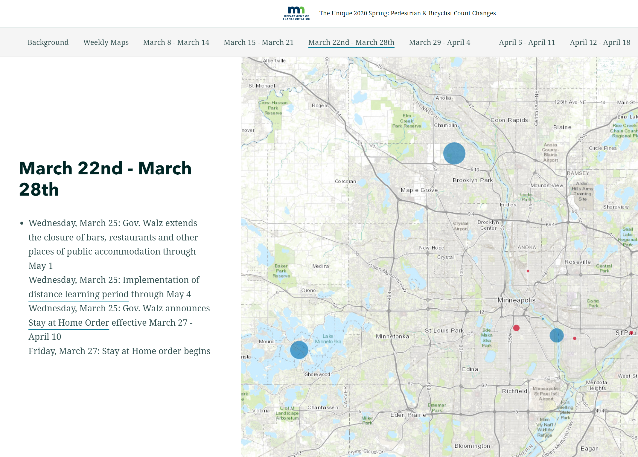
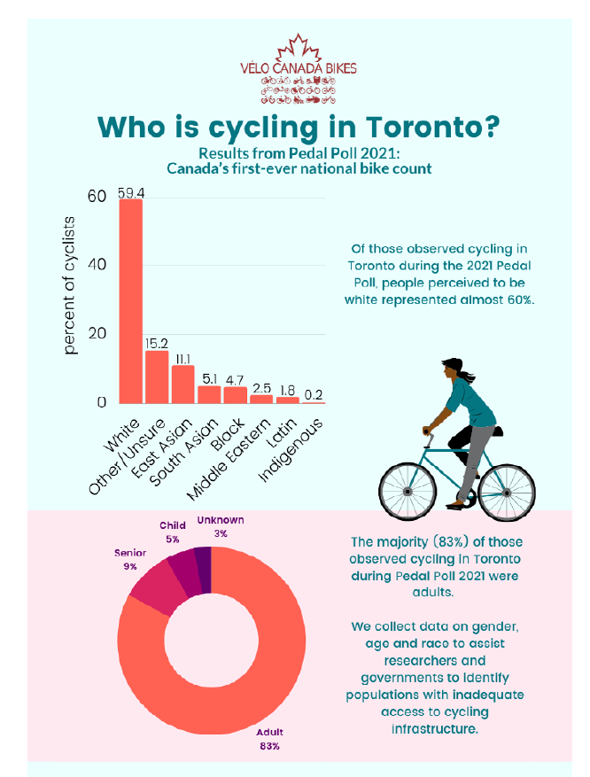
Potential Use and Data Visualization
Potential Use of Count Data
Short or Long Report
Trip Pattern Map
Determine Baseline Volumes
Track Changes in Activity
Track Performance Measures
Inform the Public
Prioritize Bike and Pedestrian Projects
Conduct Risk or Exposure Analysis
Inform Road Safety Audits
Inform Intersection Control Evaluations
Use in Factoring and Studies
Data Visualization
Web Map
Story Map
Story Telling
Source: MnDOT, Vélo Canada Bikes, Pedal Poll 2021.and Replica
Notes:
This slide outlines the various ways count data can be applied to enhance planning and decision-making.
The potential uses include:
Determine Baseline Volumes: which Establish current usage levels.
Track Changes in Activity: which Monitor variations by time, day, season, and weather.
Track Performance Measures: Evaluate project effectiveness.
Inform the Public:
Use in Prioritize bike and ped Projects:
Conduct Risk Analysis
Provide data for road safety evaluations.
Use data for intersection control planning.
Factoring and Studies
Data visualizations can take various forms, including short or long-term reports, network density maps, and trip pattern maps. Other visualization products include web maps and story maps.
For example, MnDOT provides excellent web map visualizations, while the City of Toronto effectively uses a storytelling approach in their data presentations.
These techniques help make data more accessible and engaging for different audiences. Now we can see how Toole used count data in on of our recent project

Slide 8
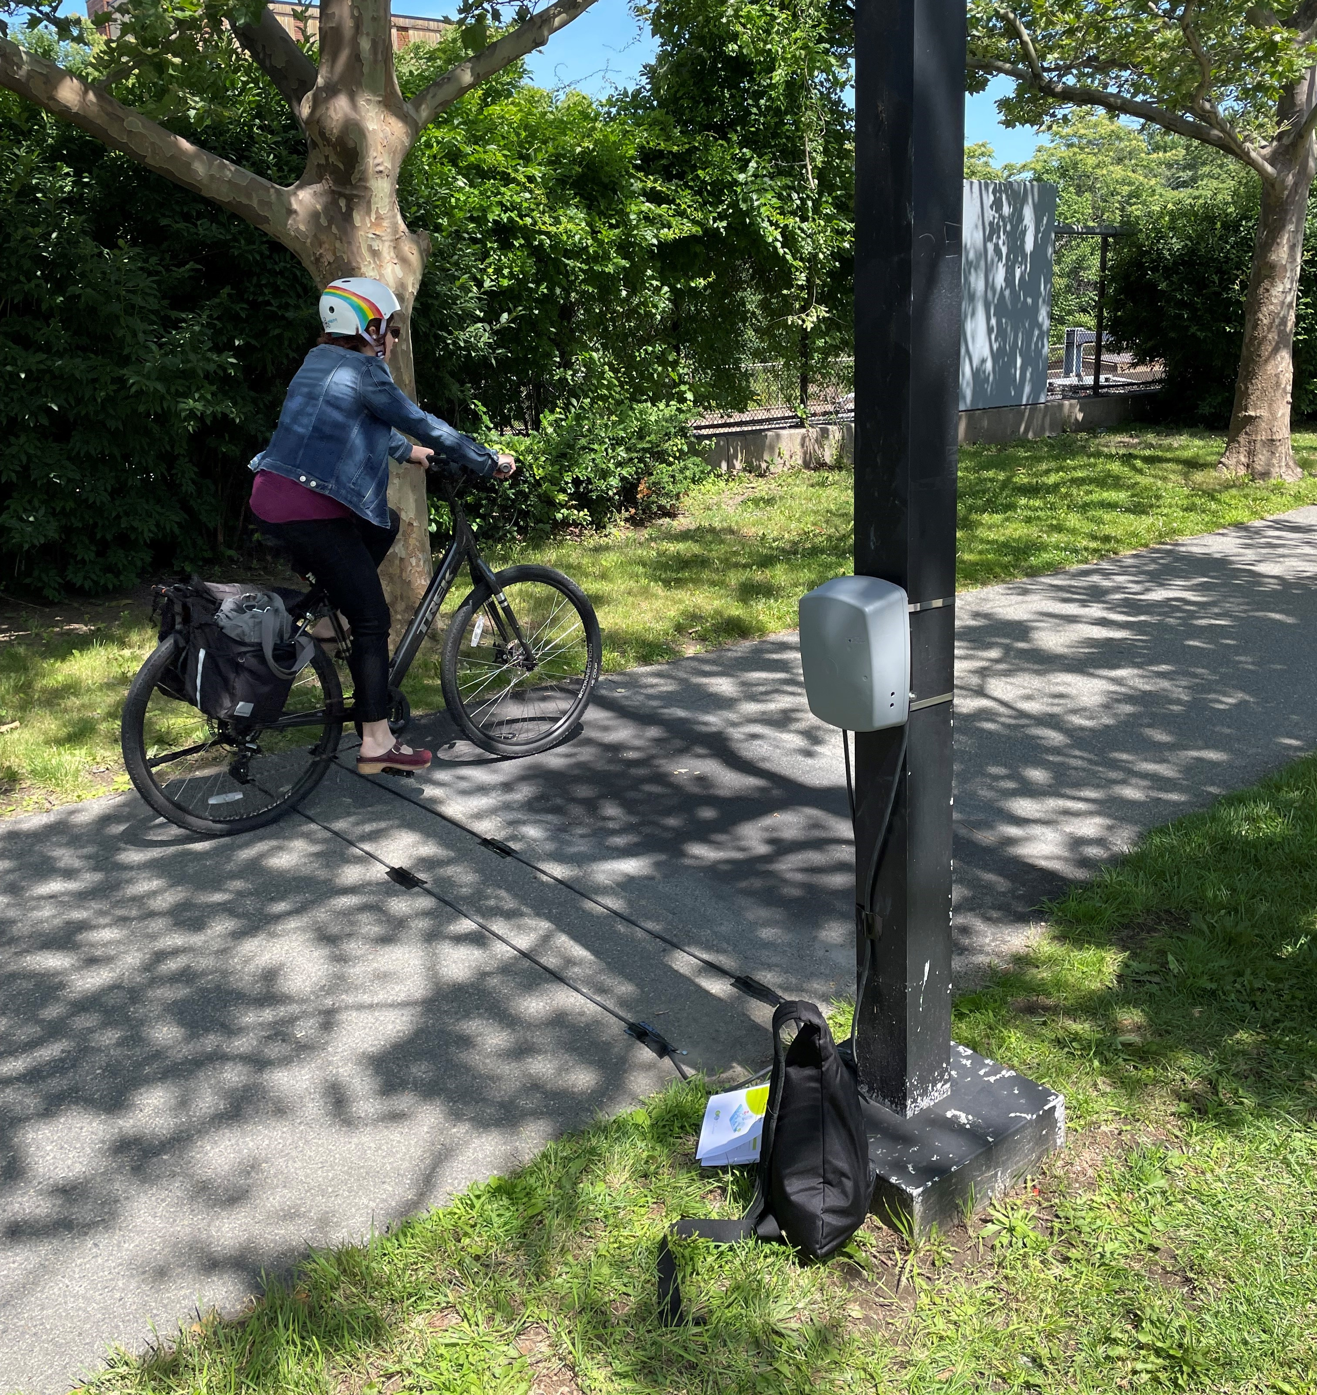
Case Study Southwest Corridor Park (SWCP) Action Plan, Boston, MA
Project
Background
Four-mile Corridor
Existing Recreational and Commuter Corridor
Busy and Narrow Paths
High Stress and Crossing Issues
Corridor Upgradation Action Plan
Data Collection
Method Employed
Count Locations & Time
Picture Courtesy: Toole Design
Automated counters (Eco-counter brand)
Wheeled User Counts
Total 6 count locations
Collected data from July to August 2022
Staff Testing the Automated Counter
Project
Area
Source: SWCP Existing Conditions Summary
Notes:
The Southwest Corridor Action Plan is nearing completion, with the final plan expected to be released in the coming months. In this project, Toole Design has played a key role by assisting with the mobility access study.
To provide some background, the Southwest Corridor in Boston is a linear park stretching roughly 4 miles. It features a variety of recreational facilities and existing commuter and recreational trail paths.
Our existing conditions study revealed several key issues, such as narrow path widths and high-stress intersections. Moreover, pedestrians and cyclists frequently share bike-designated paths, which often leads to congestion and difficulties with passing.
As a result, the path feels particularly high-stress, especially at intersections.
To address these challenges, Toole used automated counters at six locations along the corridor, collecting data from July to August 2022.
As shown in the image on the right, this is one of the count locations with our staff testing the counter.
Additionally, we manually counted wheeled users to ensure they were included in the modal split.

Slide 9
Case Study Southwest Corridor Park (SWCP) Action Plan, Boston, MA
Source: https://www.mass.gov/info-details/southwest-corridor-park-action-plan#interactive-storymap-
Notes:
This slide demonstrates our use of analysis techniques, data visualization, and storytelling to present a data-backed analysis.
The pie charts show bike and pedestrian volume data combined as mode share recorded at each count location along the corridor.
We evaluated path widths and compared volumes in each segment to understand how the number of path users affects the necessary path width for comfort and safety.
Our analysis revealed that current paths are insufficient to handle the current volume based on FHWA’s Shared Use path Level of Service and operating conditions. Pathway was at LOC C which when park is at its functional capacity and with minimal ability to absorb more users.
Consequently, we formed our recommendations based on these findings.

Slide 10
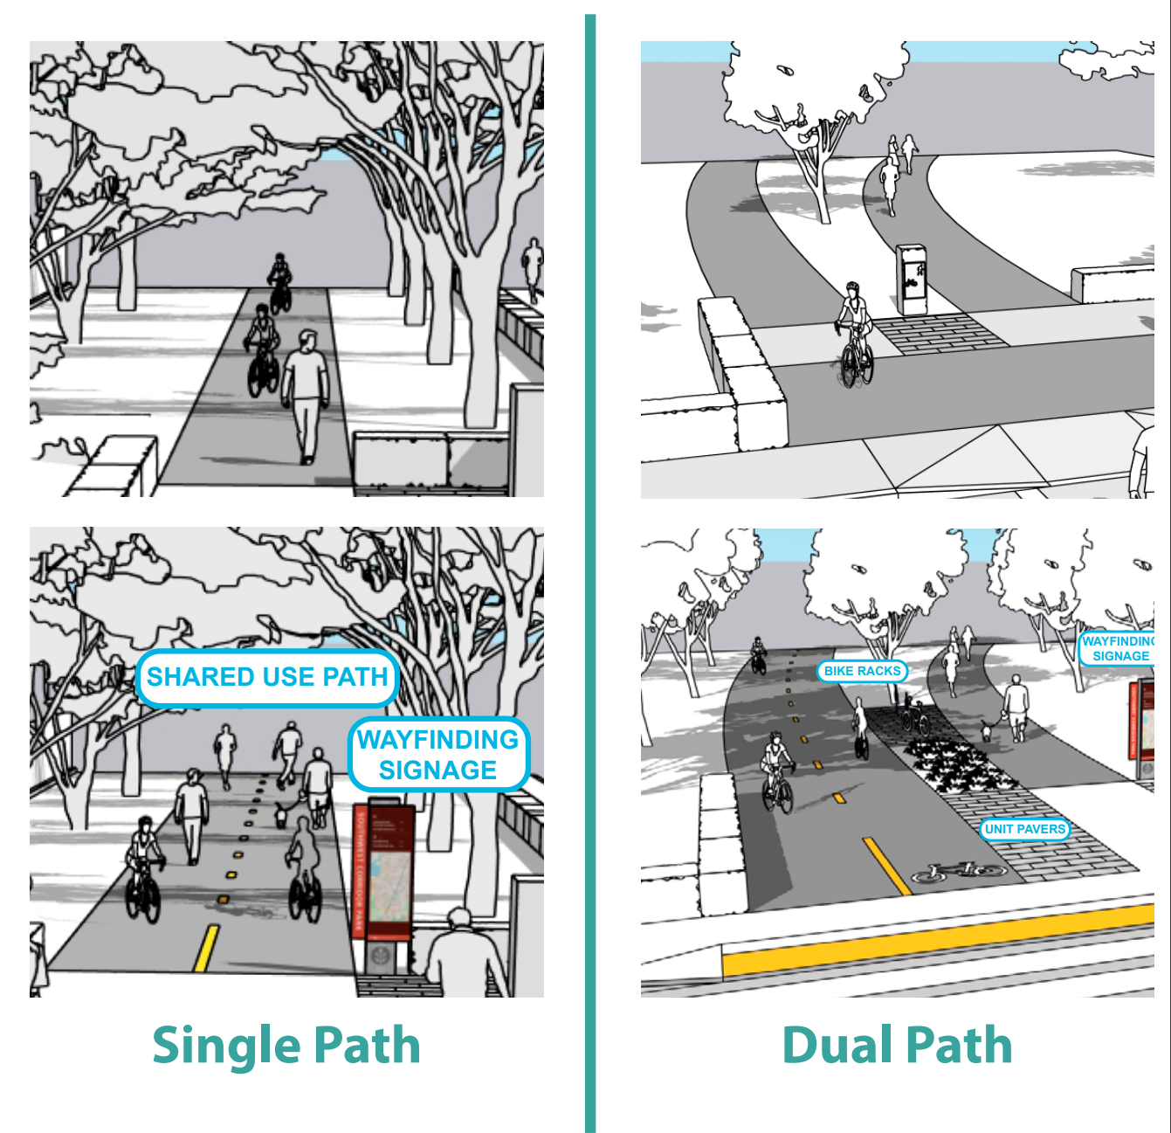
Case Study Southwest Corridor Park (SWCP) Action Plan, Boston, MA
Potential Application
Path Width
The total number of path users affects the required width of the path to accommodate everyone comfortably.
Design Decisions
Volume and mode share help determine whether to create separate parallel paths or a single shared-use path.
Future Planning
Provides a baseline for planning future use and tracking growth over time if data is collected continuously.
Existing
Proposed Improvement
Proposal
Uniform & Improved Path Width
Shared Use / Dual Paths
Improved crossing and Signages and Wayfinding's
Notes:
The count-based analysis provided data-backed rationale to improve the corridor.
We used this analysis to determine path widths and upgrade the corridor to a shared-use path
Our recommendations focused on creating uniform paths, introducing shared-use paths with increased width, and enhancing crossings and signage for improved safety and comfort.
The illustrations on the right show the existing conditions and the proposed improvements for the corridor.
This is a small example of using count data in a trail project. Similarly, we can apply these techniques to other facility types. I hope this case study gave you a clear understanding of how we used the data.

Slide 11
Some Useful Resources
Making Bikes Count - NACTO
Bicycle and Pedestrain Data Collection Manual
FHWA Bicycle – Pedestrian
Count
Non-Motorized Monitoring Program Evaluation and Implementation Plan
NCHRP
Thank You
Notes:
Now, here are some useful resources. These documents are excellent references, and I have drawn much of my content from them. I thought it would be helpful to share them with you. I can provide links if you need further assistance.
That’s all from me. Thank you!

