Slide 1

Cultivating Leadership: Engaging Appalachia’s Emerging Leaders
NADO- DDAA Washington Conference
March 11, 2025

Slide 2



Leadership Programs and Learning Opportunities
Appalachian Leadership Institute
Communities of Practice (CoPs)
Development District Association of Appalachia (DDAA) Peer-To-Peer Program and Professional Development Seminar
Southeast Regional Directors Institute (SERDI)
Community Leadership Programs
Photo Credit: DDAA
Photo Credit: EDA
Photo Credit: ARC

Slide 3
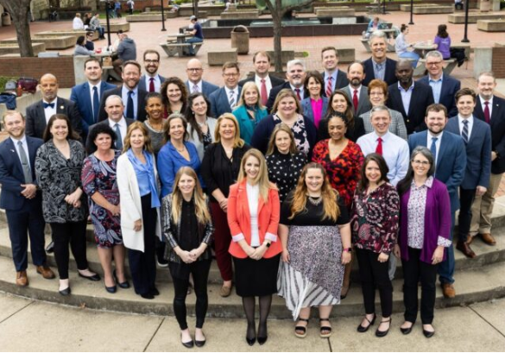
Appalachian Leadership Institute
Participant in 2021-2022 Class
Biggest Takeaways
  Collaboration is key to solving complex problems.
  You probably aren’t the only one facing the challenges you have…lean on your peers!
Photo Credit: ARC

Slide 4


Communities of Practice (CoPs)
Managed by Different Agencies Through Agreement with Economic Development Administration (EDA)
RLF Community of Practice
  Participated in Cohort 2 in 2023-2024
CEDS Peer Exchange Groups
  Current Participant
Mentor Program for Executive Directors
    Great for New EDs!
Photo Credit: EDA
Photo Credit: NADO

Slide 5
Communities of Practice (CoPs): Takeaways
  Implement what you learn.
  Don’t be afraid to try new ways of doing things…think outside the box!
  Take advantage of resources introduced to the most feasible extent for your LDD/EDD.
Photo Credit: EDA
Photo Credit: NADO

Slide 6

DDAA Peer-To-Peer Program
Reimburses Pre-Approved Travel Costs for Peer-To-Peer Visits
Reimbursable Costs
  Mileage
  Airfare
  Meals
  Lodging
Professional Development and Information Sharing
Photo Credit: DDAA

Slide 7
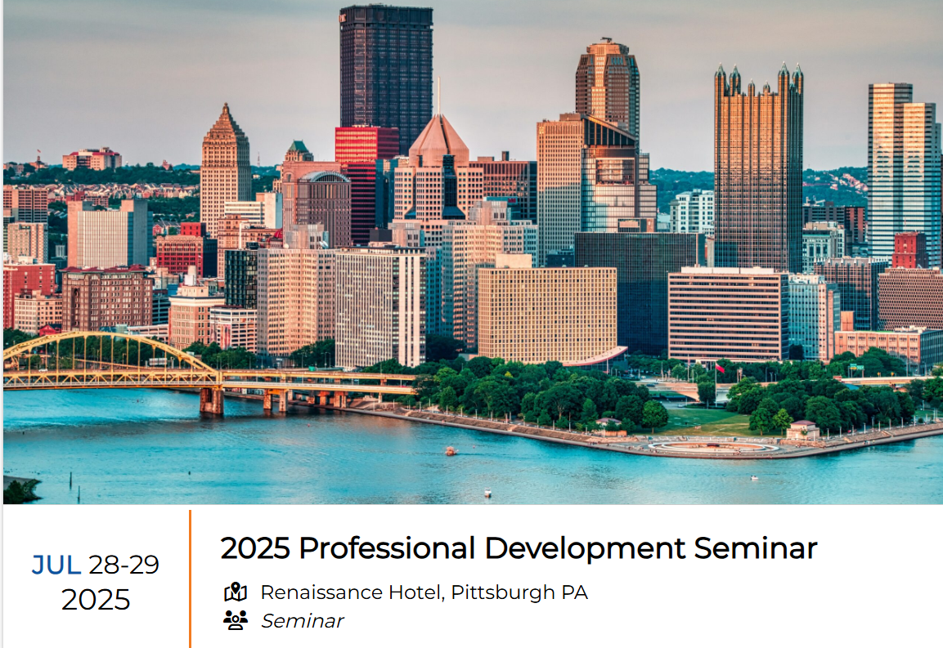
DDAA Professional Development Seminar
Real-World Executive and Employee Development Sessions
Opportunity to Improve Yourself and Your Organization
Topics for All Levels of Employees
Opportunity to Improve Work Skills and Enhance Performance
Photo Credit: DDAA

Slide 8

Southeast Regional Directors Institute (SERDI)
Offers Conferences on Occasion for Emerging Leaders
10 of 13 DDAA States Are Members (Not Ohio, Pennsylvania, and New York)
Offers Associate Membership for Those Outside the Southeast
Photo Credit: SERDI

Slide 9

Community Leadership Programs
Application Process
Existing and Emerging Leaders
Participants: Integral Parts of the Futures of Communities and Regions
Program Days
Group Projects
Photo Credit: Greater Hall Chamber of Commerce

Slide 10
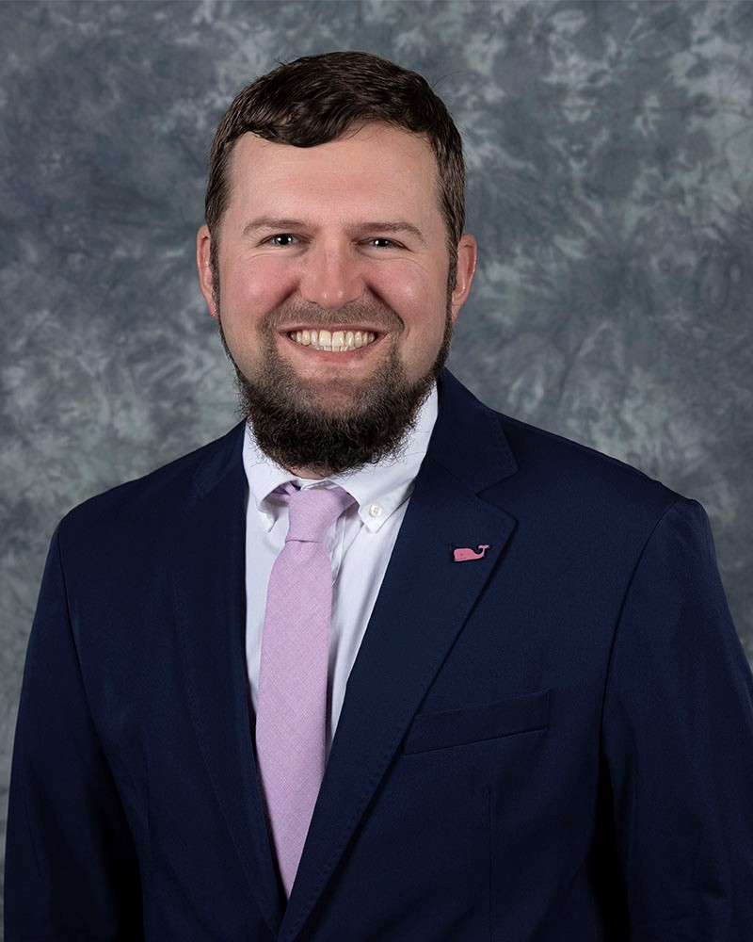
My Closing Thoughts About Leadership
Leadership Is A Mindset
Training Opportunities Are Vital
Listening: A Vital Leadership Skill
Thinking Creatively: A Must!
Be Open to Feedback
Team Mindset
  Example: Team GMRC!

Slide 11
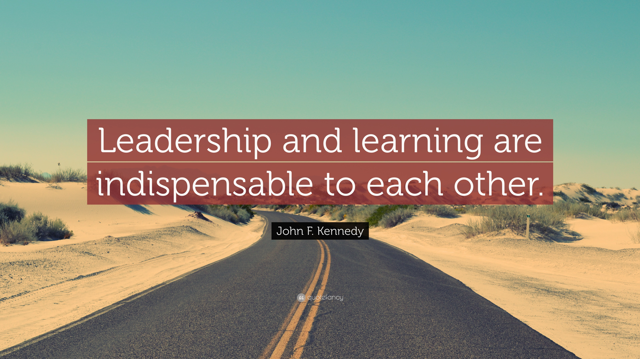
Photo Credit: quotefancy.com

Slide 12
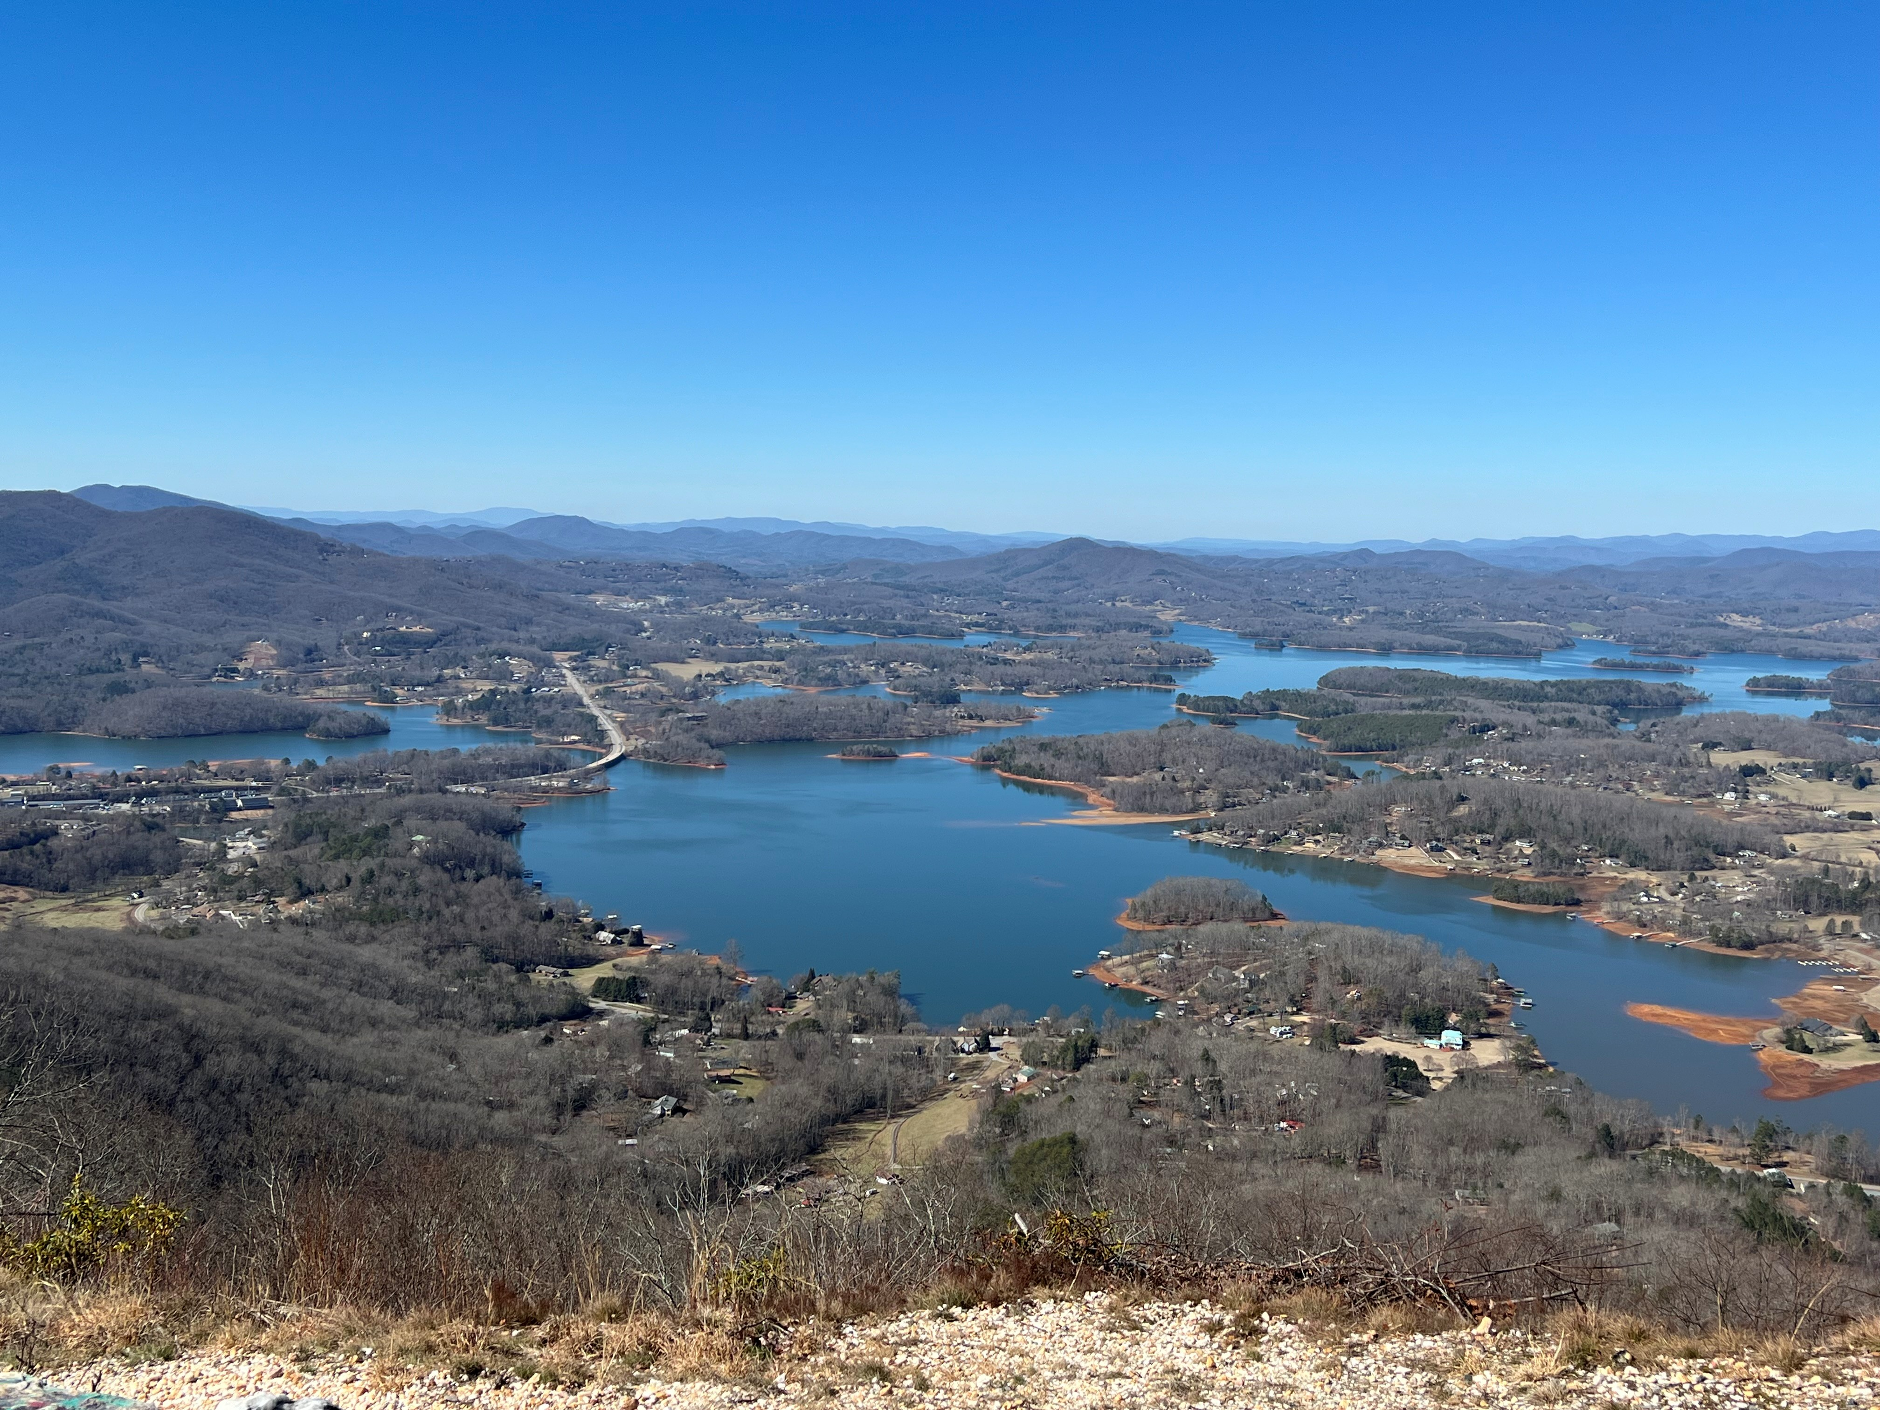
Contact Information
Patrick Larson, Economic Development Director
770-538-2611
plarson@gmrc.ga.gov
http://www.gmrc.ga.gov

