Slide 1

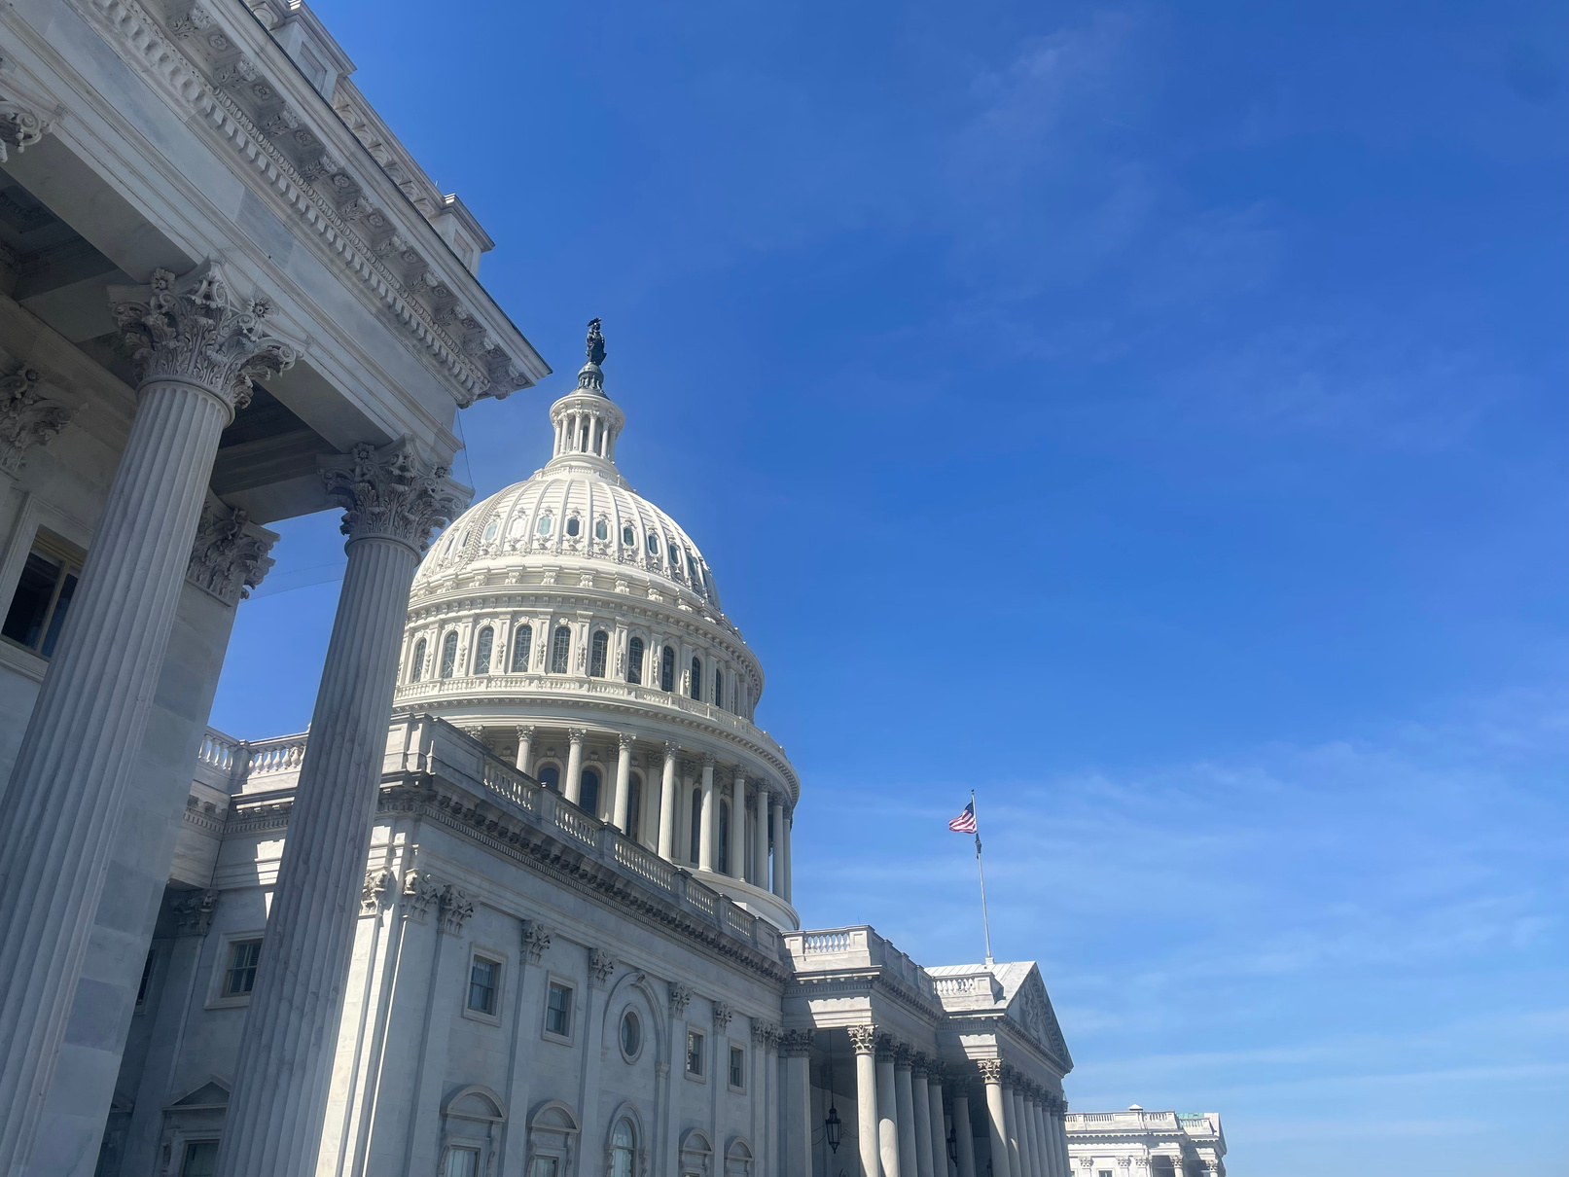

Cultivating
LEADERSHIP
Engaging Appalachia’s Emerging Leaders
Kennedy Webb
Ohio Mid-Eastern
Governments Association (OMEGA)

Slide 2
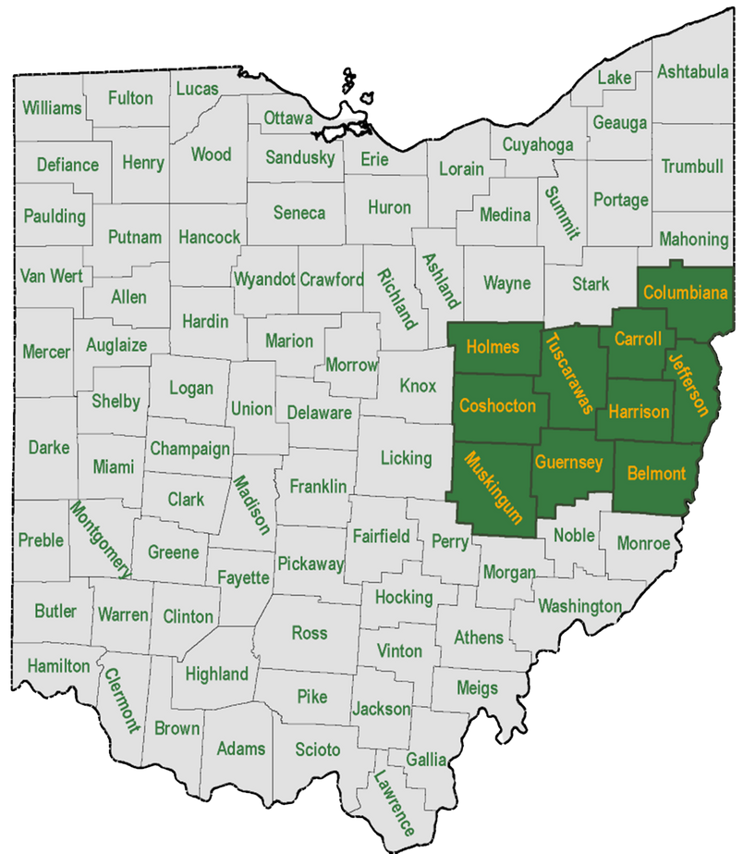
OMEGA
Who is
and what do we do?
Belmont, Carroll, Columbiana, Coshocton, Guernsey, Harrison, Holmes, Jefferson, Muskingum, & Tuscarawas Counties

Slide 3
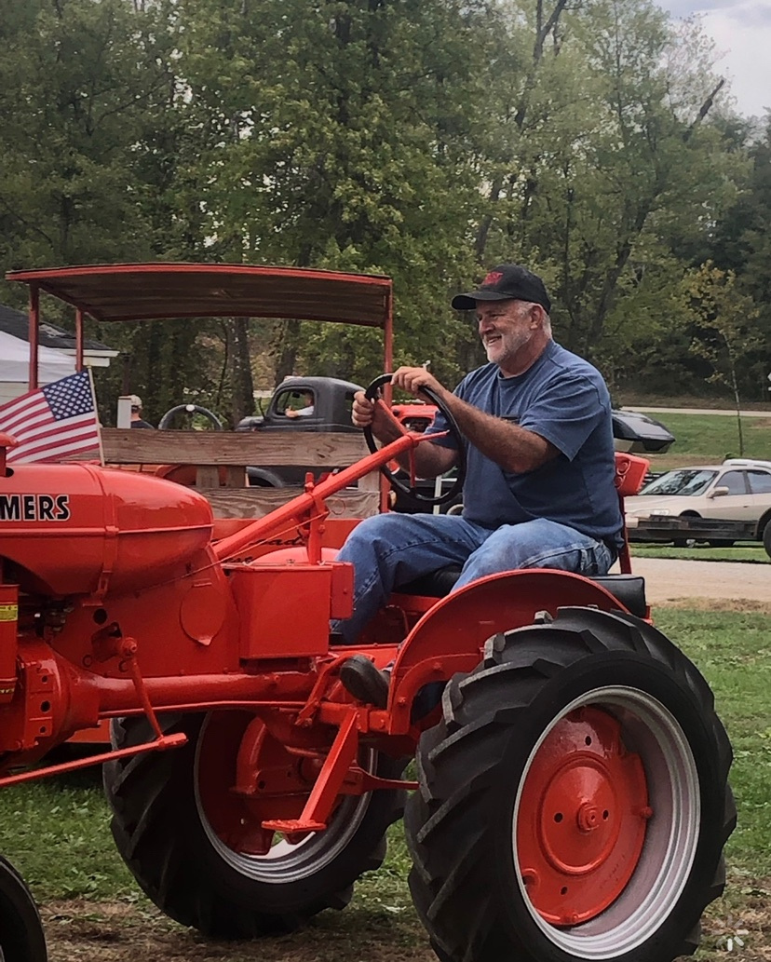
Know your
Constituency
  Attire
  Communication style
  Approach

Slide 4

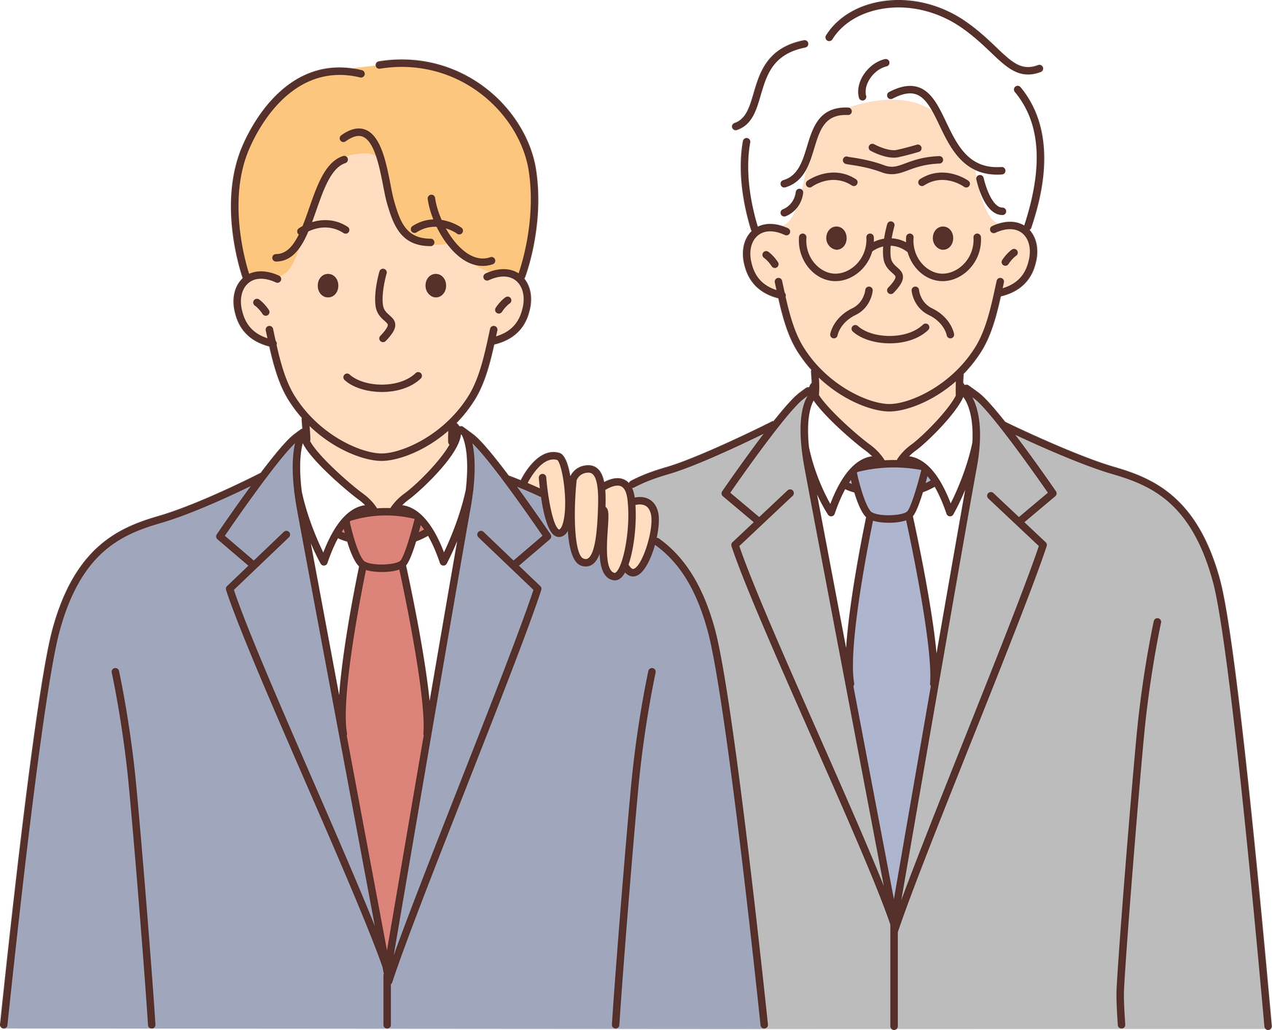
Intergenerational
Collaboration
PRIORITIES
  Work Environment
  Understanding/Supportive Management
  Work Life Balance
  Mental Health
  Opportunities for Growth
  Feeling of being Valued and Appreciated

Slide 5
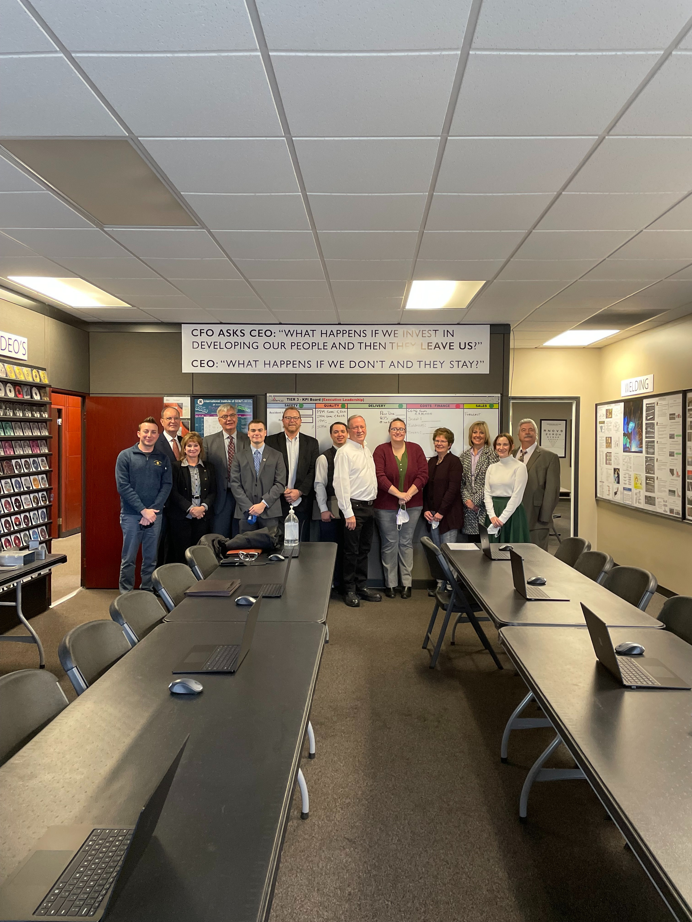
Training
and Mentorship
  COMPCO Training Facility - Salem, OH
  An opportunity for intergenerational collaboration
  Impact of Mentorship & Training

Slide 6
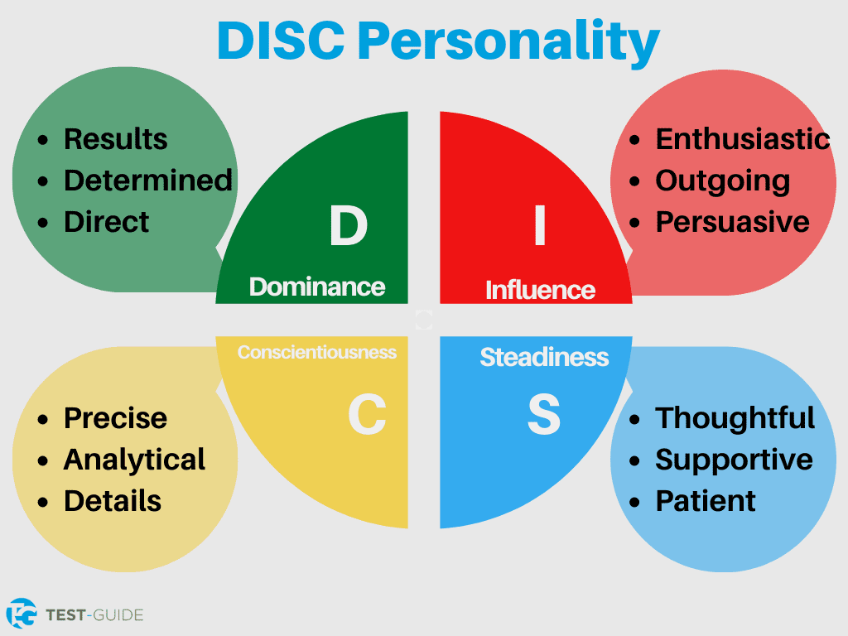

Slide 7
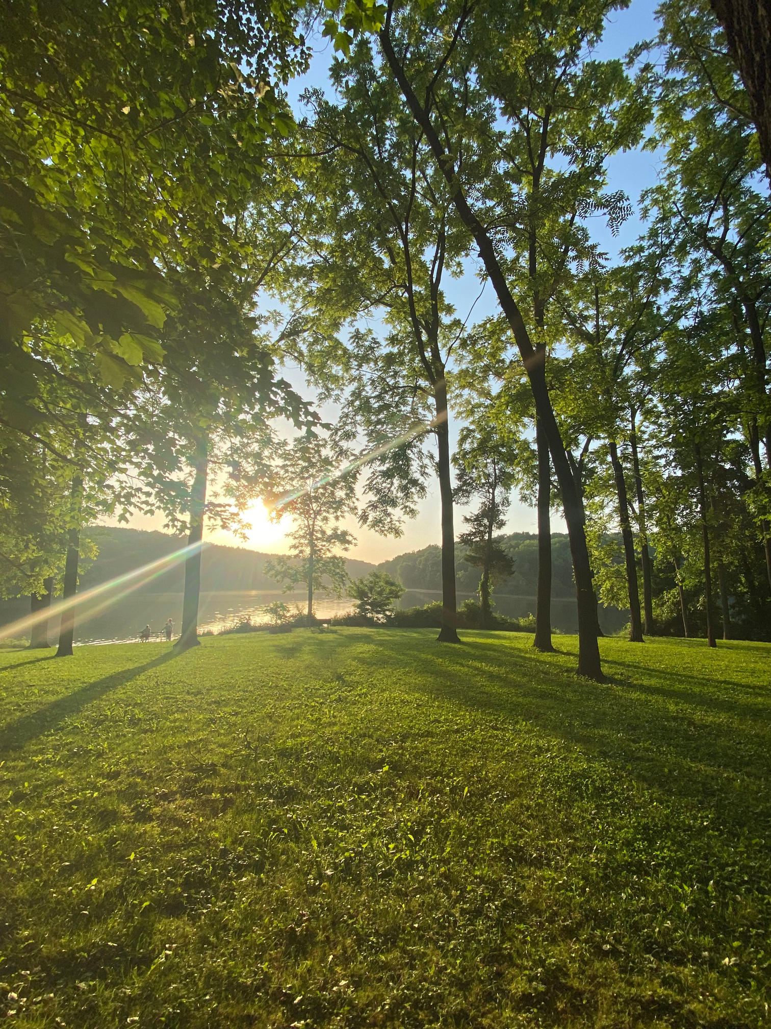
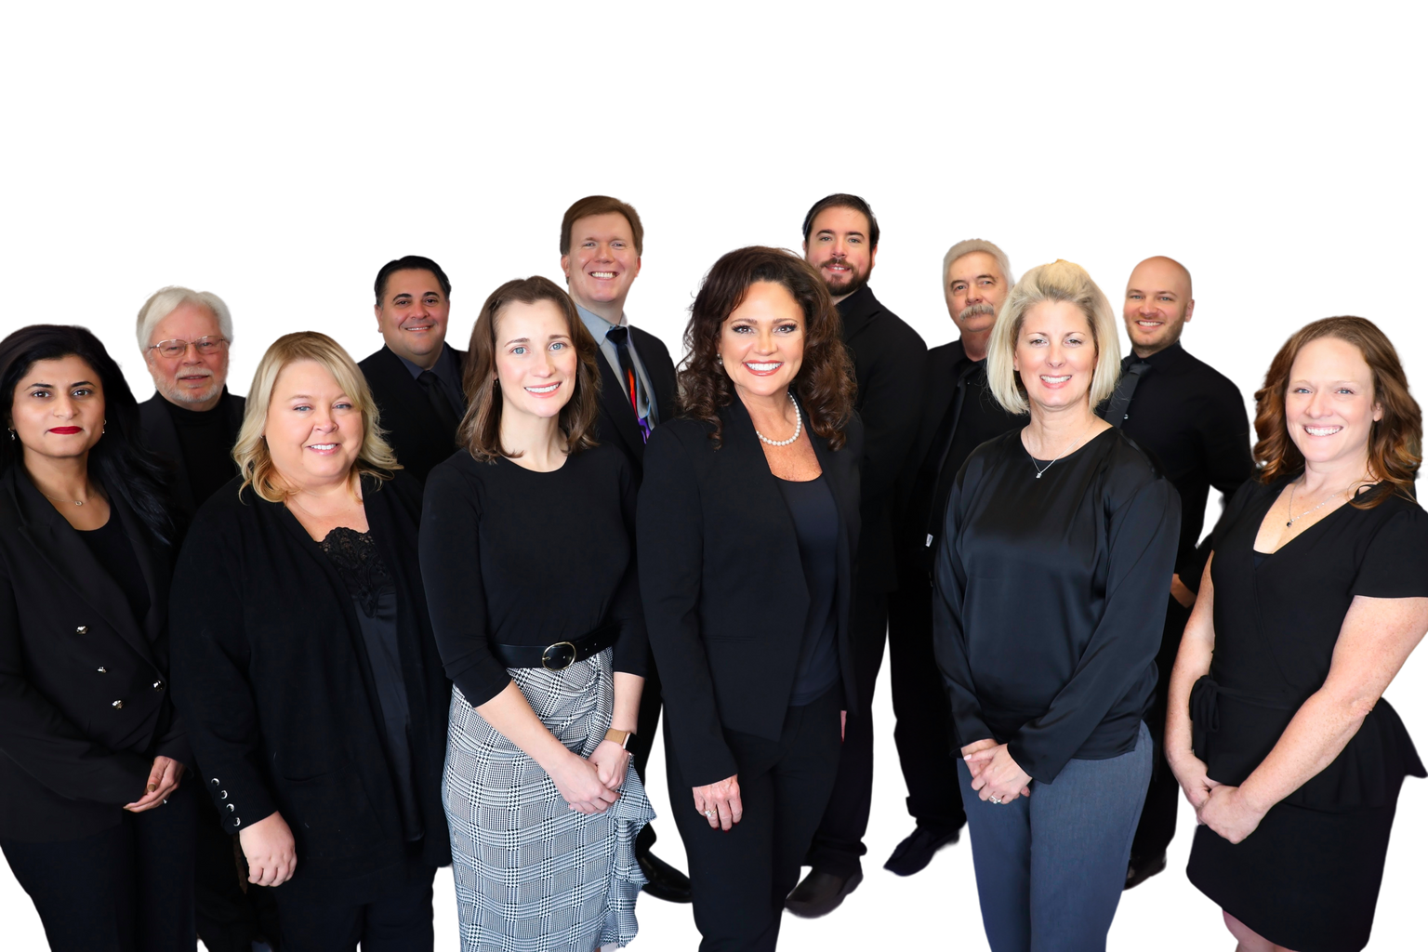
What makes a
Good Leader?
  What does NOT impact ability
  Calling to lead
  Helping your team succeed
  Power and its impact

Slide 8
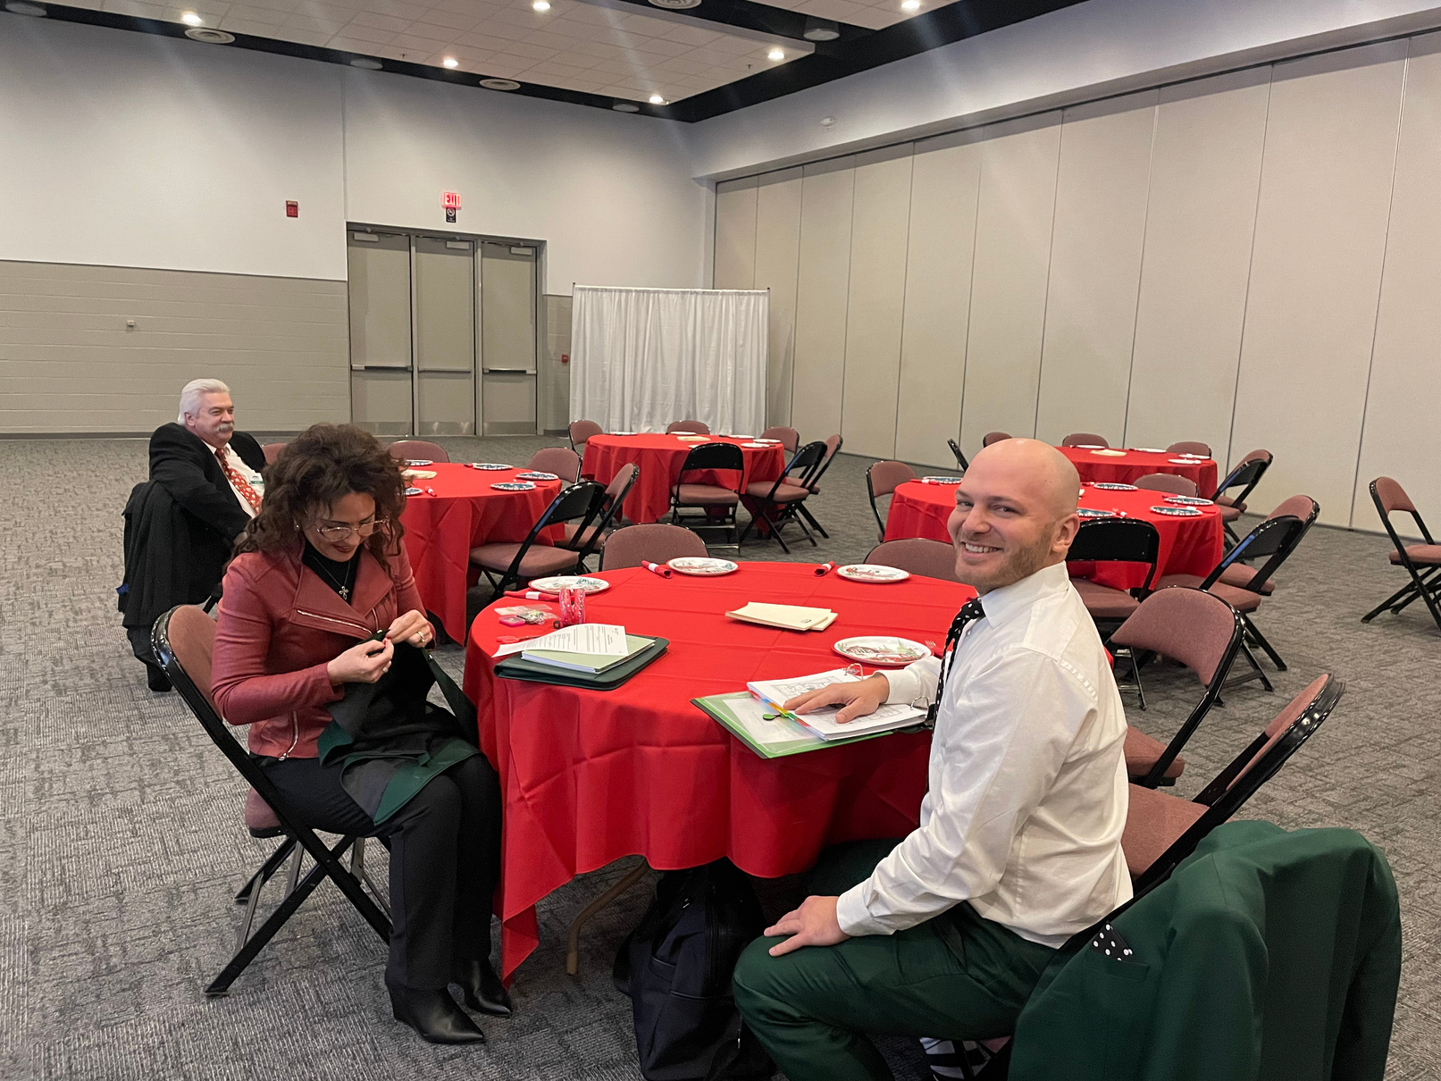
Three Tools of Leadership
01. Humility
02. Fighting Complacency
03. GRACE

Slide 9


Fighting
Complacency
Nokia
Yahoo!

Slide 10


Good
Leaders
have GRACE
Generousity
Respect
Action
Compassion
Energy

Slide 11
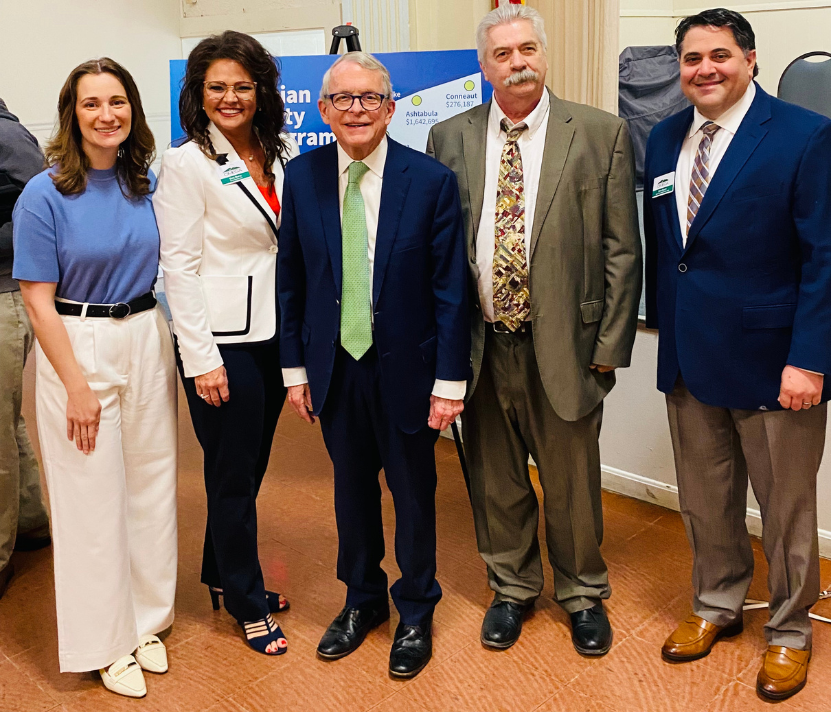





Thank you for your time!
kwebb@omegadistrict.org
www.omegadistrict.org

