Slide 1
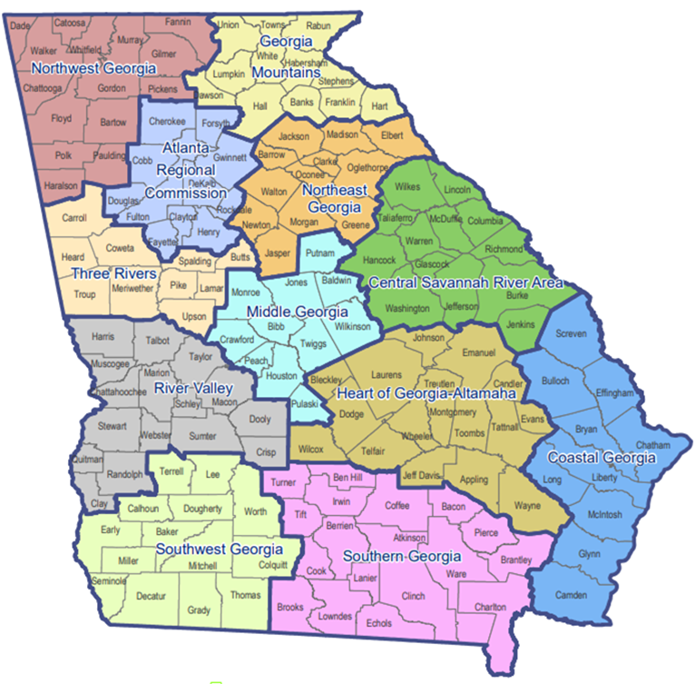
Georgia’s REVAMP
Program
NADO – DDAA 2025 Washington Conference
March 11, 2025
Faith Bryan, GISP
Georgia Mountains Regional Commission

Slide 2
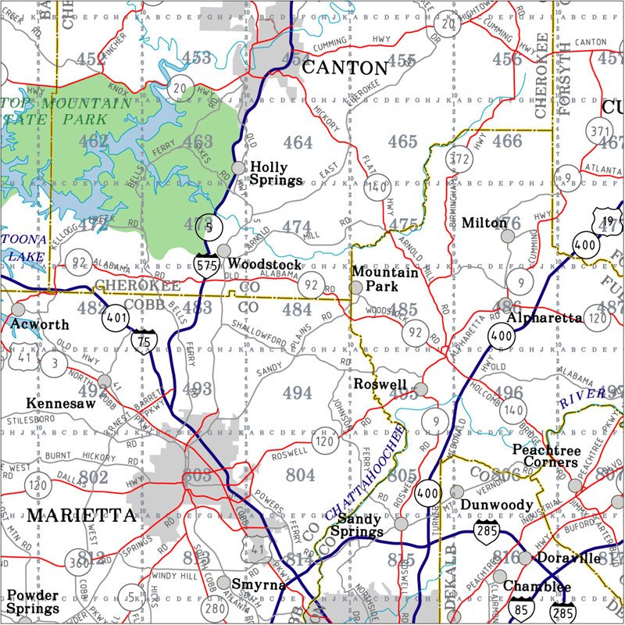

MAP-21
Moving Ahead for Progress in the 21st Century
MAP-21 Act signed into law in 2012
Funded surface transportation programs at over $105 billion for fiscal years 2013 and 2014
Enhanced federal efforts to improve the safety and efficiency of America’s roadway transportation system

Slide 3
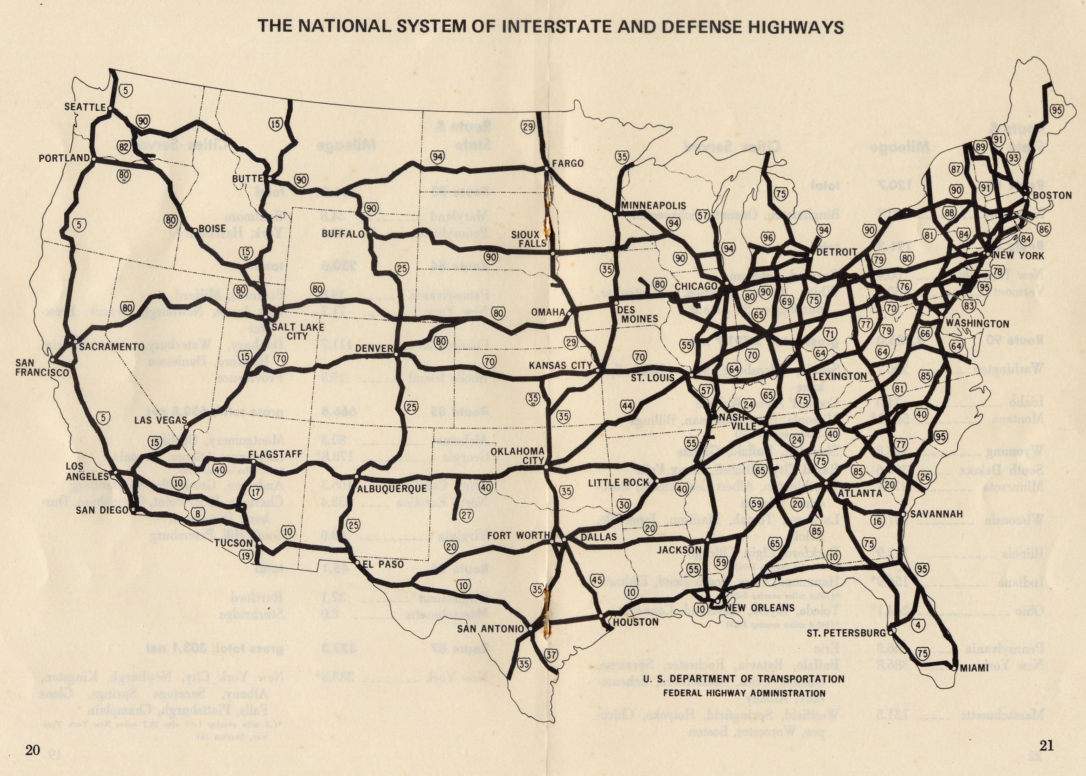
MAP-21
Moving Ahead for Progress in the 21st Century
The Mandate
In November 2016, MAP-21 required all states to expand annual validation, collection, and reporting of specific roadway elements to all public roads (state, county, and city)

Slide 4
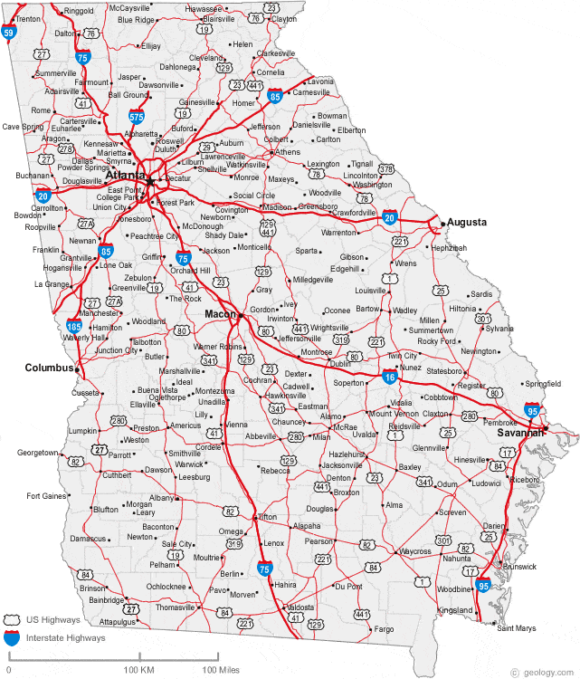
MAP-21
Moving Ahead for Progress in the 21st Century
The Mandate
For Georgia, this legislation increased the annual reporting of 18,000 federal/state centerline miles to over 125,000 public centerline miles
Previous in-house GDOT procedures to collect and report this data were no longer feasible

Slide 5



MAP-21
Moving Ahead for Progress in the 21st Century
January 2017, Georgia Department of Transportation partnered with the Georgia Association of Regional Commissions and the University of Georgia’s Carl Vinson Institute of Government to meet the MAP-21 mandated requirements for Georgia

Slide 6

MAP-21
Moving Ahead for Progress in the 21st Century
Objectives of the Program
  Capture and validate fundamental data elements (FDEs) that are important for federal reporting needs and for State, Regional, and Local Governments for data management activities

Slide 7
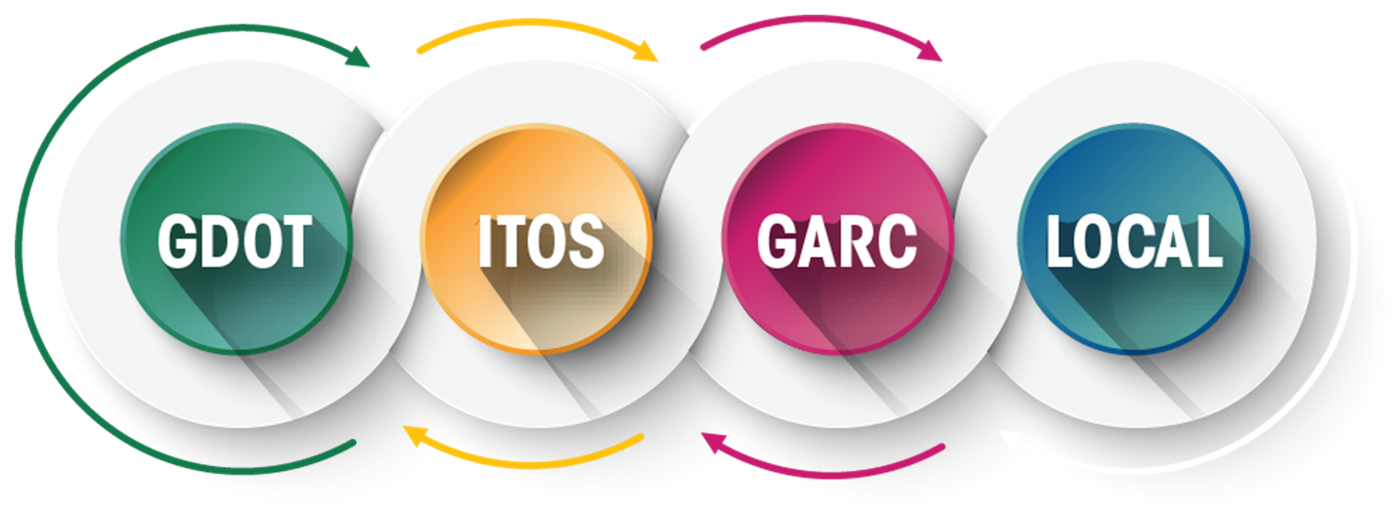

Flow of
Information
Innovative Approach
  3-Way intergovernmental partnership (PPP)
  Efficient approach to handle 159 counties
  Focus on data quality (redundant QA/QC)
  Supports asset management, planning, and safety programs on all levels (local, state, and federal)

Slide 8
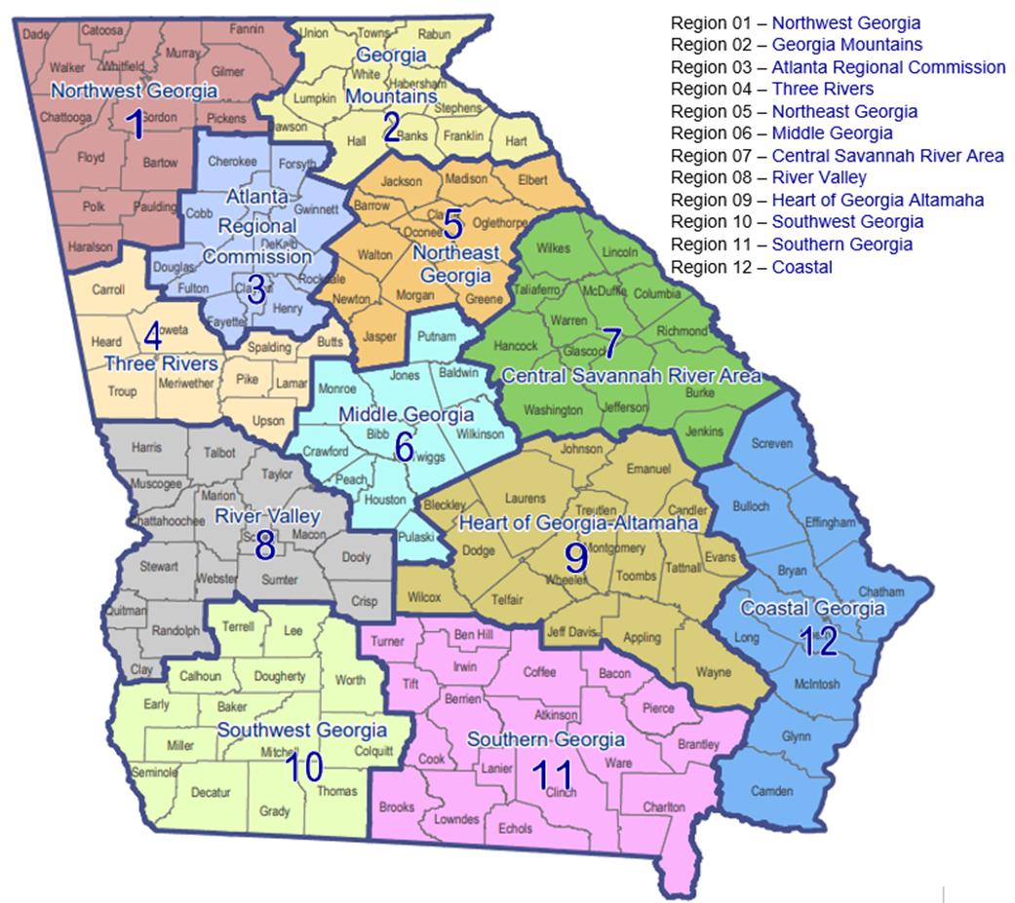
RC Roles and Responsibilities
Community Engagement / Planning
  All Regional Commissions
GIS Validation / Data Capture
  All RCs except CSRA
Advanced GIS / Scripting
  Coastal RC
  Southern Georgia RC
  Atlanta RC
Project & Fiscal Management
  Middle Georgia RC
GAP (extra-territorial) Services
  Coastal RC
  Middle Georgia RC
  Northeast Georgia RC
  Northwest Georgis RC
  Southern Georgia RC
~25 GIS Staff across Regional Commissions

Slide 9
MAP-21
Moving Ahead for Progress in the 21st Century
Current Status
Phase 1: Complete (January 2017 – February 2021) = 49 months
  Ownership (County or City)
  Operation (One-Way, Two-Way)
  Surface Type (Asphalt, Gravel, Concrete)
  Through Lanes (Number of Lanes)
  Median Type (If number of lanes more than two)
  Road Names
  Traffic Control Devices

Slide 10
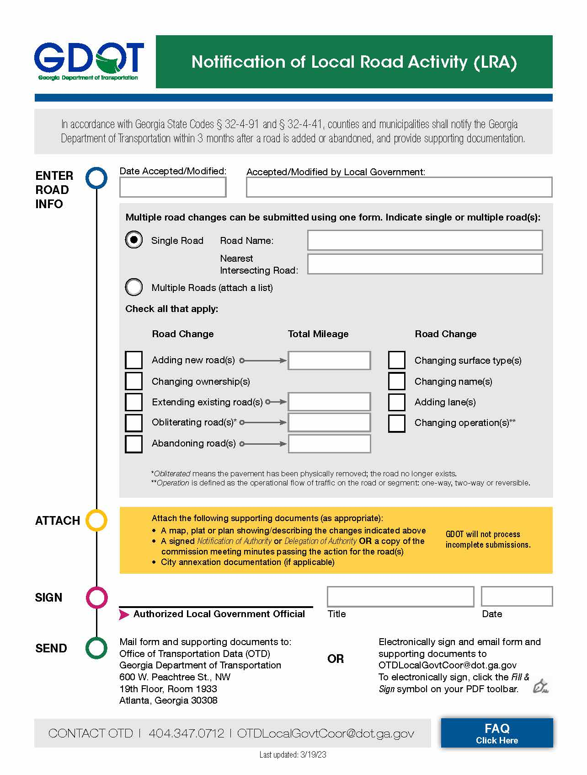
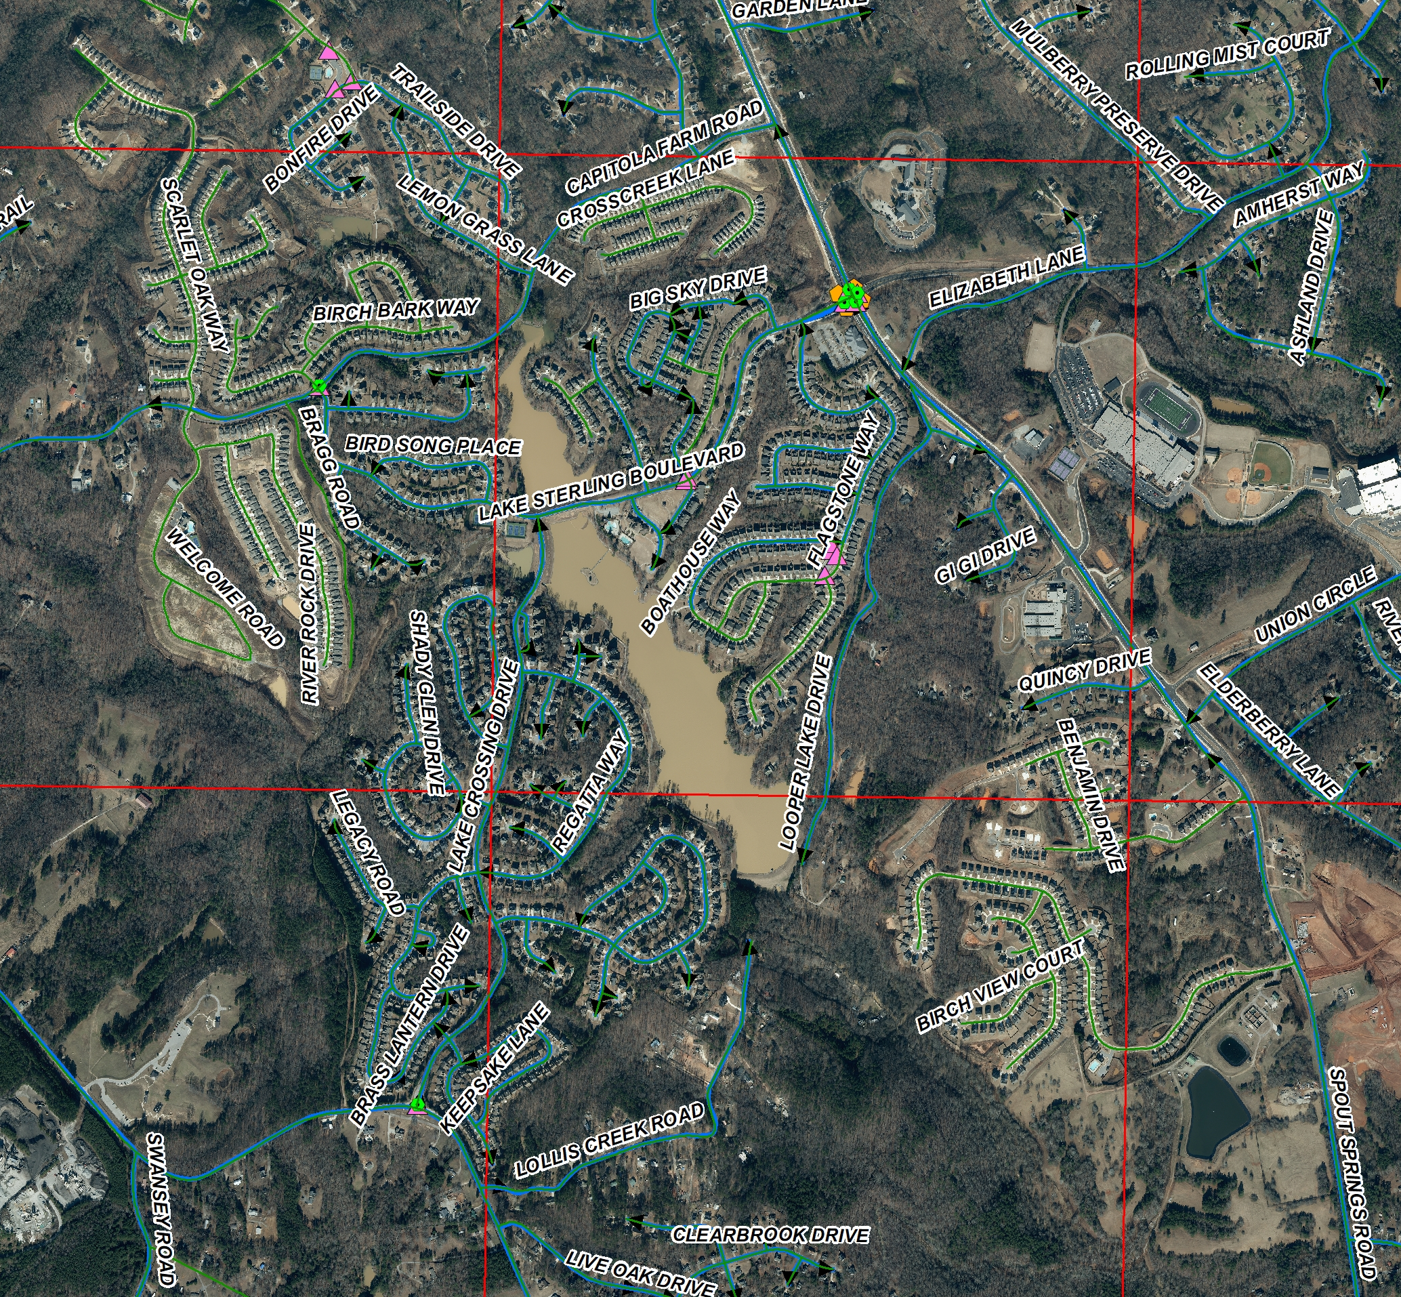
GDOT Local Road Activity Program

Slide 11
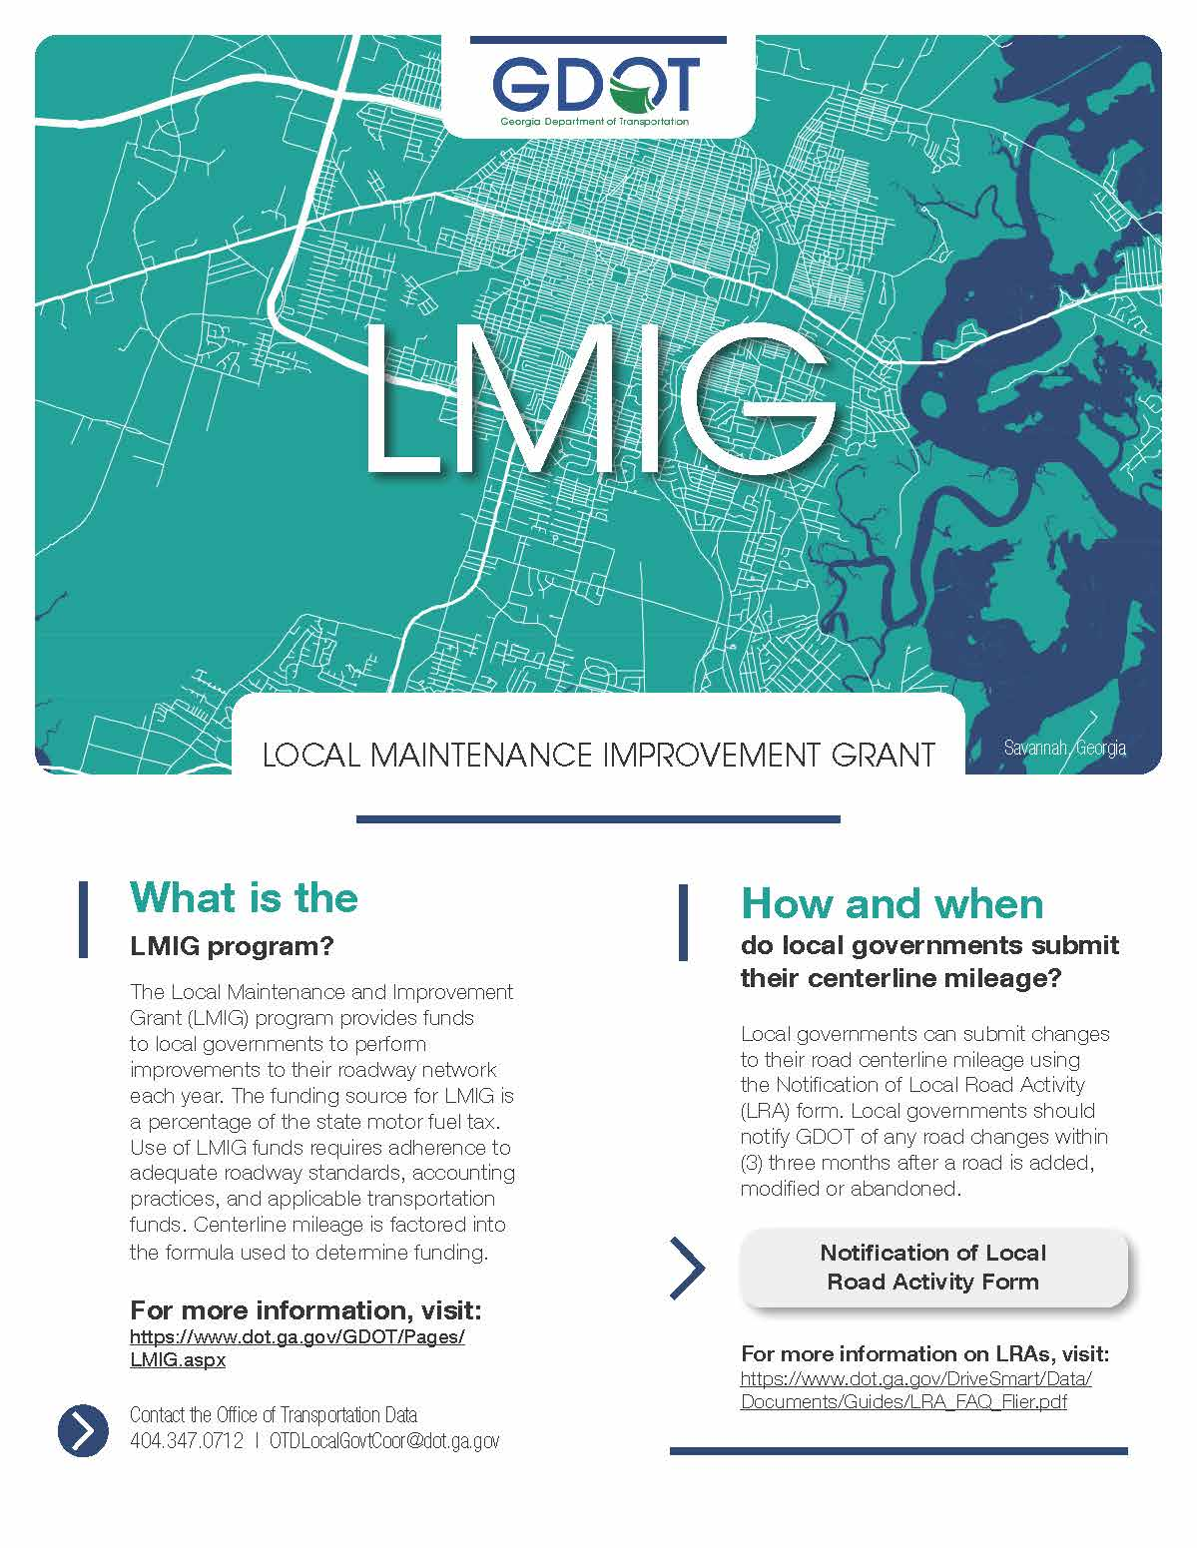
GDOT Local Maintenance
Improvement Grant

Slide 12
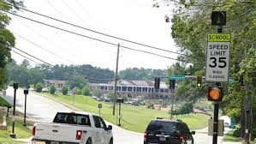
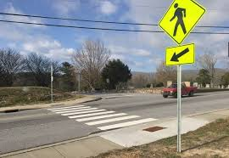
MAP-21
Moving Ahead for Progress in the 21st Century
Current Status
Phase 2: Complete (March 2021 – September 2022) = 19 months
  School Zone Locations
  Sidewalk Presence (within municipal boundaries and near schools)
  Pedestrian Signal Presence (within municipal boundaries)
  Crosswalk Presence (within municipal boundaries)

Slide 13
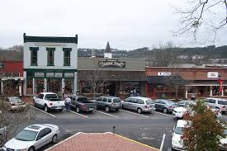
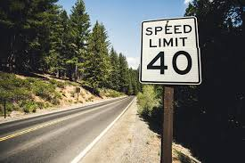
MAP-21
Moving Ahead for Progress in the 21st Century
Current Status
Phase 2: Complete (March 2021 – September 2022) = 19 months
  On Street Parking (within municipal boundaries)
  Turn Lanes
  Speed Limit Zones (Federal Aid System)
  Re-branded to REVAMP –
  Roadway Element Validation and
  Mapping Program

Slide 14




Slide 15
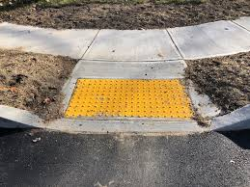

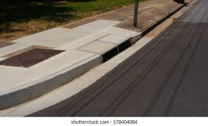
REVAMP
Roadway Element Validation and Mapping Program
Current Status
Phase 3: Complete (October 2022 – January 2024) = 16 months
  Sidewalk Presence (full county)
  Pedestrian Signal Presence (full county)
  Crosswalk Presence
  Curb Ramps
  Curb Presence
  Bike Lanes (marked)
  Median Barrier Type

Slide 16


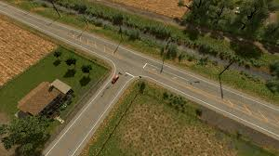
REVAMP
Roadway Element Validation and Mapping Program
Current Status
Phase 4: Complete (February 2024 – December 2024) = 11 months
  Edge Line Presence
  Type of Intersection
  Intersection Number of Legs
  Intersection Geometry
  Roundabout – Inscribed Diameter
  Median Type at Intersection

Slide 17
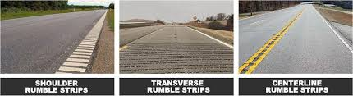
REVAMP
Roadway Element Validation and Mapping Program
Current Status
Phase 5: (February 2025 – TBD)
  Median Crossover/Left-Turn Lane Type (Fed Aid Roads)
  Right Turn Channelization (Fed Aid Roads)
  Centerline and Right Shoulder Rumble Strips (Local Roads)
  Transverse Rumble Strip (Local Roads)
  Multi-Use Paths (All Roads)

Slide 18
REVAMP
Roadway Element Validation and Mapping Program
Data Elements: Phases 1 - 5
Ownership
Surface Type
Number of Lanes
Median Type
Median Barrier Type
Operation (1-way or 2-way)
Road Names
School Zones
Sidewalk Presence
Crosswalk Presence
Pedestrian Signal Presence
Curb Presence
Curb Ramps
Number of Turn Lanes
On-Street Parking Type
Speed Limit Signage
Bike Lanes (Marked)
Multi-Use Paths
Type of Intersection
Intersection Number of Legs
Intersection Geometry
Median Type at Intersection
Roundabout – Inscribed Diameter
Edge Line Presence
Median Crossover / Left Turn Lane Type
Right Turn Channelization
Centerline and Right Shoulder Rumble Strip Presence
Transverse Rumble Strip Presence
Guardrail Presence
Traffic Control Devices

Slide 19
REVAMP
Roadway Element Validation and Mapping Program
Important Program Recognition Points
  GDOT recognizes that required data elements cannot reasonably be collected through previous business processes prior to MAP-21
  MAP-21 mandate is the responsibility of the State of Georgia
  No one knows the data or roads better than the local governments

Slide 20
REVAMP
Roadway Element Validation and Mapping Program
Innovative Approach
  REVAMP supports asset management and safety programs on all levels (local, state and federal)
  Is focused on data quality
  2017 NADO Innovation Award Recipient for MAP-21
  2023 FHWA AEGIS National Recognition

Slide 21

Faith Bryan, GISP
Director of Information Services
(770)538-2626 fbryan@gmrc.ga.gov

