Slide 1

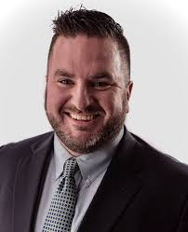
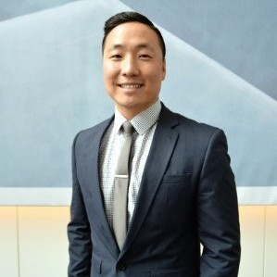
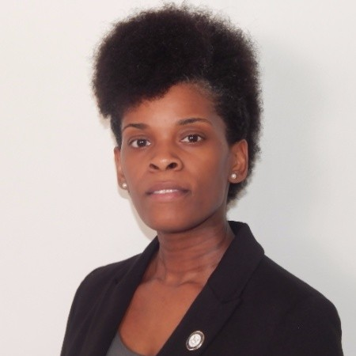
Innovative Readiness Training: A Model for Defense Communities
Blake Edge
Director, Community and Economic Development
Green River Area Development District
Captain Chris Park
Deputy Program Manager, IRT
Air National Guard, United States Air Force
Christina Wooden
Health Programs Manager
Delta Regional Authority

Slide 2
Captain Park Video

