Slide 1


InfoMentum
An Economic Development Data Engine for Upstate SC

Slide 2

Picture it: Upstate SC, 1991(ish)

Slide 3
InfoMentum Overview
ACOG program started in 1995 to help economic developers attract industry and create jobs
Suite of services provides:
  GIS-based research tools
  Robust market data
  Online industrial and office property database
Overseen by the Economic Development Information Systems (EDIS) Partnership, a board of program investors

Slide 4

InfoMentum Investors

Slide 5
InfoMentum Online
  An online data clearinghouse and mapping tool
  Full access available to investors, limited access available to public
  Provides investor-branded marketing materials for sites and buildings
  53 demographic & market research reports available
  14,700+ variables

Slide 6
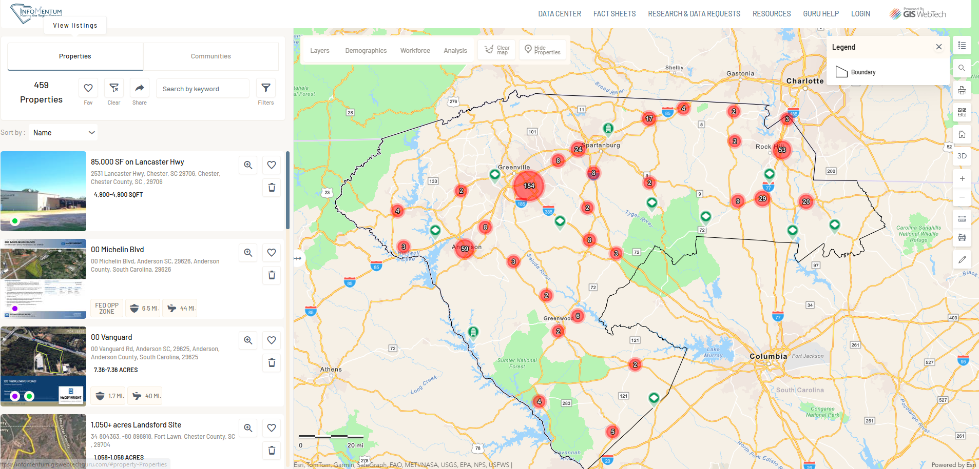

Slide 7
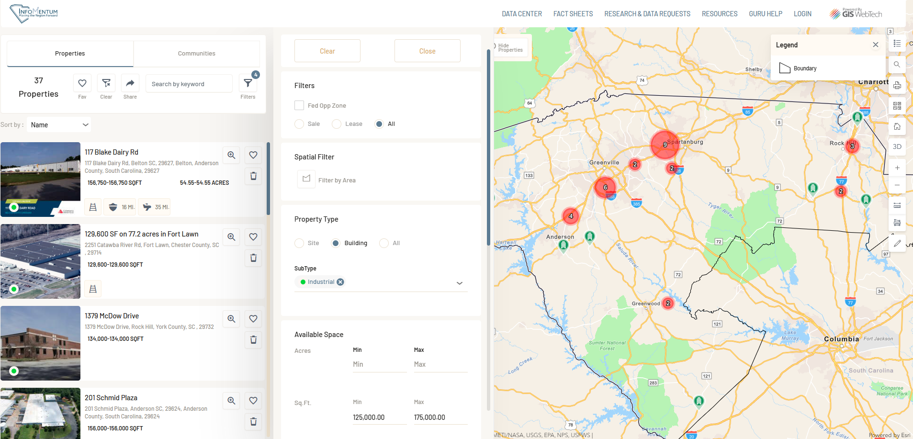

Slide 8
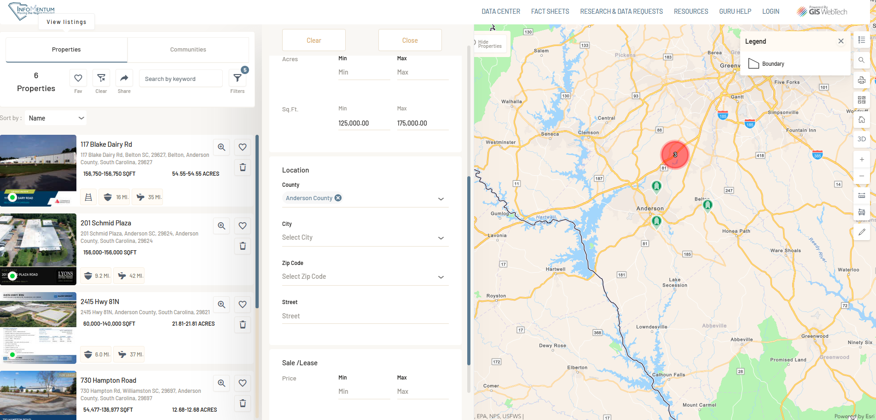

Slide 9
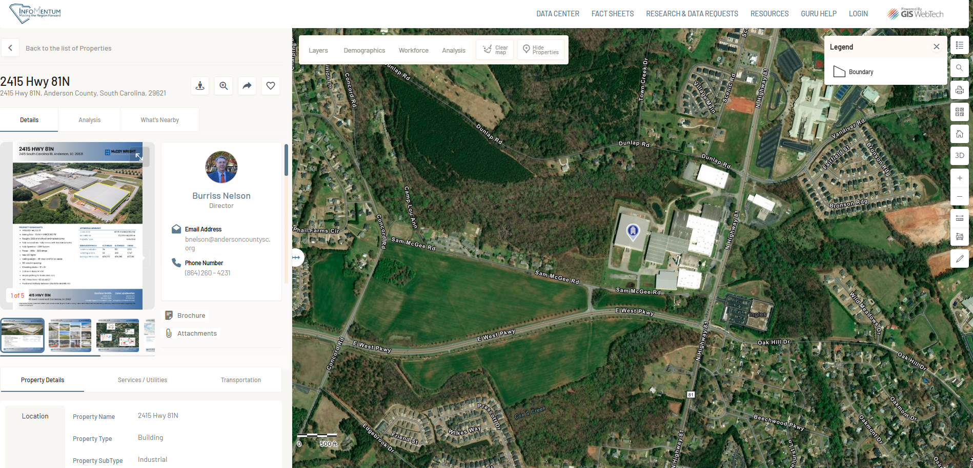

Slide 10
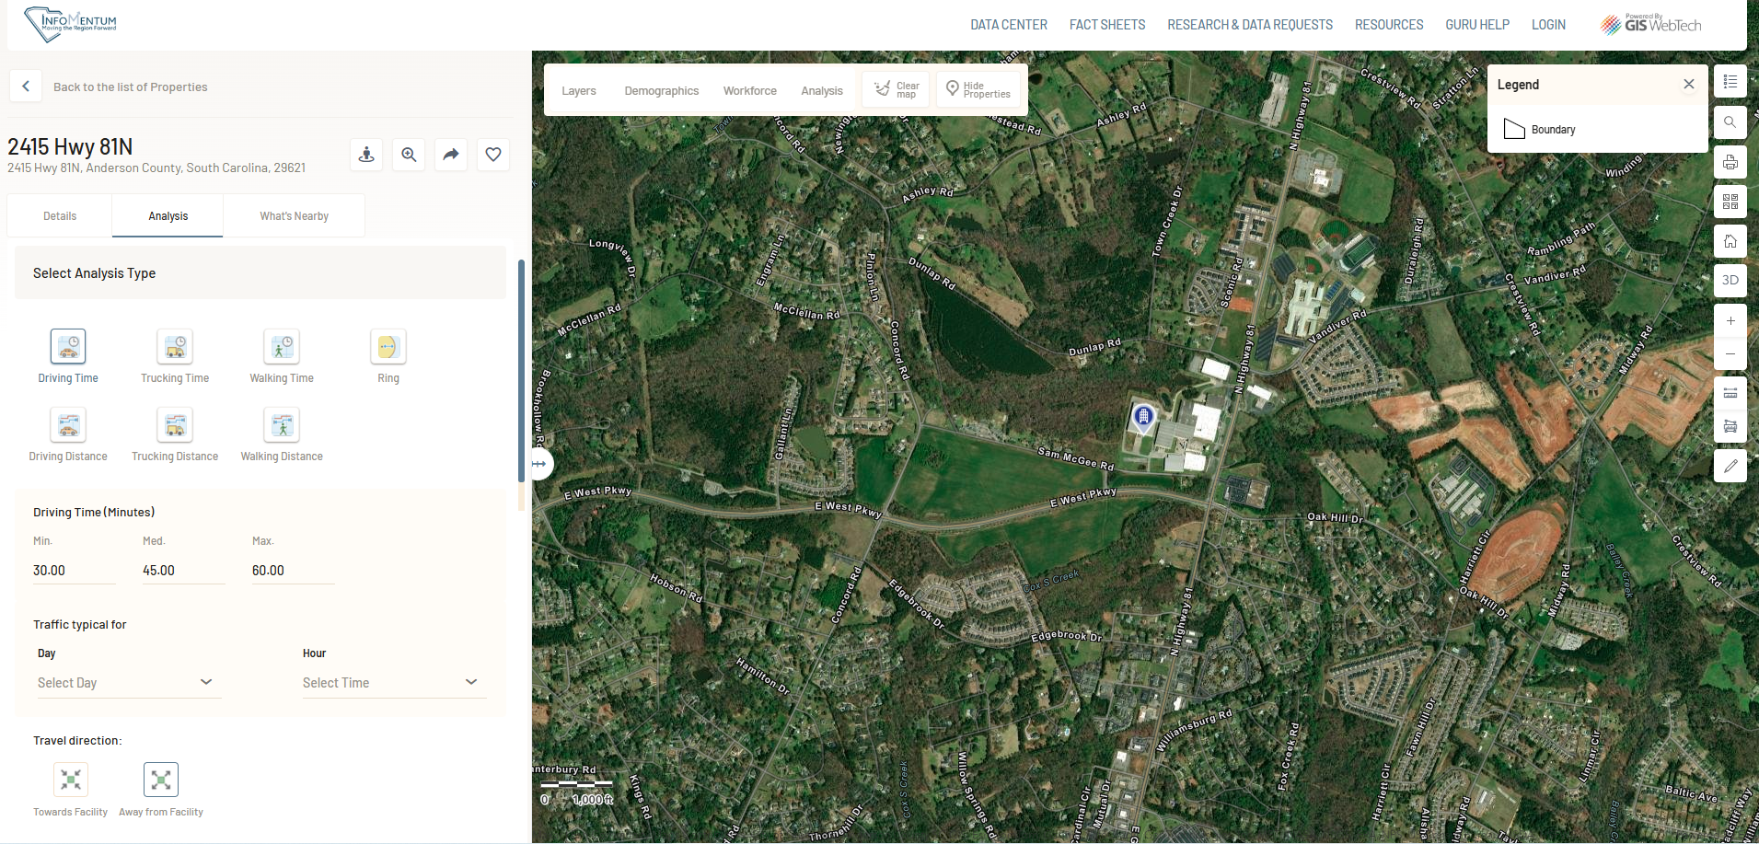

Slide 11
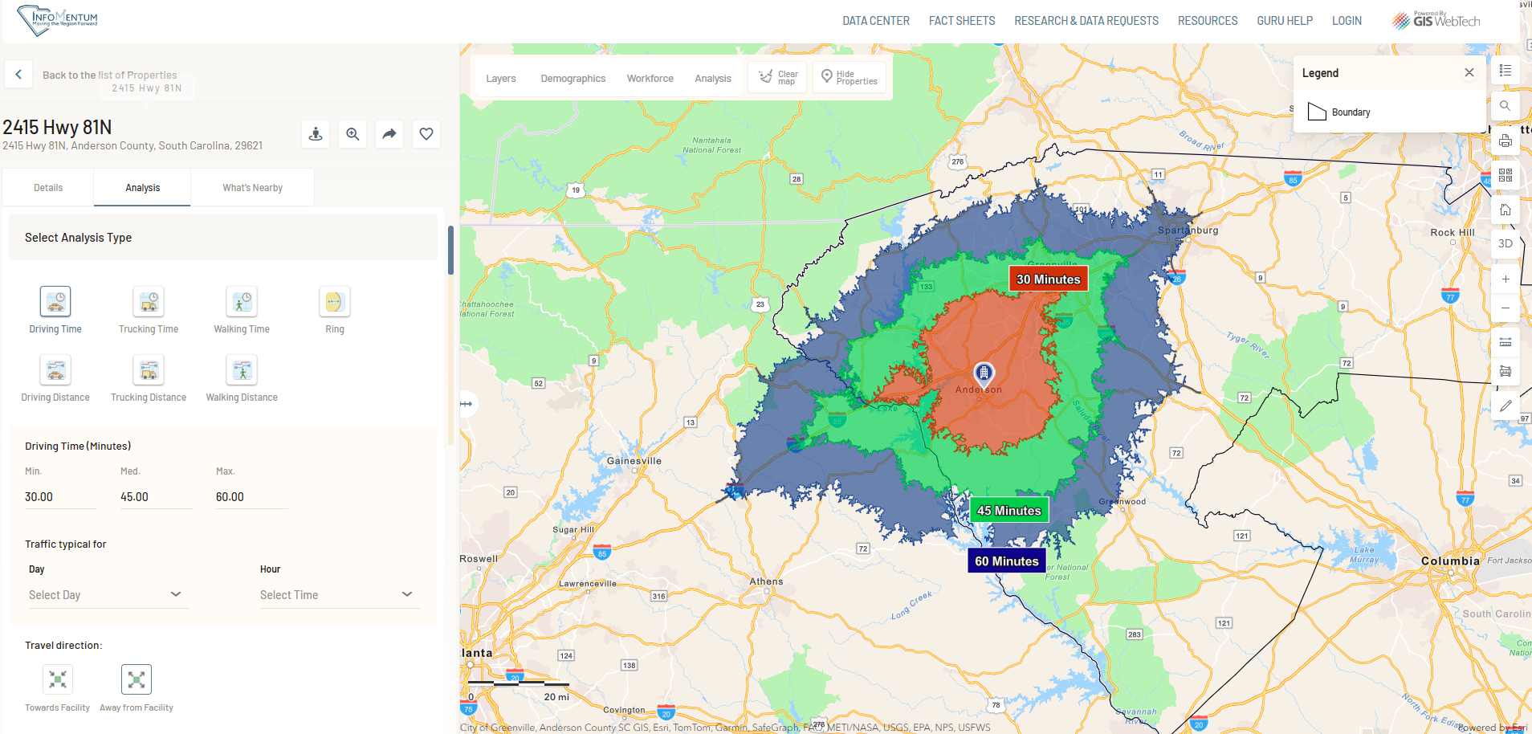

Slide 12
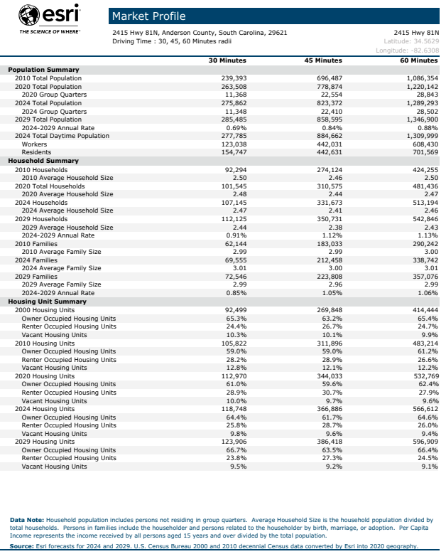
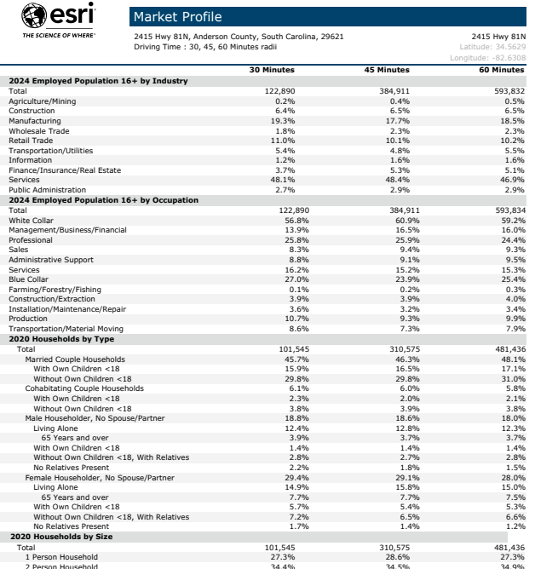

Slide 13
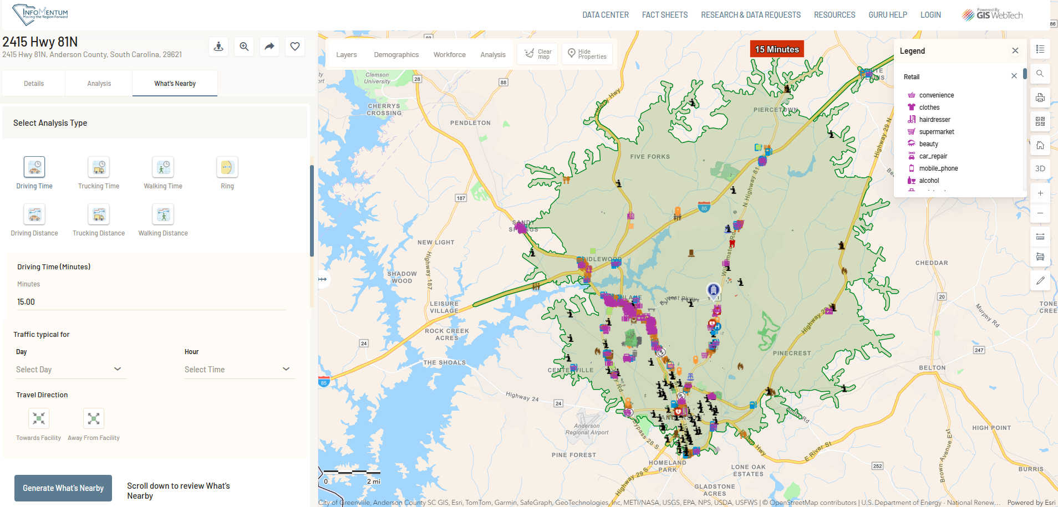

Slide 14
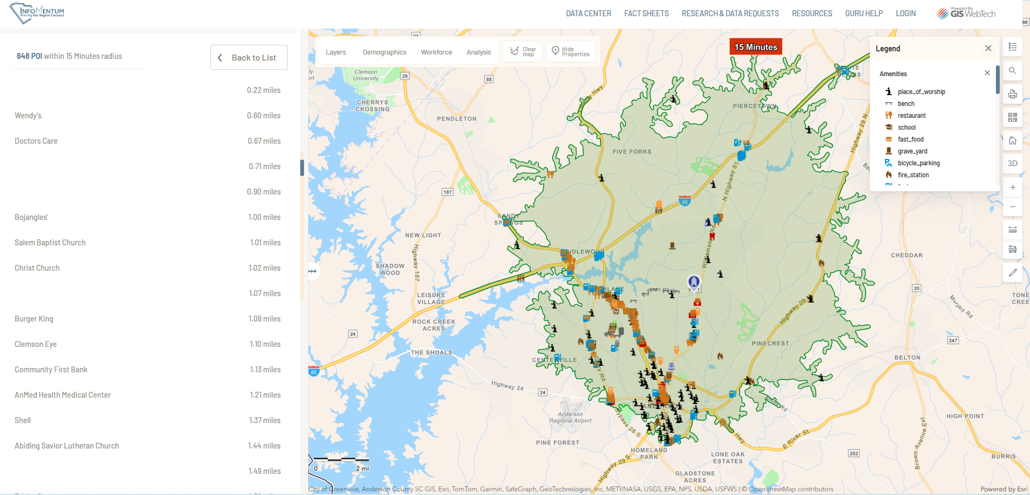

Slide 15
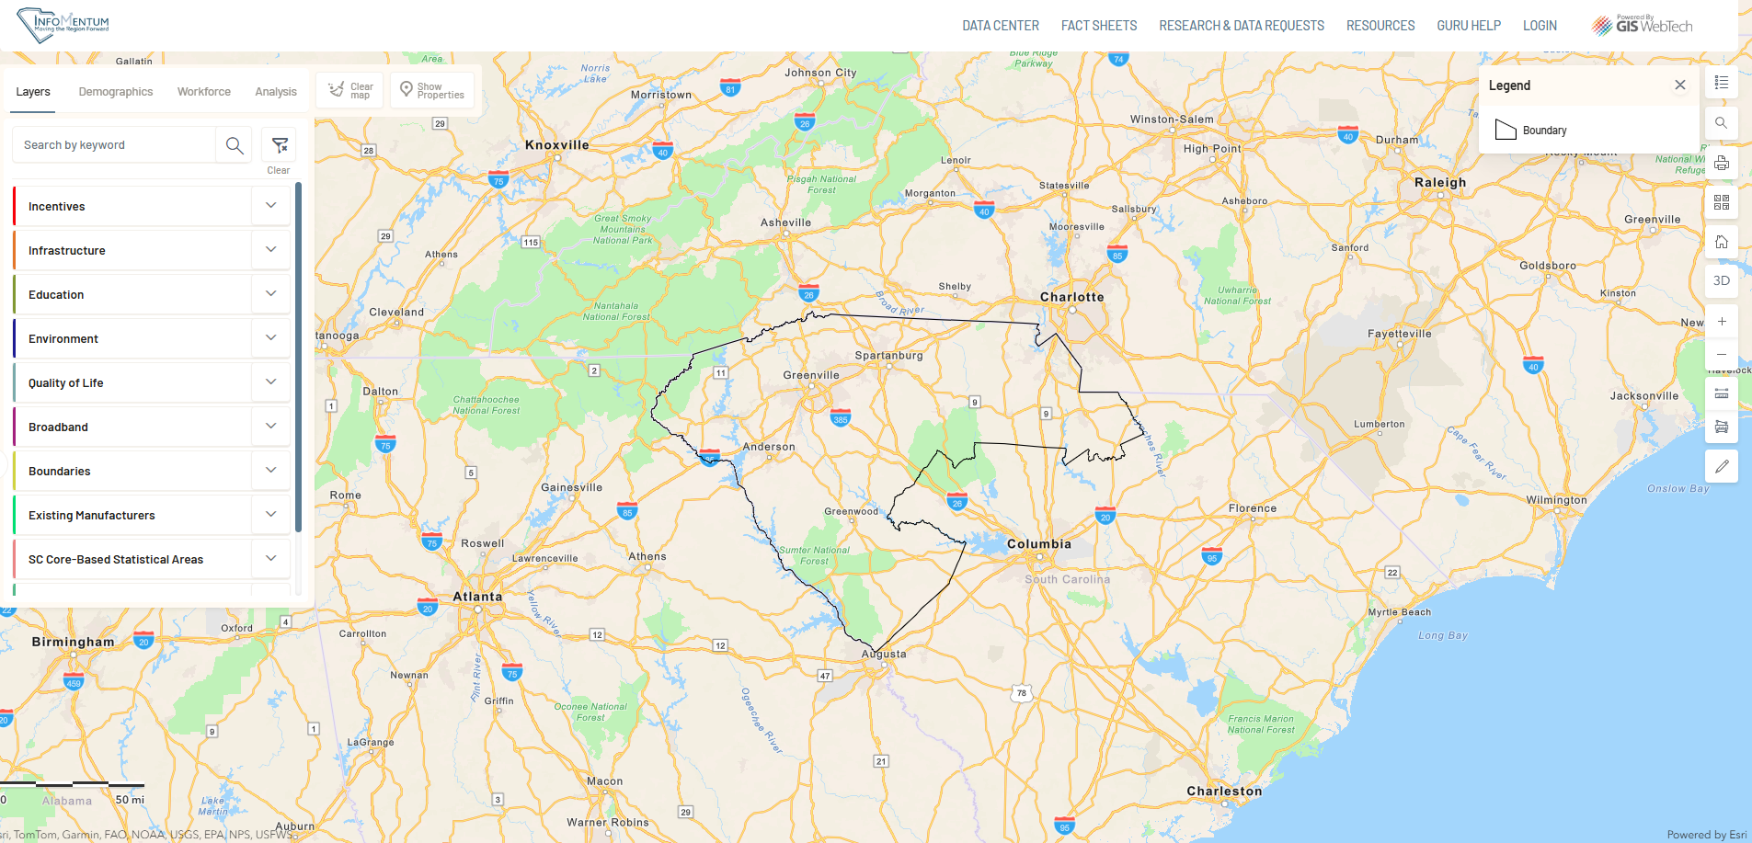

Slide 16
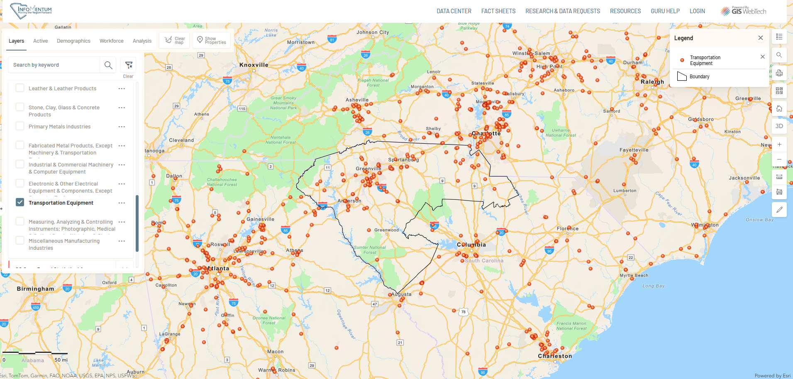

Slide 17
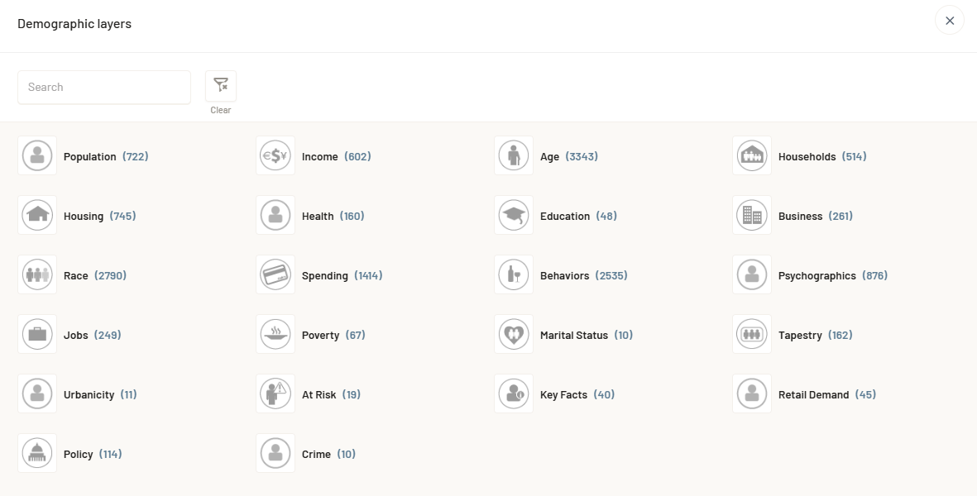

Slide 18
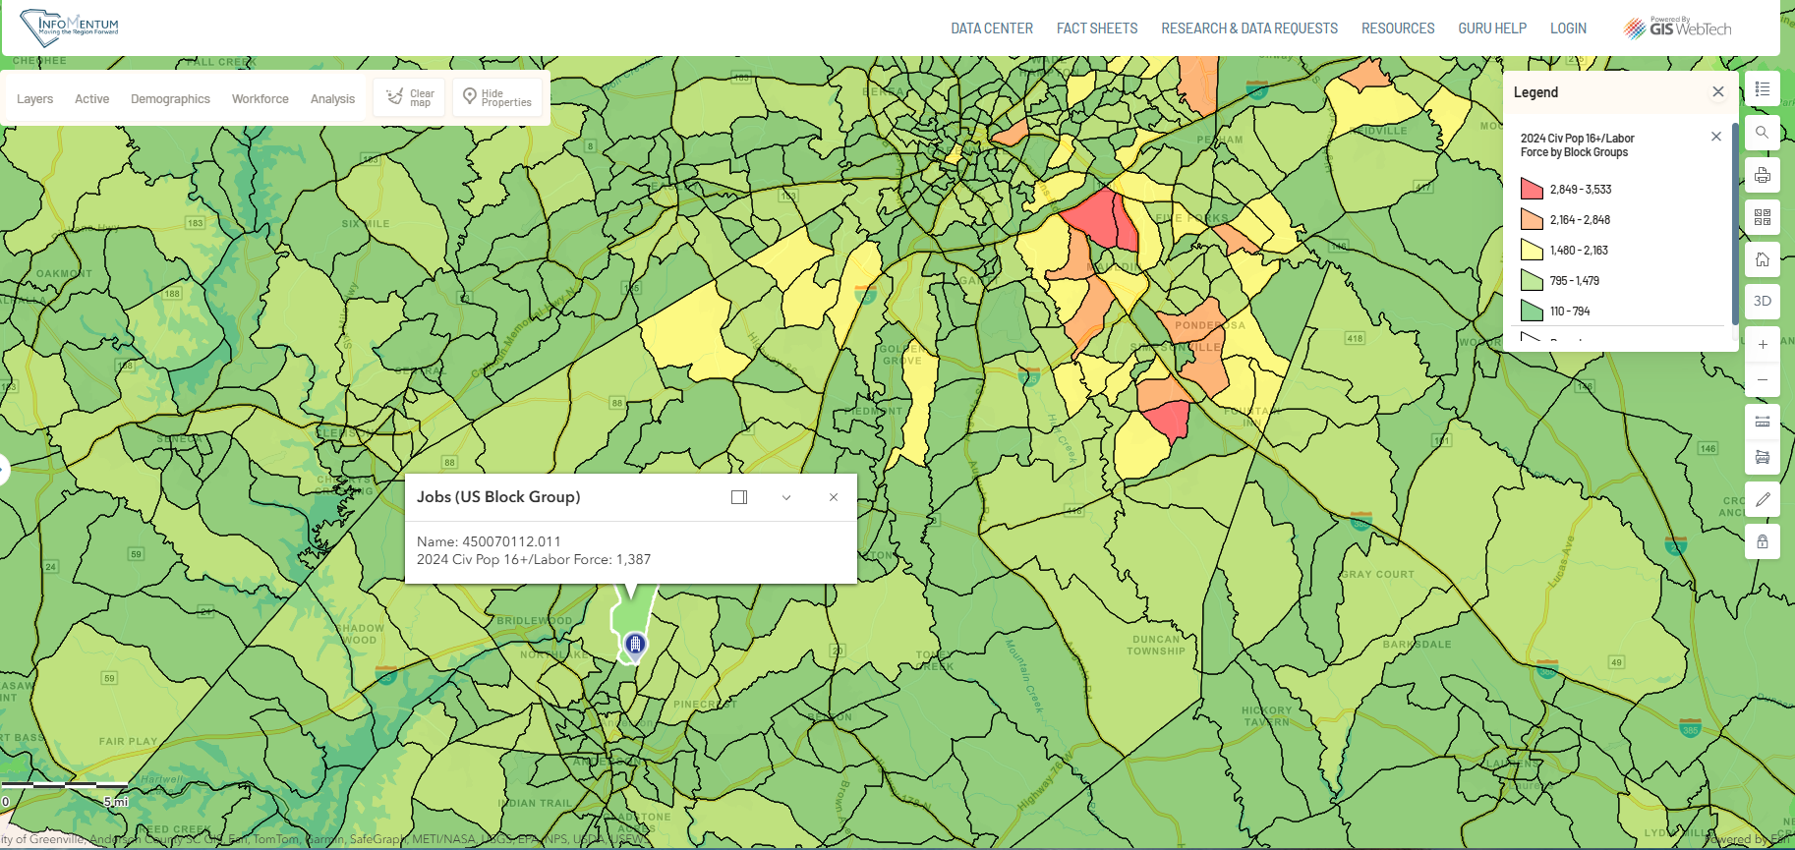

Slide 19
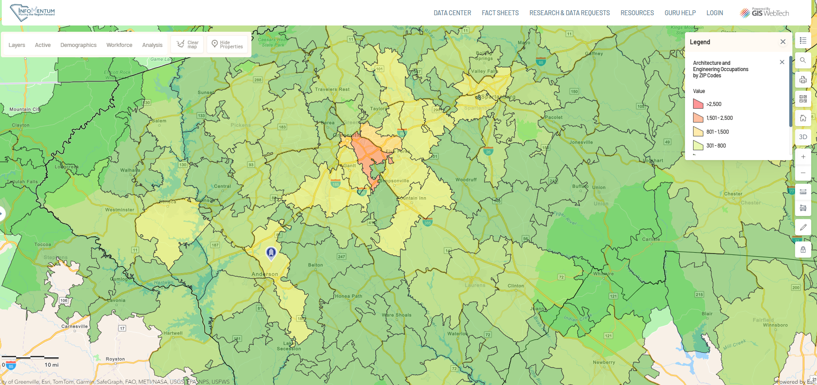

Slide 20
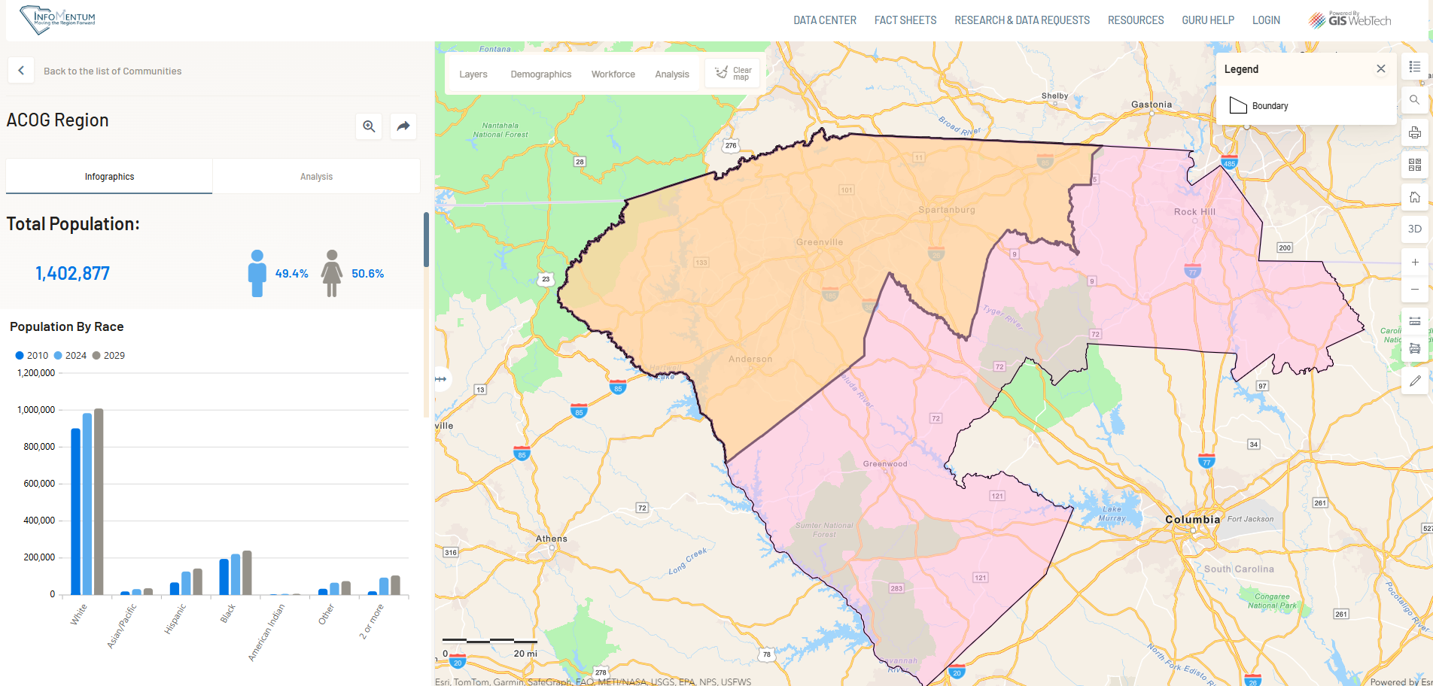

Slide 21
Data Centers
Interactive socioeconomic databases
Built using Tableau data visualization software
Customized data centers have been created for the ACOG and Upstate Alliance regions, plus Anderson, Greenville, Pickens, and Spartanburg counties
Users can find frequently used data sets in a central location
Raw data and visualizations are available for download

Slide 22
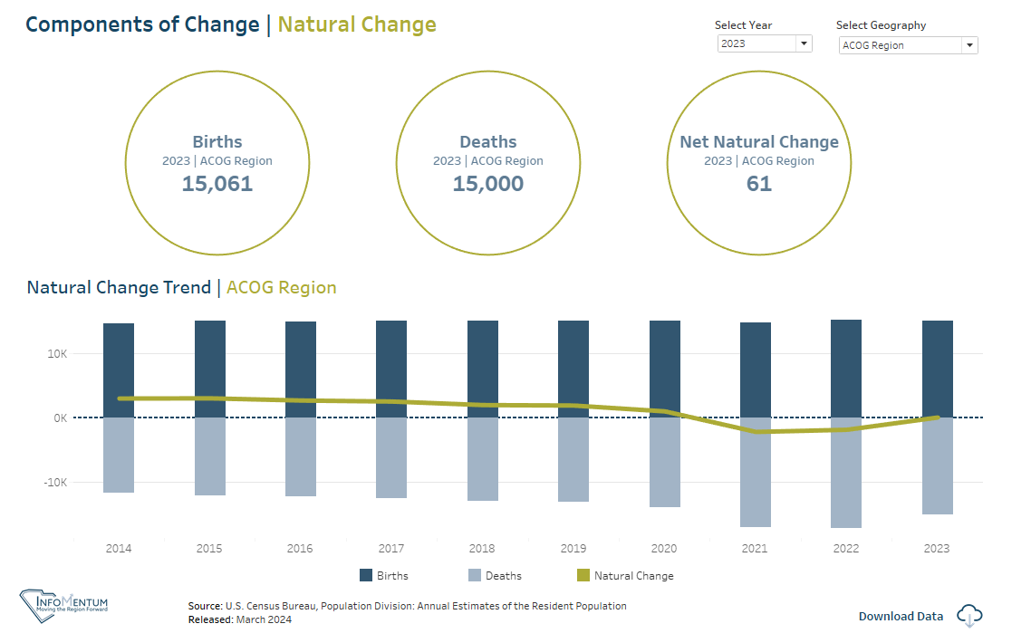

Slide 23
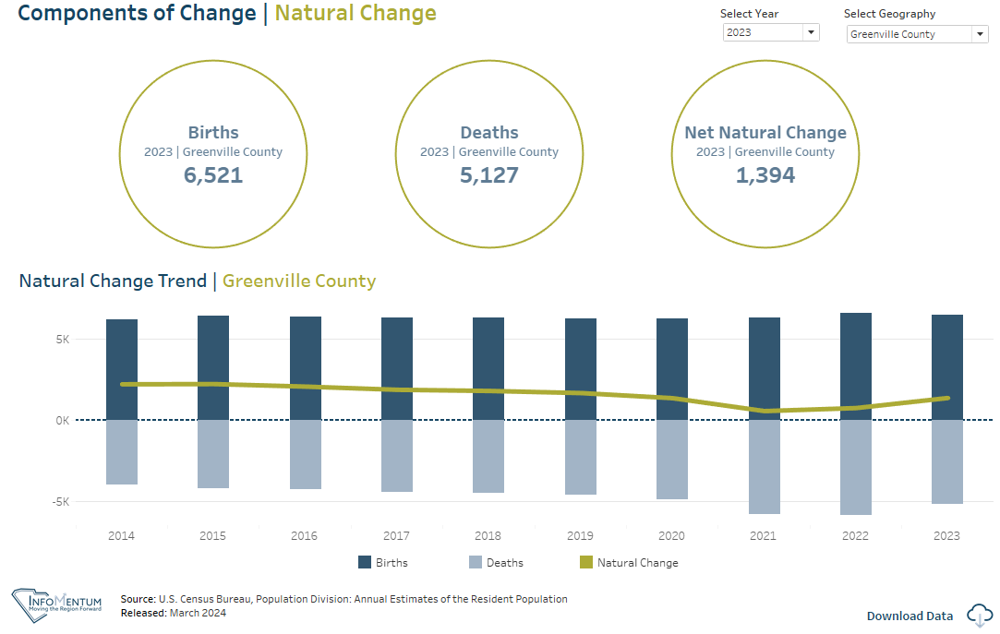

Slide 24
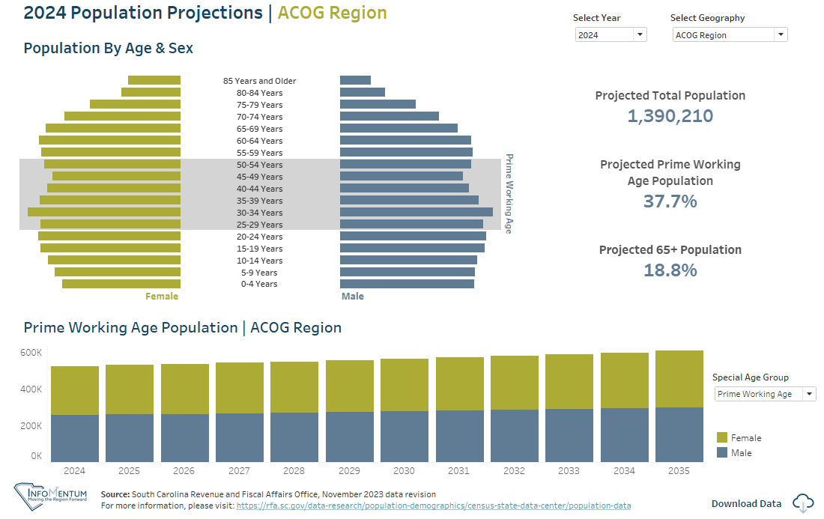

Slide 25
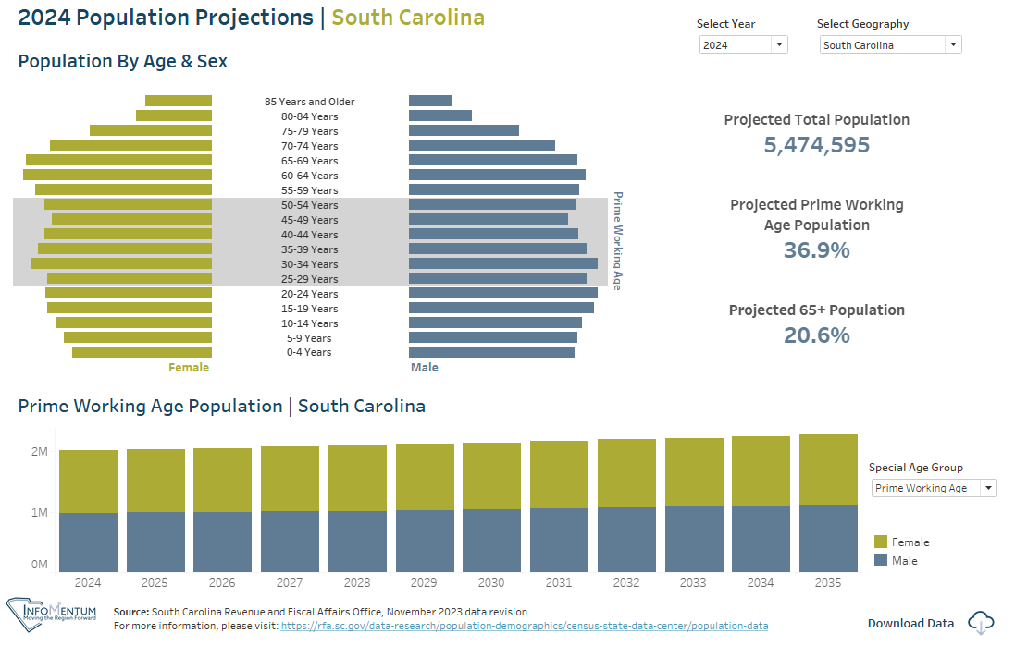

Slide 26
JobsEQ
  Provides access to robust labor market data
  Helps identify unique workforce characteristics within communities
  Describes current industry & demographic trends, and targeted occupation & labor market information
  Uses charts, tables, and maps to help visualize the talent pipeline

Slide 27
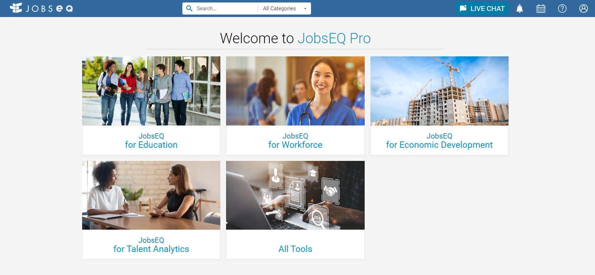

Slide 28
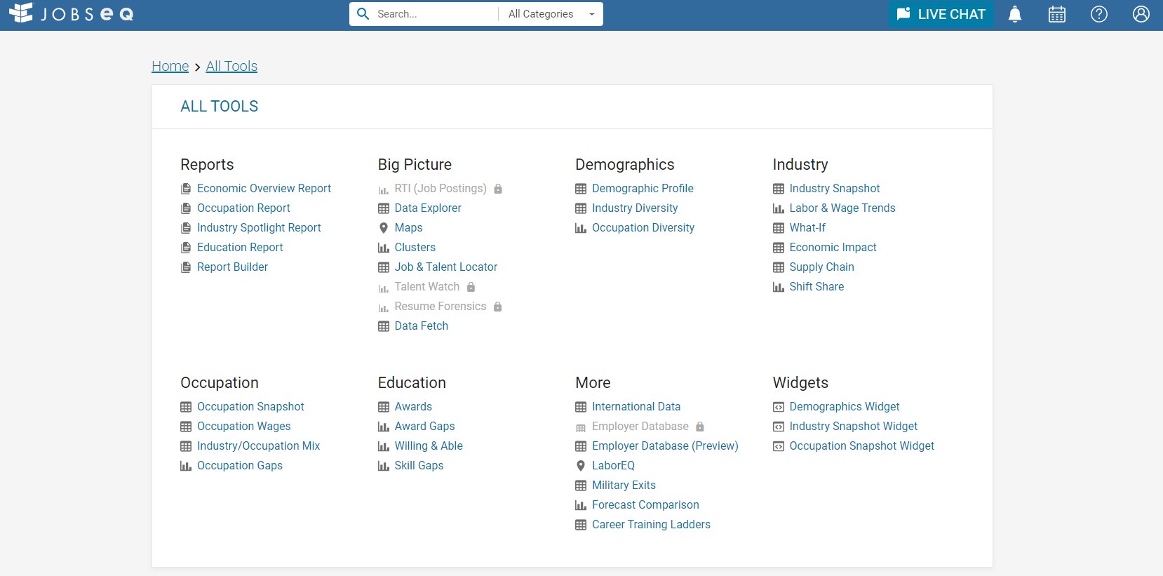

Slide 29
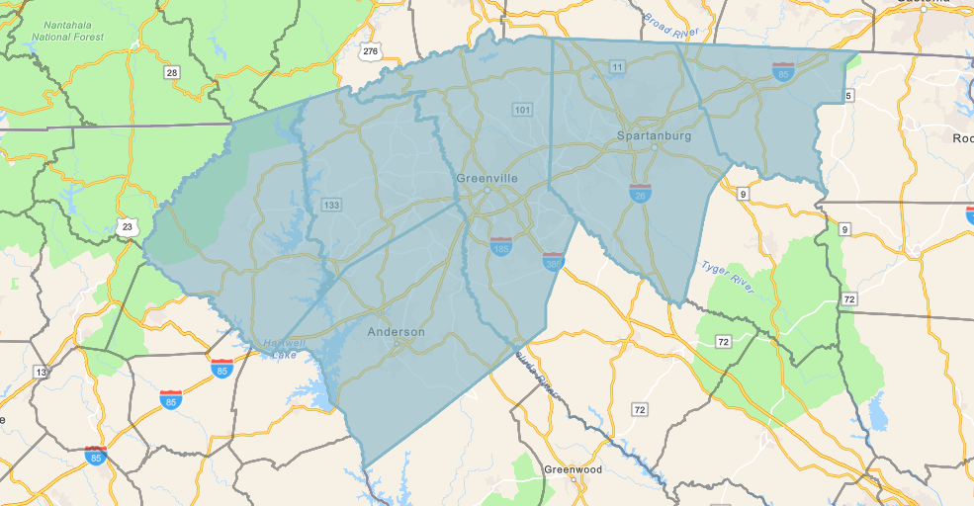

Slide 30
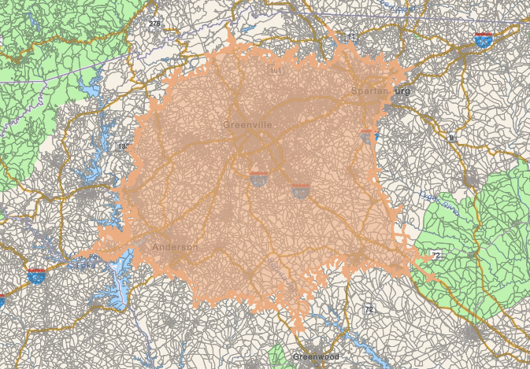

Slide 31
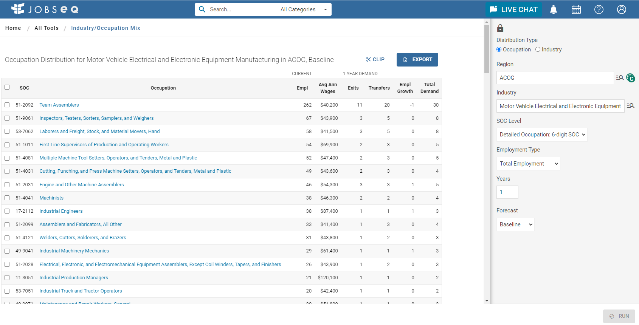

Slide 32
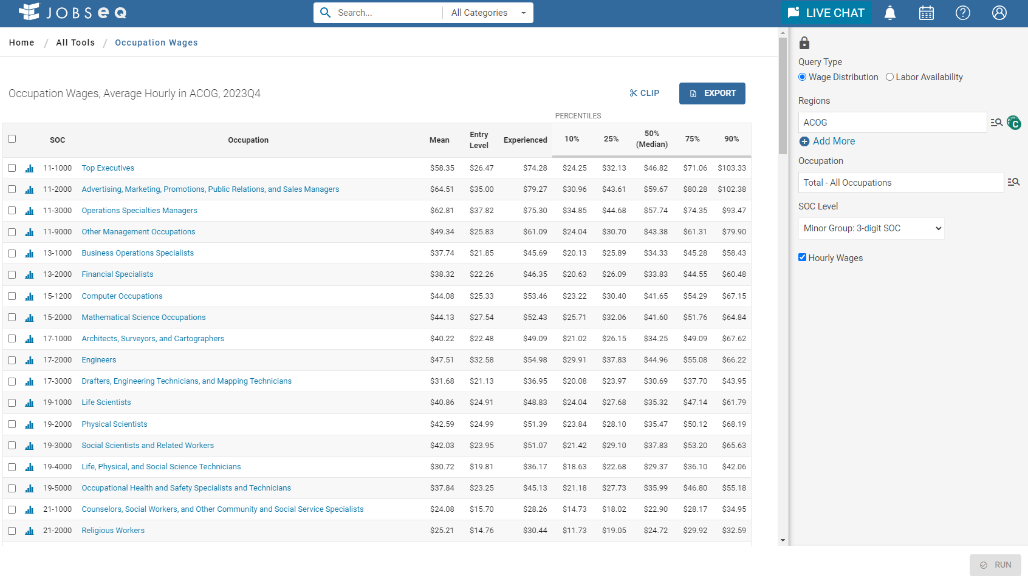

Slide 33
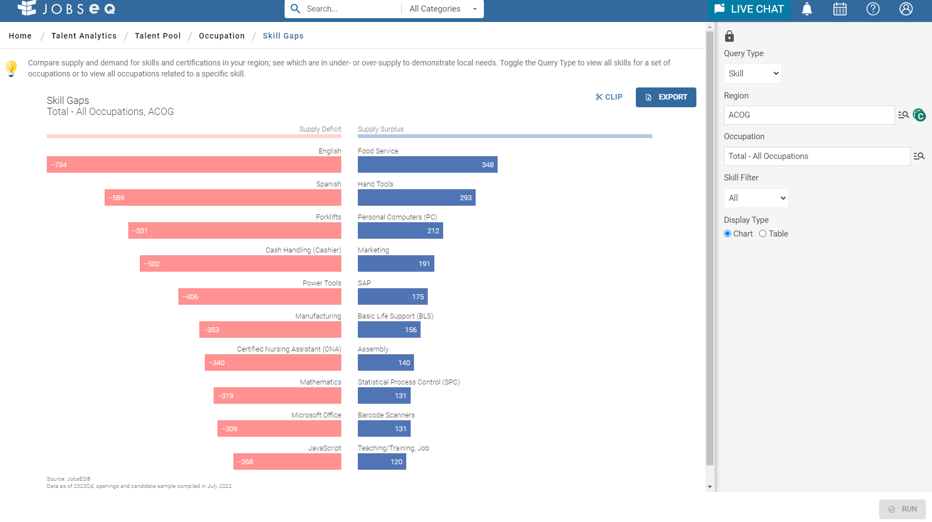

Slide 34
Fact Sheets
  4-page fact sheets for the ACOG and Upstate Alliance regions, as well as all 10 Upstate SC counties
  2-page fact sheets for each municipality in the ACOG region
  Data sources include the US Census Bureau, Bureau of Labor Statistics, Esri, GSP Airport, SC Department of Revenue, SC Ports Authority, and InfoMentum investor organizations

Slide 35
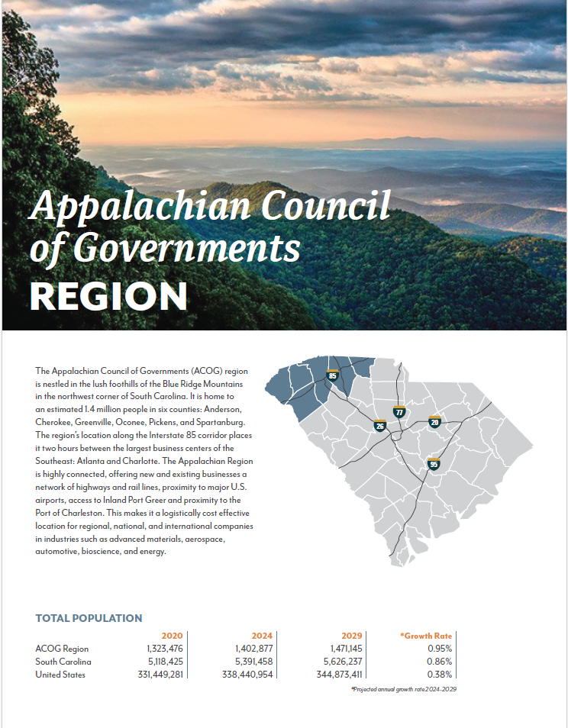
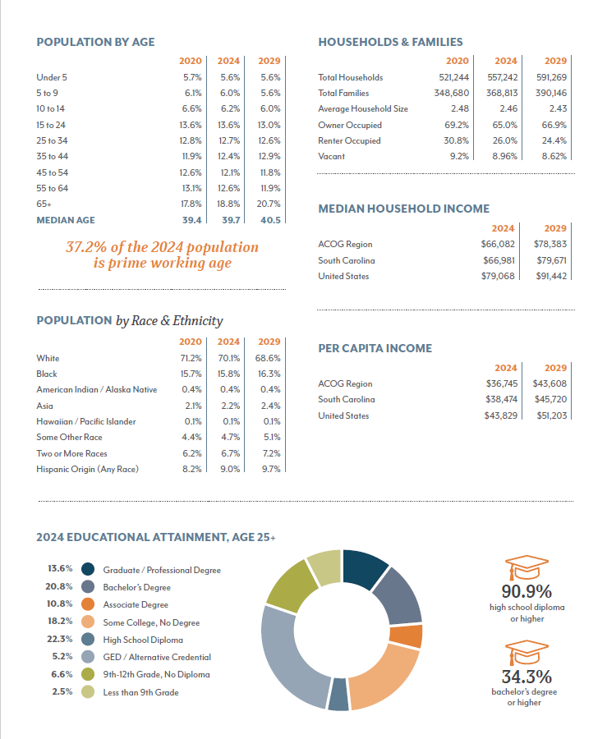

Slide 36



Thank you!
Brooke Ferguson
Economic Development Director
Appalachian Council of Governments
(864) 241-4649
bferguson@scacog.org
www.scacog.org

