Slide 1



Wealth Creation & the CEDS
NADO Washington Conference
March 10, 2025

Slide 2


More info at: www.nado.org/EDDCoP

Slide 3

We are (Still) in a Golden Age for the CEDS
Rawpixels.com

Slide 4
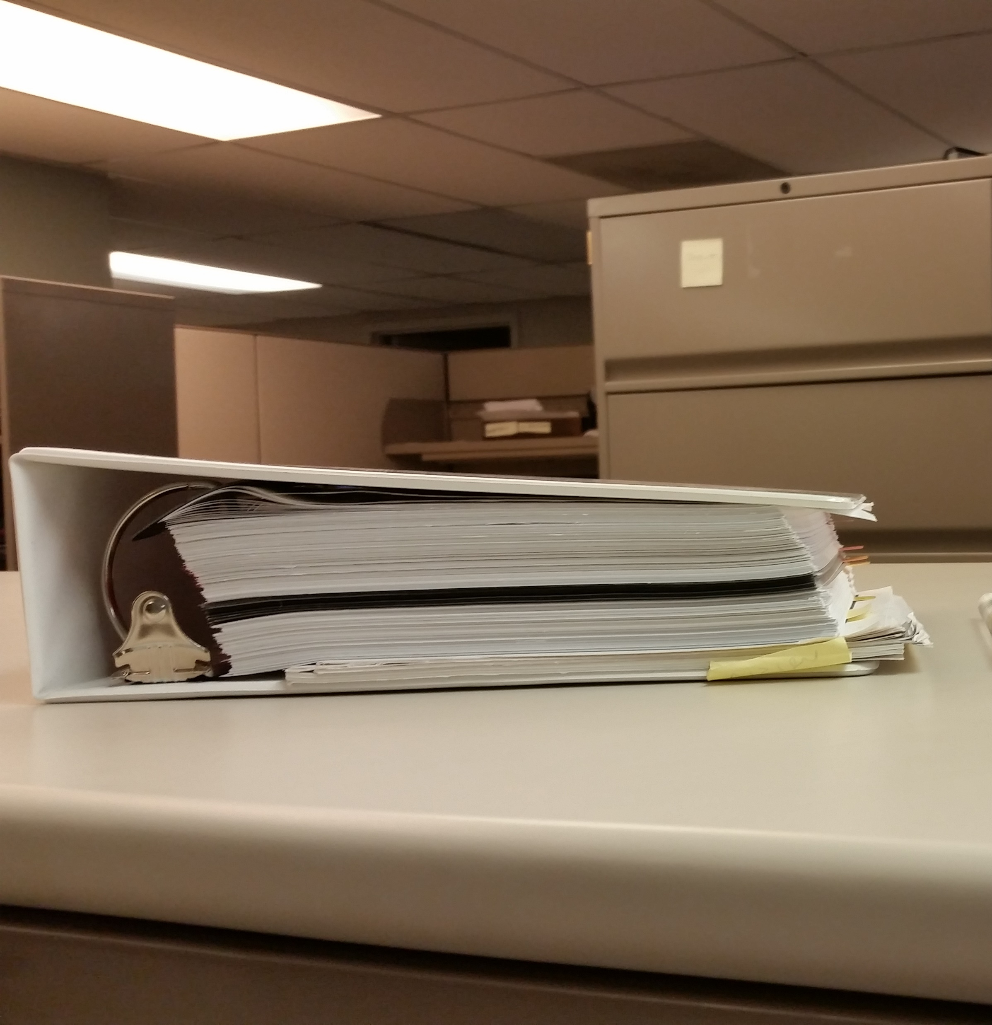

Slide 5
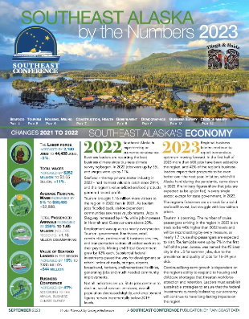
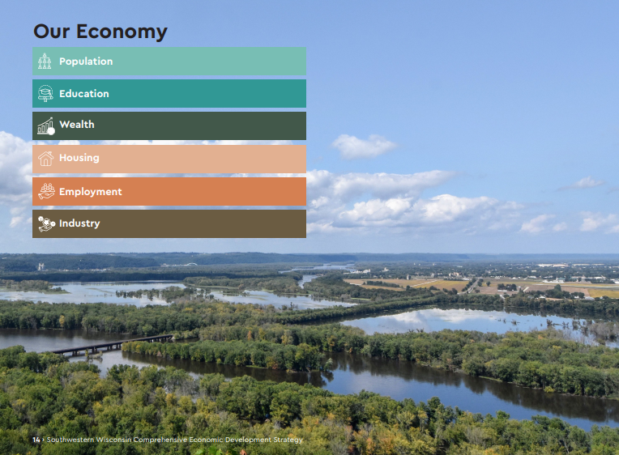
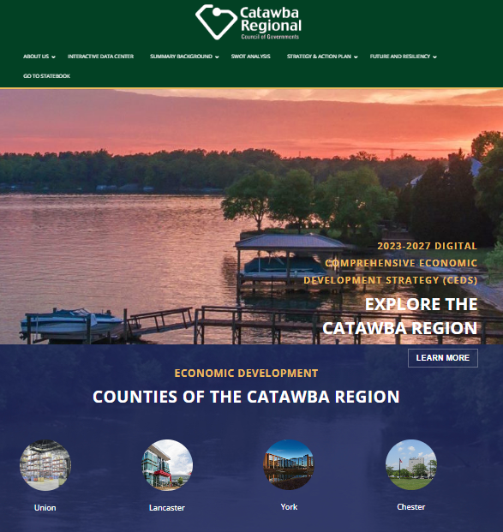
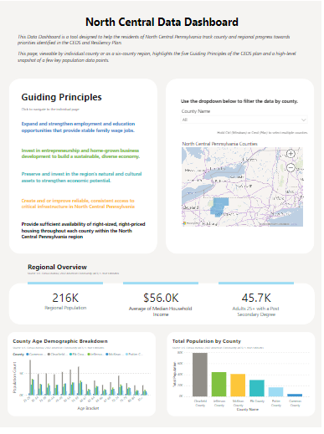
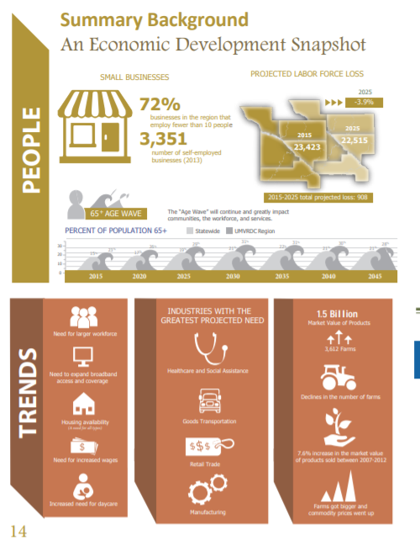


Slide 6
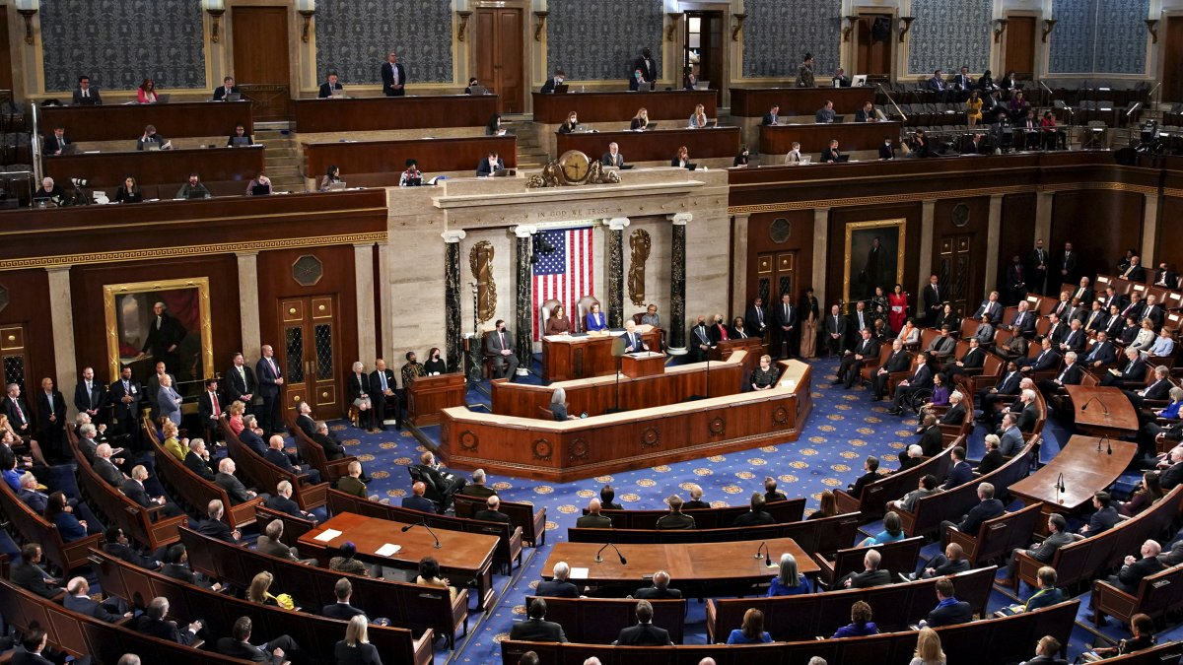
The CEDS as a Region’s “State of the Union”
NBC4 News

Slide 7

The CEDS as the Region’s Strategic Plan
Harvard Business School

Slide 8

The CEDS as a Roadmap for Regional Economic Development
Francesco Paggiaro

Slide 9

The CEDS as a Conduit of Resources to the Region

Slide 10
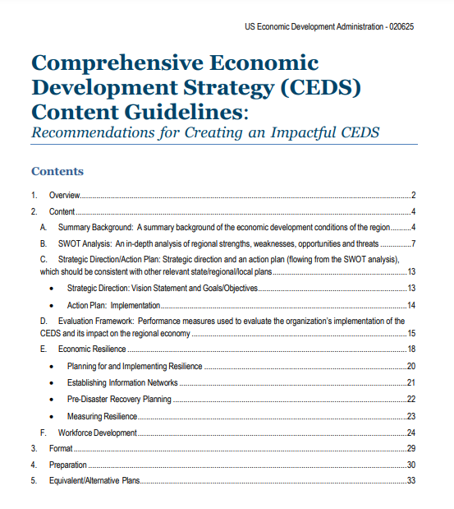
CEDS Content Guidelines
Intended to help regional planning organizations craft more impactful CEDS
Provides guidance on the required sections of the CEDS
  Summary Background
  SWOT
  Strategic Direction/Action Plan
  Evaluation Framework
  Economic Resilience
Focused on best practices, case studies, and links
Collection of suggestions and recommendations. . .not a list of additional requirements
https://www.eda.gov/CEDS

Slide 11


Slide 12
CEDS Content Guidelines
Intended to help regional planning organizations craft more impactful CEDS
Provides guidance on the required sections of the CEDS
  Summary Background
  SWOT
  Strategic Direction/Action Plan
  Evaluation Framework
  Economic Resilience
Focused on best practices, case studies, and links
Collection of suggestions and recommendations. . .not a list of additional requirements
https://www.eda.gov/CEDS

Slide 13
CEDS Evaluation Framework
The evaluation framework serves as a mechanism to gauge progress on the successful implementation of the overall CEDS…
The evaluation framework is an important element of the ongoing planning process and should answer the questions “How are we doing?” and “What can we do better?”
The evaluation framework, with its associated measures and timelines, should cascade from the strategic direction and action plan, which, in turn, flow from the SWOT analysis.
https://www.eda.gov/resources/comprehensive-economic-development-strategy/content/evaluation-framework

Slide 14
Wealth Creation as Part of the Evaluation Framework
[T]he concept of wealth is one that should be highlighted because of its natural alignment with asset-based strategies and approaches. More than just jobs and income, regional wealth is represented by intellectual, individual, social, natural, built environment, political, financial, and cultural assets. These assets, when invested in, nurtured, and leveraged appropriately, can reflect the true level of a region’s economic (and social) well-being.
Finding ways to better identify, foster, and measure these assets can help a region towards a more lasting prosperity since a focus on wealth creation and retention can build a region’s resiliency and long-term sustainability.
https://www.eda.gov/resources/comprehensive-economic-development-strategy/content/evaluation-framework

Slide 15
A wealth creation approach to the CEDS:
Is noted as a best practice by EDA in the CEDS Content Guidelines
Offers an asset-based approach to economic development
Provides a vocabulary to engage the stakeholders about regional issues
Can complement traditional metrics like job creation / GDP / etc
Is fun and inspiring!

Slide 16
More info at: www.nado.org/EDDCoP

Slide 17
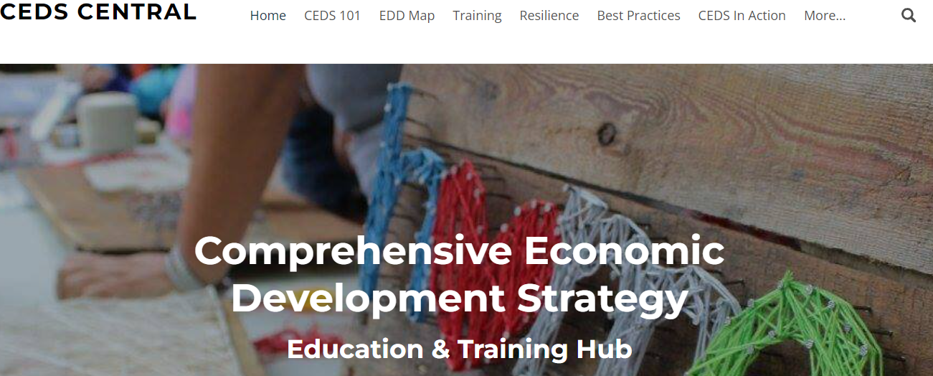
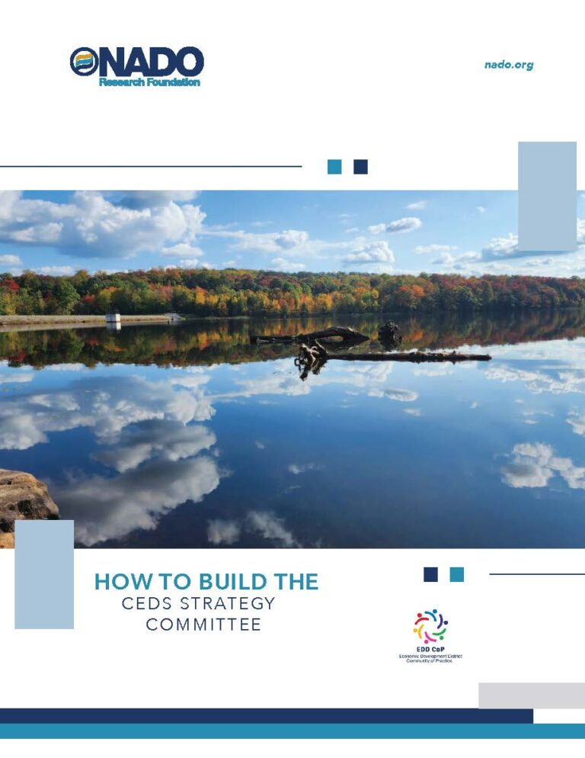

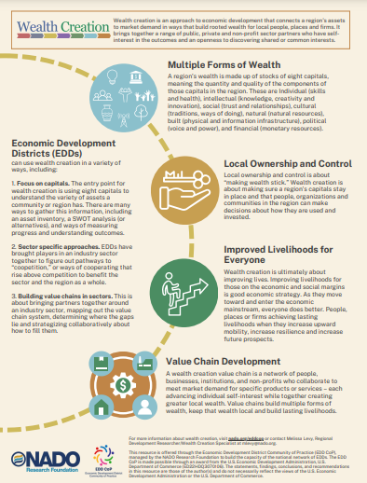

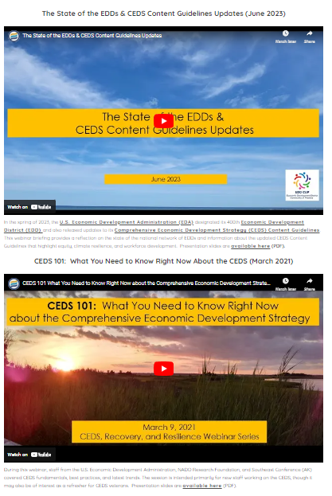


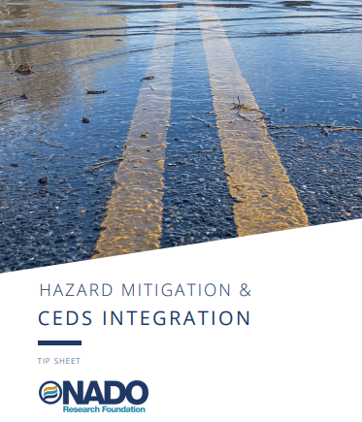
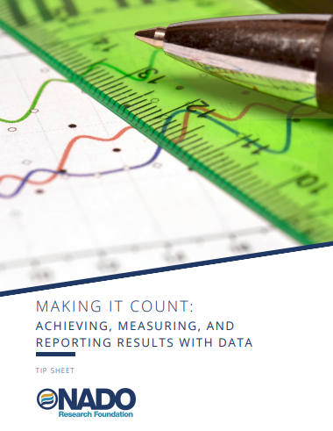
Visit: www.cedscentral.com & www.nado.org/eddcop

Slide 18
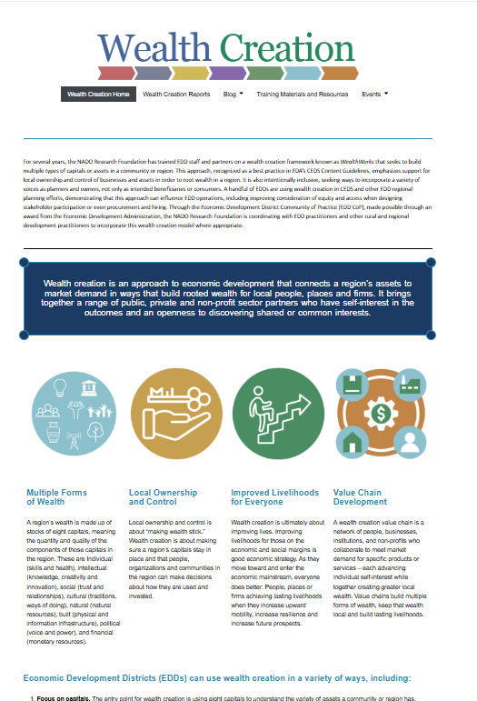
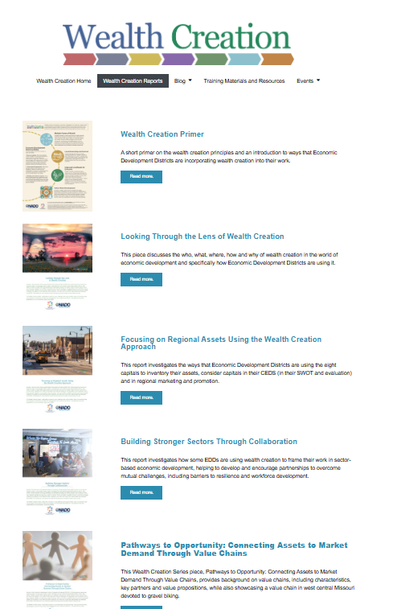
https://www.nado.org/wealthcreation/

Slide 19
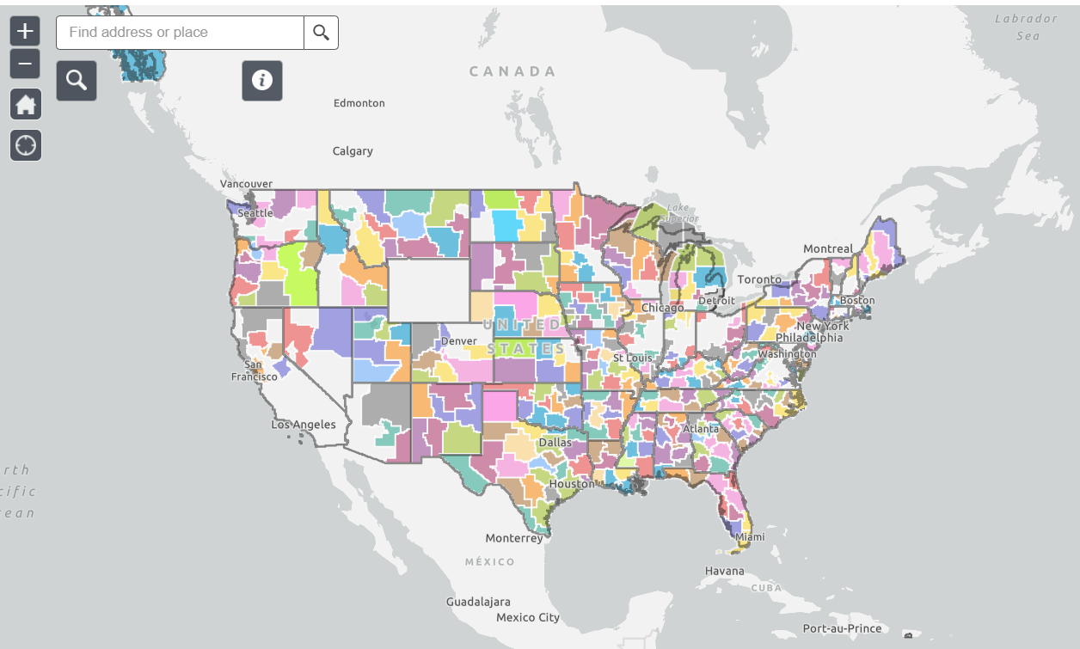
Interactive EDD Map available at: www.nado.org/EDDMap

Slide 20
Creative
Engaging
Driven by Data
Storytellers
The Most Impactful CEDS Are:

Slide 21
Stay in Touch!
Brett Schwartz
Associate Director
NADO Research Foundation
bschwartz@nado.org

